Slide 1
Our True Faith from the Book of James
The Words of our lips
James 3:1-13

Slide 2

James 3:1,2
Dear brothers and sisters, not many of you should become teachers in the church, for we who teach will be judged more strictly.
Indeed, we all make many mistakes/stumble. For if we could control our tongues, we would be perfect and could also control ourselves in every other way.

Slide 3
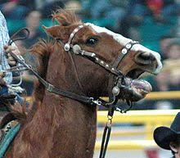
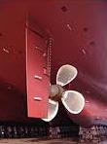
₃ We can make a large horse go
wherever we want by means
of a small bit in its mouth.
⁴ And a small rudder makes a
huge ship turn wherever the
pilot chooses to go, even though
the winds are strong.
⁵ In the same way, the tongue is a small thing that makes grand speeches.

Slide 4
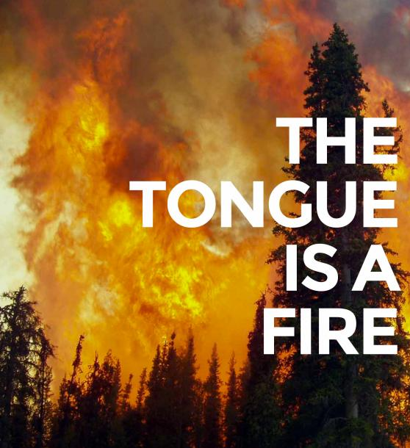
But a tiny spark can set a great forest on fire.
⁶ And among all the parts of the body, the tongue is a flame of fire.
It is a whole world of wickedness, corrupting your entire body.
It can set your whole life on fire, for it is set on fire by hell itself.

Slide 5
⁷ People can tame all kinds of animals,
birds, reptiles, and fish,
⁸ but no one can tame the tongue.
It is restless and evil, full of
deadly poison.

Slide 6
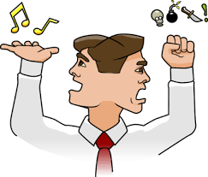
⁹ Sometimes it praises our Lord and Father, and sometimes it curses those who have been made in the image of God. ¹⁰ And so blessing and cursing come pouring out of the same mouth. Surely, my brothers and sisters, this is not right!
¹¹ Does a spring of water bubble out with both fresh water and bitter water? ¹² Does a fig tree produce olives, or a grapevine produce figs? No, and you can’t draw fresh water from a salty spring.

Slide 7

Jesus said:

Slide 8
\ /
The Holy Spirit
Alive!
Your spirit
Your soul
“You”
will
(decisions)
mind
(thoughts and
memories)
emotions
Your
body
Transformation process …
mouth

Slide 9
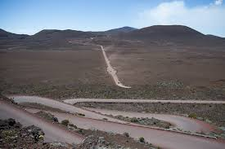
A spiritually untransformed heart is a bit like a volcano
Death

Slide 10
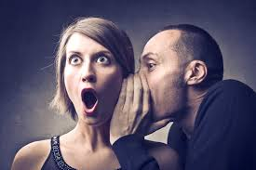
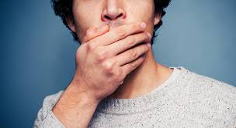
“Death and Life are in the power of the tongue”
Proverbs 21:18
3 choices:
Death
or
Zip
or …….

Slide 11
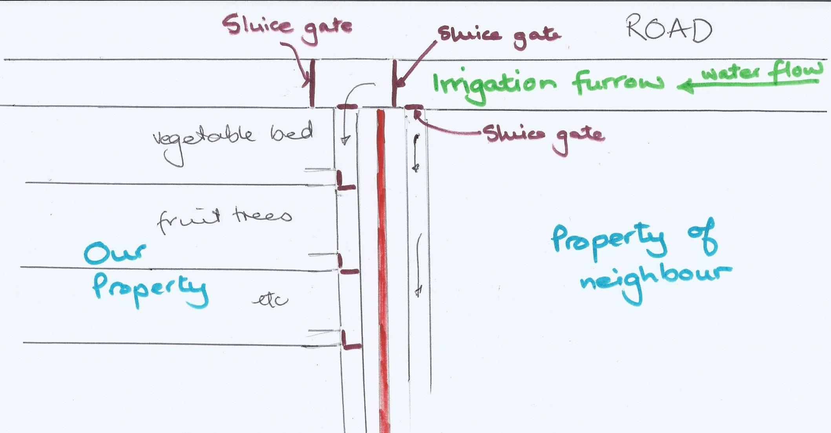
Speak life

Slide 12
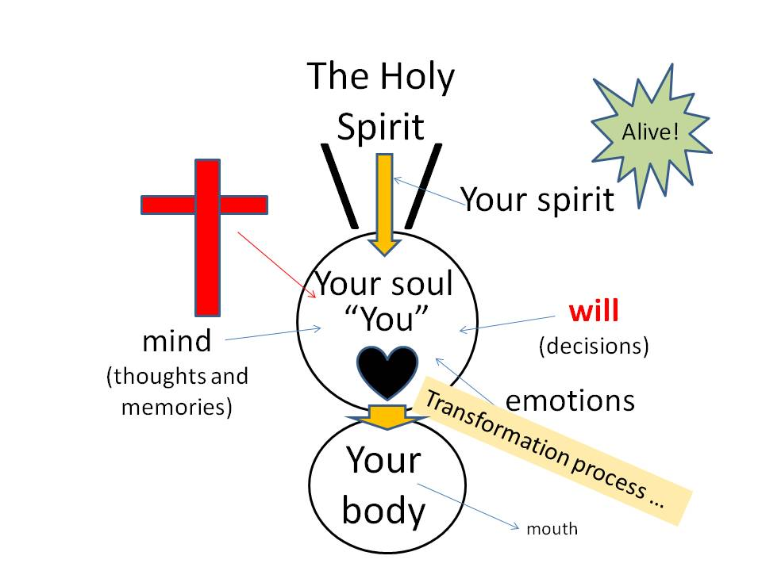

Slide 13
What are words of “life?”
“The words I have spoken to you are spirit and life”
John 6:63
Encouragement
John 16:33 Hebrews 3:13 Hebrews 10:25
Affirmation and praise
Matthew 25:21,23
Thanks
Luke 17:11-19
Blessing
Proverbs 31: 28,293 Numbers 6:23:

Slide 14
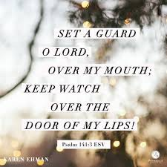
Psalm 141:3

Slide 15
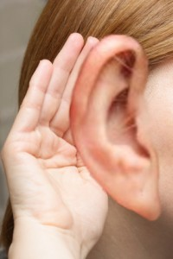
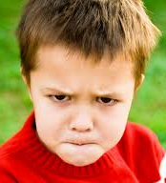
A prayer from James 1:19
“Dear Lord, help me to be quick to hear,
Slow to speak
And slow to anger.”

Slide 16

“Dear Lord, today may my lips give grace to those who hear .” Ephesians 4:29

