Slide 1

James 3 : 13-18
Godly
James 3:13-18

Slide 2

“Who is wise and understanding among you?
Let them show it by their good life, by deeds done in the humility that comes from wisdom.
But if you harbour bitter envy and selfish ambition in your hearts, do not boast about it or deny the truth. Such “wisdom” does not come down from heaven but is earthly, unspiritual, demonic. For where you have envy and selfish ambition, there you find disorder and every evil practice.
But the wisdom that comes from heaven is first of all pure; then peace-loving, considerate, submissive, full of mercy and good fruit, impartial and sincere.
Peacemakers who sow in peace reap a harvest of righteousness.”
James 3 : 13-18

Slide 3
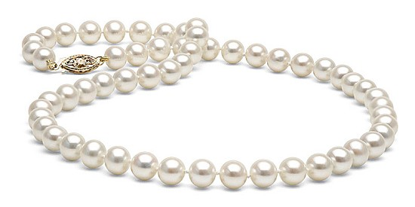


Proverbs 3: 13-18
¹³“Blessed are those who find wisdom, those who gain understanding,
¹⁴ for she is more profitable than silver and yields better returns than gold.
¹⁵ She is more precious than rubies; nothing you desire can compare with her.
¹⁶ Long life is in her right hand; in her left hand are riches and honour.
¹⁷ Her ways are pleasant ways, and all her paths are peace.
¹⁸ She is a tree of life to those who take hold of her; those who hold her fast will be blessed.”

Slide 4

We have a choice…
…a way that seems right to a man, or
a way that God would lead us in…
James 1:5
“If any of you lacks wisdom, he should ask God, who gives generously to all…”
Proverbs 16:25
“There is a way that seems right to a man, but its end is the way to death”

Slide 5
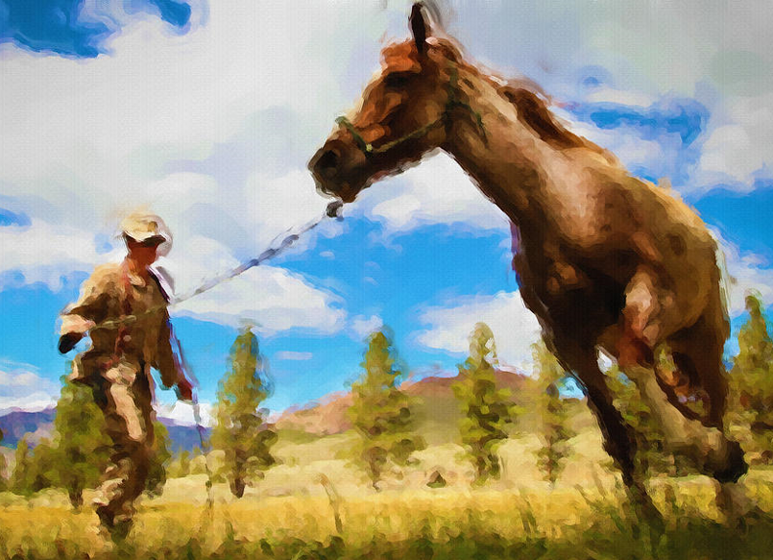
^{v13} Who is wise and understanding among you?
Let them show it by
their good life,
by deeds done in the
humility (gentleness;
meekness;
‘broken-inness’)
that comes from wisdom.
James 3 v 13

Slide 6
A Tale of Two Wisdoms
¹⁴But if you harbour bitter envy and selfish ambition in your hearts, do not boast about it
or deny the truth. ¹⁵ Such “wisdom” does not
come down from heaven but is earthly,
unspiritual, demonic. ¹⁶ For where you have
envy and selfish ambition, there you find
disorder and every evil practice.
¹⁷ But the wisdom that comes from heaven is
first of all pure; then peace-loving,
considerate, submissive, full of mercy
and good fruit, impartial and sincere.
James 3 v 14-17

Slide 7

Godly Wisdom
pure ● peace-loving ● considerate
submissive ● full of mercy ● full of good fruit impartial ● sincere

Slide 8

Earthly Wisdom | Godly Wisdom
It’s all about US (our intellect, our understanding, our views, our preferences) May be motivated out of jealousy/bitter envy Influenced by what is personally to our advantage ie. selfish-gain Disorder, confusion and disharmony result | It’s all about JESUS We live influenced by, and in the power of, the HOLY SPIRIT Surrendered to GOD A life lived out in humility (gentleness) because we know that we didn’t deserve to be saved Living in service and holiness with thankfulness to Jesus How Jesus views our hearts is what matters !

Slide 9
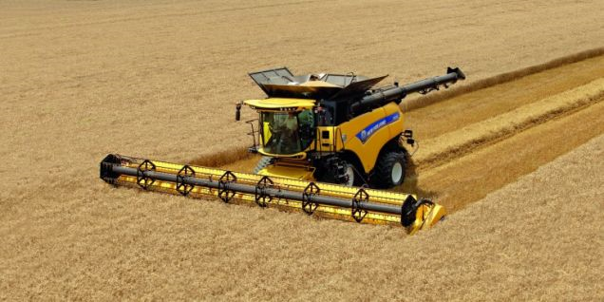
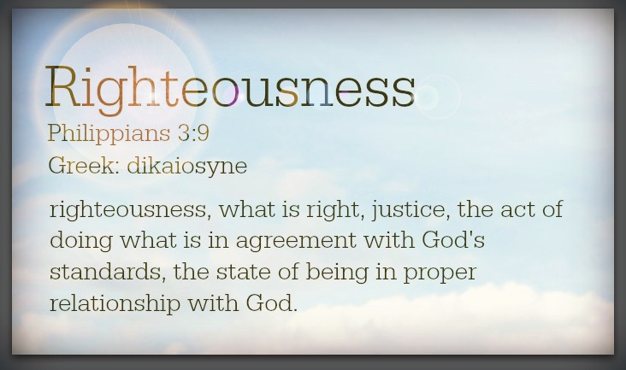
“Peacemakers who sow in peace reap a
harvest of righteousness.”
James 3 v 18

Slide 10


Colossians 2:3 “In Him lie hidden all the treasures of wisdom and knowledge”
APPLICATION:
… Will you seek Jesus wholeheartedly?

