Slide 2
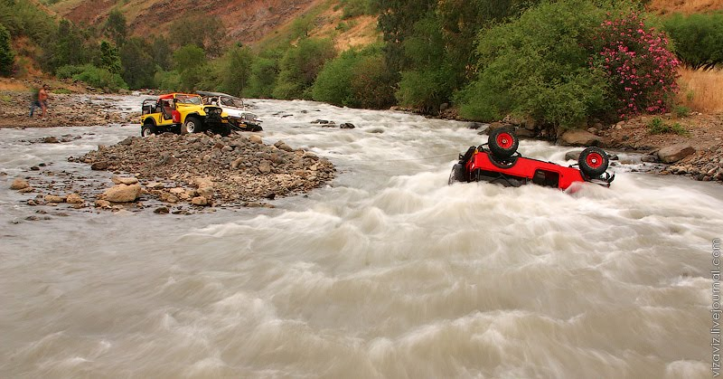
To Cross the Jordan
Break camp, and move into a new inheritance.
Do it together.
Consecrate yourselves.
Personal disciplines.
Take courage.

Slide 3
Introduction:
It is written to BELIEVERS
  “My brothers and sisters” 1:2 1:16 1:19
  2:1 “My brothers and sisters, believers in our glorious Lord Jesus Christ”
  James had no doubt as to the salvation of those he was writing to.
Potential to be mis-interpretted – Luther.
The literature of the book is written as a collection of punchy concepts, with the purpose of challenging the readers on how they lived.
          He has a way of “getting up your nose”!
Take care if not certain of one’s position before God.

Slide 4
So what is salvation??
God made it all good. Adam (human) was made in the image of God, meaning to reflect God’s character (love and holiness) and to represent God’s rule on the earth.
God gives Adam the dignity of free will, and Adam messes it up – he chose to not listen to God.
God immediately starts the process of rescue and,
The OT is the story of God’s rescue plan through the family of Abraham, but man falls again and again.
The whole way through the OT, God points to a Messiah who will save, not only the Israelites, but the whole world.
Then God sends his only son who fulfils the many prophecies of the OT.
But God turns everything on its head when the Saviour dies (gives his life) in place of (as a ransome for) all people. And the way to be restored to God is revealed as simply putting your trust in Jesus who has done everything we need. As we believe in what Jesus has done, God restores us spiritually to life, and immediately we have a glorious future inheritance as children of God.

Slide 5
James 2:14-17
“What good is it, my brothers and sisters, if someone claims to have faith but has no deeds? Can such faith save them? Suppose a brother or a sister is without clothes and daily food. If one of you says to them, “Go in peace; keep warm and well fed,” but does nothing about their physical needs, what good is it? In the same way, faith by itself, if it is not accompanied by action, is dead.”
What good is it, my brothers and sisters, if someone claims to have faith but has no deeds? Can such faith save them?

Slide 6
“...save” … (The Theologians)
Used 5 times in James.
1:21 …the word will save your souls..
4:12 God is …able to save or destroy…
5:15 prayer will save a sick person.
5:20 he who turns a sinner around…will save his soul.
Save always refers to something that someone does for someone else. It is an action away from oneself to “save” another person.
And similarly in 2:14, “Can such faith save them”.

Slide 7
So, who is “them”?
2:2 … a poor man in filthy clothes...
2:3… say to the poor man …
2:5... God has chosen the poor…
2:6…you have dishonoured the poor…
2:8 …love your neighbour…
2:9 … if you show favouritism…
2:10-13 lawbreakers but there is a higher law
2:14 … can such faith save them?
2:15… brother or sister without clothes or daily food…

Slide 8
“I like your Christ, I do not like your Christians.
Your Christians are so unlike your Christ.”
Gandhi
R T Kendell

Slide 9
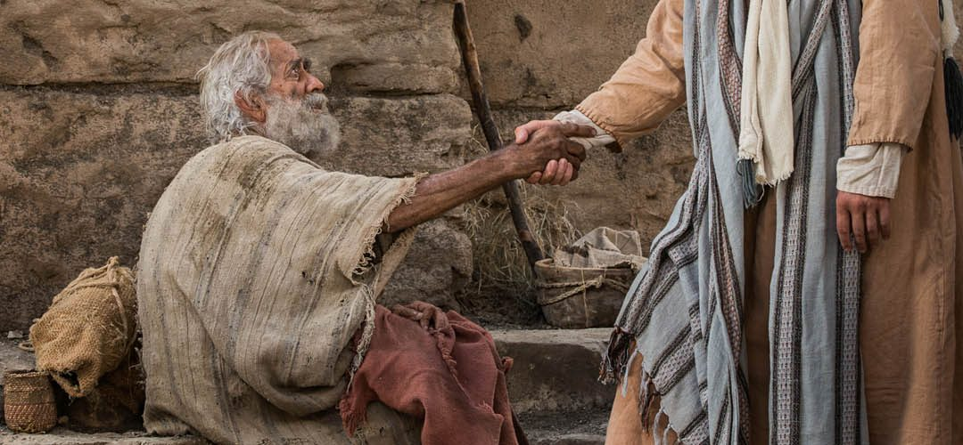
…have the same mindset as Christ Jesus Phil 2:5
Touched the lepers
Ate with sinners
Forgave a prostitute
Washed feet
Forgave his persecutors
Gave his life
He loved

Slide 10
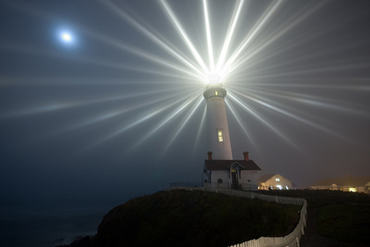
“You are the light of the world…
In the same way, let your light shine before others, that they may see your good deeds and glorify your Father in heaven”
                Matthew 5:13-16

