Slide 1

Notes:
Gawie spoke to us last week about the importance of faith and obedience if we’re going to walk in the purposes that God has for us as individuals and as a church.
It was really a great introduction to the book of James which has lots to say about faith. So before we get going with the book of James I want to give an overview of faith and what growing faith looks like…

Slide 2

Hebrews 11:1
“Now faith is confidence in what we hope for and assurance about what we do not see.”
Hebrews 11:6
“Without faith it is impossible to please God.”
Ephesians 2:8
“For it is by grace you have been saved, through faith—and this is not from yourselves, it is the gift of God.”
Notes:
Before we dive into a discussion about faith, it’s important for us to understand what it is….
Hebrews 11:1 “Now faith is confidence in what we hope for and assurance about what we do not see.”
Based on this definition, we can have faith in a range of different things from things we may own (like a car – which we trust to get us from one place to another) to people (who we perhaps trust to fix the car if it breaks down) to God (who we may trust to get us where we’re going, or to take us to heaven if we don’t get to our destination).
What is very clear from scripture though, is that Faith is central to our walk with Jesus. Paul makes this very clear in Hebrews 11 where he writes:
Hebrews 11:6 Without faith it is impossible to please God
We also know that for us to have a relationship with God, we have to put our faith in Jesus and accept the grace that he gives us.
Ephesians 2:8
“For it is by grace you have been saved, through faith—and this is not from yourselves, it is the gift of God.”

Slide 3
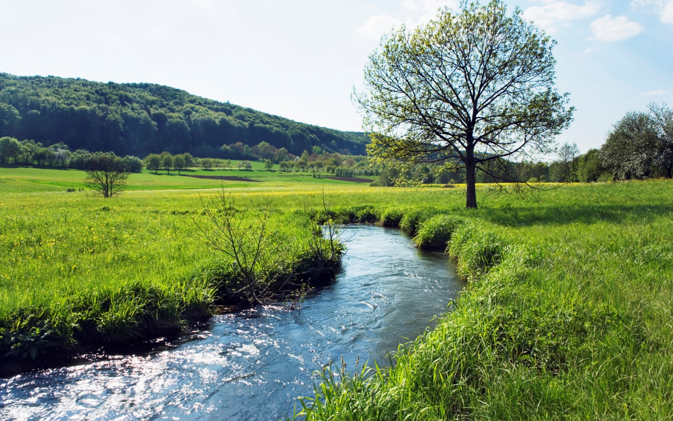
Jeremiah 17:7-8
⁷ “But blessed is the one who trusts in the Lord, whose confidence is in him. ⁸ They will be like a tree planted by the water that sends out its roots by the stream. It does not fear when heat comes; its leaves are always green. It has no worries in a year of drought and never fails to bear fruit.”
Notes:
So the illustration that we’re given about faith is of a seed that becomes a tree and that the bears fruit.
But for any tree, we know that what is above ground is just as important as what is under the ground. And the extent of our roots is based on the extent to which we trust God with our hearts and our lives…
If a tree has shallow roots, it’s likely to be blown down by any storm that comes it’s way. But if it’s roots are deep, (if we cultivate a deep faith in God), it will stand strong, like a tree that has become established along a river bank, even when trouble comes.

Slide 4
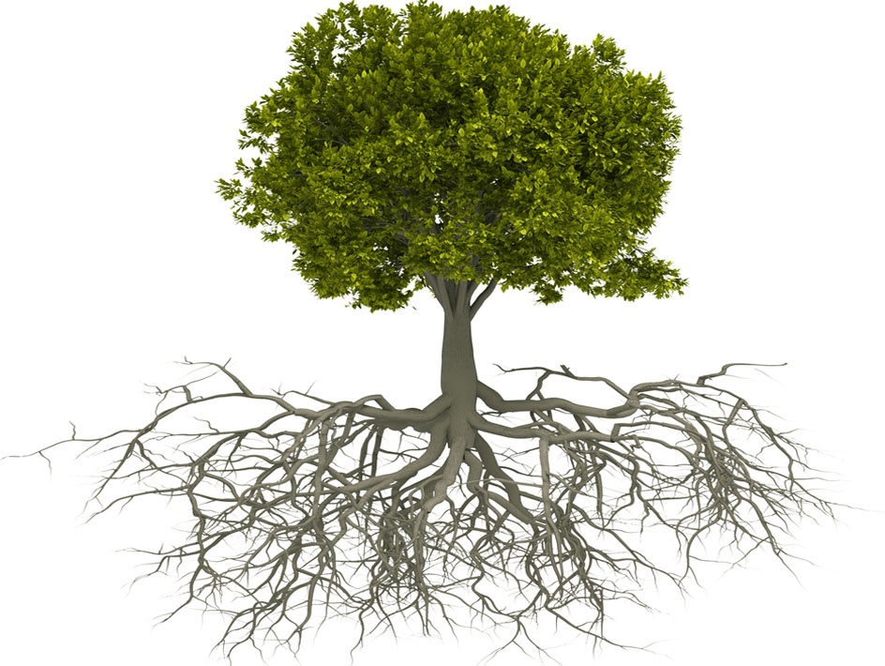
Walk of Faith
James 2:17-19
“¹⁷ In the same way, faith by itself, if it is not accompanied by action, is dead. ¹⁸ But someone will say, “You have faith; I have deeds.” Show me your faith without deeds, and I will show you my faith by my deeds. ¹⁹ You believe that there is one God. Good! Even the demons believe that—and shudder.”
Trust in God
Notes:
So if we look at faith, we can look at it as having 2 components:
Faith: Believing & Trusting in God & Living it out through our actions
1) There are the roots that grow below ground. This reflect our belief & trust in God. This happens in our heart and spirit, and is not something anyone else can see.
2) Then there is the tree that is displayed above ground. This is an expression of our faith – it’s about living our faith out through our actions. It represents the degree to which our actions reflect our beliefs. It’s the true measure of out faith…the way we live.
We read about this duality of faith:
James 2:17-19
“In the same way, faith by itself, if it is not accompanied by action, is dead. But someone will say, “You have faith; I have deeds.” Show me your faith without deeds, and I will show you my faith by my deeds. You believe that there is one God. Good! Even the demons believe that—and shudder.”
So telling others that we trust in God, but not living it out is of little value and suggests that we have a shallow or counterfeit faith.

Slide 5

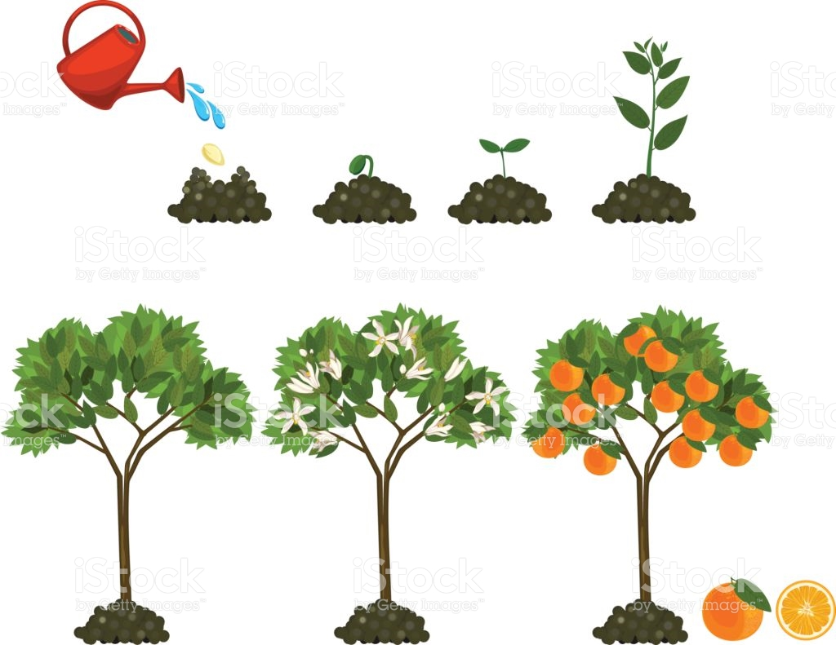
BUT WHAT GROWS OUR FAITH?
Notes:
So we’ve learnt that faith is something that grows in our hearts as we trust in God – like the roots that give life to a tree.
As these roots develop, they start to support life. A tree starts to grow – but what is it that grows our faith in the Lord?
Let’s have a look at 5 things that can grow our faith.

Slide 6
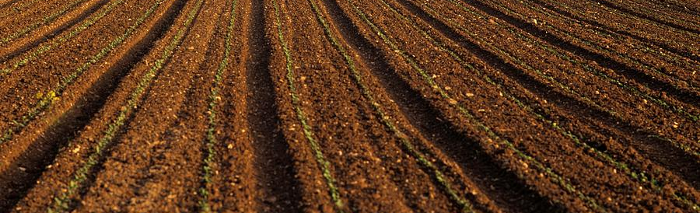
1. The “soil of our hearts”
Mathew 13 – The parable of the sower
…²³But the seed falling on good soil refers to someone who hears the word and understands it. This is the one who produces a crop, yielding a hundred, sixty or thirty times what was sown.”
Trust in God
Notes:
The “Soil of our hearts”
Mathew 13 – The parable of the sower
…²³But the seed falling on good soil refers to someone who hears the word and understands it. This is the one who produces a crop, yielding a hundred, sixty or thirty times what was sown.”
Our faith will not grow if the soil of our hearts is not prepared, and ready to receive the seed that is sewn. This is a personal responsibility and it means:
We need to be careful not to get caught up with worries instead of bringing them to God;
We need to be careful to not get so caught up in pleasures and the pursuit of wealth that we are too distracted to allow God to grow us

Slide 7

2. God’s word
It is fertilized by the word of God
Romans 10:17
“Faith comes from hearing the message, and the message is heard through the word about Christ.”
Trust in God
Notes:
2) God’s word
We been reminded often about personal spiritual disciplines, and how important that is for growing our faith and walk in Jesus.
This is emphasised in Romans 10:17, where Paul says “Faith comes from hearing the message, and the message is heard through the word about Christ.”
Another way of deepening faith is by hearing practical teaching that you can hold onto and apply in your life. It’s like fertilizer that helps a plants roots to grow…
So if you want to please God, and grow your faith, it’s critical that you spend time wrestling with the scriptures and finding out for yourself what following Jesus is all about. Without understanding God’s word, what is your faith built on…?

Slide 8


3. Special Godly relationships
It is fertilized by the word of God
Proverbs 27:17
“As iron sharpens iron, so one person sharpens another.”
Trust in God
Notes:
3) Special Godly relationships
God also uses people in our lives to grow our faith. This includes testimonies that people share of God working in their lives and close, godly friendships that steady us through challenging times and challenge us when we are not living our lives like God intended.
Proverbs 27:17
“As iron sharpens iron, so one person sharpens another.”
So friendships are like water to a tree: they can bring refreshing when we’re feeling dry and need support and encouragement…

Slide 9
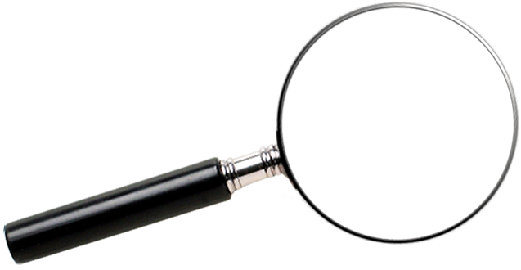
4. Trouble
It is fertilized by the word of God
We must be careful not to blame God for the trouble we experience…
James 1:12-15
¹⁶ So don’t be misled, my dear brothers and sisters. ¹⁷ Whatever is good and perfect is a gift coming down to us from God our Father, who created all the lights in the heavens. He never changes or casts a shifting shadow. ¹⁸ He chose to give birth to us by giving us his true word. And we, out of all creation, became his prized possession.
James 1: 2-3
Consider it pure joy, my brothers and sisters, whenever you face trials of many kinds, because you know that the testing of your faith produces perseverance. Let perseverance finish its work so that you may be mature and complete, not lacking anything.
Ministry
Challenging circumstances
Notes:
4) Trouble
God wants us to learn to trust him. Sometimes he will use trouble to grow our trust in Him in new and different ways.
This is an aspect of growing faith that James speaks to in James 1: 2-3
“Consider it pure joy, my brothers and sisters, whenever you face trials of many kinds, because you know that the testing of your faith produces perseverance. Let perseverance finish its work so that you may be mature and complete, not lacking anything.”
A) This is often in the form of external circumstances that shake our world…
But these times can cause us to deepen our roots – to allow them to be extended into new areas of our lives where we perhaps didn’t trust God before. I kind of see it like roots that branch out as we go…with our faith being extended into:
Relationships
Finances
Work
Health…
B) We can also choose “trouble” in a sense by stepping out in faith into new areas of life or ministry, where we are forced to lean heavily on the Lord. I can certainly testify to this in my life over the past year or so – being thrown into ministry has forced me to really lean into God and extend my roots in many different ways

Slide 10

4. Trouble
It is fertilized by the word of God
How should we handle trouble?
Option 1: Blame God
Option 2: Ignore God
Option 3: Trust God
Focus on Jesus
Stand firm
Hebrews 12: 1-2
And let us run with endurance the race God has set before us. We do this by keeping our eyes on Jesus, the champion who initiates and perfects our faith.
1 Corinthians 16:13
Be on your guard; stand firm in the faith; be courageous; be strong.
Notes:
But how should we handle trouble?
I believe we have 3 options:
Blame God – Throw it back at Him, get angry with God, and perhaps even turn away from God
Ignore God – We can decide to handle trouble on our own, in our strength. And yes, we might make it through OK, but what a lonely walk and a lost opportunity!
Trust God – This is obviously the option that James is exhorting us to follow. It means trusting God to lead us through our troubles and to grow our character and our faith through this process.
We’re also given some practical advice on how to handle trouble.
A) We’re called to Trust God
Hebrews 12: 1-2
And let us run with endurance the race God has set before us. We do this by keeping our eyes on Jesus, the champion who initiates and perfects our faith.
B) We’re called to stand firm
1 Corinthians 16:13
Be on your guard; stand firm in the faith; be courageous; be strong.

Slide 11
4. Trouble
It is fertilized by the word of God
What can we trust God for in times of trouble?
WISDOM
WEALTH
DIRECTION
REFUGE
PEACE
James 1: 5-8
⁵ If you need wisdom, ask our generous God, and he will give it to you. He will not rebuke you for asking. ⁶ But when you ask him, be sure that your faith is in God alone. Do not waver, for a person with divided loyalty is as unsettled as a wave of the sea that is blown and tossed by the wind. ⁷ Such people should not expect to receive anything from the Lord. ⁸ Their loyalty is divided between God and the world, and they are unstable in everything they do.
James 1: 9-10
⁹ Believers who are poor have something to boast about, for God has honored them. ¹⁰ And those who are rich should boast that God has humbled them. They will fade away like a little flower in the field. Y11 The hot sun rises and the grass withers; the little flower droops and falls, and its beauty fades away. In the same way, the rich will fade away with all of their achievements. .
Proverbs 3:5-6
Trust in the Lord with all your heart;
do not depend on your own understanding. Seek his will in all you do, and he will show you which path to take.
Psalm 46:1
God is our refuge and strength, always ready to help in times of trouble.
John 14:27
I am leaving you with a gift—peace of mind and heart. And the peace I give is a gift the world cannot give. So don’t be troubled or afraid.
Psalm 18:30
God’s way is perfect.
All the Lord’s promises prove true. He is a shield for all who look to him for protection.
2 Corinthians 1:3-4
All praise to God, the Father of our Lord Jesus Christ. God is our merciful Father and the source of all comfort. He comforts us in all our troubles so that we can comfort others. When they are troubled, we will be able to give them the same comfort God has given us.
WITH US
Deuteronomy 31:6
“So be strong and courageous! Do not be afraid and do not panic before them. For the Lord your God will personally go ahead of you. He will neither fail you nor abandon you.”
FOR US
Romans 8:28
And we know that God causes everything to work together for the good of those who love God …
Notes:
But the reality is that Trouble can also cause us to lose faith…particularly if God does not meet our expectations or live up to what we expect Him to do.
So it is critical to understand what we can trust God for when trouble strikes… So I spent a bit of time searching the scriptures to see what God does promise (not just to an individual, but as children of God). This is not an exhaustive list, but hopefully it will be something that you can think back to next time you’re going through a difficult season in your life…
Wisdom: James 1: 5-8
Wealth: James 1: 9-10
Direction: Proverbs 3:5-6
Refuge: Psalm 46:1 / Psalm 18:30
Peace: John 14:27 / 2 Corinthians 1:3-4
For us: Romans 8:28
With us: Deuteronomy 31:6

Slide 12

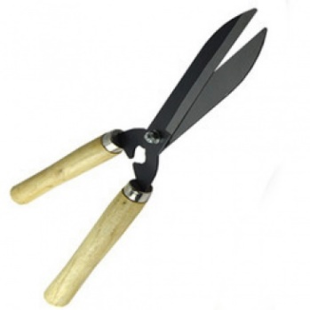
5. God’s discipline
It is fertilized by the word of God
John 15:1-5
“I am the true vine, and my Father is the gardener. He cuts off every branch in me that bears no fruit, while every branch that does bear fruit he prunes so that it will be even more fruitful. You are already clean because of the word I have spoken to you. Remain in me, as I also remain in you. No branch can bear fruit by itself; it must remain in the vine. Neither can you bear fruit unless you remain in me.
Walk of Faith
Proverbs 3:11
“My son, do not despise the Lord’s discipline, and do not resent his rebuke, because the Lord disciplines those he loves, as a father the son he delights in.
Discipline is different to temptation – temptation does not come from God
James 1:12-15
¹² God blesses those who patiently endure testing and temptation. Afterward they will receive the crown of life that God has promised to those who love him. ¹³ And remember, when you are being tempted, do not say, “God is tempting me.” God is never tempted to do wrong, and he never tempts anyone else. ¹⁴ Temptation comes from our own desires, which entice us and drag us away. ¹⁵ These desires give birth to sinful actions. And when sin is allowed to grow, it gives birth to death.
Notes:
5) Discipline
Discipline is something that we don’t like to experience, but if it’s coming from a good father, who loves us, we know that it is for our good.
Proverbs 3:11
“My son, do not despise the Lord’s discipline, and do not resent his rebuke, because the Lord disciplines those he loves, as a father the son he delights in.
This is different to trouble that comes across our path from external circumstances – this involves a closeness and a deliberateness in what God is doing in our lives as expressed so beautifully by the parable of the vine and the gardener. Each clip of the scissors is purposeful and designed specifically for growth.
John 15:1-5
Note: Discipline is different to temptation – temptation does not come from God
James 1:12-15 – temptation comes from our own sinful desires. God has no desire to see us sin…

Slide 13
SUMMARY
It is fertilized by the word of God
Walk of Faith
Trust in God
Notes:
So to sum up then:
Faith has two aspects to it:
(Roots) Believing & Trusting in God &
(Branches) Living it out through our actions
God wants to grow our faith, but that can depend on and be developed by a range of things:
The soil of our hearts
Word of God
Special Godly relationships
Trouble (and how we handle it)
Discipline
I’ve certainly enjoyed getting a better handle on this concept of faith – I hope you’ve learnt something today and that something in your heart will be stirred to deepen your trust in God as we start working through James together during the weeks ahead….

