Slide 1

4 WORDS SHAPING WHO WE ARE…
Notes:
As we begin with a new year, it’s provided us with an opportunity to reflect on what God has done and the direction He is leading us in.
There certainly has been a lot of water under the bridge last year, but we can look back and say “God is Good” and we can see that He is shaping and building us as a church.
So as we get settled in to the year ahead, I’d like to speak to 4 words that have really stood out over the last 12 months. They are words that are shaping who we are as a local church and the culture that we believe God is calling us to build.

Slide 2

1
"Grace comes into the soul, as the morning sun into the world; first a dawning; then a light; and at last the sun in his full and excellent brightness” Thomas Adams
Each One...
Notes:
This is a phrase that has been foregrounded as NB since the inception of our church…then it was “Each one a portion of the work”.
We recognize that its easy to get comfortable to slip into a way of doing church where it’s all about us, and meeting our needs and expectations. Where we perhaps sit back and criticize if the preaching is not up to scratch and we’re not getting the focused attention we feel we deserve.
It’s also easy to look to a leader to fill us up without seeing our need to contribute.
But we’ve been reminded of the richness of doing church together as we’ve pulled together as a church over the trying times last year.
Avi Pratt shared a picture that she had for our church. It was one of God wanting to unearth a treasure box of gems / jewels that had been lying covered in sand. This was a picture about God wanting to uncover and expose the gifts and talents that He has placed in us…ones that have laid dormant but which God wants to unearth

Slide 3
1
Each One...
Romans 12 v 6-8
"⁶We all have gifts. They differ in keeping with the grace that God has given each of us. Do you have the gift of prophecy? Then use it in keeping with the faith you have. ⁷Is it your gift to serve? Then serve. Is it teaching? Then teach. ⁸Is it telling others how they should live? Then tell them. Is it giving to those who are in need? Then give freely. Is it being a leader? Then work hard at it. Is it showing mercy? Then do it cheerfully." NIRV
Notes:
Scripture reading

Slide 4
1
Each One...
The church is the body of Christ…each one of us has a specific role to play.
Notes:
God gives gifts and talents to each and every one of us. Each one is important, each of you is important to the functioning of this local church.
So as we move forward this year, let’s do it together, with each one contributing to building God’s kingdom. That’s the way God designed it and how we want it to stay…

Slide 5

2
Wholehearted
Notes:
The next word is “Wholehearted”…this is what we're called to become..each and every one of us.
This world will numb us into a pattern of following Christ that can reflect more of the culture that we live in than it reflects what the bible teaches about following Christ.
So we need to be willing to reflect on our faith and check that our living is aligned to the word of God and not on how we see other people living out their faith

Slide 6
2
Wholehearted…
Romans 12:1-2:
“Brothers and sisters, God has shown you his mercy. So I am asking you to offer up your bodies to him while you are still alive. Your bodies are a holy sacrifice that is pleasing to God. When you offer your bodies to God, you are worshiping him. Don't live any longer the way this world lives. Let your way of thinking be completely changed. Then you will be able to test what God wants for you. And you will agree that what he wants is right. His plan is good and pleasing and perfect.”
Notes:
Scripture reading
There is an expectation for us to each respond to the love that Jesus has shown to us.
We're called to offer ourselves to God as a sacrifice – elsewhere in scripture, Paul says that we should be viewing ourselves as slaves to God – not following our own plans and desires but seeking to please Him
So let’s press in to find out what “wholehearted” looks like. Let’s let the Holy Spirit mould the way we think and shape the way we live.

Slide 7
2
Wholehearted…
We are called to be wholehearted believers who actively live out our faith.
Notes:
What is clear though, is that “wholehearted” means transformation –allowing God to change and grow us to be more like Jesus. That means that as we walk with Jesus:
Our actions speak louder than our words
Our values are shaped and aligned with the heart of God
Our priorities are aligned with what God is calling us to rather than simply following our own plans and priorities
It also means being committed:
Committed to meeting together and building this church and our influence in this community
Committed to each other by really caring for and loving one another
Spending time with Jesus and allowing his word to challenge and shape our thinking (Just do it!)

Slide 8
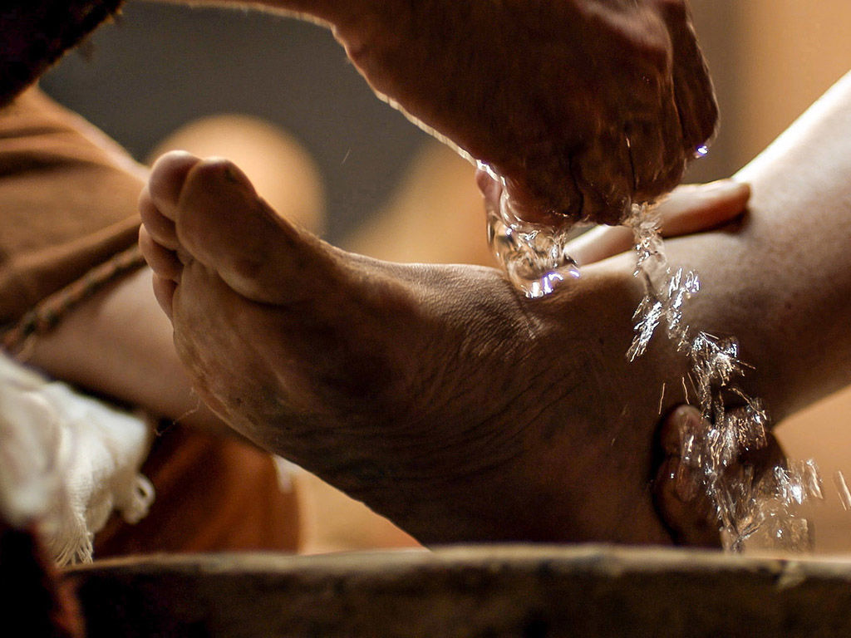

3
Serve
Notes:
3. “Serve” speaks to our attitude to following Jesus.
Cultural clubs, gatherings and events often attract people for what they can get out of it…but as much as church should be a place where we receive, Jesus was very clear on setting an example for us to follow (washing his disciples feet)

Slide 9
3
Serve…
John 13:14-15:
“I, your Lord and Teacher, have washed your feet. So you should also wash one another’s feet. I have given you an example, that you should do as I have done to you”.
Notes:
So serving is an expectation of everyone who follows Jesus…it’s an example that Jesus calls us to follow.

Slide 10
3
Serve…
If Jesus is our example, serving is for each of us!
Notes:
If Jesus is our example, serving is for all of us…
Practically speaking, this means that all of us should be finding was to serve one another, at home, at church and in our communities.
To facilitate this in church, we've formed 4 serving teams and we really would encourage each of you to be committed to these teams.
It’s an opportunity to get to know others in the church and to muck in at helping to get things ready and cleaned up afterwards.
Some members are also involved in SS, TC or the worship team, which are critical ministries in our church
The dates are set out for the year, so when you’re planning holidays, sports events or other activities, please try and plan around these dates as far as possible.
We've found that as serving teams grow, the time taken to get things set up and cleaned up is getting less. What this does provide though, is the time to build relationships with others and to join with others in prayer before the service.
But we’re called to be servants in the way we live our lives so let’s let this value of serving become part of how we live Monday to Sunday and not just something we do at church.

Slide 11

4
Connect…
Notes:
Being “Connected” is critical in Church, because we’re all part of the body of Christ.
If we’re going to be able to respond to the head (Jesus), then we need to be connected to one another.
This means connecting regularly at church services and seeking His will for our lives and our church together.

Slide 12
4
Connect…
Hebrews 10:24-25
“Let us consider how we can stir up one another in love. Let us help one another to do good works. Let us not give up meeting together. Some are in the habit of doing this. Instead, let us cheer each other up with words of hope. Let us do this all the more as you see the day coming when Christ will return”.
Notes:
Read scripture…
Connecting is also critical to our spiritual growth and maturity. We were never designed to walk alone…
Rather, we’re called to meet regularly together to:
Stir one another in love and good works – we all need this encouragement to really live out our faith.
Encourage one another and support one another through the ups and downs of our journey.

Slide 13

4
Connect…
Being connected is what it means to be part of a body & is critical to the functioning of our church.
Notes:
To help foster connection, it means that connect groups are central to the way we do church:
It provides a space for deepening friendships and real fellowship with others.
It provides a place for caring and meeting needs.
As much as it may be convenient to pass this on as a pastoral / leadership responsibility, this is not the way Church is meant to function.
We’re each called to love and care for one another – it’s meant to be one of the distinguishing features of the local church.
It is also a place for discipleship and accountability, where we challenge and encourage each other in our walk with the Lord – so bible study needs to be a central part of any connect group.
So if you’re not in a connect group, we’d love you to join a group.
If there is not a suitable group to attend, let’s create new groups so that all can be connected.

Slide 14

Serve
Each One
Wholehearted
Connect
Notes:
So that’s a brief overview of some key aspects of church culture that we’re looking to nurture and grow as we continue to meet together.
We’d ask each one of you to commit with us on this journey as we press in to becoming wholehearted followers of Jesus. We really want to do this together…
Part of this journey involves making a decision to serve and connect with one another. Let’s let that become part of who we are as we trust God to continue leading us through the year ahead.

