Slide 1
2018

Slide 2
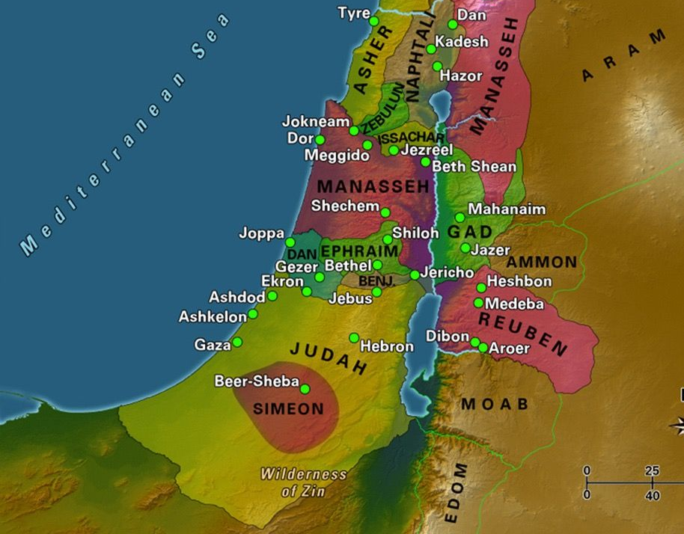

Slide 3
Break camp, and move forward
“So when the people broke camp to cross the Jordan…” Josh 3:14.
The Israelites left behind 40 years of life but they did it as they believed God had something better for them.
There is a time when you need to recognize that you need to move on, but not just to anything, to something better.
Josh 1:3-4 “When you see the ark of the covenant of the Lord your God, and the Levitical priests carrying it, you are to move out from your positions and follow it. [4] Then you will know which way to go, since you have never been this way before.

Slide 4
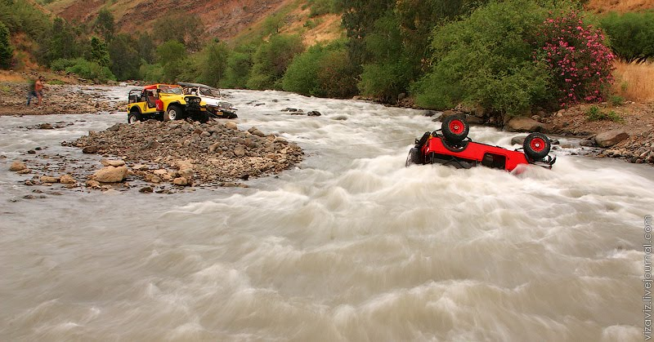
Now the Jordan is at flood stage during the harvest. Josh 3:15

Slide 5
They did it together
[Josh 3:17] The priests who carried the ark of the covenant of the Lord stopped in the middle of the Jordan and stood on dry ground, while all Israel passed by until the whole nation had completed the crossing on dry ground.
What does this inheritance look like?

Slide 6
Consecrate yourselves, and circumcision
[Josh 3:15] “Joshua told the people, “Consecrate yourselves, for tomorrow the Lord will do amazing things among you.
[Josh 5:2-3] At that time the Lord said to Joshua, “Make flint knives and circumcise the Israelites again.” [3] So Joshua made flint knives and circumcised the Israelites at Gibeath Haaraloth
Take a stand on purity
Cut away what is unnecessary – put down distractions

Slide 7
Personal disciplines
[Josh 1:9-10] Keep this Book of the Law always on your lips; meditate on it day and night, so that you may be careful to do everything written in it. Then you will be prosperous and successful. …be strong and courageous.
Personal time with God.
Just do it.
Persevere
Read, pray and relate

Slide 8
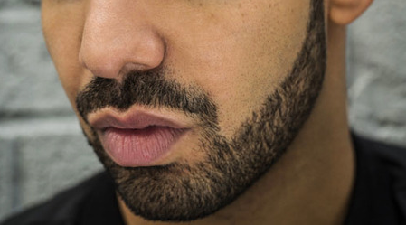
Discussion in the church.
Discussion in families.
Declaration. Rom 12

Slide 9

Courage
[Josh 1:6] Be strong and courageous.

Slide 10
  [Matt 14:27 ;Mark 6:50]
  Jesus said, “Take courage, it is I. Don’t be afraid”.
Peter chose to believe Jesus rather than the principles of nature and the elements of the world.
Peter chose to hear Jesus’ voice above the noise of the waves.
[Eph 1:20 Msg]

Slide 11
Courage is an act that reflects the belief of your heart.
If you do not prepare for courage, you are going to miss out on what God has for you. Be expectant of God to speak to you and prepare yourself beforehand to take courage to do it.

Slide 12
To Cross the Jordan
Break camp, and move forward
Do it together
Consecrate yourselves
Personal disciplines
Take courage
Josh 1 :4 Then you will know which way to go, since you have never been this way before.

