Slide 1
How do people know me?
By a number:
801127 5017 08 4
992 232 670
456 688 17
634 585 51
073 958 7152
079 507 4386
076 430 6899
By a name:
Jonathan
Jon
Jono
Jonty
Tyler
Oom
Caleb’s Dad
Notes:
How do people know me?
Depends how well. To some I’m just a number
SA gov – ID #
UKZN –
Vodacom –
To others I’m a name.
If I’m in trouble or you don’t know me so well – Jonathan
To a very few special family members - Jonty
One of my favourite names Caleb’s Dad!!

Slide 2
How does God know me?
“And the very hairs on your head are all numbered.” Matthew 10:30
“You made all the delicate, inner parts of my body and knit me together in my mother’s womb.” Psalms 139:13
Notes:
Better than any of the above!

Slide 3
God cares for us deeply
“Then the Lord God took some soil from the ground and formed a man out of it; he breathed life-giving breath into his nostrils and the man began to live.” Genesis 2:7
“For this is how God loved the world: He gave his one and only Son, so that everyone who believes in him will not perish but have eternal life.” John 3:16
Notes:
We are God’s hand made perfection! Everything else on the planet was simply spoken into being.
Gen 2:7 ……..
Then in the new testament and probable the best know verse in the Bible.
John 3:16 ……..
This then leads to a burning question, often asked by people searching for the truth.

Slide 4
But then why is there……?
Disease
Illness
Financial issues
Murder
Rape
Violence
Abuse
Orphans
War
Starvation
Notes:
This leads to the real topic of the message today.

Slide 5
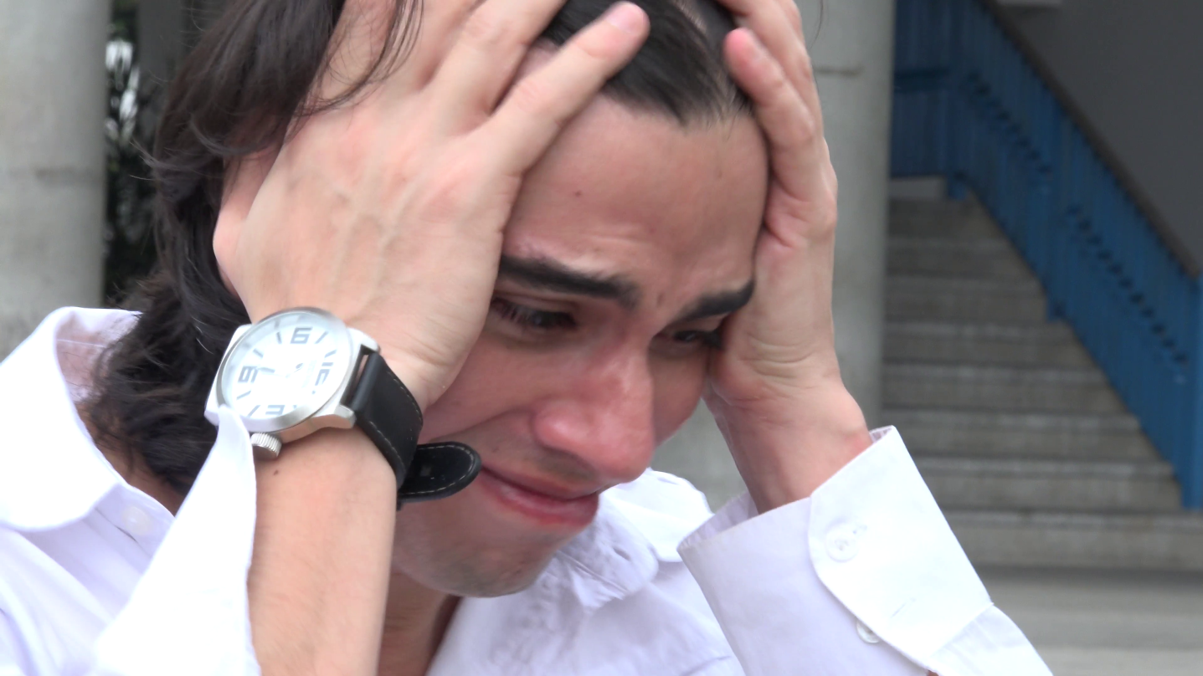
Why do we suffer?
Notes:
Just because we identify with Christ or call ourselves Christian, that does not mean that we are not going to suffer!
This is a topic very close to me heart. Nics and I had been married fro about 18 months when I found out I was unable to have children. And this lead to many heated debates with God. Your story may not be exactly the same as this but I’ll give the highlights and you can draw what ever similarities you can think of.
This is a snippet of a typical fight I’ve had with God. “We’ve been very good and waited until marriage, we’ve tried to plan our family carefully, and now!!! You gave them a child and they’re not even married! How fair is that!?! What have I done that is so bad as to deserve to suffer like this Lord!! If you really loved me you’d heal me and give us a child!”
To add insult to injury, the then leaders of our home group arrived on the night I found out the news that I wouldn’t be able to father children and announced that they were pregnant!! I can’t tell you the blow!
Another fight with God. “Oh COME ON GOD!!!!!” That’s about of that fight as much as I’m comfortable repeating church!
In the depth of the suffering the last thing you feel like or even dream of doing is giving God any praise at all! You go through the motions but inside you’re a dead branch. A dried up well with nothing to give!

Slide 6
Human feelings and insights
It’s the Devil
  He’s picking on you in your weakest moments
  The Devil is powerful and can do what he likes when he likes
You’re being punished by God for a sin you’ve committed
  If not you then it’s generational sin coming back to bite you
  Repent and you’ll be fine
Notes:
In the depth of the despair people love to give you advice.
More often than not it looks something like what is not screen behind me.

Slide 7
What does the Bible say?
Christians suffer:
  “But the gateway to life is very narrow and the road is difficult, and only a few ever find it.” Matthew 7:14
Examples:
  Paul
  Job
  Daniel
  Shadrach, Meshach and Abednego
Notes:
No one said being a Christian would be easy. Jesus himself said in Matt 7:14
The book of Job is all about a man going through suffering. In brief Job is super rich with a massive family and good health. He loses it all but through all his lows and suffering he never takes his eyes off God.

Slide 8
It’s the Devil
Yes and no
  Yes it is the devil but he acts with God’s permission
  Job 1: 6-12
  Job 2: 1-7
Suffering is God filtered
God will never give you more than He knows you can handle
  “For my yoke is easy to bear, and the burden I give you is light” Matthew 11:30
Notes:
Key point 1:
Suffering is God filtered
Beginning of Job 1 & Job 2 we read that Satan is present in the heavenly court and needs to ask God’s permission before brining any hardship to Job. So the Devil does not just have free reign to do what he pleases. All the works of the devil are filtered through God 1st.
Matthew 11:30 in red so from the mouth of Jesus “For my yoke is easy to bear, and the burden I give you is light”

Slide 9
You’re being punished
Possibly
  “Those who spare the rod of discipline hate their children. Those who love their children care enough to discipline them.” Proverbs 13:24
Not always though
  “Have you noticed my servant Job? He is blameless – a man of complete integrity. He fears God and stays away from evil. And he has maintained his integrity, even though you urged me to harm him without cause.” Job 2:3

Slide 10
Then why?
God wants a real relationship with you, in which your love for Him is honest and heartfelt and not a paid-for “false” friendship!
Notes:
If you paid someone to be your best friend. You give them money, provide food and shelter for them and give them everything their heart desires would that person be your true friend?

Slide 11
Reward for remaining faithful
Paul - the walls of the jail fell down
Job - was restored double what he had initially
Daniel walked out of the lions den
Shadrach, Meshach and Abednego danced in the fire and walked out unburned

Slide 12


Slide 13
The ULTIMATE reward
Eternal life

Slide 14
Another possible answer
“We now have this light shining in our hearts, but we ourselves are like fragile clay jars containing this great treasure. This makes it clear that our great power is from God, not from ourselves.” 2 Corinthians 4:7
Notes:
Sometime God has to allow us to be broken in order for other to see His light shining out of our brokenness!

