Slide 1
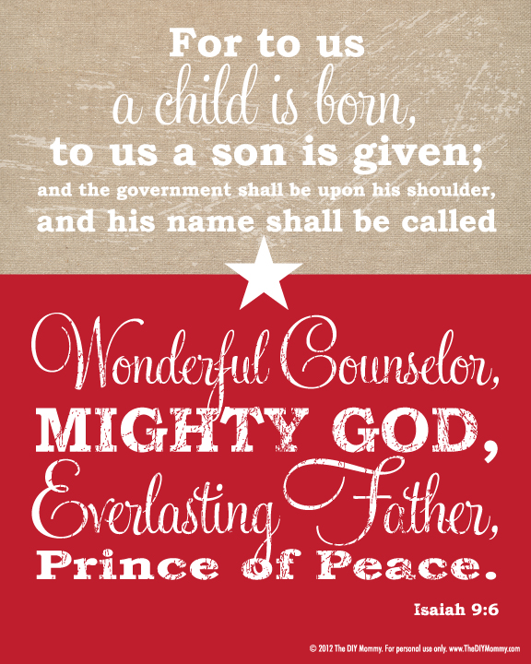


Slide 2
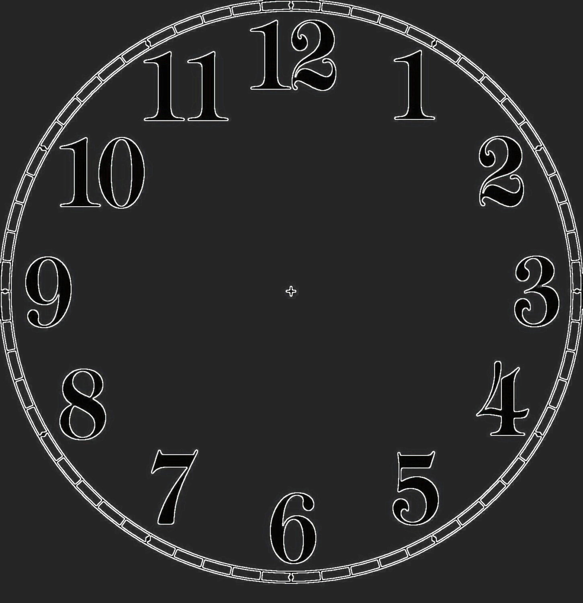

It’s time for…
12 Insights on “Mighty God”
12 insights on Mighty God

Slide 3
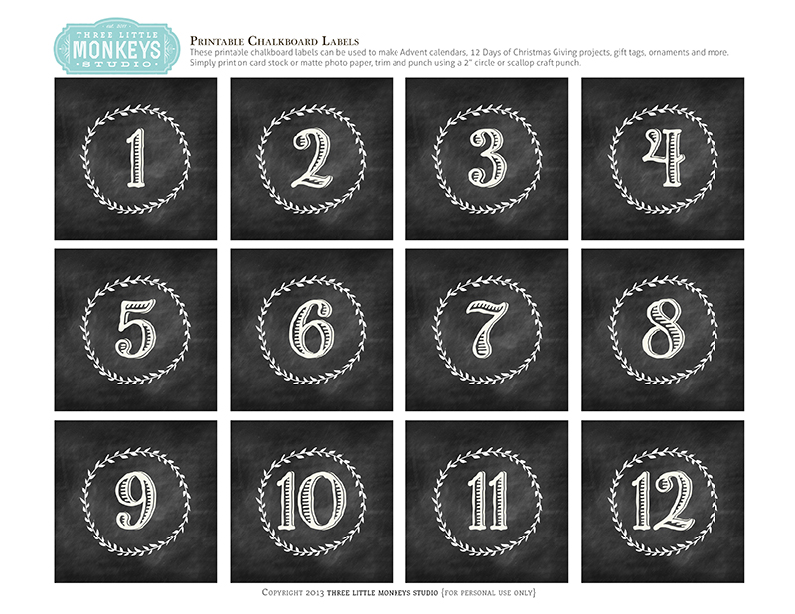
Exodus 6:1-8 (NIV)
¹Then the Lord said to Moses, “Now you will see what I will do to Pharaoh: Because of my mighty hand he will let them go; because of my mighty hand he will drive them out of his country.”
Do I really believe the MIGHTY hand of God
can achieve the impossible?
² God also said to Moses, “I am the Lord. ³ I appeared to Abraham, to Isaac and to Jacob as God Almighty, but by my name the Lord I did not make myself fully known to them.
⁴ I also established my covenant with them to give them the land of Canaan, where they resided as foreigners. ⁵ Moreover, I have heard the groaning of the Israelites, whom the Egyptians are enslaving, and I have remembered my covenant. ⁶ “Therefore, say to the Israelites: ‘I am the Lord, and I will bring you out from under the yoke of the Egyptians. I will free you from being slaves to them, and I will redeem you with an outstretched arm and with mighty acts of judgment.

Slide 4
⁷ I will take you as my own people, and I will be your God. Then you will know that I am the Lord your God, who brought you out from under the yoke of the Egyptians.
⁸ And I will bring you to the land I swore with uplifted hand to give to Abraham, to Isaac and to Jacob. I will give it to you as a possession. I am the Lord.’”
Also Deuteronomy 7:8
“Rather, it was simply that the Lord loves you, and he was keeping the oath he had sworn to your ancestors. That is why the Lord rescued you with such a mighty hand from your slavery and from the oppressive hand of Pharaoh, king of Egypt.”
God shows He is MIGHTY because…
-He LOVES His people
-He always keeps His covenant PROMISES
-He wants us to KNOW Him as Lord

Slide 5
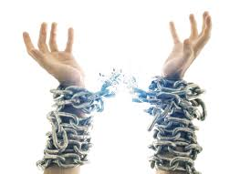
What is your Egypt?
Or who is your Pharaoh?
What could be holding you back from
entering your promised land?
What is keeping you in slavery?
Are you feeling trapped/enslaved/in bondage?
You must believe Mighty God LOVES you
and wants to set you FREE so you can KNOW Him.
Jeremiah 31:3 "I have loved you with an everlasting love”
John 8:32 “Then you will know the truth, and the truth will set you free.“
Galatians 5:1 “It is for freedom that Christ has set us free. “

Slide 6
Exodus 6:9
“So Moses told the people of Israel what the LORD had said, but they refused to listen anymore. They had become too discouraged…”
Other versions “discouraged”: anguished, despondent, broken-spirited
We need to keep on listening to Mighty God, no matter how bleak our circumstances may be.
He works all things together for good.
Exodus 6:10-12
“¹⁰Then the Lord said to Moses, ¹¹“Go, tell Pharaoh king of Egypt to let the Israelites go out of his country.”
¹²But Moses said to the Lord, “If the Israelites will not listen to me, why would Pharaoh listen to me, since I speak with faltering lips?””
God uses ordinary people, and our “faltering/clumsy/unskilled speech” is no obstacle for God to accomplish Mighty acts.

Slide 7
Moses and Aaron didn’t have to even use their own words or even think of what to do, they simply were OBEDIENT to EXACTLY what God told them.
Every specific detail as to what Moses was to say and what his brother Aaron was to do, what Pharaoh would do, what events will happen etc are outlined in Exodus 7:9-20 right to end of Chp14.
God loves DETAILS. We can trust Him with the details of our lives.
Exodus 7:5
⁵And the Egyptians will know that I am the Lord when I stretch out my hand against Egypt and bring the Israelites out of it.”
God’s redemptive acts are so mighty that even the enemy knows He is LORD.

Slide 8
Deuteronomy 5:15
^{“15}Remember that you were slaves in Egypt and that the Lord your God brought you out of there with a mighty hand and an outstretched arm”
Psalm 111:4
“He has made His wonderful works to be remembered.”
Psalm 21:13
“Be exalted in your strength, Lord; we will sing and praise your might.”
God wants us to REMEMBER His mighty acts
…by recording, reflecting, being mindful and retelling others of the mighty things He has done. This also reminds & builds our faith in Him!
Could I journal? Do I reflect? Am I mindful of what God is doing? Do I tell others about my God-adventures? Is my faith being built up by being reminded of His mighty acts of power?

Slide 9
God provides mightily for His people….
Spared from the effects of the 10 plagues
Miraculous escape from Egypt
Parts the sea for them to cross
Destroys the Egyptian army
Guides them with Pillar of fire & Cloud
Where (route) to walk, and when to walk
Angelic protection in front & behind
Water (bitter to sweet at Marah; 12 Springs at Elim; later from a rock)
Shade when needed
Promise of healing and no disease while obeying God
Manna & Quail (for 40 years!!)
Victory in battle when attacked by Amalekites
Ten commandments for living
And later…Jesus came in human form, Jesus’ resurrection from death, forgiveness of sin, Gentiles brought into the family of God, miraculous healings/raised from dead, eternal life!
Mighty God provides all we need. Always.

Slide 10
Isaiah 9:1-7
“¹Nevertheless, there will be no more gloom for those who were in distress. In the past…. but in the future…
²The people walking in darkness have seen a great light; on those living in the land of deep darkness a light has dawned. ³You have enlarged the nation and increased their joy...
⁶For to us a child is born, to us a son is given, and the government will be on his shoulders. And he will be called Wonderful Counselor, Mighty God, Everlasting Father, Prince of Peace. ⁷Of the greatness of his government and peace there will be no end. He will reign on David’s throne and over his kingdom, establishing and upholding it with justice and righteousness from that time on and forever. The zeal of the Lord Almighty will accomplish this.”
More & more open to His light & joy
PAST…
Gloom
Distress
Oppression
Contempt
Darkness
Burdened
More & more surrendered to His rule & reign
MIGHTY GOD

Slide 11
1 Peter 5 : 6,7
⁶Humble yourselves, therefore, under God’s mighty hand, that He may lift you up in due time.
⁷Cast all your anxiety on Him because He cares for you.
When we have an understanding of
how MIGHTY God’s hand is,
we really can trust Him with our anxiety,
and humble ourselves under Him.
Ephesians 6 : 10-12
¹⁰Finally, be strong in the Lord and in His mighty power.
¹¹Put on the full armour of God, so that you can take your stand against the devil’s schemes.
Our strength must be in God’s mighty power.
We need it to stand against the devil.

Slide 12

Ephesians 1 : 18-21
¹⁸I pray that the eyes of your heart may be enlightened in order that you may know the hope to which he has called you, the riches of his glorious inheritance in his holy people,
¹⁹and his incomparably great power for us who believe. That power is the same as the mighty strength
²⁰he exerted when he raised Christ from the dead and seated him at his right hand in the heavenly realms,
²¹far above all rule and authority, power and dominion, and every name that is invoked, not only in the present age but also in the one to come.
The mighty power /extraordinary divine force by which Jesus was raised from the dead & seated in heaven is the
SAME mighty power
at work in & through US !!

Slide 13
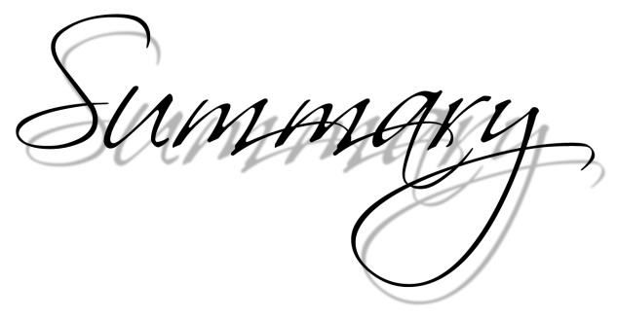
Do I really believe the MIGHTY hand of God can achieve the IMPOSSIBLE?
2. God is MIGHTY because…He LOVES His people , He always keeps His covenant PROMISES, & He wants us to KNOW Him as Lord
3. We need to keep on LISTENING to Mighty God, no matter how bleak our circumstances are. He works all things together for good.
4. God uses ORDINARY people, and our “faltering/clumsy/unskilled speech” is no obstacle for God to accomplish Mighty acts.
5. God loves DETAILS. We can trust Him with the details of our lives.
6. God’s redemptive acts are so mighty that even the ENEMY knows He is LORD.

Slide 14
7. God wants us to REMEMBER His mighty acts…by recording, reflecting, being mindful and retelling others of the mighty things He has done. This also reminds & builds our faith in Him!
8. Mighty God PROVIDES all we need. Always.
9. Mighty God wants us to be more & more open to His LIGHT & JOY; more & more surrendered to his REIGN & RULE
10. When we have an understanding of how MIGHTY God’s hand is, we really can trust Him with our ANXIETY, and HUMBLE ourselves under Him.
11. Our STRENGTH must be in God’s mighty power. We need it to stand against the devil.
12. The mighty power /extraordinary divine force by which Jesus was raised from the dead & seated in heaven is the SAME mighty POWER AT WORK IN & THROUGH US !!

Slide 15
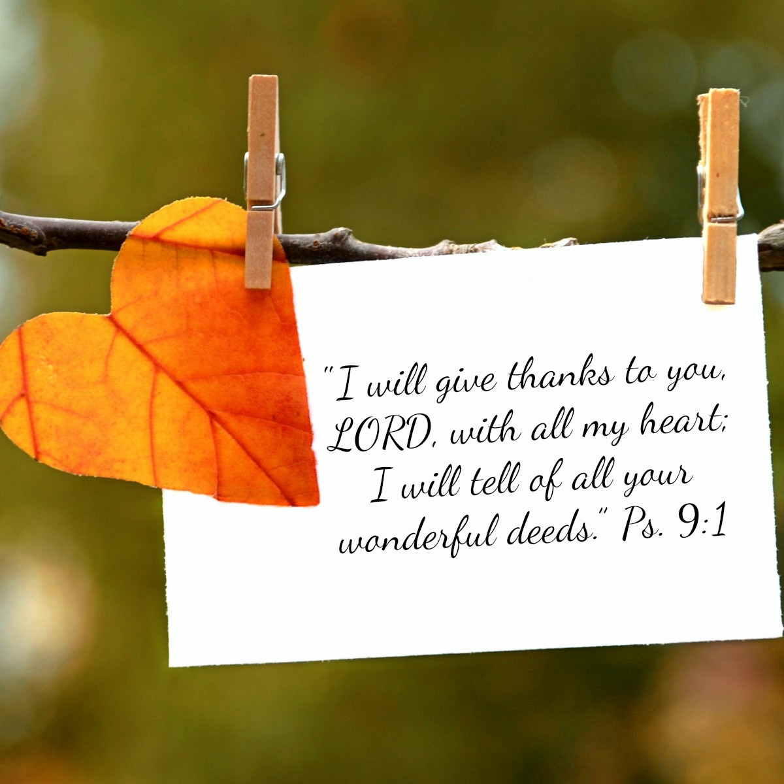
A closing prayer…

