Slide 1
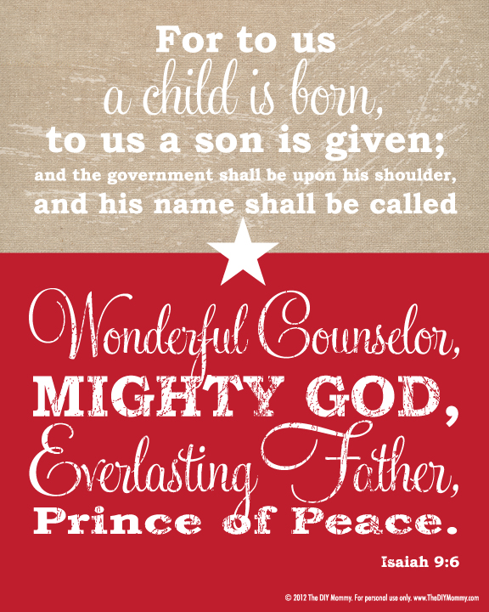


Slide 2
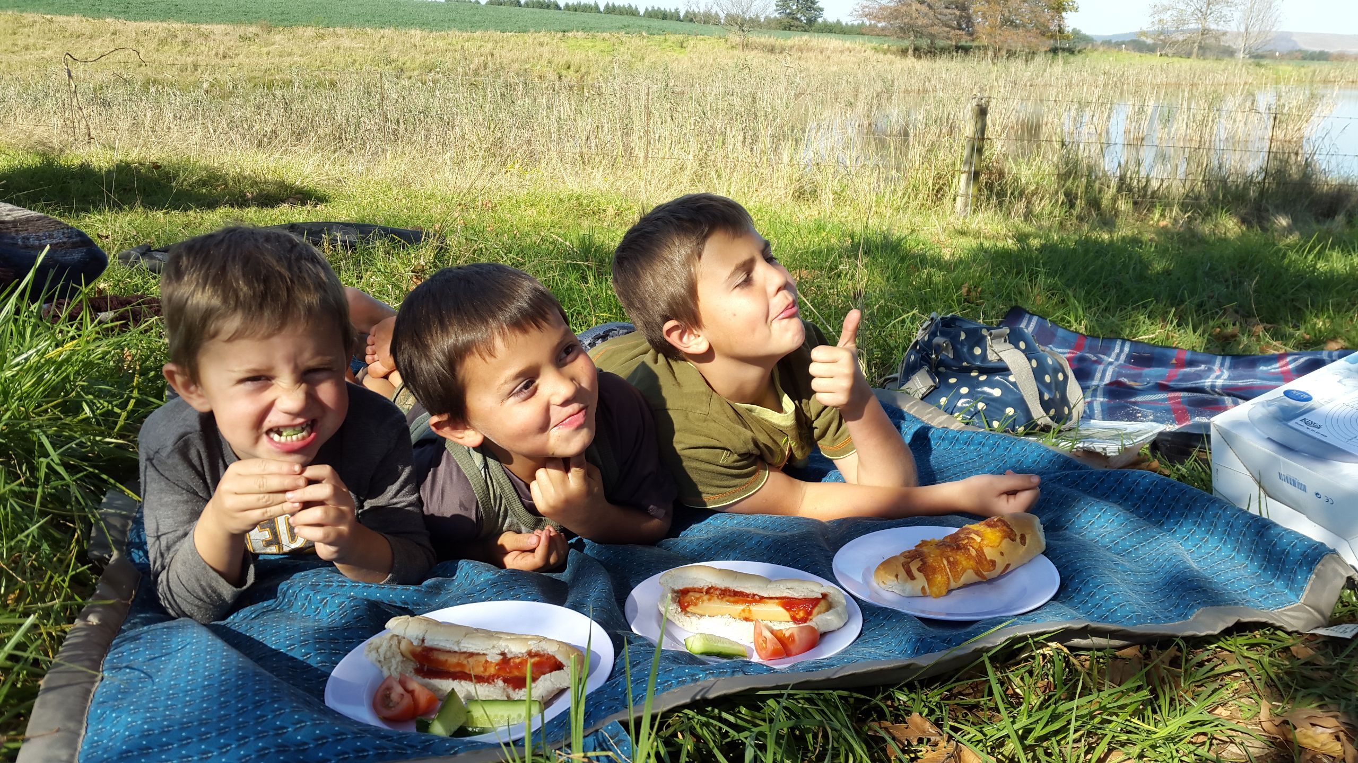
Foundations of a good relationship
Love
Sacrifice
Respect
Trust….

Slide 3
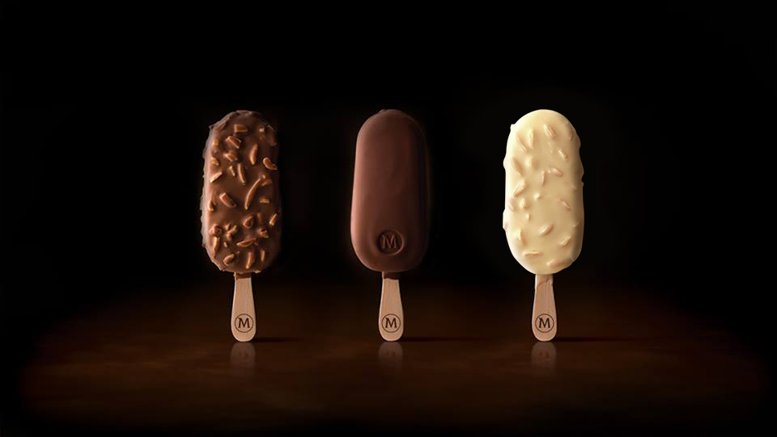
Trust & Ice-cream…
Hebrews 11:6: And it is impossible to please God without faith (Trust). Anyone who wants to come to him must believe that God exists and that he rewards those who sincerely seek him.

Slide 4

“When he was still a long way off, his father saw him. His heart pounding, he ran out, embraced him, and kissed him. The son started his speech: ‘Father, I’ve sinned against God, I’ve sinned before you; I don’t deserve to be called your son ever again.’ “But the father wasn’t listening. He was calling to the servants, ‘Quick. Bring a clean set of clothes and dress him. Put the family ring on his finger and sandals on his feet. Then get a grain-fed heifer and roast it. We’re going to feast! We’re going to have a wonderful time! My son is here—given up for dead and now alive! Given up for lost and now found!’ And they began to have a wonderful time.
Luke 20-24 MSG

Slide 5
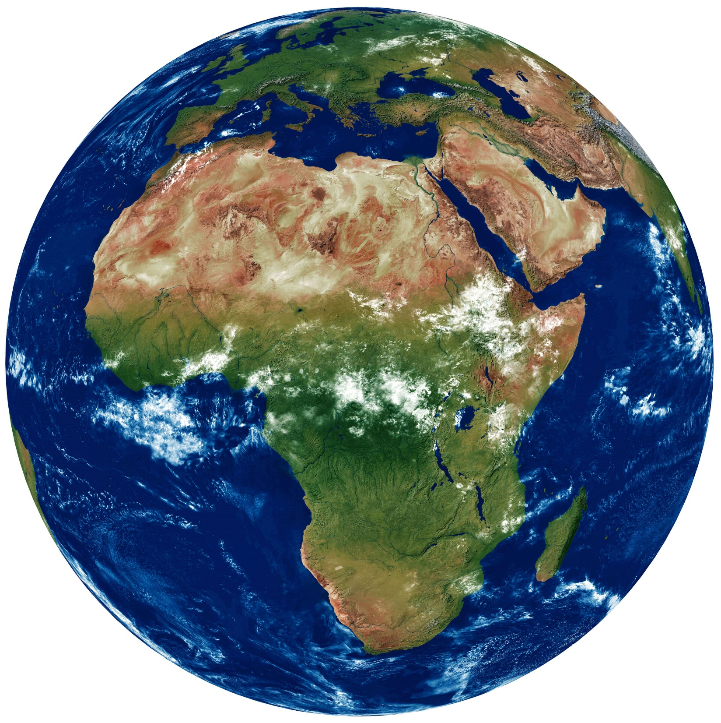






Slide 6


Slide 7

“For this is how God loved the world: He gave his one and only Son, so that everyone who believes in him will not perish but have eternal life.
John 3:16 NLT

Slide 8
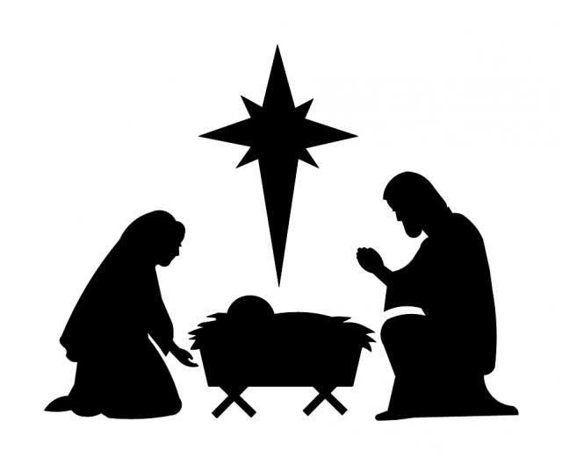
EVERLASTING FATHER
Where does this leave you this Christmas?

