Slide 1
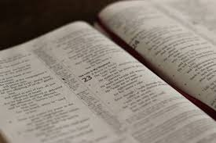
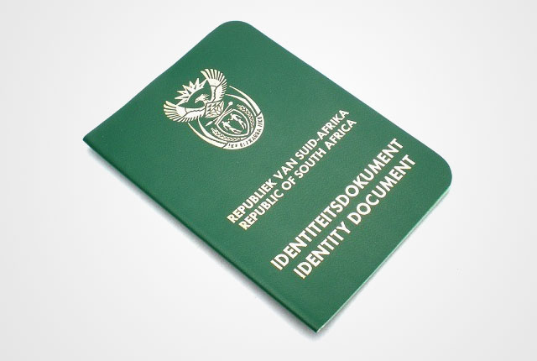
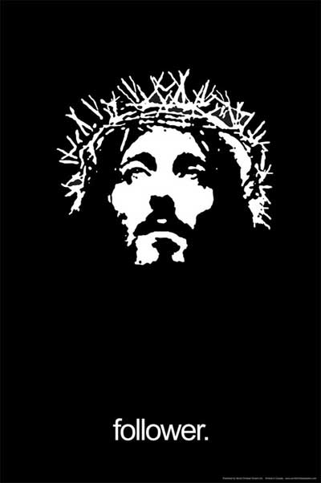
Identity Matters!

Slide 2

“Identity”
Your beliefs about Who You Are
Your tribe
Body
Personality
Parents
Hobbies
Friends
Ancestors
Clothing
Achievements
Vocation
Interests
Choices
Culture

Slide 3
Recap of the series thus far:
  Our identity in Jesus
  Identity Theft
  Finding our identity in Christ
  Identity Calling
A story illustrating the importance of identity

Slide 4
Our identity in Jesus
We have a new Father
We have a new Nature
We have a new Hope
Are you living with our old ID?

Slide 5
Identity Theft
John 10v10: “The thief comes only to steal and kill and destroy. I have come so they can have life. I want them to have it in the fullest possible way"
He would have us doubt our faith
He would deceive us into not having a right view of God and our own identity in Christ
He would accuse and condemn us so that we feel unworthy to serve Jesus.

Slide 6


Identity Theft
God’s word is central to defending our identity
  So faith comes from hearing the message (Romans 10 v 17)
  Jesus’ response to temptation: “It is written…(Luke 4)

Slide 7
Finding our identity in Christ
God knows us and loves us individually
What you believe dictates your feelings and behaviour
“In Christ” vs “In the World”
Romans 12:2 "Don’t copy the behaviour and customs of this world, but let God transform you into a new person by changing the way you think. Then you will learn to know God’s will for you, which is good and pleasing and perfect."

Slide 8
Finding our identity in Christ
Feelings
Truth
Actions
Belief
Standing on the truth of God's word rather than our feelings

Slide 9
Identity Calling
Called to follow
A calling to be
A calling to act
Romans 12:2 "Don’t copy the behaviour and customs of this world, but let God transform you into a new person by changing the way you think. Then you will learn to know God’s will for you, which is good and pleasing and perfect."

Slide 10
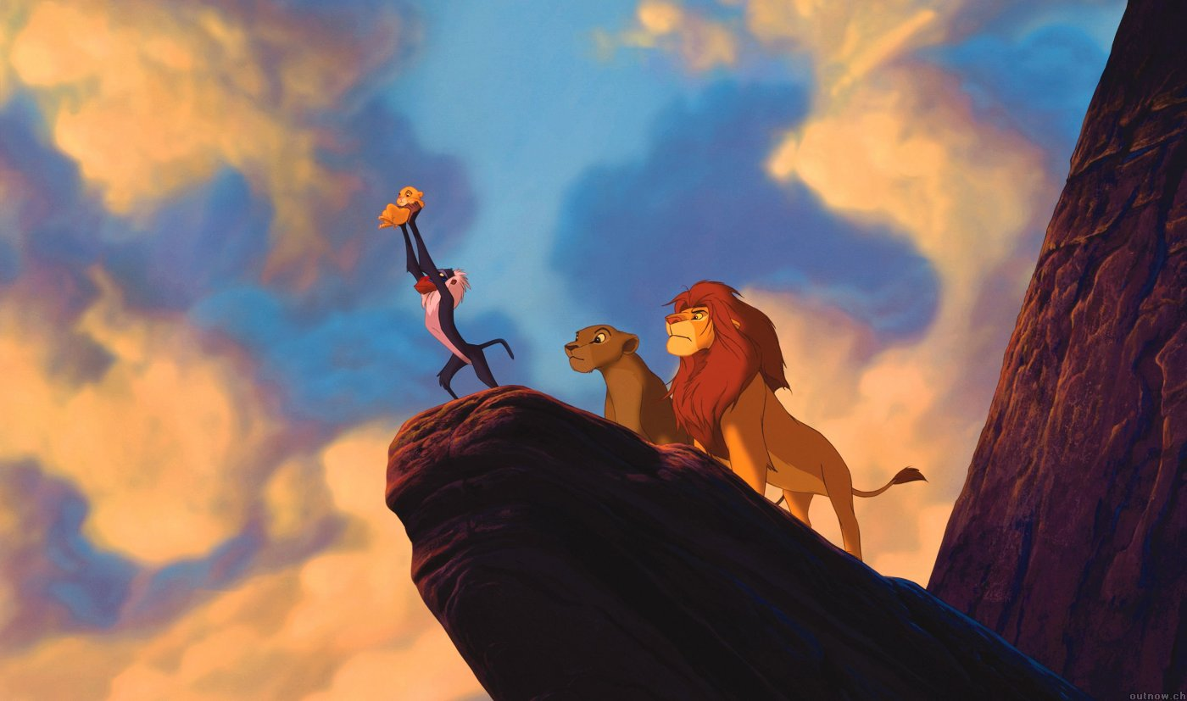
A story of lost and found identity
…born as a child of the king…
Notes:
Next steps…

Slide 11
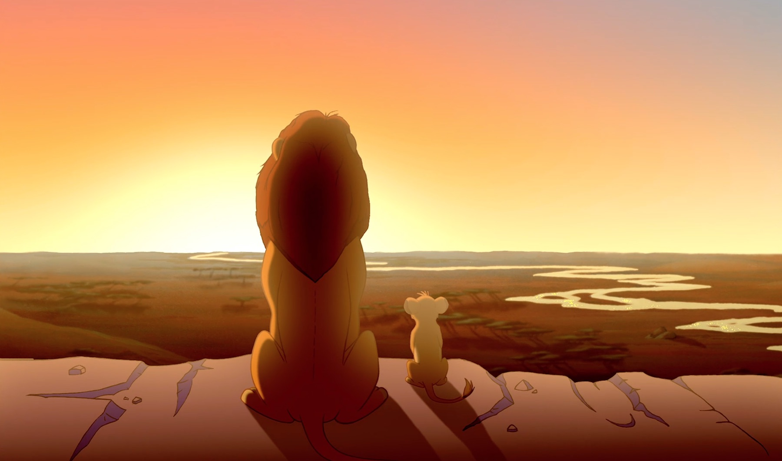
A story of lost and found identity
…destined for greatness…
Notes:
Next steps…

Slide 12
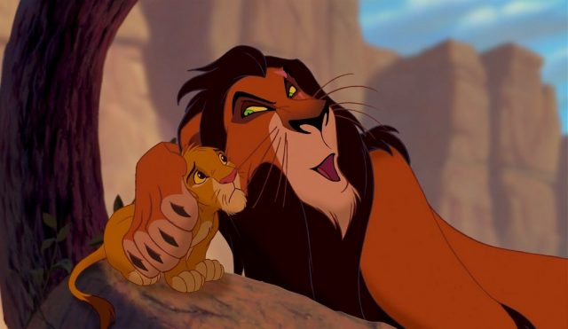
A story of lost and found identity
…deceived by lies…
Notes:
Next steps…

Slide 13
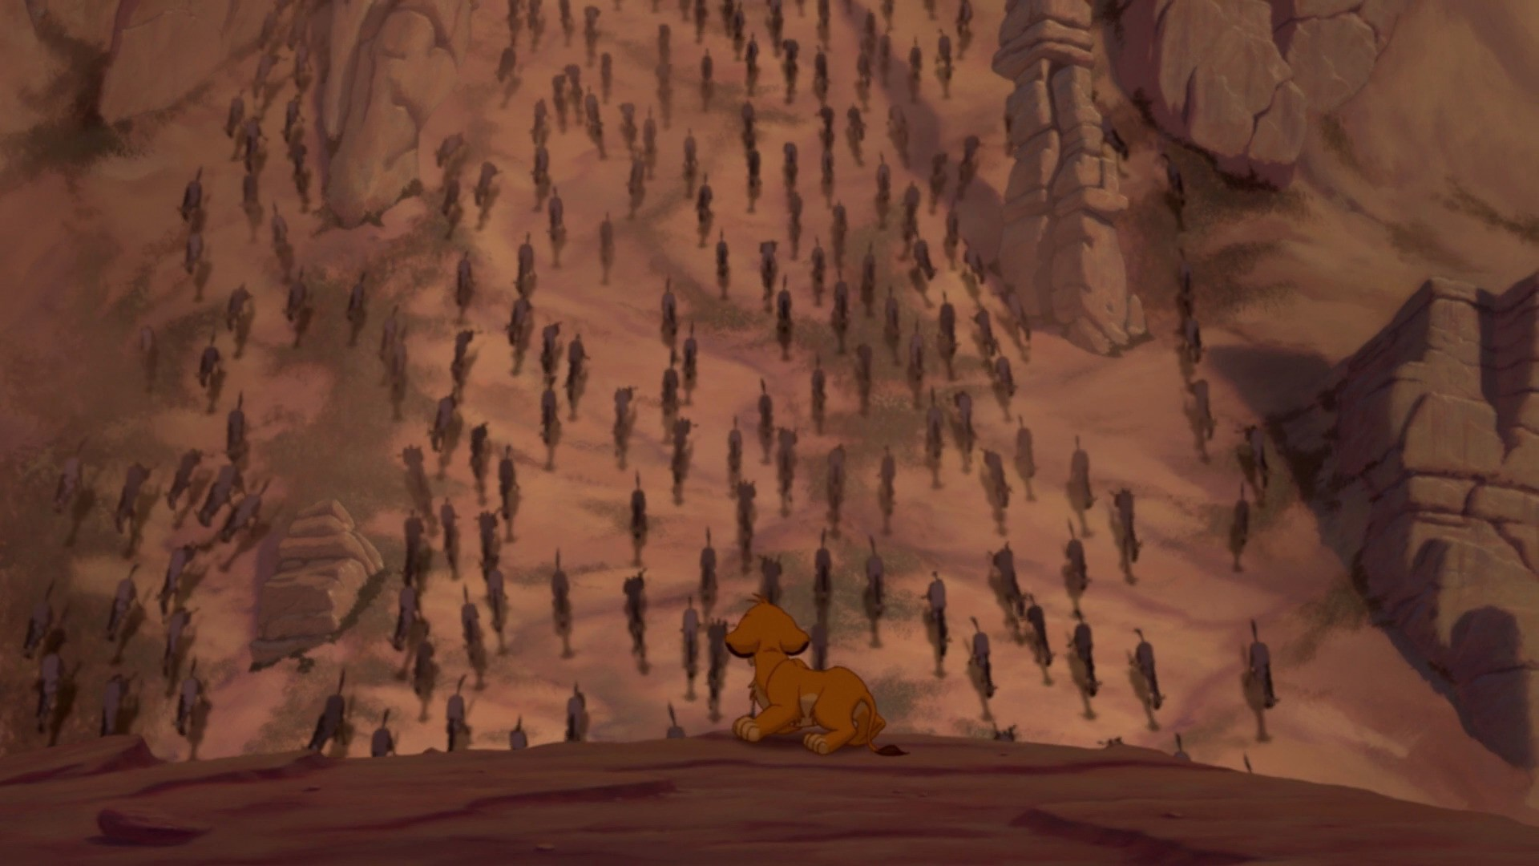
A story of lost and found identity
…caught in a wicked scheme…
Notes:
Next steps…

Slide 14
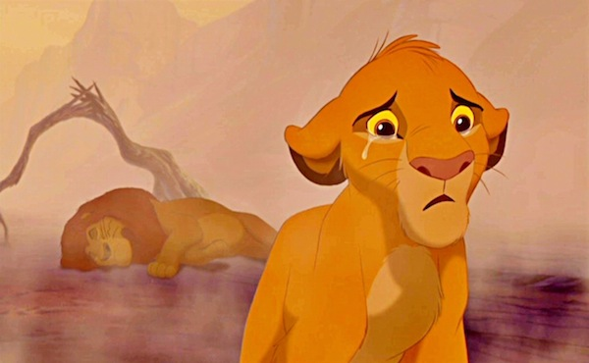
A story of lost and found identity
…it’s your fault…
Notes:
Next steps…

Slide 15
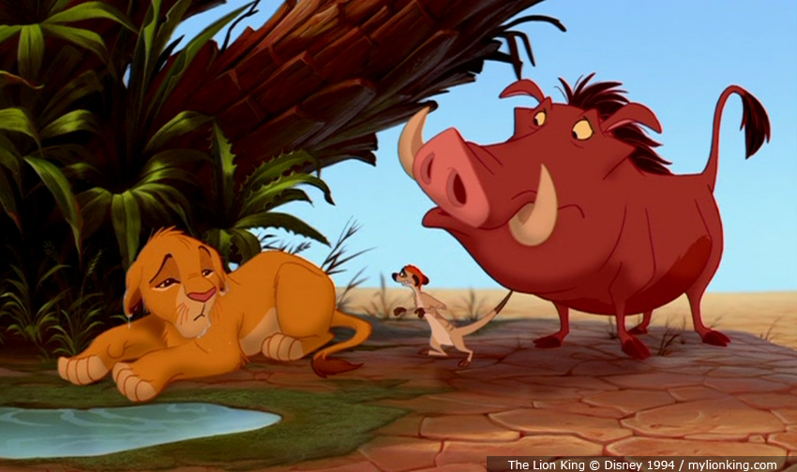
A story of lost and found identity
…new friends…
Notes:
Next steps…

Slide 16
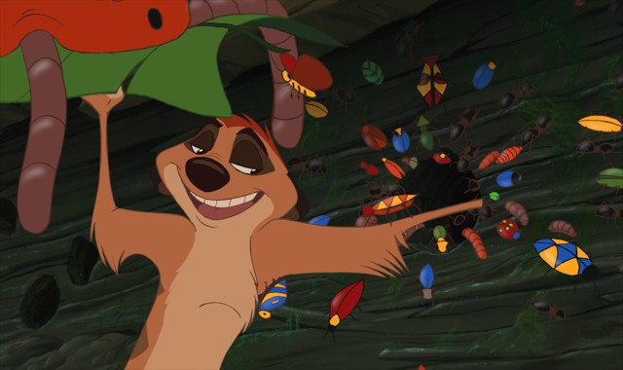
A story of lost and found identity
…new lifestyle…
Notes:
Next steps…

Slide 17
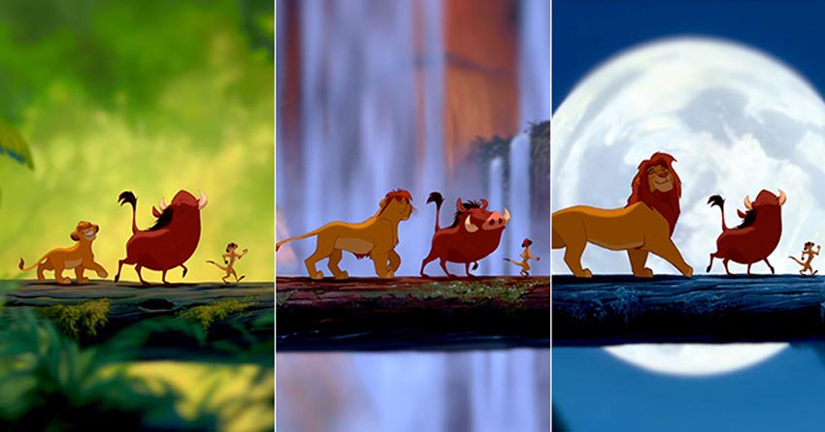
A story of lost and found identity
…new identity…
Notes:
Next steps…

Slide 18


A story of lost and found identity
Notes:
Next steps…

Slide 19
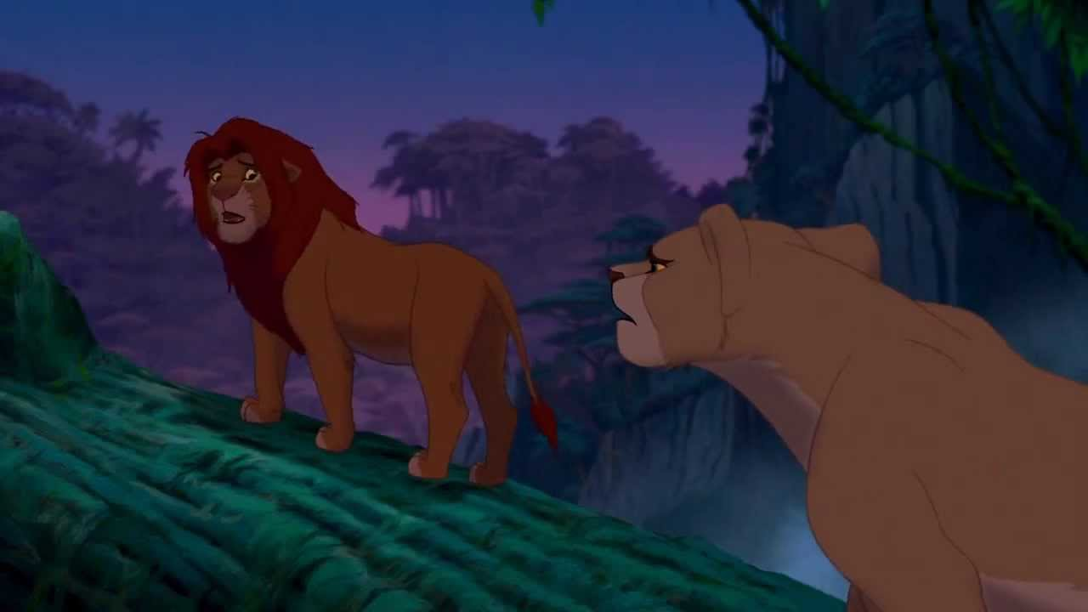
A story of lost and found identity
…Truth…or…Feelings…
Notes:
Next steps…

Slide 20
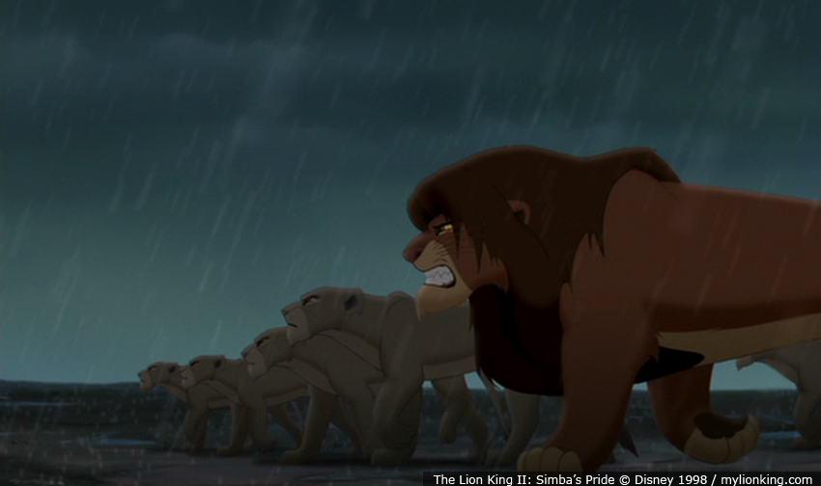
A story of lost and found identity
…a choice to “BE” and “ACT” out his identity…
Notes:
Next steps…

Slide 21
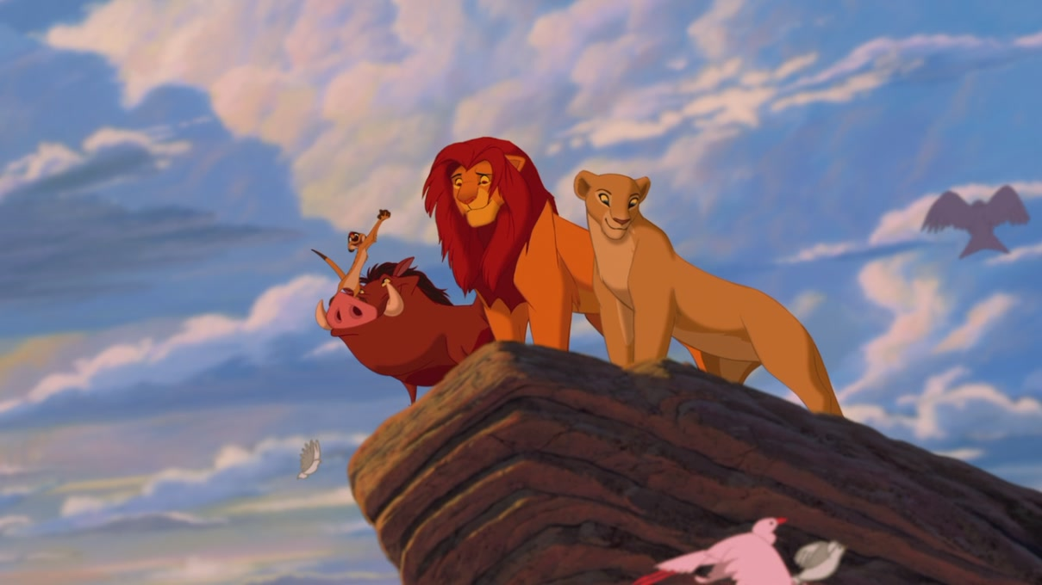
A story of lost and found identity
A new identity realised
Notes:
Next steps…

Slide 22
Let’s look to Jesus
His identity and purpose was rooted in God
Jesus stood for His beliefs in the way he lived
Because of His death, we have a new identity “In Christ”
Let’s keep turning to Him to shape our identity as loved children of God!

