Slide 1

Identity Crisis

Slide 2

Idyllic life
Temptation and choice of evil
Loss of relationship with God

Slide 3
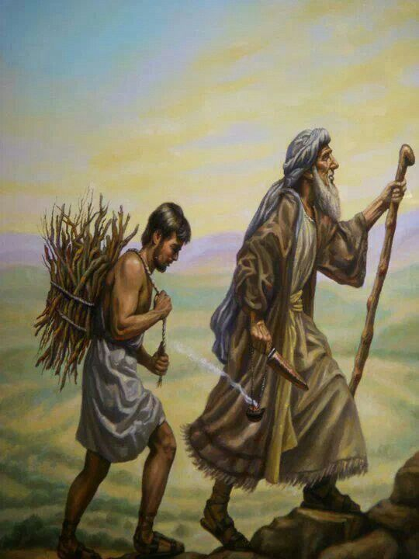
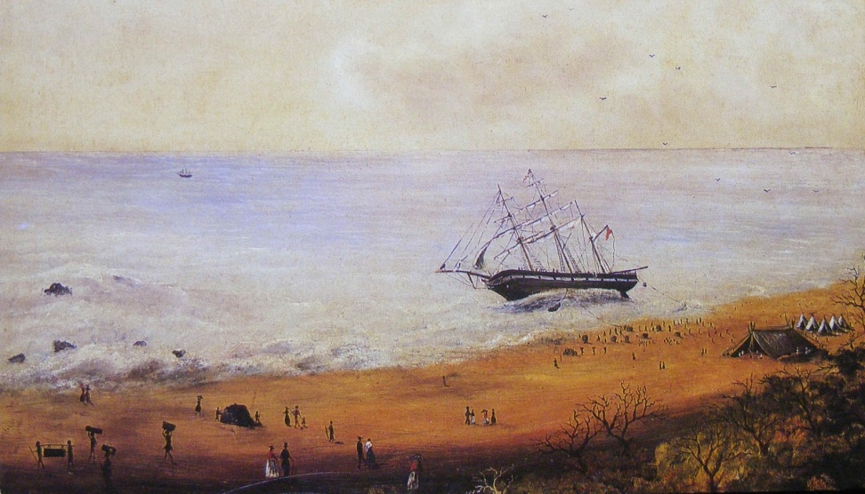
Ancestors
Andersons on the Minerva
ABRAHAM
and the Nation of Israel

Slide 4
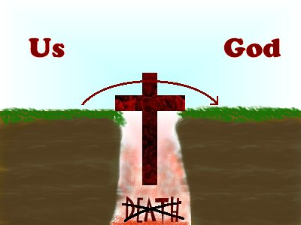
Only because GOD sent us his Son:
Can we be forgiven
Can we be made spiritually alive
Can we be reconciled to God
Can we live in peace with Him

Slide 5
2 Corinthians 5:17
¹⁷ Therefore, if anyone is in Christ, the new creation has come: The old has gone, the new is here!

Slide 6
Who I am in Christ.
Do you know who you are?
  Jesus was identified as God’s Beloved Son
Peter was identified as the Rock on which the Church is built
Paul repeatedly told believers that they are:
The Holy Ones, the Chosen ones, adopted Sons and Daughters of the Father, the Redeemed, the Forgiven.
Peter proclaimed believers are A Royal Priesthood, a Holy Nation, A People belonging to God

Slide 7
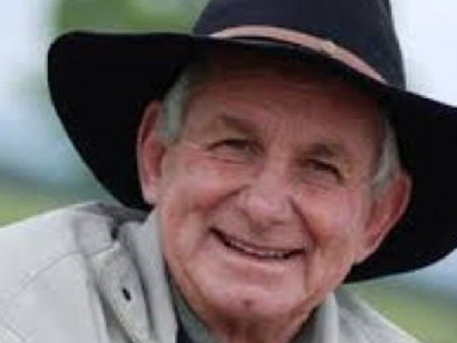
…but GOD……

Slide 8
2 Corinthians 5:17, 18,21
¹⁷ Therefore, if anyone is in Christ, he is a new creation:The old has gone, the new has come! ¹⁸ All this is from God, who reconciled us to himself through Christ and gave us the ministry of reconciliation: ²¹ God made him who had no sin to be sin for us, so that in him we might become the righteousness of God.
Colossians 1:27
….Christ in you the hope of glory

Slide 9
Jesus teaches us to let God’s heart, attitude and behaviour define who we are.
Because Jesus is our Lord, I can be God’s son or daughter.
2 Corinthians 6:16 “We are the temple of the Holy Spirit”
“I will live with them and walk among them, I WILL BE THEIR GOD and THEY WILL BE MY PEOPLE”

Slide 10
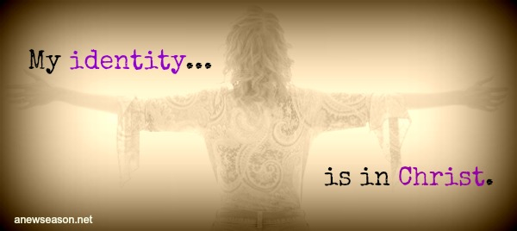
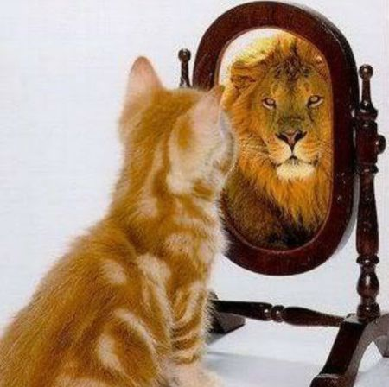
See yourself as GOD sees you.

