Slide 1
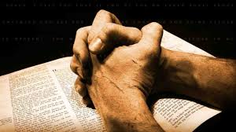
Prayer

Slide 2
What is prayer?
Communication with God
Relationship with God

Slide 3
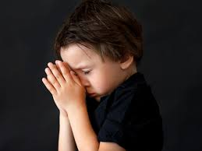
Different types of prayer
The prayer of faith

Slide 4
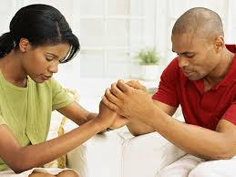
Different types of prayer
The prayer of faith
The prayer of agreement

Slide 5
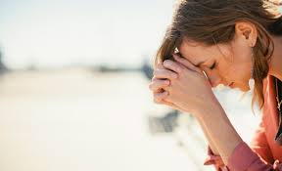
Different types of prayer
The prayer of faith
The prayer of request

Slide 6
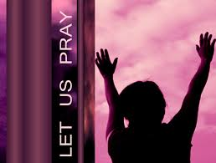
Different types of prayer
The prayer of thanksgiving
The prayer of faith

Slide 7

Different types of prayer
The prayer of worship
The prayer of faith

Slide 8
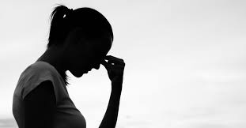
Different types of prayer
The prayer of faith
The prayer of
consecration

Slide 9
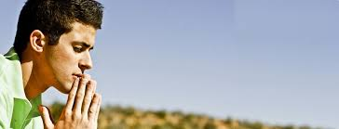
Different types of prayer
The prayer of faith
The prayer of intercession

Slide 10
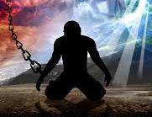
Different types of prayer
The prayer of faith
The prayer of imprecation

Slide 11
But HOW do we pray?
Matthew 6:9-13 (NIV)
⁹ “This, then, is how you should pray:
“‘Our Father in heaven, hallowed be Your name,
¹⁰ Your kingdom come, Your will be done,
on earth as it is in heaven.
¹¹ Give us today our daily bread.
¹² And forgive us our debts,
as we also have forgiven our debtors.
¹³ And lead us not into temptation,^{[a]}
but deliver us from the evil one.^{[b]}’
The prayer of faith

Slide 12
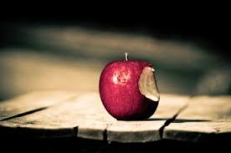
Hindrances to prayers
Sin
The prayer of faith

Slide 13
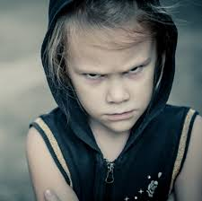
Hindrances to prayer
The prayer of faith
Un-forgiveness
Offence
Hatred
Resentment of others

Slide 14
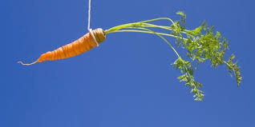
Hindrances to prayer
The prayer of faith
Wrong motivation /
Selfish motivation

Slide 15
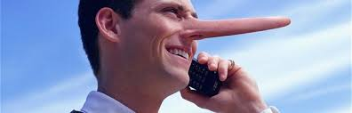
Hindrances to prayer
The prayer of faith
Dishonesty / Insincerity

Slide 16
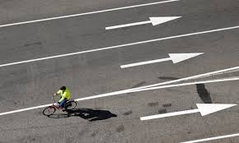
Hindrances to prayer
The prayer of faith
Disobedience to God

Slide 17
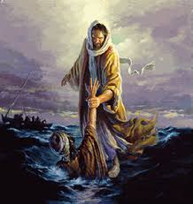
Hindrances to prayer
The prayer of faith
Lack
of
faith

Slide 18
Mathew 7:7-8 NIV
⁷ “Ask and it will be given to you; seek and you will find; knock and the door will be opened to you. ⁸ For everyone who asks receives; the one who seeks finds; and to the one who knocks, the door will be opened.
The prayer of faith

Slide 19
James 5:13-17 (NIV)
¹³ Is anyone among you in trouble? Let them pray. Is anyone happy? Let them sing songs of praise. ¹⁴ Is anyone among you sick? Let them call the elders of the church to pray over them and anoint them with oil in the name of the Lord. ¹⁵ And the prayer offered in faith will make the sick person well; the Lord will raise them up. If they have sinned, they will be forgiven. ¹⁶ Therefore confess your sins to each other and pray for each other so that you may be healed. The prayer of a righteous person is powerful and effective.
¹⁷ Elijah was a human being, even as we are. He prayed earnestly that it would not rain, and it did not rain on the land for three and a half years.
The prayer of faith

