Slide 1

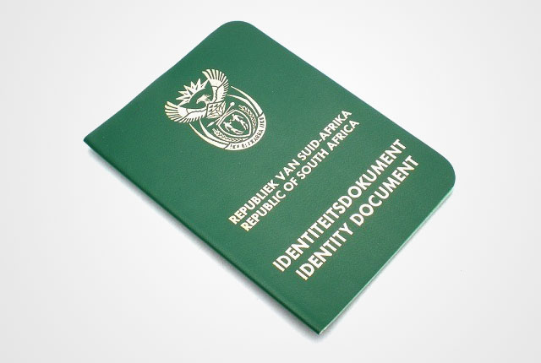
Identity Matters
The truth about who I am in Christ

Slide 2


Slide 3
Identity theft quotes

Slide 4


Slide 5

“The thief’s purpose is to steal and kill and destroy. My purpose is to give them a rich and satisfying life.”
John 10:10
The thief is the Devil / Satan

Slide 6

His tactics (which haven’t changed!)
Doubt
Genesis 2:15 -17
The Lord God placed the man in the Garden of Eden to tend and watch over it. ¹⁶ But the Lord God warned him, “You may freely eat the fruit of every tree in the garden— ¹⁷ except the tree of the knowledge of good and evil. If you eat its fruit, you are sure to die.”
Genesis 3:1
The serpent was the shrewdest of all the wild animals the Lord God had made. One day he asked the woman, “Did God really say you must not eat the fruit from any of the trees in the garden?”

Slide 7
His tactics
Doubt
Matthew 3:16-17
¹⁶ After his baptism, as Jesus came up out of the water, the heavens were opened and He saw the Spirit of God descending like a dove and settling on Him. ¹⁷ And a voice from heaven said, “This is My dearly loved Son, who brings Me great joy.”
Matthew 4:1
Then Jesus was led by the Spirit into the wilderness to be tempted there by the devil. ² For forty days and forty nights He fasted and became very hungry. ³ During that time the devil came and said to Him, “If You are the Son of God, tell these stones to become loaves of bread.”

Slide 8



His tactics
2. Deception
Revelation 12:9
And the great dragon was thrown down, the serpent of old who deceives the whole world …

Slide 9

His tactics
3. Lying accusations
Revelation 12:10
… the accuser of our brethren has been thrown down, who accuses them before our God day and night.
Accusations are designed to bring condemnation

Slide 10

How can we be proactive about protecting the identity of who we are in Christ?
When tempted to doubt, place your faith in what the Word of God says
Faith comes from hearing and hearing by the Word of God. Rom 10:17
Jesus said,
“It is written…:”
Matt 4:4

Slide 11
How can we be proactive about protecting the identity of who we are in Christ?
What about being deceived into thinking you are someone that you are not?
Psalm 51:6
You desire truth/honesty in the inward parts
What do you do about a low self image?
Source the root
Forgive
Ask the Holy Spirit
Build your new identity in Christ

Slide 12

How can we be proactive about protecting the identity of who we are in Christ?
When I sin,
the Holy Spirit convicts
and I repent and ask
for forgiveness
but
the devil condemns
using
lying accusations

Slide 13
How can we be proactive about protecting the identity of who we are in Christ?
Revelation 12:11
And they have defeated / overcame him by the blood of the Lamb and by the word of their testimony
Make sure your sin is confessed so that your slate is clean and the devil has no legal grounds to stand on
Tell the devil that the blood of Jesus has cleansed you from your sin and that “ … there is no condemnation for those who are in Christ Jesus.” (Romans 8:1)

Slide 14
Some of us have homework to do ….

