Slide 1

What can we learn from the brokenness we find in ourselves, as well as in the world around us?
Does Jesus provide us with any solutions?

Slide 2
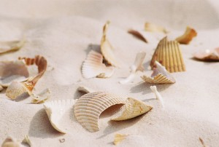
Collecting seashells
Perhaps the ability to see beauty in broken seashells resembles a God who loves to pick up the fragments of shattered lives and gently put them back together again

Slide 3

How do Christians deal with brokenness?

Slide 4
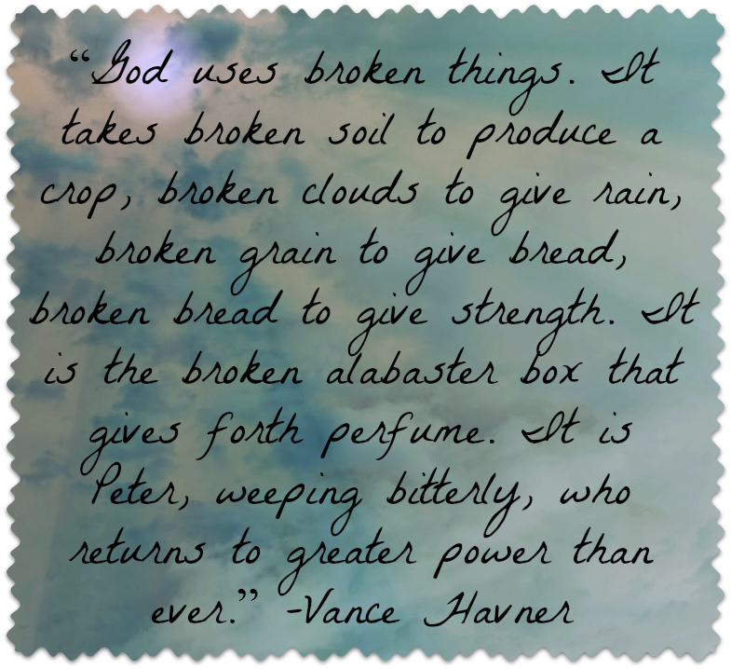
My God, my God why have you forsaken me???
John 12:24 says I say to you unless a grain of wheat falls into the earth and dies it remains alone, but if it dies it bears much fruit…
Isaiah 58:7-9What I’m interested in seeing you do is:
sharing your food with the hungry, inviting the homeless poor into your homes, putting clothes on the shivering ill-clad, being available to your own families.
Do this and the lights will turn on, and your lives will turn around at once.
Your righteousness will pave your way. The God of glory will secure your passage.
Then when you pray, God will answer.
You’ll call out for help and I’ll say, ‘Here I am.

Slide 5

G= Give
I = It
F= Forward
T= Today

Slide 6
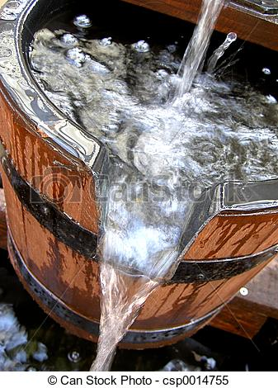
Jesus broke and gave:

Slide 7
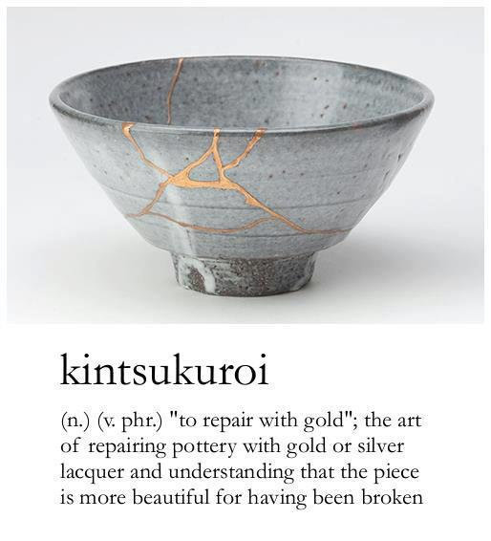
The Process

Slide 8

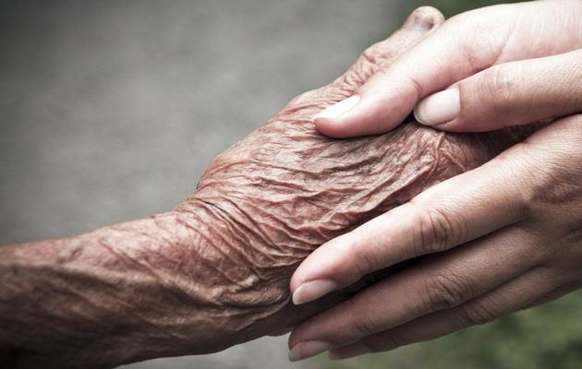
Jesus was moved with Compassion:
Passion (suffering) Com (with)

Slide 9
Lessons learnt from broken seashells
… a God who sees how the waves of life batter and rage against us, and who doesn’t love us any less.
… a God who chooses the foolish to confound the wise, the weak to shame the strong.
… a God who offered Himself up to be broken, so the world could be put back together again.
… a God who showcases broken seashells – knowing what we once were and, better yet, what we will one day again become.

Slide 10
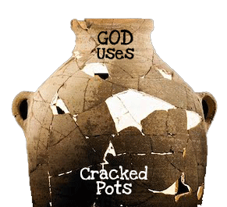
Are you prepared for use?

