Slide 1
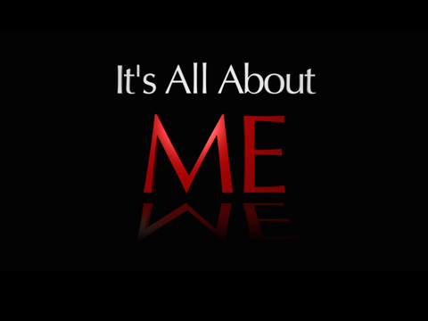

Slide 2
God’s Agenda for me versus
My Agenda for me

Slide 3

People

Slide 4
  Zaccheus
  Blind Bartimaeus
  The story of the Good Samaritan

Slide 5

The
Connection

Slide 6
  Zaccheus
  Blind Bartimaeus
  The story of the Good Samaritan
  The walls of Jericho

Slide 7
  Zaccheus
  Example of Jesus
  Jesus notices … Zaccheus
  He was a sinner
  Jesus could see what the crowd could not
  Notice the response to the love he
  received from Jesus
  What was the end result?
  “Today salvation has come to your house.”
  - What can we learn from this story?

Slide 8
  Blind Bartimaeus
  Example of Jesus
  “Son of David, have mercy on me!”
  Let’s not let the stuff of our lives exclude
  needy people
  People who have needs are receptive
  What was the end result?
  He followed Jesus.
  - What can we learn from this story?

Slide 9
  The Traveller to Jericho
  He was a sorry sight … beaten, stripped
  and half dead.
  - The “religious” people deliberately
  avoided him.
  Why?
  The Samaritan:
  - he felt compassion
  - he went more than the extra mile
  - Jesus commends such a person

Slide 10
  Jericho
  A walled city.
  Some people are like walled cities
  especially when it comes to the Gospel
  - We can pray (2 Corinthians 10:4,5)
  - We can listen to what God’s strategy is
  - We can obey Him
  - We can be strong and courageous
  - God is at work on the inside of people

Slide 11
  A Prayer to pray daily
  “Lord God, I want to be available to You today to prioritise what is on Your heart when it comes to people. Help me to “notice” people as I’m about my job, about my daily routine, during times of leisure even and help me to make time for people in my busy day. Show me the people in whose hearts You are at work, the people who have needs and who will be receptive to You. Show me how I can help meet needs, show love. Help me to feel compassion …
  In Jesus’ name. Amen”

