Slide 1

Notes:
Next steps…

Slide 2
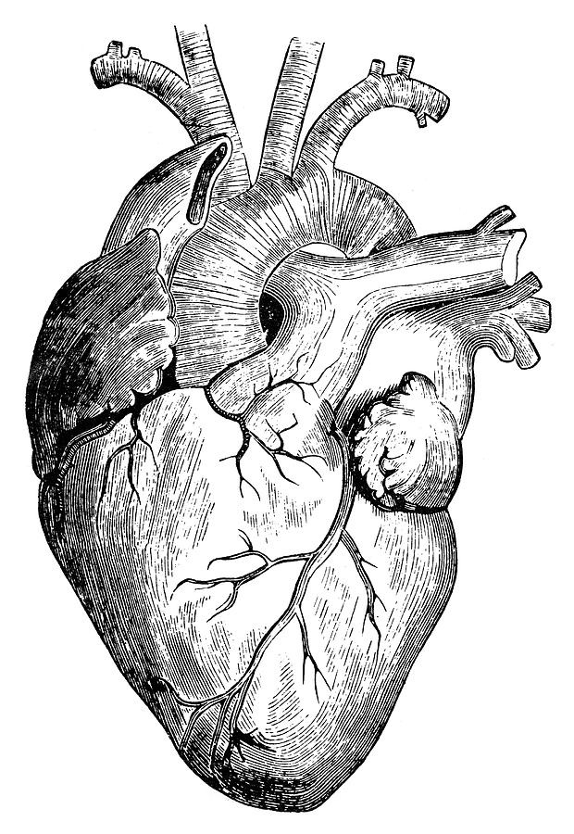
The
Generous
Heart

Slide 3
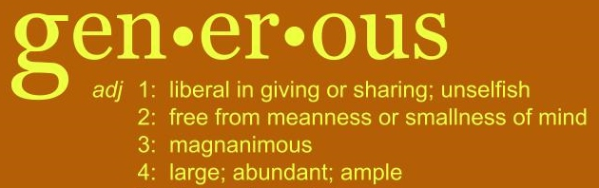

What does being generous mean?
The Generous Heart of God toward us
My hearts response to His generosity
The Generous Heart

Slide 4
1. The Generous Heart of God toward us
Genesis 1:27 – “So God created mankind in his own image, in the image of God he created them; male and female he created them.”
He created us for a loving relationship with Him.
Genesis 2:15 – “The LORD God placed the man in the Garden of Eden to tend and watch over it.”
God knew we needed purpose and significance
The Generous Heart

Slide 5
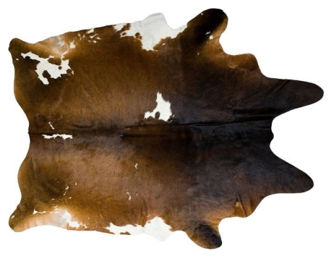


1. The Generous Heart of God toward us
Genesis 2:18 – “Then the LORD God said, "It is not good for the man to be alone. I will make a helper who is just right for him."”
He understood our need to have value and worth through meaningful relationships.
.
Genesis 3 v 21 – “And the LORD God made clothing from animal skins for Adam and his wife.”
After man sinned, God Himself made the first sacrificial atonement for sin by shedding blood to reconcile us to Himself.
The Generous Heart

Slide 6

1. The Generous Heart of God toward us
God our Father chose to make the ultimate sacrifice by giving us His very own Son
…to save the whole world
…the biggest rescue plan
…the most generous He could be !
The Generous Heart

Slide 7
1. The Generous Heart of God toward us
Then when Jesus ascended to heaven, He gave us His precious Holy Spirit
As a seal on His people
As a helper/counsellor/comforter/advocate for us
To teach/guide us into all Truth
To Intercede (pray on our behalf) (Romans 8)
To “bear witness” with our spirits that we belong to Him and thereby assure us of our salvation.
To convict us of our sin
To produce in us the fruit of the Spirit (Gal 5)
The Generous Heart

Slide 8

1. The Generous Heart of God toward us
Jesus himself said God’s purpose is to give us a rich and satisfying life
John 10 v 10 – “The thief comes only to steal and kill and destroy; I have come that they may have life, and have it to the full (NIV) / have a rich and satisfying life (NLT) / an abundant life (ESV)
The Generous Heart

Slide 9

1. The Generous Heart of God toward us
We have been given we need for this life
2 Peter 1 v 3-11
V 3, 4 “His divine power has given us everything we need for a Godly life through our knowledge of Him who called us by His own glory and goodness. Through these He has given us His very great and precious promises…”
2 Corinth 9 v 8 – “And God is able to bless you abundantly, so that in all things at all times, having all that you need, you will abound in every good work.”
The Generous Heart

Slide 10
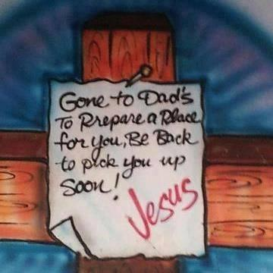
1. The Generous Heart of God toward us
And God in His generosity has blessings for us even beyond this present life, in what is still to come for those who believe in Him
John 14 v 2,3 – “My Father’s house has many rooms; if that were not so, would I have told you that I am going there to prepare a place for you? And if I go and prepare a place for you, I will come back and take you to be with me that you also may be where I am.”
The Generous Heart

Slide 11
2. My heart’s response to God’s generosity
God’s heart is so very generous toward us!
Now how do I respond to His generosity?
My heart matters to God
My heart is where my treasure is
My heart is where I choose obedience
My heart is the source from which I can give generously as a conduit of God’s generosity to me
The Generous Heart

Slide 12
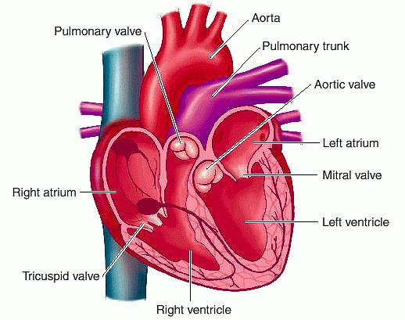
2. My heart’s response to God’s generosity
a) My heart matters to God
c) My heart is where I choose obedience
b) My heart
& my treasure
d) My heart from which I give generously
The Generous Heart

Slide 13
2. My heart’s response to God’s generosity
a) Does MY heart really matter to God?
Psalm 33 v 15 – “He made their hearts, so he understands everything they do.”
Psalm 27 v 8 – “My heart has heard you say, "Come and talk with me." And my heart responds, "LORD, I am coming."”
Matt 15 v 8 – “These people honour me with their lips, but their hearts are far from me.”
Jeremiah 17 v 10 – “I the Lord search the heart and examine the mind.”
The Generous Heart

Slide 14
2. My heart’s response to God’s generosity
b) Where is my treasure?
Matthew 6 v 19-21 - “Do not store up for yourselves treasures on earth, where moth and rust destroy, and where thieves break in and steal. “But store up for yourselves treasures in heaven, where neither moth nor rust destroys, and where thieves do not break in or steal; for where your treasure is, there your heart will be also.”
Proverbs 4 v 23 – “Above all else, guard your heart, for everything you do flows from it.”
The Generous Heart

Slide 15

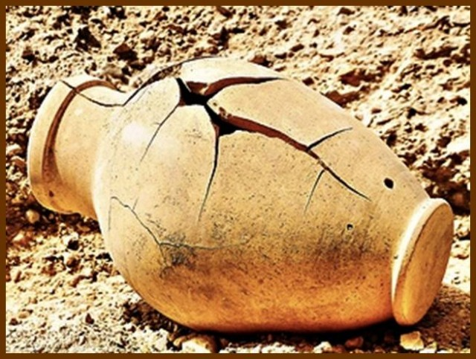
2. My heart’s response to God’s generosity
b) Where is my treasure?
Jeremiah 2 v 13 …the fountain of living water
VS cracked cisterns that can hold no water at all
VS
What ‘cracked cisterns’ am I looking to, to sustain/fill me?
The Generous Heart

Slide 16
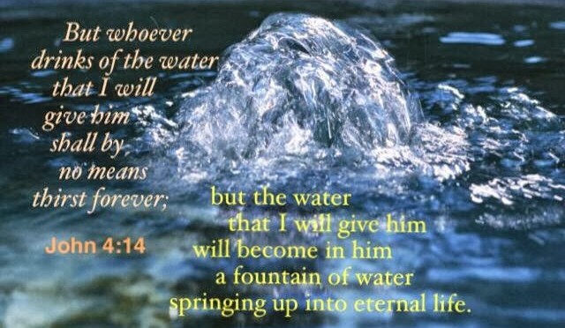
2. My heart’s response to God’s generosity
Am I treasuring Creation
or the Creator?
The Generous Heart

Slide 17
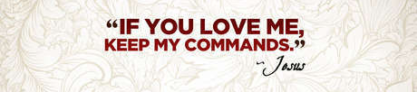
2. My heart’s response to God’s generosity
c) Is my heart choosing obedience to God’s commands?
John 14 v 15
John 15 v 10-12 – “If you keep my commands, you will remain in my love, just as I have kept my Father’s commands and remain in his love. I have told you this so that my joy may be in you and that your joy may be complete. My command is this: Love each other as I have loved you.”
The Generous Heart

Slide 18

2. My heart’s response to God’s generosity
c) Is my heart choosing obedience to God’s commands?
1 John 5 v 3 – “Loving God means keeping his commandments, and his commandments are not burdensome.”
Romans 6 v 16 – “Don’t you realize that you become the slave of whatever you choose to obey? You can be a slave to sin, which leads to death, or you can choose to obey God, which leads to righteous living.”
The Generous Heart

Slide 19
2. My heart’s response to God’s generosity
d) Is my heart giving generously?
1 Peter 4:7-11 What am I urged to give?
LOVE “…show deep love for each other”
HOSPITALITY “…Cheerfully share your home with those who need a meal or a place to stay…”
GIFTINGS “…God has given each of you a gift from his great variety of spiritual gifts. Use them well to serve one another…”
The Generous Heart

Slide 20

2. My heart’s response to God’s generosity
d) Is my heart giving generously?
The same 3 things are emphasized in Romans 12 v 6-13
(using our gifting, showing love, practising hospitality)
GENEROUSLY
In addition there is the specific encouragement in
Romans 12 v 8 that if your gift “…is giving, give generously”.
Since our God is the source of all abundance ,
we have much to give generously!
The Generous Heart

Slide 21

2. My heart’s response to God’s generosity
d) Is my heart giving generously?
The Godly principle:
Proverbs 11 v 25 –“The generous will prosper; those who refresh others will themselves be refreshed.”
Acts 20 v 35 – “Remember the words of the Lord Jesus, how he himself said, ‘It is more blessed to give than to receive.’”
When we give, it pleases Him, we’re blessed, and He responds in giving more for us to give...
The Generous Heart

Slide 22

2. My heart’s response to God’s generosity
d) Is my heart giving generously?
Good Samaritan in Luke 10 v 33-35
Love, Hospitality, Gifting… AGAIN! and he used his own money to meet the need
What did Jesus instruct those listening to do, in response to the parable? …. “Do the same”
Am I
?
The Generous Heart

Slide 23
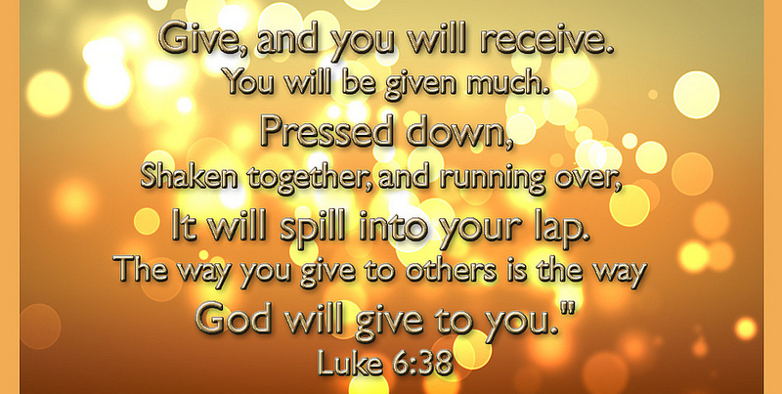
2. My heart’s response to God’s generosity
d) Is my heart giving generously?
The running over into our laps begins with “Give”
The Generous Heart

Slide 24
2. My heart’s response to God’s generosity
a) My heart matters to God
c) My heart is where I choose obedience
b) My heart
& my treasure
d) My heart from which I give generously
The Generous Heart

Slide 25
SUMMARY
My God has a generous heart toward me for my life and my eternal future
My heart really matters to God
Is my treasure in creation or the creator because there my heart will be
When I choose obedience I love God and remain in His love
The Generous Heart

Slide 26
SUMMARY
LOVE others out of the abundant love God has given me - I share His love with the world
Practice HOSPITALITY – I can meet needs (food, place to stay) and share Jesus with the world
Use my God-given GIFTINGS – I serve and bless others as Jesus would have me do
When I GIVE MONEY generously – God returns the measure given and my lap runs over with His generous provision for others
The Generous Heart

Slide 27
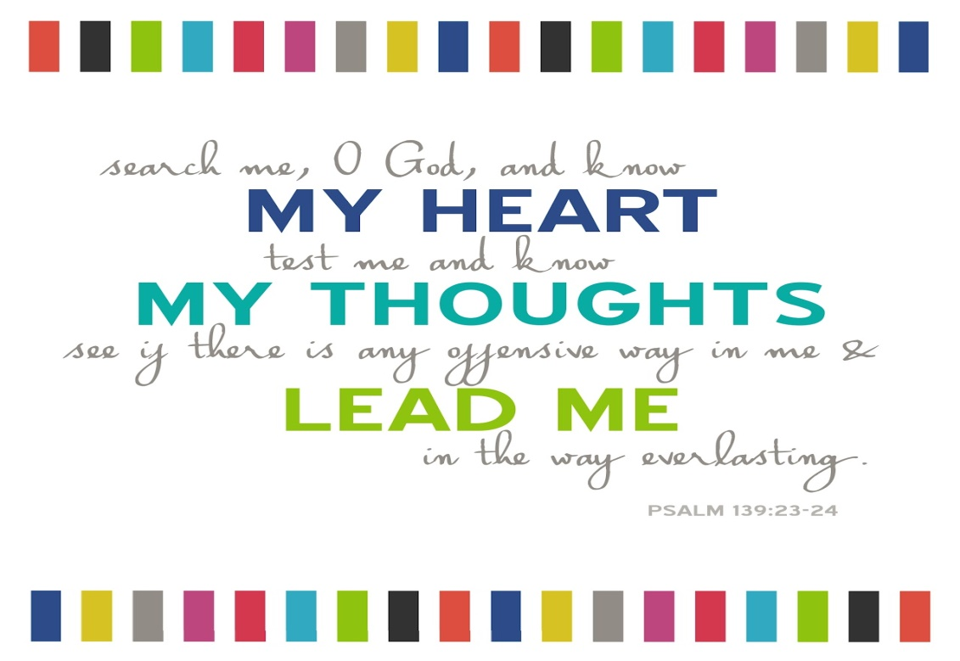
SUMMARY
Decide right now, here, today , to live a life
of staggering generosity – Matthew Kelly
The Generous Heart

