Slide 1

Running the Race
Notes:
Next steps…

Slide 2
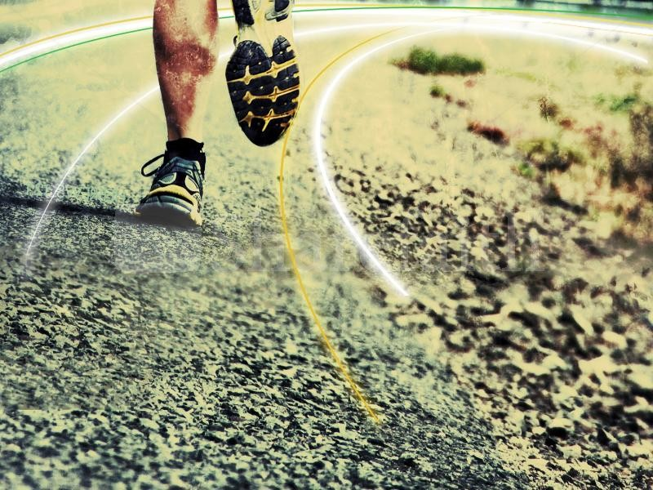
Hebrews 12:1: “Therefore, since we are surrounded by such a huge crowd of witnesses to the life of faith, let us strip off every weight that slows us down, especially the sin that so easily trips us up. And let us run with endurance the race God has set before us.”
Notes:
Next steps…

Slide 3
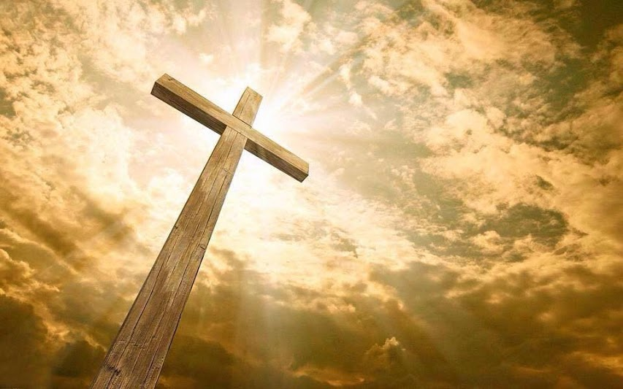
What is the race about?
Complete transformation of the human character into the image of Christ

Slide 4
What is the race about?
Winning the prize
Philippians 3v14: “I press on to reach the end of the race and receive the heavenly prize for which God, through Christ Jesus is calling us.”
1 Corinthians 9v25: “All athletes are disciplined in their training. They do it to win a prize that will fade away, but we do it for an eternal prize.”

Slide 5
What is the race about?
Living as a testimony to others
Hebrews 12:1: “Therefore, since we are surrounded by such a huge crowd of witnesses to the life of faith, let us strip off every weight that slows us down, especially the sin that so easily trips us up. And let us run with endurance the race God has set before us.”

Slide 6
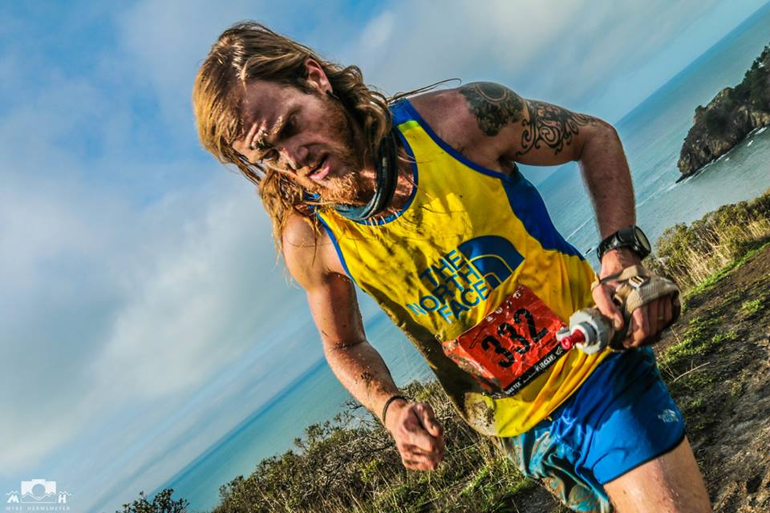
How are we expected to run?
Run “with endurance”
Hebrews 12:1: “Therefore, since we are surrounded by such a huge crowd of witnesses to the life of faith, let us strip off every weight that slows us down, especially the sin that so easily trips us up. And let us run with endurance the race God has set before us.”

Slide 7

How are we expected to run?
“Endurance is the ability of an organism to exert itself and remain active for a long period of time, as well as its ability to resist, withstand, recover from, and have immunity to trauma, wounds, or fatigue.”

Slide 8
How are we expected to run?
1 Corinthians 9:24‭: "Don’t you realize that in a race everyone runs, but only one person gets the prize? So run to win!‬
1 Corinthians 9:25‭-‬27: "All athletes are disciplined in their training. They do it to win a prize that will fade away, but we do it for an eternal prize. So I run with purpose in every step. I am not just shadowboxing. I discipline my body like an athlete, training it to do what it should. Otherwise, I fear that after preaching to others I myself might be disqualified."

Slide 9
How are we expected to run?
Run away from sin and rather pursue righteous living
2 Timothy 2:22: "Run from anything that stimulates youthful lusts. Instead, pursue righteous living, faithfulness, love, and peace. Enjoy the companionship of those who call on the Lord with pure hearts."
Philippians 4v8: “And now, dear brothers and sisters, one final thing. Fix your thoughts on what is true, and honourable, and right, and pure, and lovely, and admirable”.

Slide 10
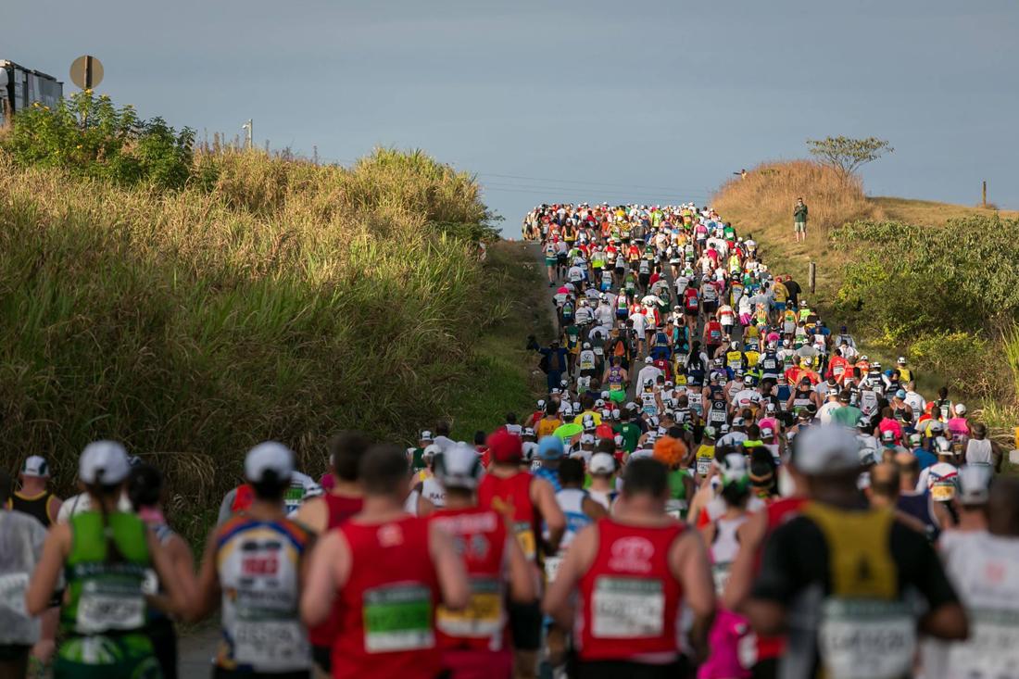
How are we expected to run?
Run with others
2 Timothy 2:22: "Run from anything that stimulates youthful lusts. Instead, pursue righteous living, faithfulness, love, and peace. Enjoy the companionship of those who call on the Lord with pure hearts."
Ecclesiastes 4v9:” Two people are better off than one, for they can help each other succeed”.

Slide 11
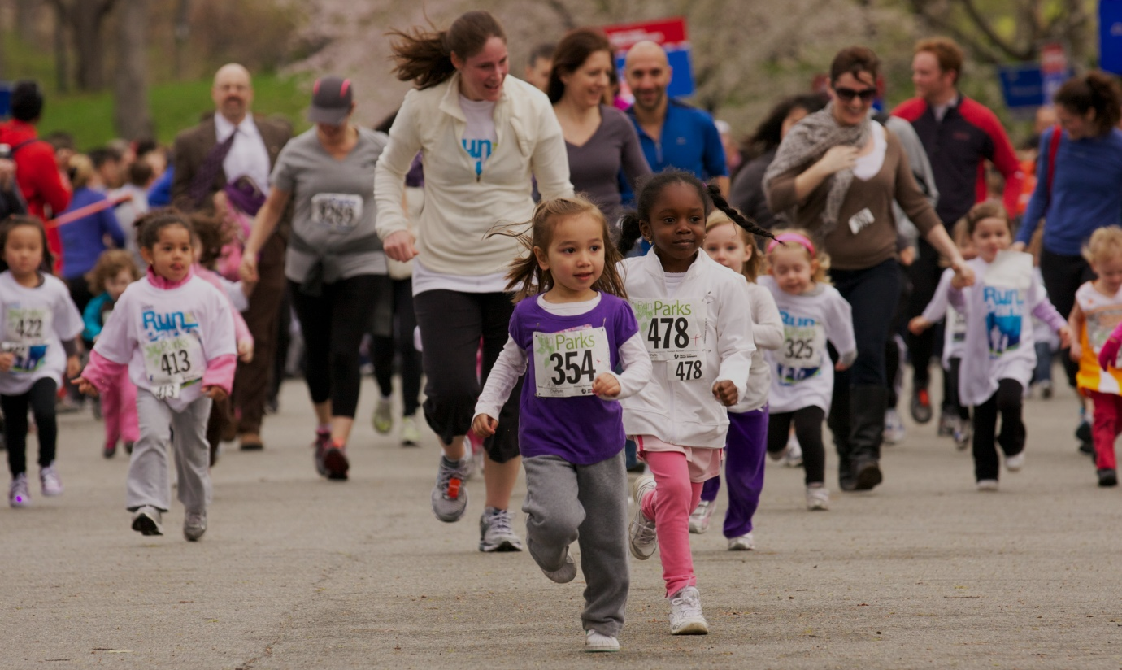
Who has designed the race?
God has set the path for our lives
Hebrews 12:1: “Therefore, since we are surrounded by such a huge crowd of witnesses to the life of faith, let us strip off every weight that slows us down, especially the sin that so easily trips us up. And let us run with endurance the race God has set before us.”

Slide 12

Who has designed the race?
…but what does the path look like?
Romans 5:3‭-‬4: "We can rejoice, to, when we run into problems and trials, for we know that they help us develop endurance. And endurance develops strength of character, and character strengthens our confident hope of salvation."‬

Slide 13
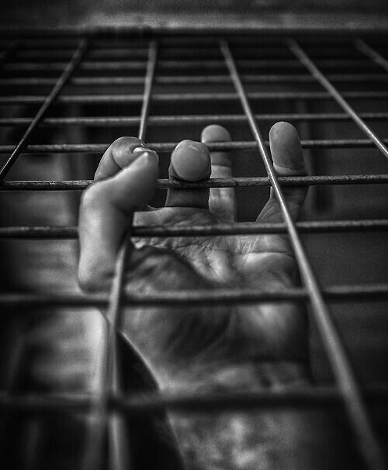

Where are you in the race?
In a trap…
…or free to run?
Hebrews 12:1: “Therefore, since we are surrounded by such a huge crowd of witnesses to the life of faith, let us strip off every weight that slows us down, especially the sin that so easily trips us up. And let us run with endurance the race God has set before us.”

Slide 14

How do we run this race well?
1. Keep our eyes on Jesus
Hebrews 12:2 -4: "We do this by keeping our eyes on Jesus, the champion who initiates and perfects our faith. Because of the joy awaiting him, he endured the cross, disregarding its shame. Now he is seated in the place of honour beside God’s throne. Think of all the hostility he endured from sinful people; then you won’t become weary and give up. After all, you have not yet given your lives in your struggle against sin."

Slide 15
How do we run this race well?
2. Learn to rely on the Holy Spirit
Romans 8:5 “Those who are dominated by the sinful nature think about sinful things, but those who are controlled by the Holy Spirit think about things that please the Spirit”.
Galatians 5:16. “So I say, let the Holy Spirit guide your lives. Then you won’t be doing what your sinful nature craves.”

Slide 16
How do we run this race well?
2. Learn to rely on the Holy Spirit
Romans 8:13 “If by the Spirit you are putting to death the deeds of the body, you will live”
Ephesians 6:17 “Put on salvation as your helmet, and take the sword of the Spirit, which is the word of God.”

Slide 17
How do we run this race well?
3. We need to respond appropriately to the Father’s correction
Hebrews 12:5-11 "And have you forgotten the encouraging words God spoke to you as his children? He said, “My child, don’t make light of the Lord ’s discipline, and don’t give up when he corrects you. For the Lord disciplines those he loves, and he punishes each one he accepts as his child.”

Slide 18

Reflection
Are you further along the journey towards Christ-likeness than I was this day last year, this day ten years ago, this day twenty years ago?
Hebrews 12: 12-13 "So take a new grip with your tired hands and strengthen your weak knees. Mark out a straight path for your feet so that those who are weak and lame will not fall but become strong."

