Slide 1
Where are you?

Slide 2
Genesis 3:9
The context:
• God is all about relationship
• God wanting to meet with Adam
• God wanting Adam and Eve to enjoy His presence
• God wanting to give Life to Adam and Eve

Slide 3
God is all about relationship
(meeting with us)
The family
…. A reflection of the value God Himself puts
on relationship
.… The God of Abraham, Isaac and Jacob
…. Jacob sets up a stone and calls the place
where God met with him:
Bethel, the House of God
…. Jacob’s name is changed to “Israel.”
…. God, the God of Israel
…. God chooses Israel as a nation to be His own
people.

Slide 4
God institutes CORPORATE WORSHIP
• Tabernacle (Tent of meeting) in the Wilderness
Sacrifices … Priests
• Temple in Jerusalem
where God Himself dwelt in the Holy of holies behind the veil
Priests … Sacrifices … Feasts
• After the exile and the destruction of the Temple,
synagogues were built = “assemblies”

Slide 5
The example of Jesus
Mark 6: 1-3
6 Jesus went out from there and came into His hometown; and His disciples followed Him. ² When the Sabbath came, He began to teach in the synagogue; and the many listeners were astonished, saying, “Where did this man get these things, and what is this wisdom given to Him, and such miracles as these performed by His hands? ³ Is not this the carpenter, the son of Mary, and brother of James and Joses and Judas and Simon? Are not His sisters here with us?”
Luke 4:16
¹⁶ And He came to Nazareth, where He had been brought up; and as was His custom, He entered the synagogue on the Sabbath, and stood up to read.
Synagogues were places where Jewish people assembled together for prayer, worship, teaching, and public reading of scripture.

Slide 6
What did the new Christian believers do?
Hebrews 10:19-25
¹⁹ Therefore, brethren, since we have confidence to enter the holy place by the blood of Jesus, ²⁰ by a new and living way which He inaugurated for us through the veil, that is, His flesh, ²¹ and since we have a great priest over the house of God, ²² let us draw near with a sincere heart in full assurance of faith, having our hearts sprinkled clean from an evil conscience and our bodies washed with pure water. ²³ Let us hold fast the confession of our hope without wavering, for He who promised is faithful; ²⁴ and let us consider how to stimulate one another to love and good deeds, ²⁵ not forsaking our own assembling together, as is the habit of some, but encouraging one another; and all the more as you see the day drawing near.

Slide 7
Why?
for ENCOURAGEMENT

Slide 8
The NT is full of instruction for CORPORATE TIMES TOGETHER
1 Cor 14:26
²⁶ When you assemble, each one has a psalm, has a teaching, has a revelation, has a tongue, has an interpretation.
Acts 2:42
⁴² They were continually devoting themselves to the apostles’ teaching and to fellowship, to the breaking of bread and to the prayers.
Acts 2:46
⁴⁶ Day by day continuing with one mind in the temple, and breaking bread from house to house, they were taking their meals together
Acts 2:45
⁴⁴ And all those who had believed were together and had all things in common; ⁴⁵ and they … were sharing them with all, as anyone might have need.

Slide 9
Why is MEETING TOGETHER so VITALLY IMPORTANT?
• The preacher waits on God for what God wants said or taught to the Church
The Church needs to be present to hear it
• The Holy Spirit waits to minister
The Church needs to be present to “hear what the Spirit says to the Church.”
• People have needs that need to be met.
• Bible teaching is important
• Corporate worship is God ordained
• Jesus set an example of doing this for us to follow

Slide 10

Notes:
Next steps…

Slide 11
We are calling for a
COMMITMENT from each one of us
to MEET TOGETHER REGULARLY.

Slide 12

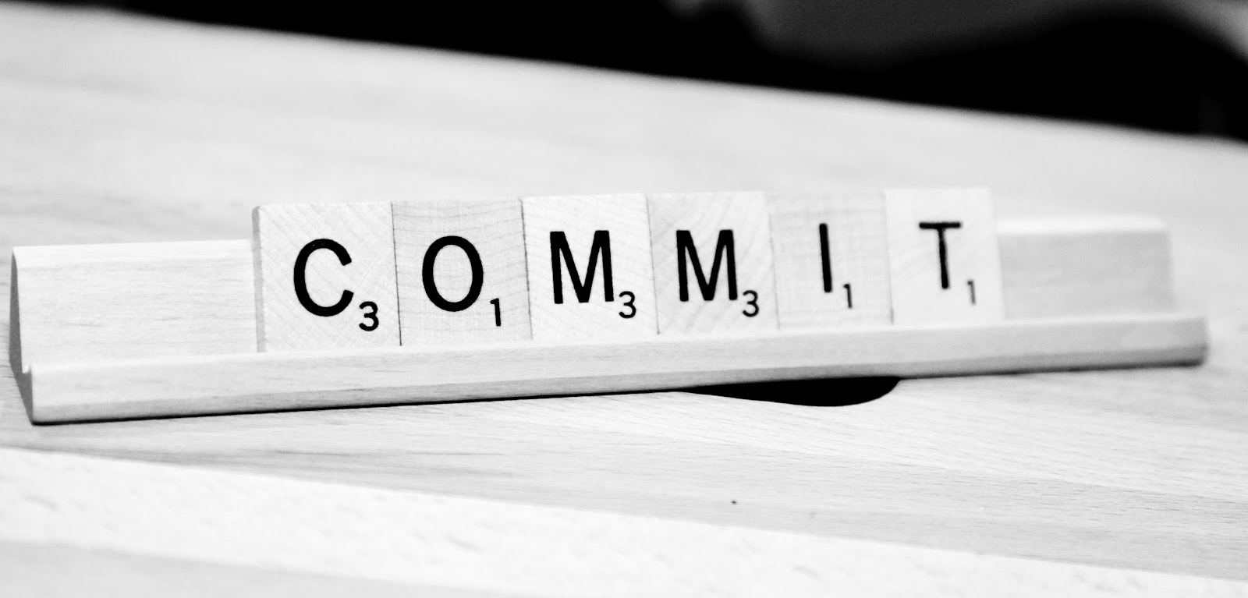
Notes:
Next steps…

Slide 13



Slide 14



Slide 15
Q: Where are you?

