Slide 1

Notes:
Next steps…

Slide 2
A Biblical Perspective…
Romans 12:1-2
Brothers and sisters, God has shown you his mercy. So I am asking you to offer up your bodies to him while you are still alive. Your bodies are a holy sacrifice that is pleasing to God. When you offer your bodies to God, you are worshiping him. Don't live any longer the way this world lives. Let your way of thinking be completely changed. Then you will be able to test what God wants for you. And you will agree that what He wants is right. His plan is good and pleasing and perfect.
Notes:
Next steps…

Slide 3
A Biblical Perspective…
Proverbs 3:5‭-‬6
Trust in the Lord with all your heart; do not depend on your own understanding. Seek his will in all you do, and he will show you which path to take.
Psalms 37:3‭-‬6
Trust in the Lord and do good. Then you will live safely in the land and prosper. Take delight in the Lord , and he will give you your heart’s desires. Commit everything you do to the Lord . Trust him, and he will help you. He will make your innocence radiate like the dawn, and the justice of your cause will shine like the noonday sun
Notes:
Next steps…

Slide 4


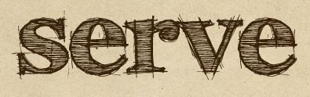

Commit
Connect

Slide 5
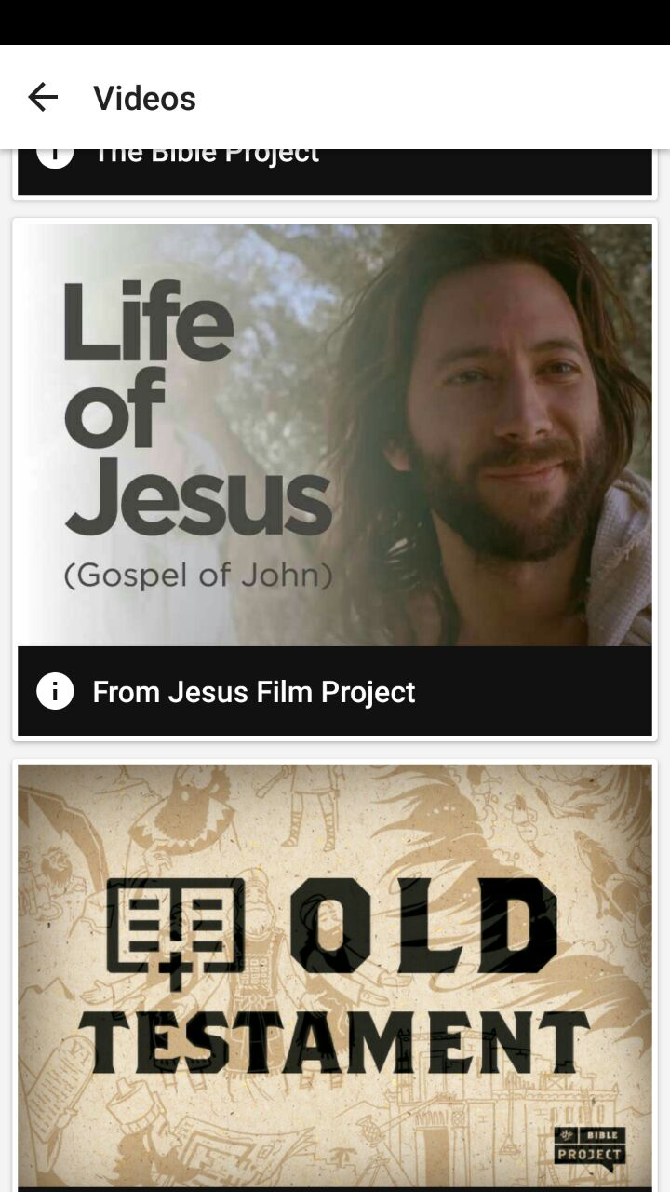
Jesus’ example…
Notes:
Next steps…

Slide 6
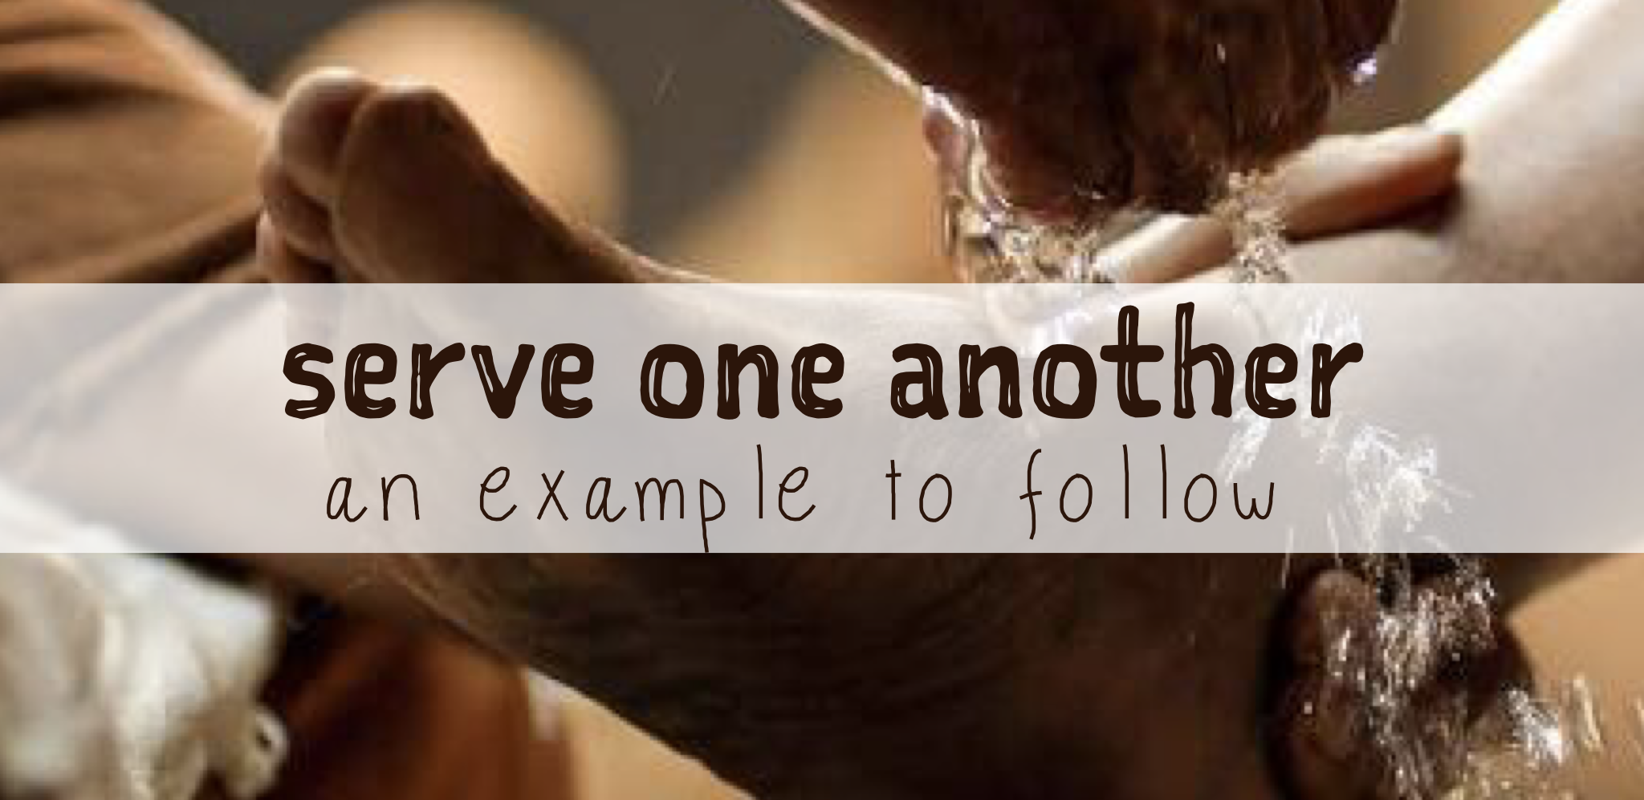
John 13:12‭-‬17
After washing their feet, he put on his robe again and sat down and asked, “Do you understand what I was doing? You call me ‘Teacher’ and ‘Lord,’ and you are right, because that’s what I am. And since I, your Lord and Teacher, have washed your feet, you ought to wash each other’s feet. I have given you an example to follow. Do as I have done to you. I tell you the truth, slaves are not greater than their master. Nor is the messenger more important than the one who sends the message. Now that you know these things, God will bless you for doing them.‬
Notes:
Next steps…

Slide 7
Philippians 2:5‭-‬8
You must have the same attitude that Christ Jesus had. Though he was God, he did not think of equality with God as something to cling to. Instead, he gave up his divine privileges; he took the humble position of a slave and was born as a human being. When he appeared in human form, he humbled himself in obedience to God and died a criminal’s death on a cross.‬
Notes:
Next steps…

Slide 8
Matthew 16:24‭-‬25
Then Jesus said to his disciples, “If any of you wants to be my follower, you must give up your own way, take up your cross, and follow me. If you try to hang on to your life, you will lose it. But if you give up your life for my sake, you will save it.‬”
Matthew 10:39
If you cling to your life, you will lose it; but if you give up your life for me, you will find it.
Notes:
Next steps…

Slide 9

True greatness in the kingdom does not come from lording it over others, but from serving one another
Mark 9 v 35:
He sat down, called the twelve disciples over to him, and said, “Whoever wants to be first must take last place, and be the servant of everyone else.”
Notes:
Next steps…

Slide 10
Mark 10:35-37
Then James and John, the sons of Zebedee, came over and spoke to him. “Teacher,” they said, “We want you to do us a favour.” “What is your request?” he asked. They replied, “When you sit on your glorious throne, we want to sit in places of honour next to you, one on your right and the other on your left.”
Mark 10 v 42-45
Jesus called them together and said, “You know that those who are regarded as rulers of the Gentiles lord it over them, and their high officials exercise authority over them. Not so with you. Instead, whoever wants to become great among you must be your servant, and whoever wants to be first must be slave of all. For even the Son of Man did not come
to be served, but to serve, and to give his life as a
ransom for many.”
Notes:
Next steps…

Slide 11

All are called to serve
Acts 20:35
And I have been a constant example of how you can help those in need by working hard. You should remember the words of the Lord Jesus: ‘It is more blessed to give than to receive.’
Philippians 2 v 3-7
Do nothing out of selfish ambition or vain conceit. Rather, in humility value others above yourselves, not looking to your own interests but each of you to the interests of the others.
In your relationships with one another, have the same mindset as Christ Jesus: Who, being in very nature God,
did not consider equality with God something to be used
to his own advantage; rather, he made himself nothing by
taking the very nature of a servant, being made in human likeness.
Notes:
Next steps…

Slide 12
All are called to serve
Romans 12:11
Never be lazy, but work hard and serve the Lord enthusiastically.
Galatians 5 v 13
You, my brothers and sisters, were called to be free. But do not use your freedom to indulge the flesh; rather, serve one another humbly in love.
Notes:
Next steps…

Slide 13

We all have gifts & talents to use
Romans 12 v 4-8
Just as our bodies have many parts and each part has a special function, so it is with Christ’s body. We are many parts of one body, and we all belong to each other. In his grace, God has given us different gifts for doing certain things well. So if God has given you the ability to prophesy, speak out with as much faith as God has given you. If your gift is serving others, serve them well. If you are a teacher, teach well. If your gift is to encourage others, be encouraging. If it is giving, give generously. If God has given you leadership ability, take the responsibility seriously. And if you have a gift for showing kindness to others, do it gladly.
1 Peter 4 v 10
Each of you should use whatever gift you have
received to serve others, as faithful stewards of
God’s grace in its various forms.
Notes:
Next steps…

Slide 14
Jesus has set the ultimate example for us to follow
Serving should be modelled by those in authority
Every member of this church is called to be involved.
We need each other and the variety of gifts that each brings

Slide 15
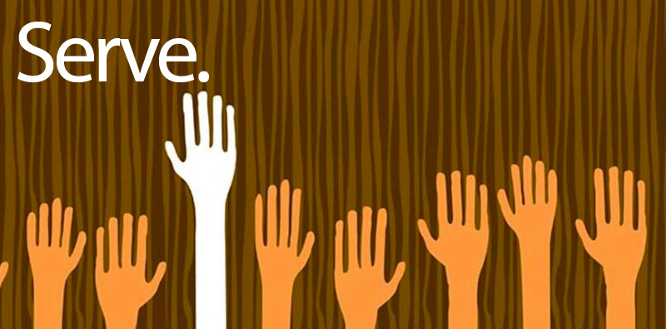

Slide 16
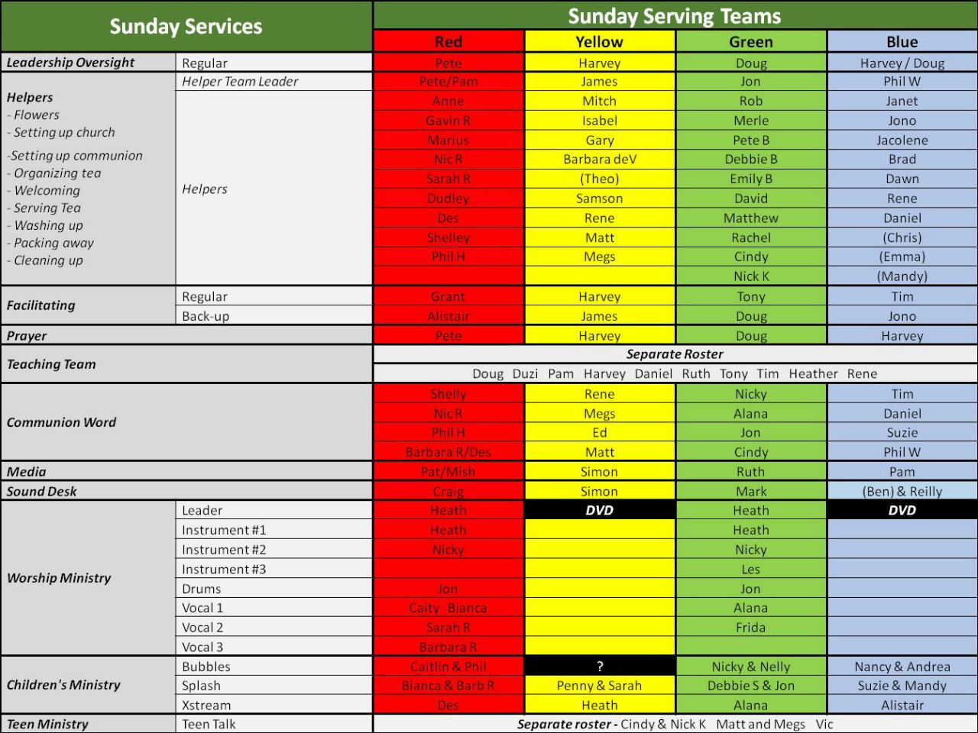

Slide 17
