Slide 1

Notes:
Next steps…

Slide 2
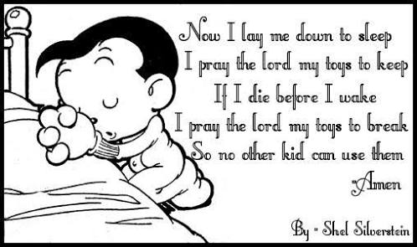
Where we start…
Notes:
Next steps…

Slide 3

Called to Maturity
Notes:
Next steps…

Slide 4
Biblical perspectives…
Cultural Christian | Biblical Christian
We’re saved when we say a prayer. | Making an initial commitment is only the start “Not everyone who calls out to me, ‘Lord! Lord!’ will enter the Kingdom of Heaven. Only those who actually do the will of my Father in heaven will enter. On judgment day many will say to me, ‘Lord! Lord! We prophesied in your name and cast out demons in your name and performed many miracles in your name.’ But I will reply, ‘I never knew you. Get away from me, you who break God’s laws.’ Matthew 7:21-23 NLT
No lasting transformation. | Being transformed – growing to be more like Jesus “But the seeds on good soil stands for those with a noble and good heart, who hear the word, retain it, and by persevering produce a crop. Luke 8:15 NIV
Notes:
Next steps…

Slide 5
Biblical perspectives…
Cultural Christian | Biblical Christian
Still “Me” focussed – pursuing “My” ambitions first | Kingdom Focussed – pursuing what Jesus wants first “Seek the Kingdom of God above all else, and live righteously, and he will give you everything you need.” Matthew 6:33 NLT
Focus on satisfying myself | Focus on serving others “Then Jesus said to his disciples, “If any of you wants to be my follower, you must give up your own way, take up your cross, and follow me. If you try to hang on to your life, you will lose it. But if you give up your life for my sake, you will save it. And what do you benefit if you gain the whole world but lose your own soul? Is anything worth more than your soul?” Matthew 16:24-26 NLT
Focus on financial success | Focus on God’s Kingdom and trusting God for His provision Seek the Kingdom of God above all else, and live righteously, and he will give you everything you need. Matthew 6:33 NLT
Notes:
Next steps…

Slide 6
2 Corinthians 13:11 NLT
“Dear brothers and sisters, I close my letter with these last words: Be joyful. Grow to maturity. Encourage each other. Live in harmony and peace. Then the God of love and peace will be with you.”
Notes:
Next steps…

