Slide 1
IT’S ALL ABOUT
ME

Slide 2
Its all about God - Series
Commitment
Service
Connecting
It’s all about Meeting
It’s all about Serving
It’s all about Loving

Slide 3
God’s Love and Ours
^{1Jn 4:7} Dear friends, let us love one another, for love comes from God. Everyone who loves has been born of God and knows God. ^{1Jn 4:8} Whoever does not love does not know God, because God is love.
^{1Jn 4:9} This is how God showed his love among us: He sent his one and only Son into the world that we might live through him.
^{1Jn 4:10} This is love: not that we loved God, but that he loved us and sent his Son as an atoning sacrifice for our sins.
^{1Jn 4:11} Dear friends, since God so loved us, we also ought to love one another. ^{1Jn 4:12} No one has ever seen God; but if we love one another, God lives in us and his love is made complete in us.
^{1Jn 4:16} And so we know and rely on the love God has for us.
God is love. Whoever lives in love, lives in God, and God in him.
^{1Jn 4:17} In this way, love is made complete among us so that we will have confidence on the day of judgment, because in this world we are like him.
^{1Jn 4:18} There is no fear in love. But perfect love drives out fear, because fear has to do with punishment. The one who fears is not made perfect in love. ^{1Jn 4:19} We love because he first loved us. ^{1Jn 4:20} If anyone says, “I love God,” yet hates his brother, he is a liar. For anyone who does not love his brother, whom he has seen, cannot love God, whom he has not seen. ^{1Jn 4:21} And he has given us this command: Whoever loves God must also love his brother.

Slide 4

It’s all about
God is Love
God’s Love for us
God’s Love through us

Slide 5


Slide 6
^{Ex 34:5} Then the LORD came down in the cloud and stood there with him and proclaimed his name, the LORD. ⁶ And he passed in front of Moses, proclaiming, “The LORD, the LORD, the compassionate and gracious God, slow to anger, abounding in love and faithfulness, ⁷ maintaining love to thousands, and forgiving wickedness, rebellion and sin.
^{1Jn 4:10} This is love: not that we loved God, but that he loved us and sent his Son as an atoning sacrifice for our sins.

Slide 7
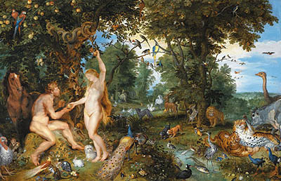
God’s LOVE for US

Slide 8


Slide 9
God’s love is POWERFUL
SO loved that he GAVE his ONLY SON
That we might have ETERNAL life
^{2Co 5:17} Therefore, if anyone is in Christ, he is a new creation; the old has gone, the new has come!
God’s love gives us power!

Slide 10
God’s love is PERSONAL
God so LOVED the world = YOU
^{Gal 2:20} I have been crucified with Christ and I no longer live, but Christ lives in me. The life I live in the body, I live by faith in the Son of God, who loved me and gave himself for me.
^{1Jn 3:1} How great is the love the Father has lavished on us, that we should be called children of God! And that is what we are!
God’s love gives us identity!

Slide 11
GOD’s love is PURPOSEFUL
^{2Co 5:14} For Christ’s love compels us, because we are convinced that one died for all, and therefore all died. ¹⁵ And he died for all, that those who live should no longer live for themselves but for him who died for them and was raised again.
God’s love gives us purpose!

Slide 12
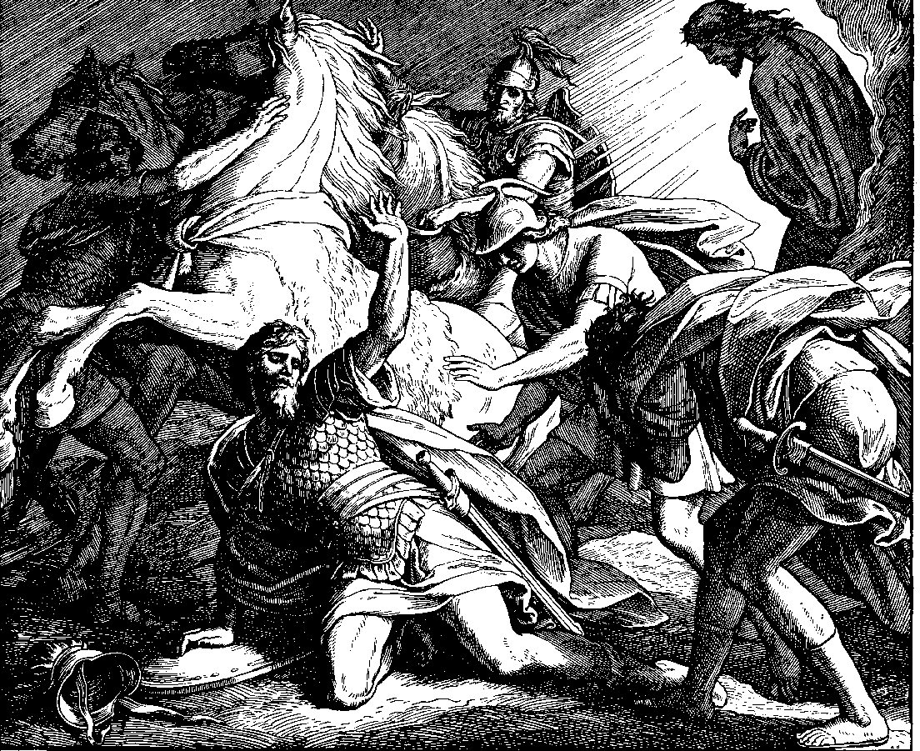

Slide 13
God’s love THROUGH US
^{Eph 5:1} Be imitators of God, therefore, as dearly loved children ² and live a life of love, just as Christ loved us and gave himself up for us as a fragrant offering and sacrifice to God.
^{1Jn 4:9} This is how God showed his love among us: He sent his one and only Son into the world that we might live through him.
^{1Jn 4:11} Dear friends, since God so loved us, we also ought to love one another

Slide 14
The Most Excellent Way
^{Eph 3:16} I pray that out of his glorious riches he may strengthen you with power through his Spirit in your inner being,
^{Eph 3:17} so that Christ may dwell in your hearts through faith. And I pray that you, being rooted and established in love,
^{Eph 3:18} may have power, together with all the saints, to grasp how wide and long and high and deep is the love of Christ,
^{Eph 3:19} and to know this love that surpasses knowledge—that you may be filled to the measure of all the fullness of God.
^{Eph 3:20} Now to him who is able to do immeasurably more than all we ask or imagine, according to his power that is at work within us,
^{Eph 3:21} to him be glory in the church and in Christ Jesus throughout all generations, for ever and ever! Amen.

