Slide 1

Do you want to experience
Marriage the way God intended?
Why not try some…
Notes:
God was not surprised by what was going to happen, and Moses had given these instructions to the Israelites before they crossed over the Jordan River (1400BC) – close to 300 years before the first king (Saul).
Already points to some important foundations for Godly leadership:
A king should not take many wives – they would turn his hear away from the Lord (e.g. Solomon)
Shouldn’t run after wealth – God knew the effect that money could have…
The importance of daily meditation on the word of God to keep him on track

Slide 2
1 Peter 3:1-4 NLT
In the same way, you wives must accept the authority of your husbands. Then, even if some refuse to obey the Good News, your godly lives will speak to them without any words. They will be won over by observing your pure and reverent lives. Don’t be concerned about the outward beauty of fancy hairstyles, expensive jewellery, or beautiful clothes. You should clothe yourselves instead with the beauty that comes from within, the unfading beauty of a gentle and quiet spirit, which is so precious to God.
Notes:
God was not surprised by what was going to happen, and Moses had given these instructions to the Israelites before they crossed over the Jordan River (1400BC) – close to 300 years before the first king (Saul).
Already points to some important foundations for Godly leadership:
A king should not take many wives – they would turn his hear away from the Lord (e.g. Solomon)
Shouldn’t run after wealth – God knew the effect that money could have…
The importance of daily meditation on the word of God to keep him on track

Slide 3
1 Peter 3:5-7 NLT
This is how the holy women of old made themselves beautiful. They put their trust in God and accepted the authority of their husbands. For instance, Sarah obeyed her husband, Abraham, and called him her master. You are her daughters when you do what is right without fear of what your husbands might do. In the same way, you husbands must give honour to your wives. Treat your wife with understanding as you live together. She may be weaker than you are, but she is your equal partner in God’s gift of new life. Treat her as you should so your prayers will not be hindered.
Notes:
God was not surprised by what was going to happen, and Moses had given these instructions to the Israelites before they crossed over the Jordan River (1400BC) – close to 300 years before the first king (Saul).
Already points to some important foundations for Godly leadership:
A king should not take many wives – they would turn his hear away from the Lord (e.g. Solomon)
Shouldn’t run after wealth – God knew the effect that money could have…
The importance of daily meditation on the word of God to keep him on track

Slide 4
Ephesians 5:21-24 NLT.
And further, submit to one another out of reverence for Christ. For wives, this means submit to your husbands as to the Lord. For a husband is the head of his wife as Christ is the head of the church. He is the Saviour of his body, the church. As the church submits to Christ, so you wives should submit to your husbands in everything.
Notes:
God was not surprised by what was going to happen, and Moses had given these instructions to the Israelites before they crossed over the Jordan River (1400BC) – close to 300 years before the first king (Saul).
Already points to some important foundations for Godly leadership:
A king should not take many wives – they would turn his hear away from the Lord (e.g. Solomon)
Shouldn’t run after wealth – God knew the effect that money could have…
The importance of daily meditation on the word of God to keep him on track

Slide 5
Ephesians 5:25-30 NLT.
For husbands, this means love your wives, just as Christ loved the church. He gave up his life for her to make her holy and clean, washed by the cleansing of God’s word. He did this to present her to himself as a glorious church without a spot or wrinkle or any other blemish. Instead, she will be holy and without fault. In the same way, husbands ought to love their wives as they love their own bodies. For a man who loves his wife actually shows love for himself. No one hates his own body but feeds and cares for it, just as Christ cares for the church. And we are members of his body.
Notes:
God was not surprised by what was going to happen, and Moses had given these instructions to the Israelites before they crossed over the Jordan River (1400BC) – close to 300 years before the first king (Saul).
Already points to some important foundations for Godly leadership:
A king should not take many wives – they would turn his hear away from the Lord (e.g. Solomon)
Shouldn’t run after wealth – God knew the effect that money could have…
The importance of daily meditation on the word of God to keep him on track

Slide 6
Ephesians 5:31-33 NLT.
As the Scriptures say, “A man leaves his father and mother and is joined to his wife, and the two are united into one.” This is a great mystery, but it is an illustration of the way Christ and the church are one.
So again I say, each man must love his wife as he loves himself, and the wife must respect her husband.
Notes:
God was not surprised by what was going to happen, and Moses had given these instructions to the Israelites before they crossed over the Jordan River (1400BC) – close to 300 years before the first king (Saul).
Already points to some important foundations for Godly leadership:
A king should not take many wives – they would turn his hear away from the Lord (e.g. Solomon)
Shouldn’t run after wealth – God knew the effect that money could have…
The importance of daily meditation on the word of God to keep him on track

Slide 7
DVD
Notes:
God was not surprised by what was going to happen, and Moses had given these instructions to the Israelites before they crossed over the Jordan River (1400BC) – close to 300 years before the first king (Saul).
Already points to some important foundations for Godly leadership:
A king should not take many wives – they would turn his hear away from the Lord (e.g. Solomon)
Shouldn’t run after wealth – God knew the effect that money could have…
The importance of daily meditation on the word of God to keep him on track

Slide 8
Ephesians 5:33 NLT.
So again I say, each man must love his wife as he loves himself, and the wife must respect her husband.
Notes:
God was not surprised by what was going to happen, and Moses had given these instructions to the Israelites before they crossed over the Jordan River (1400BC) – close to 300 years before the first king (Saul).
Already points to some important foundations for Godly leadership:
A king should not take many wives – they would turn his hear away from the Lord (e.g. Solomon)
Shouldn’t run after wealth – God knew the effect that money could have…
The importance of daily meditation on the word of God to keep him on track

Slide 9

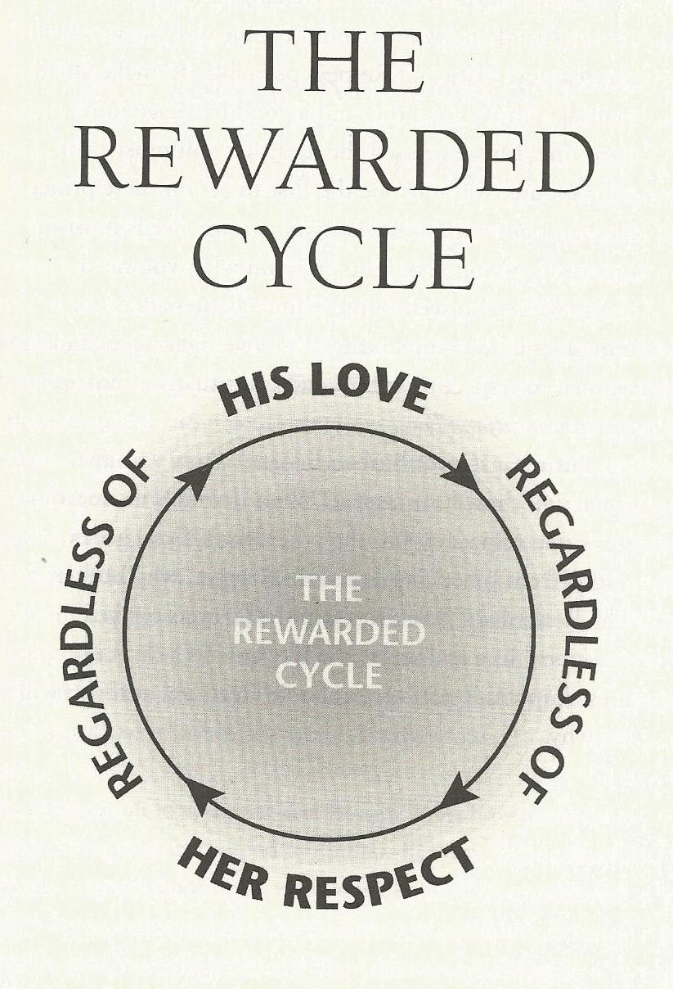


Changing the cycle…
Notes:
God was not surprised by what was going to happen, and Moses had given these instructions to the Israelites before they crossed over the Jordan River (1400BC) – close to 300 years before the first king (Saul).
Already points to some important foundations for Godly leadership:
A king should not take many wives – they would turn his hear away from the Lord (e.g. Solomon)
Shouldn’t run after wealth – God knew the effect that money could have…
The importance of daily meditation on the word of God to keep him on track

Slide 10
Dr. Emerson Eggerichs
Notes:
God was not surprised by what was going to happen, and Moses had given these instructions to the Israelites before they crossed over the Jordan River (1400BC) – close to 300 years before the first king (Saul).
Already points to some important foundations for Godly leadership:
A king should not take many wives – they would turn his hear away from the Lord (e.g. Solomon)
Shouldn’t run after wealth – God knew the effect that money could have…
The importance of daily meditation on the word of God to keep him on track

