Slide 1

"Grace comes into the soul, as the morning sun into the world; first a dawning; then a light; and at last the sun in his full and excellent brightness” Thomas Adams
Each One...

Slide 2

Each One...
1) fully devoted to Jesus
2) empowered by the Holy Spirit
3) needed…
4) committed to the body of Christ

Slide 3
Each One...
5) shepherded in line with the scriptures
6) aligned in beliefs (doctrine)
7) genuinely caring and cared for
8) belonging to a wider family

Slide 4

Before the Lord can build with us, we need to make sure that we repair any cracks in our foundations…
…a call to forgiveness & reconciliation

Slide 5
Psalm 133:1‭-‬3 NIV‬‬‬‬‬
“How good and pleasant it is when God’s people live together in unity! It is like precious oil poured on the head, running down on the beard, running down on Aaron’s beard, down on the collar of his robe. It is as if the dew of Hermon were falling on Mount Zion. For there the Lord bestows his blessing, even life forevermore”

Slide 6

Mt Hermon
Anointing oil
A precious & fragrant aroma

Slide 7
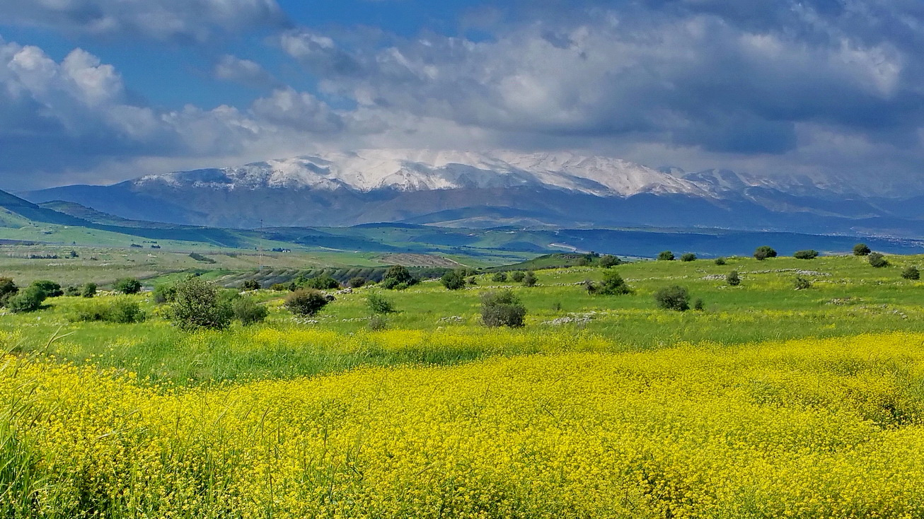
Dew of Hermon
Bringing life to a barren land…

Slide 8

Solid Foundations
Paul’s advice for the early church…
The Roman Church
12v9-10: “Love must be sincere. Hate what is evil; cling to what is good. Be devoted to one another in love. Honor one another above yourselves.”
14v9: “Let us therefore make every effort to do what leads to peace and to mutual edification.”
15v5: “May the God who gives endurance and encouragement give you the same attitude of mind toward each other that Christ Jesus had, so that with one mind and one voice you may glorify the God and Father of our Lord Jesus Christ. Accept one another, then, just as Christ accepted you, in order to bring praise to God.”

Slide 9
Solid Foundations
Paul’s advice for the early church…
The Corinthian Church
12v9-10: “Love must be sincere. Hate what is evil; cling to what is good. Be devoted to one another in love. Honor one another above yourselves.”
14v9: “Let us therefore make every effort to do what leads to peace and to mutual edification.”
15v5: “May the God who gives endurance and encouragement give you the same attitude of mind toward each other that Christ Jesus had, so that with one mind and one voice you may glorify the God and Father of our Lord Jesus Christ. Accept one another, then, just as Christ accepted you, in order to bring praise to God.”

Slide 10
Solid Foundations
Paul’s advice for the early church…
The Colossian Church
Colossians 3v12-14: “Therefore, as God’s chosen people, holy and dearly loved, clothe yourselves with compassion, kindness, humility, gentleness and patience. Bear with each other and forgive one another if any of you has a grievance against someone. Forgive as the Lord forgave you. And over all these virtues put on love, which binds them all together in perfect unity.”

Slide 11

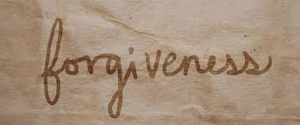
“We all agree that forgiveness is a beautiful idea until we have to practice it.”
C.S. Lewis

Slide 12
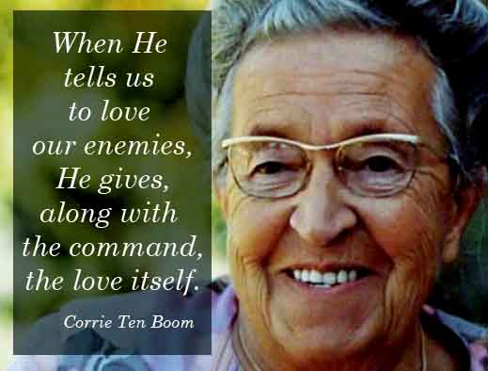

Slide 13
“To forgive is to set a prisoner free, and realise the prisoner was you”

Slide 14
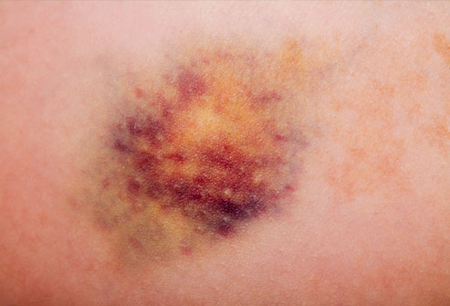
Wounds
Isaiah 1:5,6
“ … the whole head is sick and the whole heart is faint. From the sole of the foot even to the head there is nothing sound in it, only bruises, welts and raw wounds; not pressed out / closed, or bandaged, nor softened with oil.”

Slide 15
Bruises
… Time heals a bruise
Welts
… Other loving relationships help to heal
Raw wounds / putrefying sores
… Need the ministry of the Holy Spirit

