Slide 1
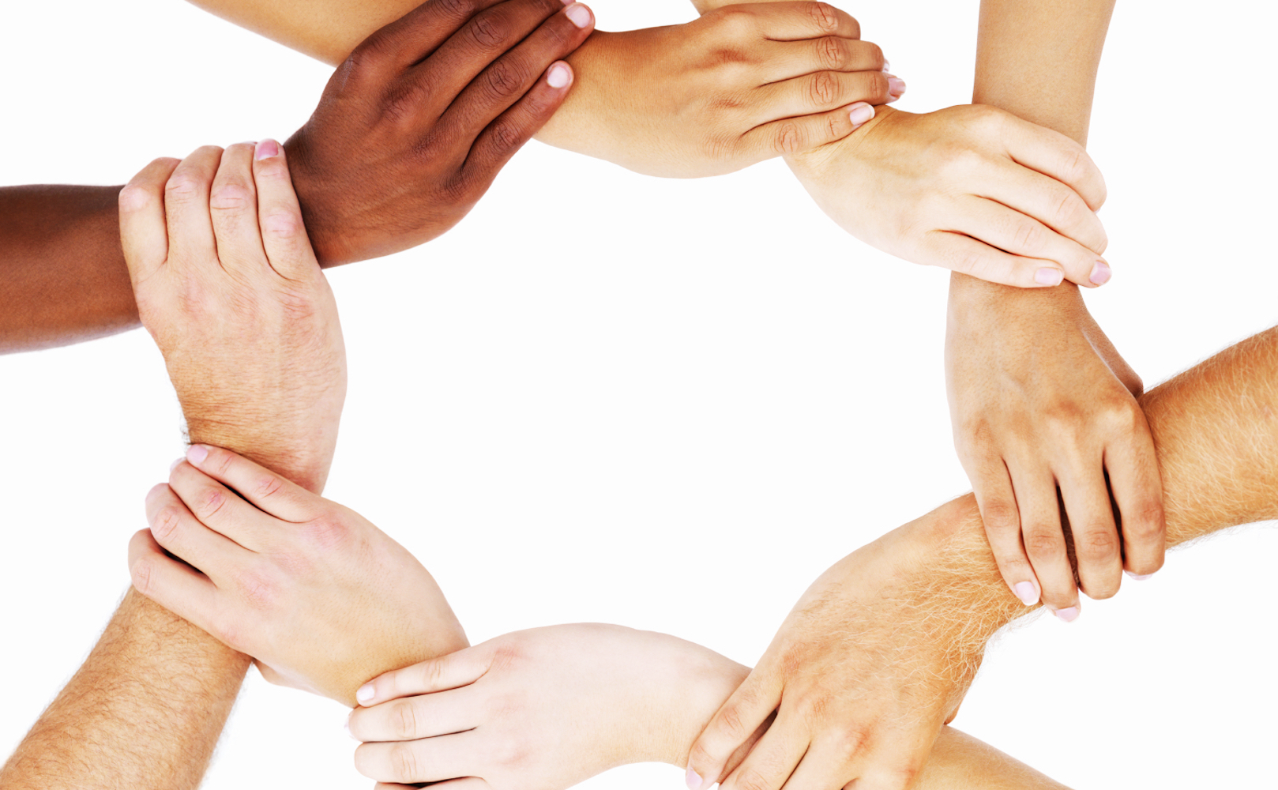
"Grace comes into the soul, as the morning sun into the world; first a dawning; then a light; and at last the sun in his full and excellent brightness” Thomas Adams
Each One...

Slide 2
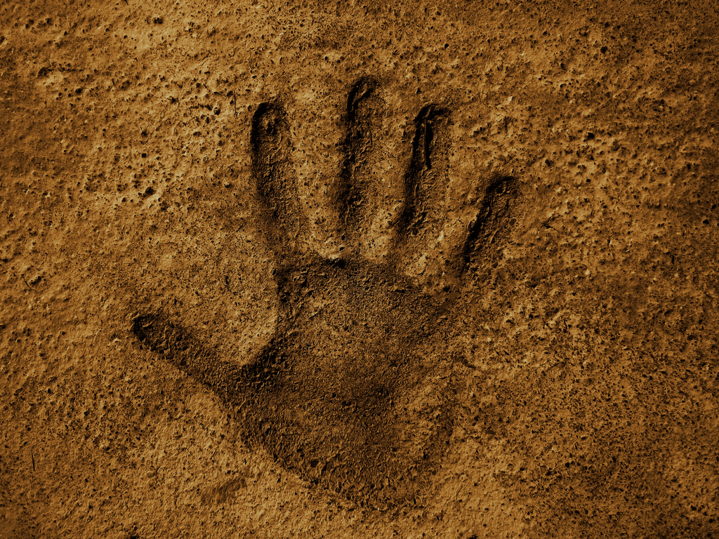

followers of Christ

Slide 3
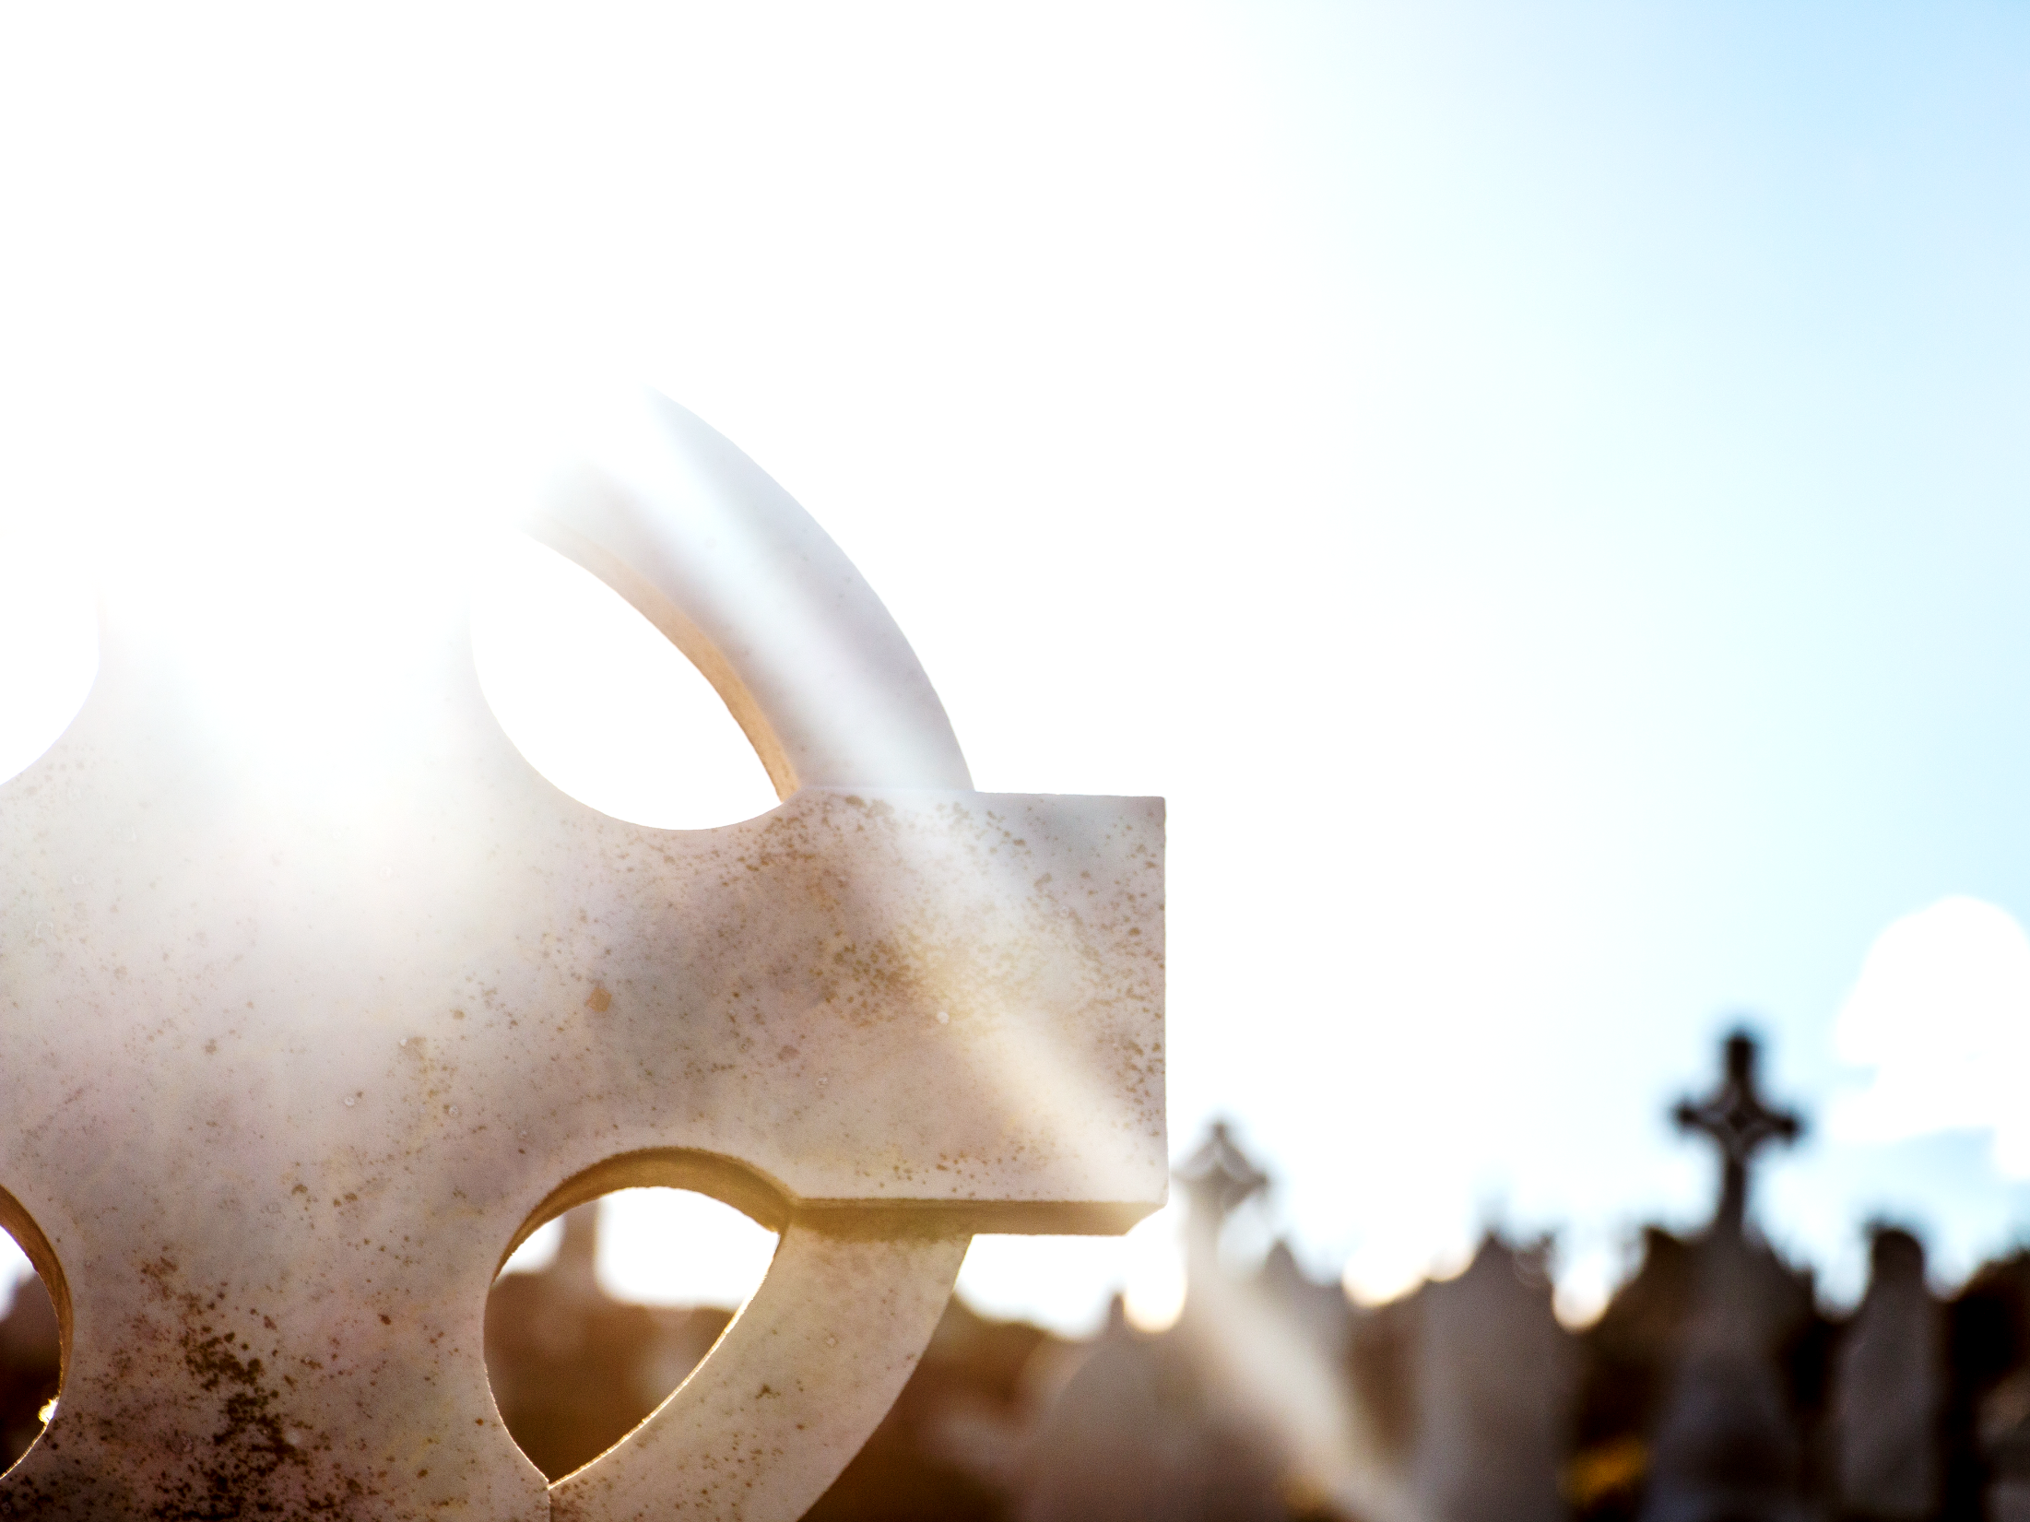
The starting point: Saved by God’s grace – what an amazing privilege!
Romans 5:1‭-‬2: “We have been made right with God because of our faith. Now we have peace with him because of our Lord Jesus Christ. Through faith in Jesus we have received God's grace. In that grace we stand. We are full of joy because we expect to share in God's glory.”‬‬

Slide 4
The starting point: God’s Grace
Who loves God’s grace?
We all do, right?
It’s free!
I could never have earned it by doing good!
It’s only through Jesus – not about me!
I’m set free!
I'm saved from God’s condemnation.

Slide 5
The starting point: God’s Grace
So...
I'm now called a friend of God
Part of the family...
I'm free to live a life blessed by God
Don’t stress – God’s got your back...
Free of condemnation, guaranteed salvation

Slide 6
The starting point: God’s Grace
Pity...
Perfection isn't possible, sin is inevitable
Holiness is impossible – thank goodness for heaven!
About our culture – no one seems to stand up for anything good anymore
That work demands so much from us – I barely manage to make time for my family...
That I don't have enough to give to those in need - there's never quite enough to go round
God’s grace was cheap for me...BUT it cost Jesus everything. These foundations seem a little shaky...

Slide 7
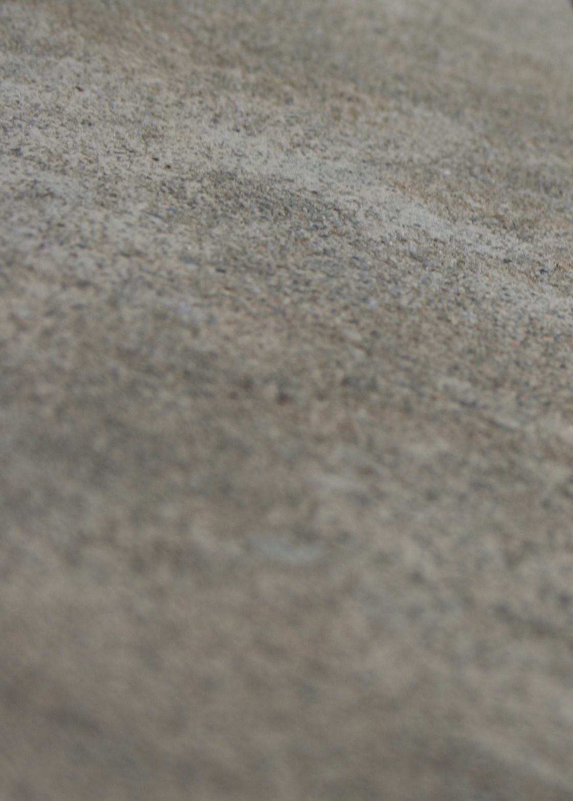
So what does it mean to build on a firm foundation?
Matthew 7:24-27: “Therefore everyone who hears these words of mine and puts them into practice is like a wise man who built his house on the rock. The rain came down, the streams rose, and the winds blew and beat against that house; yet it did not fall, because it had its foundation on the rock. But everyone who hears these words of mine and does not put them into practice is like a foolish man who built his house on sand. The rain came down, the streams rose, and the winds blew and beat against that house, and it fell with a great crash.”

Slide 8
So what does it mean to build on a firm foundation?
Slaves to God...
Romans 6:16, 22: “Don't you know that when you give yourselves to obey someone you become that person's slave?
You can be slaves of sin…Then you will die.
Or you can be slaves who obey God… Then you will live a godly life.
You have been set free from sin. God has made you his slaves. The benefit you gain leads to holy living. And the end result is eternal life.”

Slide 9
So what does it mean to build on a firm foundation?
A living sacrifice...
Romans 12:1-2: “Brothers and sisters, God has shown you his mercy. So I am asking you to offer up your bodies to him while you are still alive. Your bodies are a holy sacrifice that is pleasing to God. When you offer your bodies to God, you are worshiping him. Don't live any longer the way this world lives. Let your way of thinking be completely changed. Then you will be able to test what God wants for you. And you will agree that what he wants is right. His plan is good and pleasing and perfect.”

Slide 10

A clearer perspective…
So...
I'm now called a friend of God
Part of the family...
I'm free to live a life blessed by God
Don’t stress – God’s got your back...
Free of condemnation, guaranteed salvation
…I'm called to lay down my life for my God
with a responsibility to uphold the family name
…which requires me to
obey his commands
…We’re on shaky ground if we're not living right
…Called to work out our salvation in fear and trembling

Slide 11
A clearer perspective…
Pity...
Perfection isn't possible, sin is inevitable
Holiness is impossible – thank goodness for heaven!
About our culture – no one seems to stand up for anything good anymore
That work demands so much from us – I barely manage to make time for my family...
That I don't have enough to give to those in need - there's never quite enough to go round
Run the race with endurance & deal decisively with your sin
Be holy because I am holy
I'm called to be the light this world needs
Do not overwork to get rich. Trust God – he knows your needs
I'm called to be a blessing – God show me what that looks like and help me to bless others

Slide 12
What gets in the way?
Parable of the sower (Luke 8:5‭-‬8)
“A farmer went out to sow his seed. As he was scattering the seed, some fell along the path; it was trampled on, and the birds ate it up. Some fell on rocky ground, and when it came up, the plants withered because they had no moisture. Other seed fell among thorns, which grew up with it and choked the plants. Still other seed fell on good soil. It came up and yielded a crop, a hundred times more than was sown.” When he said this, he called out, “Whoever has ears to hear, let them hear.”

Slide 13
What gets in the way?
Explanation (Luke 8:11‭-‬15)
“This is the meaning of the parable: The seed is the word of God. Those along the path are the ones who hear, and then the devil comes and takes away the word from their hearts, so that they may not believe and be saved. Those on the rocky ground are the ones who receive the word with joy when they hear it, but they have no root. They believe for a while, but in the time of testing they fall away. The seed that fell among thorns stands for those who hear, but as they go on their way they are choked by life’s worries, riches and pleasures, and they do not mature. But the seed on good soil stands for those with a noble and good heart, who hear the word, retain it, and by persevering produce a crop.”

Slide 14
Abiding...essential for each of us.
John 15:5‭-‬8
“I am the vine; you are the branches. If you remain in me and I in you, you will bear much fruit; apart from me you can do nothing. If you do not remain in me, you are like a branch that is thrown away and withers; such branches are picked up, thrown into the fire and burned. If you remain in me and my words remain in you, ask whatever you wish, and it will be done for you. This is to my Father’s glory, that you bear much fruit, showing yourselves to be my disciples.”

Slide 15
It’s our living not just our believing that makes us wholehearted followers of Christ.

Slide 16
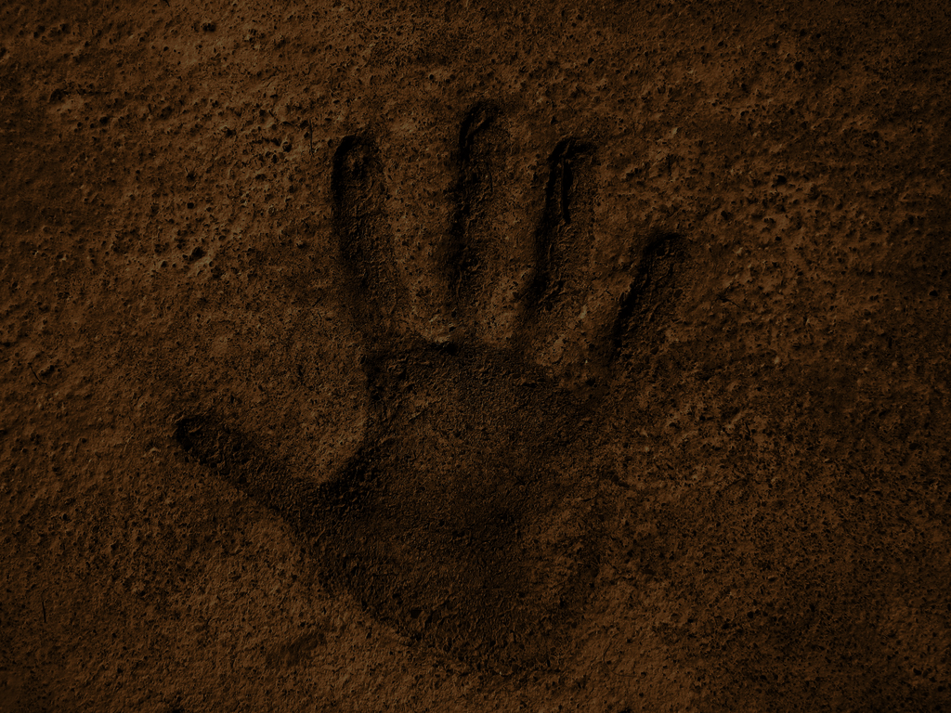
What will your response be?
It’s my choice to believe in Jesus and to accept God’s grace
It’s also my choice to follow Christ wholeheartedly
  Its my choice to spend time in God’s word
  It’s my choice not to stress about the worries of this life but to place my trust in him for the peace I need each day
  It’s my choice to not work myself to death trying to attain the “good life” but to set healthy boundaries and to learn to be content with what I have
  Its my choice to moderate the time I spend on hobbies and sport so I have time for Jesus
  It’s my choice to change – to deal with the sin my life instead of just giving up

Slide 17
"Grace comes into the soul, as the morning sun into the world; first a dawning; then a light; and at last the sun in his full and excellent brightness” Thomas Adams
Imagine what
can achieve…
Let’s take this journey together!

