Slide 1

"Grace comes into the soul, as the morning sun into the world; first a dawning; then a light; and at last the sun in his full and excellent brightness” Thomas Adams
Each One...

Slide 2
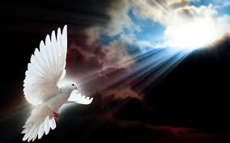
Empowered by the Spirit

Slide 3


Slide 4

Another choice:
To rebuild in our own strength or to rebuild and grow empowered by His Spirit
Each one empowered + Each one empowered + Each one empowered …… =
AN EMPOWERED C H U R C H

Slide 5
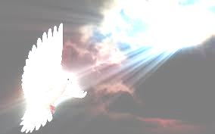
Who is the Holy Spirit?
he emerges clearly in scripture as the third person of the godhead, equipping god’s people with power to do god’s work.

Slide 6
Joel’s prophecy (OT):
God says “In the last days I will pour out My Spirit on all flesh.”
Jesus said He would send the Comforter, the Spirit of truth
(GK: “PARACLETOS” … the one called along to help)
John 7:37,38
On the last and greatest day of the festival, Jesus stood and said in a loud voice , “Let anyone who is thirsty come to Me and drink. Whoever believes in Me, as the Scripture has said, rivers of living water will flow from within them.” By this He meant the Spirit, whom those who believe in Him were later to receive. Up to that time the Spirit had not been given, since Jesus had not yet been glorified.

Slide 7
The well and the river.
John 4 The well of salvation
John 7 Rivers of living water
flowing from within you
We need the power of the indwelling Spirit to represent Jesus in the world by following Him and being obedient and being Christ-like (the fruit of the Holy Spirit)
But there’s more …

Slide 8
+
Jesus said:
“You will be baptised in the Holy Spirit not many days from now” and “You will receive power after the Holy Spirit is come upon you and you shall be My witnesses” and
that they should wait in Jerusalem until they “were clothed with power from on high.”
Acts 1:5,8 and Luke 24:49
God’s work in our world is designed to be done with and not without the power of the Holy Spirit coming upon us / the anointing.

Slide 9
How do we get empowered by /baptised in the Holy Spirit?
The pattern
He pours out …
We receive
(Gk “lumbano” which means take/receive)

Slide 10
Three common obstacles:
Lack of teaching
We need good teaching from the word on this so our faith can rise
Fear
We need our fears about the supernatural power of the Holy Spirit to be dispelled
IGNORANCE ON HOW TO RECEIVE THE BAPTISM IN THE HOLY SPIRIT
WE NEED TO BE SHOWN HOW TO POSITION OURSELVES

Slide 11
Here’s how to position yourself:
YOU NEED TO …
Believe
Be thirsty
Be willing to obey Him
Ask
Receive (take/receive)

Slide 12
The indwelling Spirit for power to live in a Christ-like , obedient way (Happens at salvation and we have a need to be filled daily)
LIVING
The clothing with power from on high (the baptism in the Holy Spirit) to do God’s work
Witnessing
(the anointing)

Slide 13
What will a church empowered by the spirit look like?
It will be a Church …
… filled with love
… ThAT IS CHRIST-LIKE
… obedient to the will of God
… that really knows God
… Full of wisdom, counsel and understanding
… that fears God
… that increases
… that witnesses
… where Jesus is glorified and central
… which is well taught
… where the supernatural gifts of the Holy
SPIRIT ARE IN USE

