Slide 1

"Grace comes into the soul, as the morning sun into the world; first a dawning; then a light; and at last the sun in his full and excellent brightness” Thomas Adams
Each One...
Needed

Slide 2
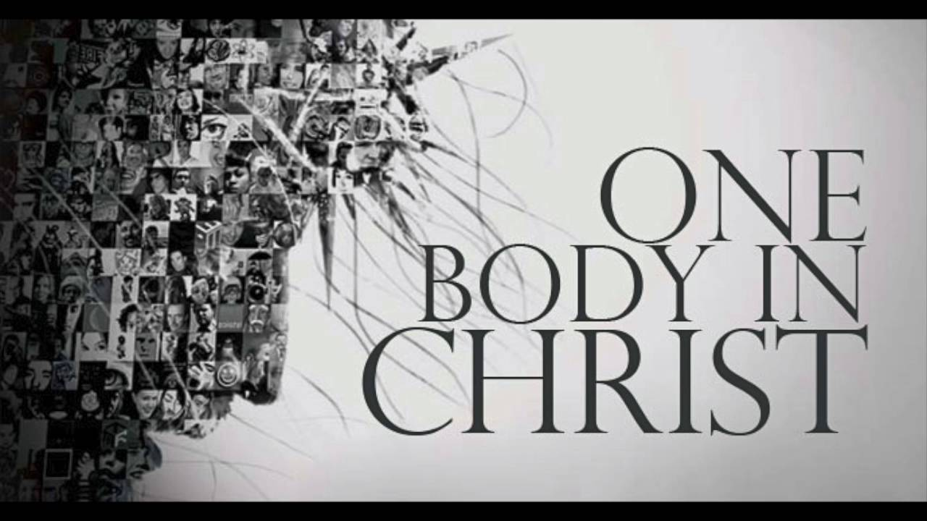

Slide 3
Romans 12:4-8
“Just as each of us has one body with many members and these members do not have the same function, so in Christ we who are many form one body and each member belongs to all the others.
We have different gifts, according to the grace given us. If it is serving, let him serve, if it is teaching let him teach, if it is encouraging let him encourage, if it is contributing to the needs of others , let him give generously, if it is leadership, let him govern diligently, if it is showing mercy let him do it cheerfully.”

Slide 4
Teaching
Exhortation
Evangelism
Mercy
Giving
Administration
Leadership
Helps
Service

