Slide 1

The Word of God

Slide 2
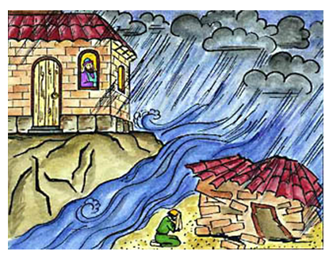
Building on a solid foundation

Slide 3
Jesus is the Word
  ¹In the beginning was the Word [Jesus], and the Word [Jesus] was with God, and the Word [Jesus] was God. ²He was in the beginning with God. ³All things were made through Him, and without Him nothing was made that was made.
…
  ¹⁴And the Word [Jesus] became flesh and dwelt among us, and we beheld His glory…
  - John 1

Slide 4
Jesus is…
…the Word (Logos)
…the divine expression of God

Slide 5
“God… has in these last days spoken to us by His Son”
- Hebrews 4 : 1-2
Jesus didn’t just bring us a message… He is the message!

Slide 6
First hand experience of Jesus…
  “We proclaim to you the one who existed from the beginning, whom we have heard and seen. We saw him with our own eyes and touched him with our own hands. He is the Word of life. This one who is life itself was revealed to us, and we have seen him. And now we testify and proclaim to you that he is the one who is eternal life. He was with the Father, and then he was revealed to us. We proclaim to you what we ourselves have actually seen and heard so that you may have fellowship with us. And our fellowship is with the Father and with his Son, Jesus Christ. We are writing these things so that you may fully share our joy”.
  - 1 John 1 : 1 – 4 NLT

Slide 7
Jesus in the Old Testament…
  “You search the Scriptures, because you think that in them you have eternal life; and these are they which testify about me”
  – John 5:39
  “If you believed Moses, you would believe me, for he wrote about me”
  – John 5:46
  “And beginning at Moses and all the Prophets, He expounded to them in all the Scriptures the things concerning Himself”
  – Luke 24:27

Slide 8
The Old Testament is also written for our benefit
  “Now all these things happened to them as examples, and they were written for our admonition, upon whom the ends of the ages have come”
  - 1 Cor 10:11
  “For whatever things were written before were written for our learning, that we through the patience and comfort of the Scriptures might have hope.”
  - Romans 15:4

Slide 9
The New Testament is in the Old Testament concealed and the Old Testament is in the New Testament revealed

Slide 10
Luke 4 : 16 - 21
  So He came to Nazareth, where He had been brought up. And as His custom was, He went into the synagogue on the Sabbath day, and stood up to read. And He was handed the book of the prophet Isaiah. And when He had opened the book, He found the place where it was written:
    The Spirit of the LORD is upon Me,
    Because He has anointed Me
    To preach the gospel to the poor;
    He has sent Me to heal the broken-hearted,
    To proclaim liberty to the captives
    And recovery of sight to the blind,
    To set at liberty those who are oppressed
    To proclaim the acceptable year of the LORD
  Then He closed the book, and gave it back to the attendant and sat down. And the eyes of all who were in the synagogue were fixed on Him. And He began to say to them, “Today this Scripture is fulfilled in your hearing”.

Slide 11
Luke 4 vs Isaiah 61
    The Spirit of the LORD is upon Me,
    Because He has anointed Me
    To preach the gospel to the poor;
    He has sent Me to heal the broken-hearted,
    To proclaim liberty to the captives
    And recovery of sight to the blind,
    To set at liberty those who are oppressed
    To proclaim the acceptable year of the LORD
    And the day of vengeance of our God…
    Jesus stops reading here…
    mid-sentence!

Slide 12
The hope of “face-to-face”
  “For now we see in a mirror, dimly, but then face to face. Now I know in part, but then I shall know just as I also am known”
  - I Corinthians 13:12
  “Beloved, now we are children of God; and it has not yet been revealed what we shall be, but we know that when He is revealed, we shall be like Him, for we shall see Him as He is. And everyone who has this hope in Him purifies himself, just as He is pure”
  - I John 3:2-3

Slide 13
The security of being rooted in the Word

Slide 14
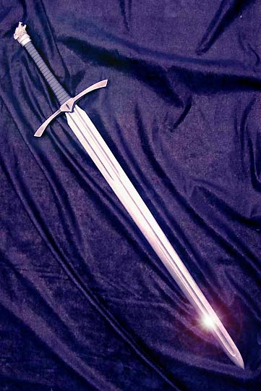
For the word of God is living and powerful, and sharper than any two-edged sword, piercing even to the division of soul and spirit, and of joints and marrow, and is a discerner of the thoughts and intents of the heart
- Hebrews 4:12

Slide 15
Warnings about deception
  “Take heed that no one deceives you” – Matthew 24:3
  “…many false prophets will rise up…” – Matthew 24:11
  “For the time will come when they will not endure sound doctrine…”
  – 2 Timothy 4:3
  “…they will turn their ears away from the truth, and be turned aside to fables”. – 2 Timothy 4:4
  “…there will be false teachers among you, who will secretly bring in destructive heresies”. – 2 Peter 2:1

Slide 16
Be like the Bereans in Acts 17 who…
“…searched the Scriptures daily to find out whether these things were so.”

Slide 17
Practical tips for reading the Word
  Start with the premise that it is true and inerrant
  Start with prayer. Ask the Holy Spirit to teach and counsel you
  Look for Jesus wherever you are reading. What is God saying?
  Get hold of a study Bible or some good commentaries
      Blue Letter Bible (www.blueletterbible.org)
  Set aside time to read

Slide 18
“And truly Jesus did many other signs in the presence of His disciples, which are not written in this book; but these are written that you may believe that Jesus is the Christ, the Son of God, and that believing you may have life in His name.”
John 20:30-31

Slide 19
2 prayers for all of us…
  “Open my eyes that I might see wonderful things in Your Word”
  - Psalm 119:18
  “Let the word of Christ dwell in you richly…”
  - Colossians 3:16a

Slide 20


