Slide 1
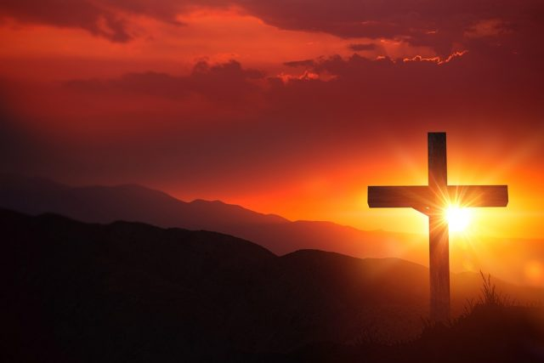
"Grace comes into the soul, as the morning sun into the world; first a dawning; then a light; and at last the sun in his full and excellent brightness” Thomas Adams

Slide 2

Ephesians 5:1‭-‬2
"¹Imitate God, therefore, in everything you do, because you are his dear children. ²Live a life filled with love, following the example of Christ. He loved us and offered himself as a sacrifice for us, a pleasing aroma to God.”

Slide 3
Ephesians 5:3‭-9
^{“3}Let there be no sexual immorality, impurity, or greed among you. Such sins have no place among God’s people. ⁴Obscene stories, foolish talk, and coarse jokes—these are not for you. Instead, let there be thankfulness to God. ⁵You can be sure that no immoral, impure, or greedy person will inherit the Kingdom of Christ and of God. For a greedy person is an idolater, worshiping the things of this world. ⁶Don’t be fooled by those who try to excuse these sins, for the anger of God will fall on all who disobey him. ⁷Don’t participate in the things these people do. ⁸For once you were full of darkness, but now you have light from the Lord. So live as people of light! ⁹For this light within you produces only what is good and right and true.”

Slide 4
Ephesians 5:10 - 18
¹⁰Carefully determine what pleases the Lord.
¹¹Take no part in the worthless deeds of evil and darkness; instead, expose them."
¹⁵So be careful how you live. Don’t live like fools, but like those who are wise.
^{“16}Make the most of every opportunity in these evil days. Don’t act thoughtlessly, but understand what the Lord wants you to do.”
¹⁸Don’t be drunk with wine, because that will ruin your life. Instead, be filled with the Holy Spirit..”

