Slide 1
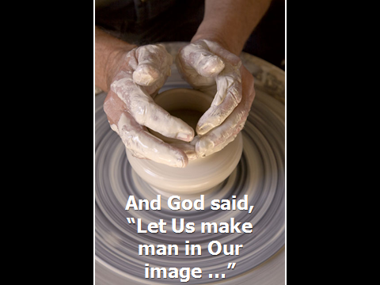

Slide 2
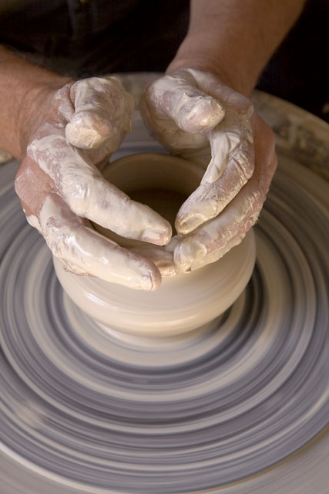
The
INTER-DEPENDENCE of the Godhead

Slide 3
The
SELFLESSNESS
the Godhead

Slide 4
The
GRACE and TRUTH
of the Godhead

Slide 5
The
WISDOM
of the Godhead

Slide 6
As individuals and as a Church, let’s reflect the inter-dependence, selflessness, compassion and wisdom of the glory of God

