Slide 1
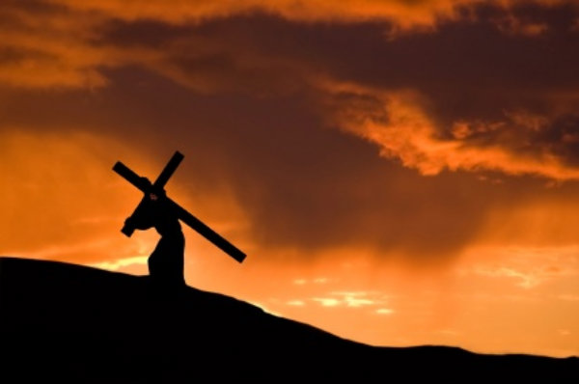
The Faith Challenge
Hard choices with high stakes

Slide 2
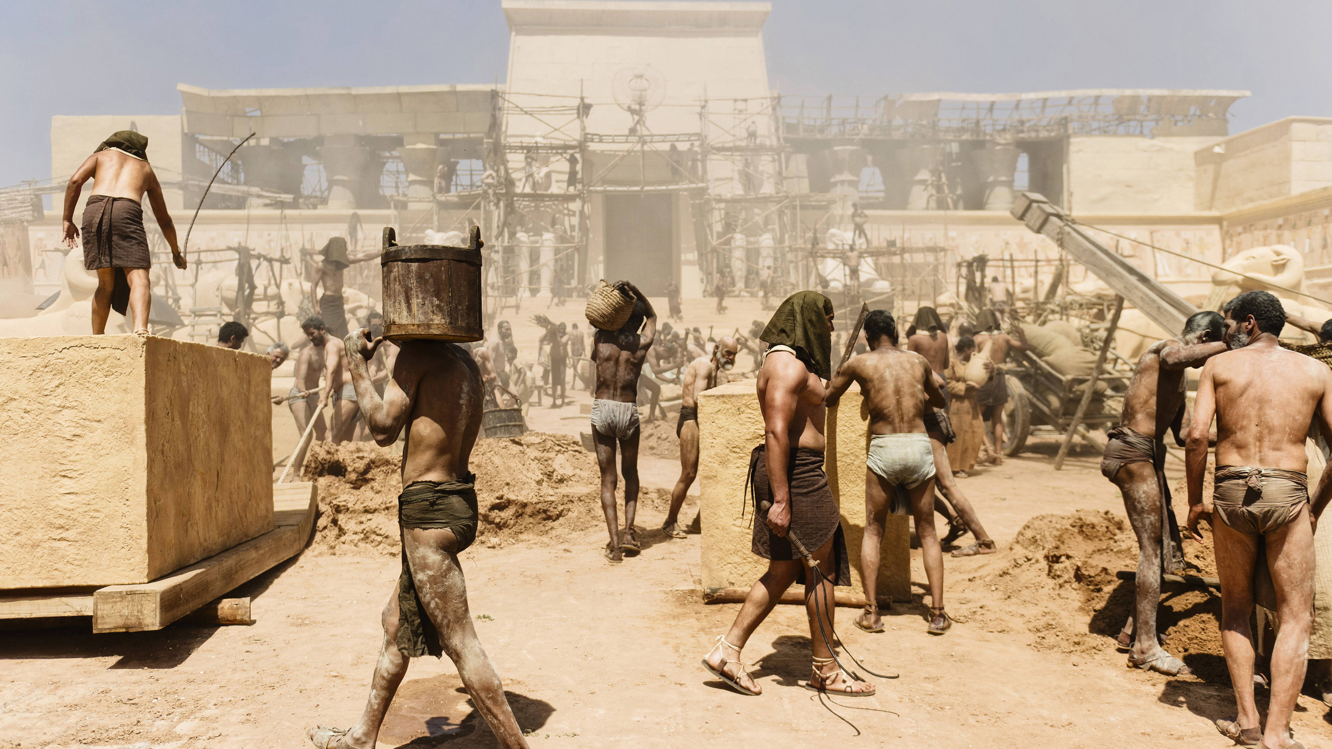
The Faith Challenge
Hebrews 11:23-26
It was by faith that Moses' parents hid him for three months when he was born. They saw that God had given them an unusual child, and they were not afraid to disobey the king's command. (24) It was by faith that Moses, when he grew up, refused to be called the son of Pharaoh's daughter. (25) He chose to share the oppression of God's people instead of enjoying the fleeting pleasures of sin.

Slide 3
The Faith Challenge
Hebrews 11:23-26
(26) He thought it was better to suffer for the sake of Christ than to own the treasures of Egypt, for he was looking ahead to his great reward.

Slide 4
The Faith Challenge
Obedience to God
Everyone must submit to governing authorities. For all authority comes from God, and those in positions of authority have been placed there by God.
(Romans 13:1)
But Peter and the apostles replied, "We must obey God rather than any human authority.”
(Acts 5:29)

Slide 5
The Faith Challenge
Opportunities Refused
(24) It was by faith that Moses, when he grew up, refused to be called the son of Pharaoh's daughter. (25) He chose to share the oppression of God's people instead of enjoying the fleeting pleasures of sin. (26) He thought it was better to suffer for the sake of Christ than to own the treasures of Egypt, for he was looking ahead to his great reward.
Hebrews 11:24-26

Slide 6
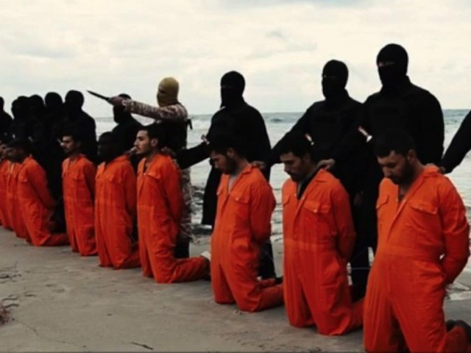
The Faith Challenge
Oppression Suffered
Persecution
of Christians

Slide 7
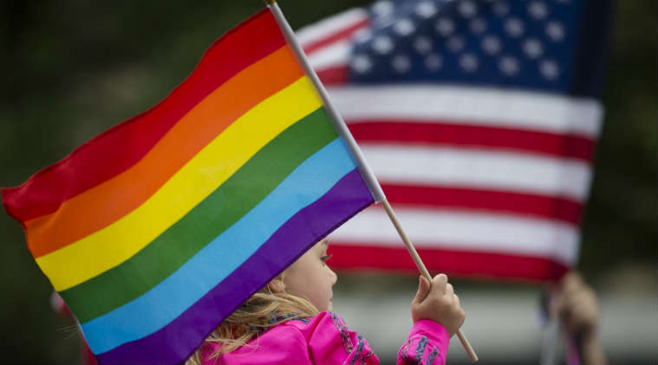
The Faith Challenge
Oppression Suffered
Polarisation of moral standards
in the world and the church.
There are an estimated 40-50 million abortions per year. This equals approximately 125,000 abortions per day.
(World Health Organisation)

Slide 8
The Faith Challenge
Oppression Suffered
Political Correctness:
The avoidance of forms of expression or action that are perceived to exclude, marginalize, or insult groups of people who are socially disadvantaged or discriminated against.
“Political correctness does not legislate tolerance; it only organizes hatred.”
-Jacques Barzun

Slide 9
The Faith Challenge
Obedience to God
Opportunities Refused
Oppression Suffered
I nominate you to take up
the faith challenge!

