Slide 1
It's Time to Act
ACTS — SERIES 1: EMPOWERED
Acts 1:1–11 | 9 August 2026

Slide 2

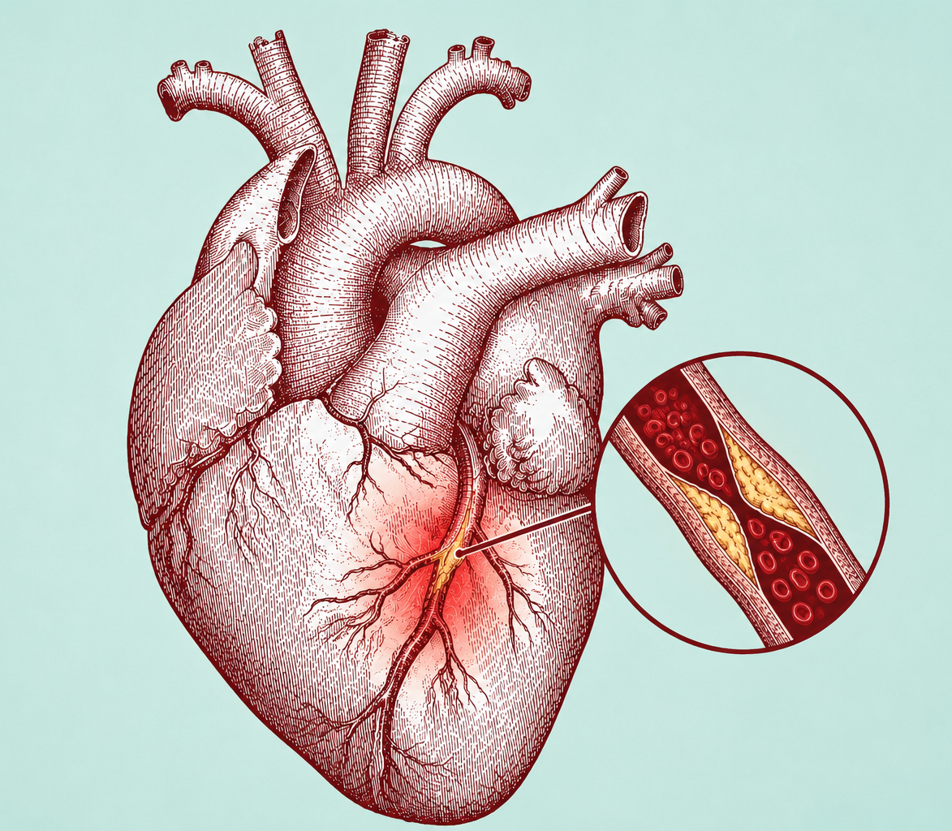
Sin.
Worry.
Busyness.
Competing priorities.
They restrict the flow of God's life through us.

Slide 3
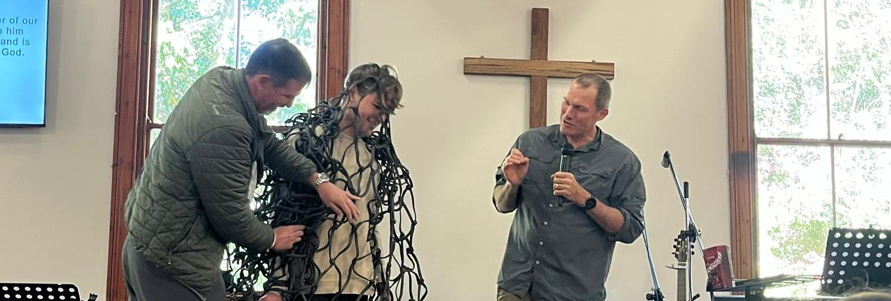
HEBREWS 12:1 NLT
Let us strip off every weight that slows us down, especially the sin that so easily trips us up.

Slide 4
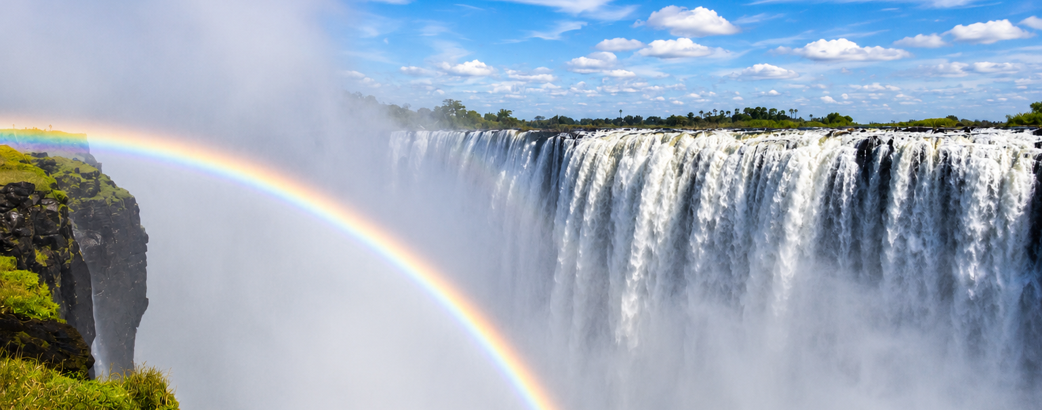
Called into a season of acceleration. Into greater fruitfulness and effectiveness….

Slide 5
It’s time to Act!

Slide 6
LUKE 24:44–48 NLT
Then he said, “When I was with you before, I told you that everything written about me in the law of Moses and the prophets and in the Psalms must be fulfilled.” Then he opened their minds to understand the Scriptures. And he said, “Yes, it was written long ago that the Messiah would suffer and die and rise from the dead on the third day. It was also written that this message would be proclaimed in the authority of his name to all the nations, beginning in Jerusalem: ‘There is forgiveness of sins for all who repent.’ You are witnesses of all these things.

Slide 7
LUKE 24:49 NLT
“And now I will send the Holy Spirit, just as my Father promised. But stay here in the city until the Holy Spirit comes and fills you with power from heaven.”

Slide 8
The Price was paid.

Slide 9
The Price was paid.
The Purpose was established.

Slide 10
The Price was paid.
The Purpose was established.
The Promise was given.

Slide 11
ACTS 1:1–3 NLT
In my first book I told you, Theophilus, about everything Jesus began to do and teach until the day he was taken up to heaven after giving his chosen apostles further instructions through the Holy Spirit. During the forty days after he suffered and died, he appeared to the apostles from time to time, and he proved to them in many ways that he was actually alive. And he talked to them about the Kingdom of God.

Slide 12
ACTS 1:4–5 NLT
Once when he was eating with them, he commanded them, “Do not leave Jerusalem until the Father sends you the gift he promised, as I told you before. John baptized with water, but in just a few days you will be baptized with the Holy Spirit.”

Slide 13
ACTS 1:6–8 NLT
So when the apostles were with Jesus, they kept asking him, “Lord, has the time come for you to free Israel and restore our kingdom?” He replied, “The Father alone has the authority to set those dates and times, and they are not for you to know. But you will receive power when the Holy Spirit comes upon you. And you will be my witnesses, telling people about me everywhere—in Jerusalem, throughout Judea, in Samaria, and to the ends of the earth.”

Slide 14
ACTS 1:9–11 NLT
After saying this, he was taken up into a cloud while they were watching, and they could no longer see him. As they strained to see him rising into heaven, two white-robed men suddenly stood among them. “Men of Galilee,” they said, “why are you standing here staring into heaven? Jesus has been taken from you into heaven, but someday he will return from heaven in the same way you saw him go!”

Slide 15
Luke wrote what Jesus BEGAN to do.
Acts is what He CONTINUED to do.

Slide 16
Before God sends His people,
He fills His people.

Slide 17
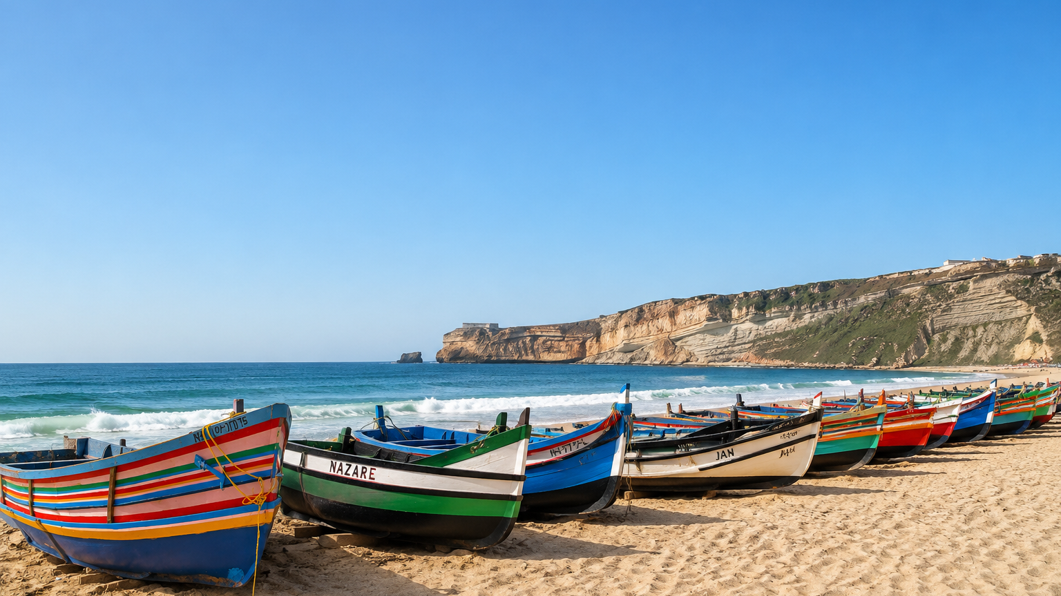
Jerusalem. Judea. Samaria.
The ends of the earth.

Slide 18
It's time to act.

Slide 19
Response and prayer
“Lord, I am hungry for more.
Fill me and use me for Your Purpose.”

