Slide 1
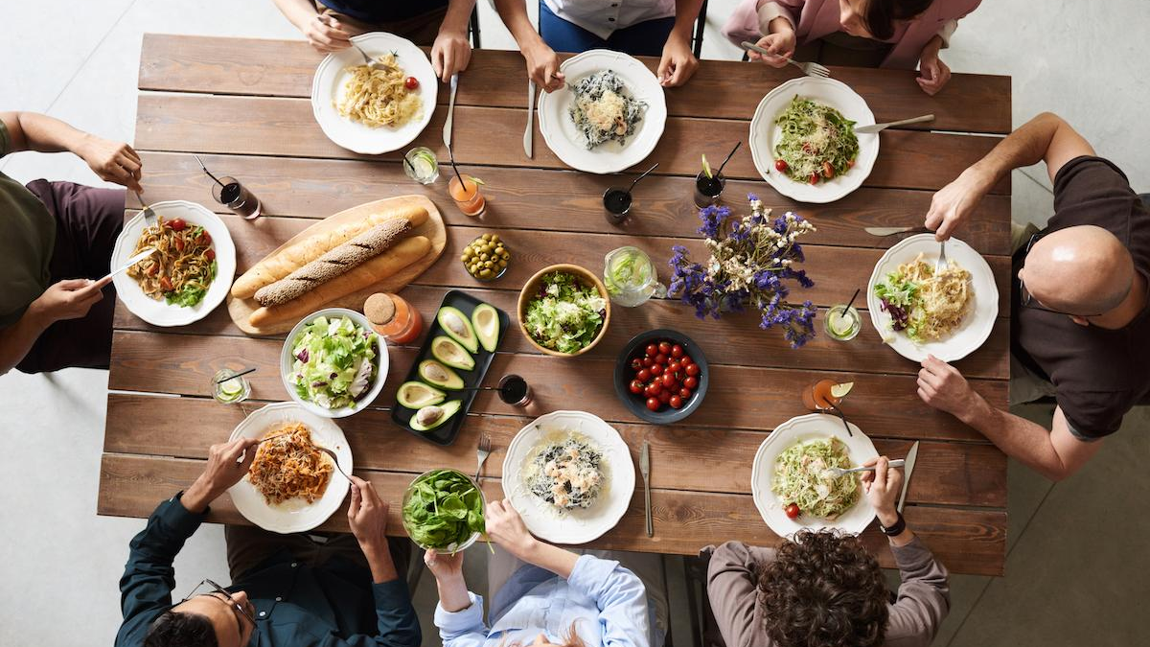
Community
God’s Family – As Defined by Jesus

Slide 2

Recap from last week
Community began as God’s design
Community and relationships are fractured by sin
God forms a covenant people - designed to reflect God to the world
Wisdom from proverbs: Choosing friends wisely & seeking good counsel from others

Slide 3

Jesus’ family
Luke 2:49-50
But why did you need to search? He asked. “Didn’t you know that I must be in my Fathers house”. But they didn’t understand what He meant.

Slide 4
Jesus’ family
Luke 1:32-33 NLT
[32] He will be very great and will be called the Son of the Most High. The Lord God will give him the throne of his ancestor David. [33] And he will reign over Israel forever; his Kingdom will never end!”
Matthew 1:21 NLT
[21] And she will have a son, and you are to name him Jesus, for he will save his people from their sins.”

Slide 5
Jesus’ family
Mark 3:20-22 NLT
[20] One time Jesus entered a house, and the crowds began to gather again. Soon he and his disciples couldn’t even find time to eat. [21] When his family heard what was happening, they tried to take him away. “He’s out of his mind,” they said. [22] But the teachers of religious law who had arrived from Jerusalem said, “He’s possessed by Satan, the prince of demons. That’s where he gets the power to cast out demons.”

Slide 6
Jesus’ family
Mark 3:31-35 NLT
[31] Then Jesus’ mother and brothers came to see him. They stood outside and sent word for him to come out and talk with them. [32] There was a crowd sitting around Jesus, and someone said, “Your mother and your brothers are outside asking for you.” [33] Jesus replied, “Who is my mother? Who are my brothers?” [34] Then he looked at those around him and said, “Look, these are my mother and brothers. [35] Anyone who does God’s will is my brother and sister and mother.”

Slide 7
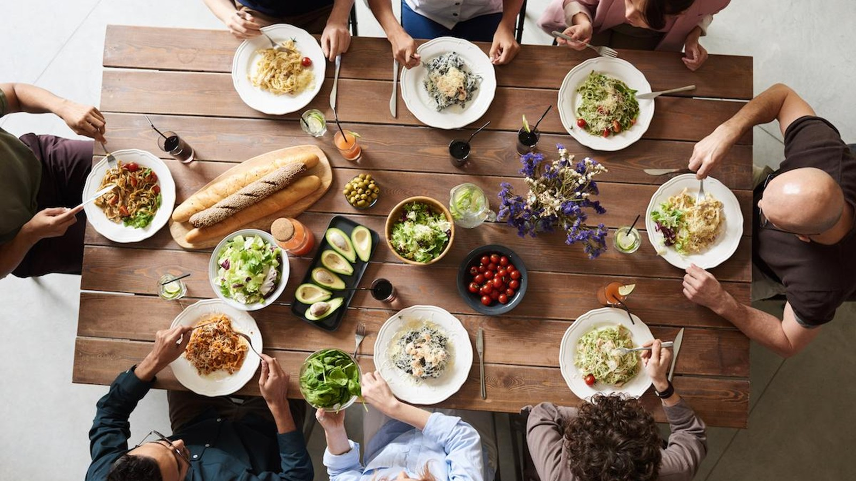
To Whom is the table opened?
Mark 2:14 NLT
[14] As he walked along, he saw Levi son of Alphaeus sitting at his tax collector’s booth. “Follow me and be my disciple,” Jesus said to him. So Levi got up and followed him.

Slide 8
To Whom is the table opened?
Luke 5:29-32 NLT
[29] Later, Levi held a banquet in his home with Jesus as the guest of honor. Many of Levi’s fellow tax collectors and other guests also ate with them. [30] But the Pharisees and their teachers of religious law complained bitterly to Jesus’ disciples, “Why do you eat and drink with such scum?” [31] Jesus answered them, “Healthy people don’t need a doctor—sick people do. [32] I have come to call not those who think they are righteous, but those who know they are sinners and need to repent.”

Slide 9
To Whom is the table opened?
Luke 7:36-39, 50 NLT
[36] One of the Pharisees asked Jesus to have dinner with him, so Jesus went to his home and sat down to eat. [37] When a certain immoral woman from that city heard he was eating there, she brought a beautiful alabaster jar filled with expensive perfume. [38] Then she knelt behind him at his feet, weeping. Her tears fell on his feet, and she wiped them off with her hair. Then she kept kissing his feet and putting perfume on them. [39] When the Pharisee who had invited him saw this, he said to himself, “If this man were a prophet, he would know what kind of woman is touching him. She’s a sinner!”..... [50] And Jesus said to the woman, “Your faith has saved you; go in peace.”

Slide 10
To Whom is the table opened?
Mark 10:21-22 NLT
[21] Looking at the man, Jesus felt genuine love for him. “There is still one thing you haven’t done,” he told him. “Go and sell all your possessions and give the money to the poor, and you will have treasure in heaven. Then come, follow me.” [22] At this the man’s face fell, and he went away sad, for he had many possessions.

Slide 11
To Whom is the table opened?
Matthew 23:17-18 NLT
Blind guides! What sorrow awaits you! For you say that it means nothing to swear ‘by God’s Temple,’ but that it is binding to swear ‘by the gold in the Temple.’ Blind fools! Which is more important—the gold or the Temple that makes the gold sacred?

Slide 12
To Whom is the table opened?
Matthew 23:25-26 NLT
[25] “What sorrow awaits you teachers of religious law and you Pharisees. Hypocrites! For you are so careful to clean the outside of the cup and the dish, but inside you are filthy—full of greed and self-indulgence! [26] You blind Pharisee! First wash the inside of the cup and the dish, and then the outside will become clean, too.

Slide 13

The character of community
John 13:34-35 NIV
[34] “A new command I give you: Love one another. As I have loved you, so you must love one another. [35] By this everyone will know that you are my disciples, if you love one another.”

Slide 14
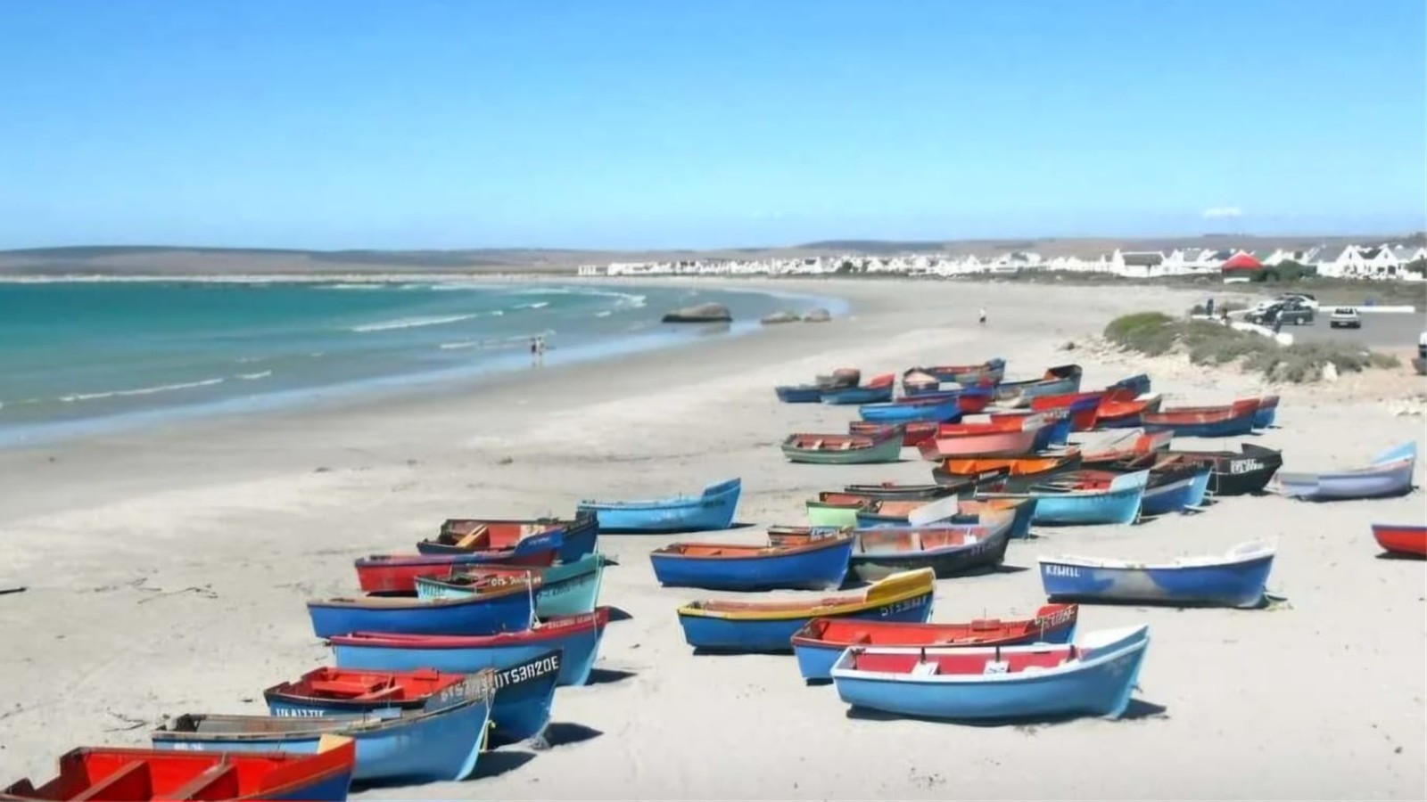
The calling of community
Mark 1:17 NLT
[17] Jesus called out to them, “Come, follow me, and I will show you how to fish for people!”
Mark 1:17 NLT
[17] Jesus called out to them, “Come, follow me, and I will show you how to fish for people!”

Slide 15
Community
Let’s step deeper into community in the week ahead!

