Slide 1
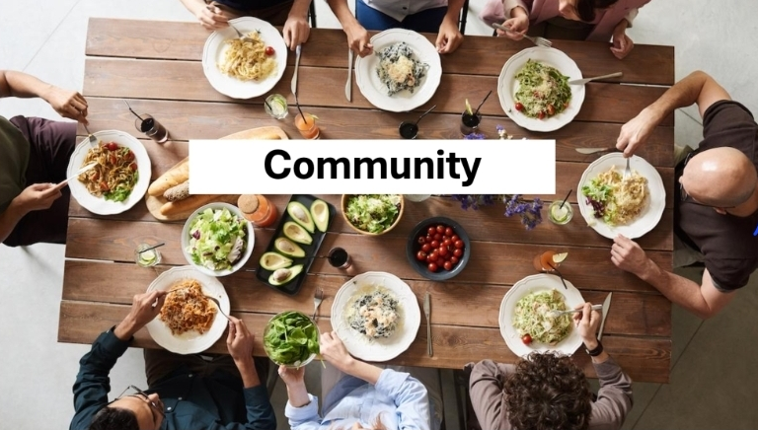
Community 3
God’s design for Shepherding

Slide 2
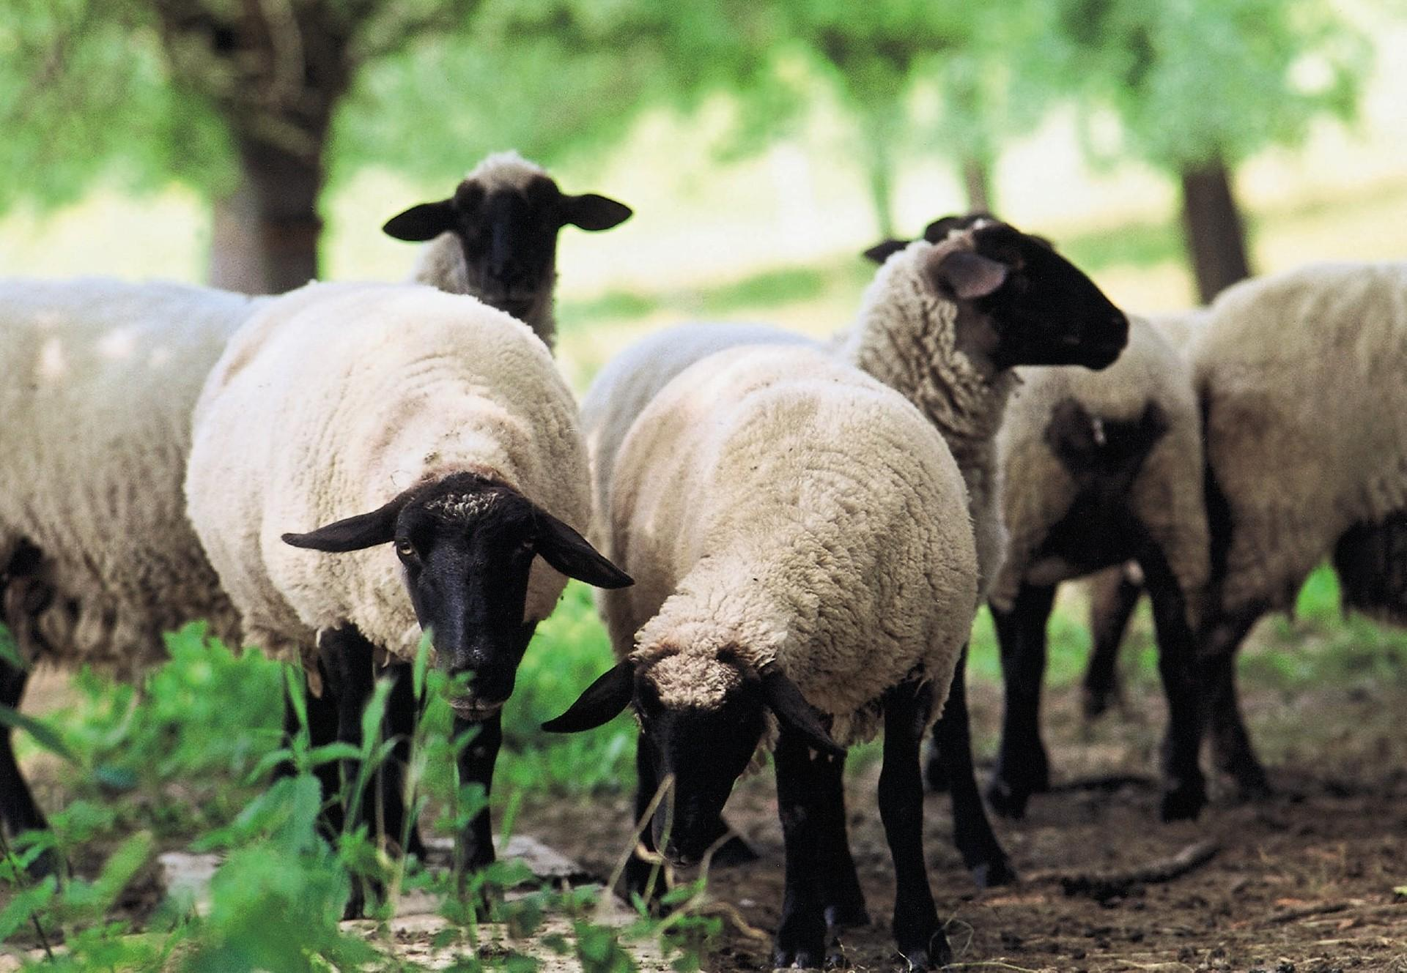

Slide 3
Own shepherding

Slide 4
Own shepherding
Over shepherding
……………………………………………………..

Slide 5
X
X
Own shepherding
Over shepherding
……………………………………………………..

Slide 6
How does God want you to be shepherded as His sheep?

Slide 7
How does God want you to be shepherded as His sheep?
By Jesus Himself
The “Great Shepherd of the sheep” Heb 13: 21

Slide 8
How does God want you to be shepherded as His sheep?
By Jesus Himself
The “Great Shepherd of the sheep” Heb 13: 21
2. By other members of the body of Christ
“Encourage one another …” Heb 3:13

Slide 9
How does God want you to be shepherded as His sheep?
By Jesus Himself
The “Great Shepherd of the sheep” Heb 13: 21
2. By other members of the body of Christ
“Encourage one another …” Heb 3:13
By Christians leaders God has raised up in
the local church Heb 13:17

Slide 10
Hebrews 13:17
17 “Obey your leaders and submit to them, for they are keeping watch over your souls, as those who will have to give an account. Let them do this with joy and not with groaning, for that would be of no advantage to you.”

Slide 11
Hebrews 13:17
“Obey your leaders and submit to them, for they are keeping watch over your souls, as those who will have to give an account. Let them do this with joy and not with groaning, for that would be of no advantage to you.”
Psalm 1:1
1 “Blessed is the man who walks not in the counsel of the wicked ….”

