Slide 1
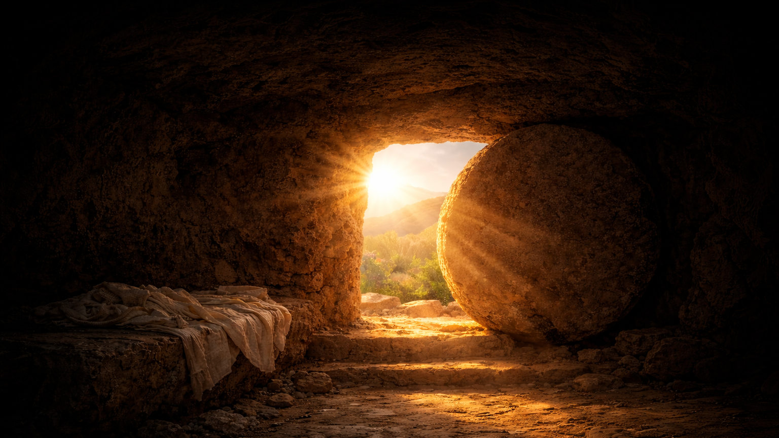
LUKE ~ SEASON 3
Fulfilled
24:13–35

Slide 2
How can we see Jesus?

Slide 3
Luke 24:16
. . . their eyes were kept from recognizing him.

Slide 4
What prevents us from seeing Jesus?

Slide 5
Luke 24:21
But we had hoped that he was the one to redeem Israel.

Slide 6
Luke 2:68ff
Blessed be the Lord God of Israel,
for he has visited and redeemed his people . . .
that we should be saved from our enemies
and from the hand of all who hate us;
that we, being delivered from the hand of our enemies,
might serve him without fear,
in holiness and righteousness before him all our days.

Slide 7
What prevents us from seeing Jesus?

Slide 8
How can we see Jesus?

Slide 9
Luke 24:25–27
And he said to them, “O foolish ones, and slow of heart to believe all that the prophets have spoken! Was it not necessary that the Christ should suffer these things and enter into his glory?” And beginning with Moses and all the Prophets, he interpreted to them in all the Scriptures the things concerning himself.

Slide 10
Luke 24:30–35
When he was at table with them, he took the bread and blessed and broke it and gave it to them. And their eyes were opened, and they recognized him. And he vanished from their sight. They said to each other, “Did not our hearts burn within us while he talked to us on the road, while he opened to us the Scriptures?” And they rose that same hour and returned to Jerusalem. And they found the eleven and those who were with them gathered together, saying, “The Lord has risen indeed, and has appeared to Simon!” Then they told what had happened on the road, and how he was known to them in the breaking of the bread.

Slide 11
How can we see Jesus?
Scripture & Sacrament

Slide 12
LUKE ~ SEASON 3
Fulfilled
24:13–35

