Slide 1
Not my will, but Yours, be done
Luke’s Gospel season 3

Slide 2
Luke 22:39 - 71
39And he came out and went, as was his custom, to the Mount of Olives, and the disciples followed him. 40And when he came to the place, he said to them, "Pray that you may not enter into temptation." 41And he withdrew from them about a stone 's throw, and knelt down and prayed, 42saying, "Father, if you are willing, remove this cup from me. Nevertheless, not my will, but yours, be done." 43And there appeared to him an angel from heaven, strengthening him. 44And being in agony he prayed more earnestly; and his sweat became like great drops of blood falling down to the ground. 45And when he rose from prayer, he came to the disciples and found them sleeping for sorrow, 46and he said to them, "Why are you sleeping? Rise and pray that you may not enter into temptation."

Slide 3
Luke 22:39 - 71
47While he was still speaking, there came a crowd, and the man called Judas, one of the twelve, was leading them. He drew near to Jesus to kiss him, 48but Jesus said to him, "Judas, would you betray the Son of Man with a kiss?" 49And when those who were around him saw what would follow, they said, "Lord, shall we strike with the sword?" 50And one of them struck the servant of the high priest and cut off his right ear. 51But Jesus said, "No more of this!" And he touched his ear and healed him. 52Then Jesus said to the chief priests and officers of the temple and elders, who had come out against him, "Have you come out as against a robber, with swords and clubs? 53When I was with you day after day in the temple, you did not lay hands on me. But this is your hour, and the power of darkness."

Slide 4
Luke 22:39 - 71
54Then they seized him and led him away, bringing him into the high priest 's house, and Peter was following at a distance. 55And when they had kindled a fire in the middle of the courtyard and sat down together, Peter sat down among them. 56Then a servant girl, seeing him as he sat in the light and looking closely at him, said, "This man also was with him." 57But he denied it, saying, "Woman, I do not know him." 58And a little later someone else saw him and said, "You also are one of them." But Peter said, "Man, I am not." 59And after an interval of about an hour still another insisted, saying, "Certainly this man also was with him, for he too is a Galilean." 60But Peter said, "Man, I do not know what you are talking about." And immediately, while he was still speaking, the rooster crowed. 61And the Lord turned and looked at Peter. And Peter remembered the saying of the Lord, how he had said to him, "Before the rooster crows today, you will deny me three times." 62And he went out and wept bitterly.

Slide 5
Luke 22:39 - 71
63Now the men who were holding Jesus in custody were mocking him as they beat him. 64They also blindfolded him and kept asking him, "Prophesy! Who is it that struck you?" 65And they said many other things against him, blaspheming him.
66When day came, the assembly of the elders of the people gathered together, both chief priests and scribes. And they led him away to their council, and they said, 67"If you are the Christ, tell us." But he said to them, "If I tell you, you will not believe, 68and if I ask you, you will not answer. 69But from now on the Son of Man shall be seated at the right hand of the power of God." 70So they all said, "Are you the Son of God, then?" And he said to them, "You say that I am." 71Then they said, "What further testimony do we need? We have heard it ourselves from his own lips."

Slide 6
Context
Chiasm – a literary device that mirrors acts in a way that points to an inflection point.
Inflection point – a moment or incident that changes the course of history and which requires an action or decision to be made.
Inflection points can be high points, but most often they are moments of deep unsettling crisis.

Slide 7
Inflection point of Temptation under Trial
Jesus warns his disciples of an impending inflection point / crisis:
22:31"Simon, Simon, behold, Satan demanded to have you, that he might sift you like wheat, 32but I have prayed for you that your faith may not fail. And when you have turned again, strengthen your brothers."
Again Jesus warns them in Gethsemene
22:40 and 46 "Pray that you may not enter into temptation.”
I pray that you do not succumb to the pressure that trials bring. and fall away = to succumb to the urge to do things your way or turn your back on God.

Slide 8
The decision when sifted
“The most important theme in this inflection point is this - whether we accept the new covenant and our place in God's kingdom.
In other words, do we reject Jesus' authority (Luke 20), reject His servanthood example, betray Him, and use Him for our own gain? Or do we accept Jesus' authority and servanthood example, emulate His servant-leadership, and fulfill the needs of others?”
(www.bibleref.com)

Slide 9









Expectation vs reality
Expectation
Gap
Reality

Slide 10
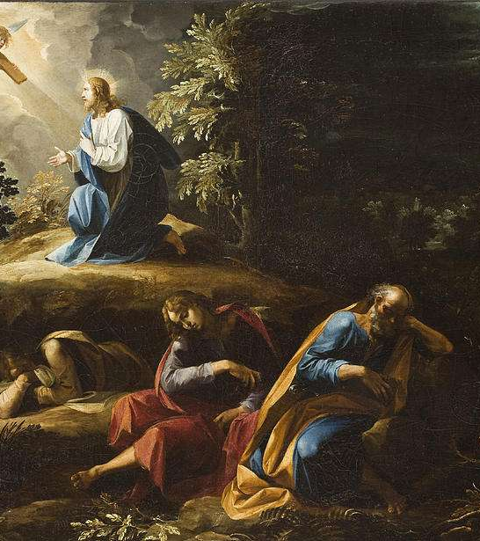
Not your will but mine be done succumbing to pressure under trial

Slide 11
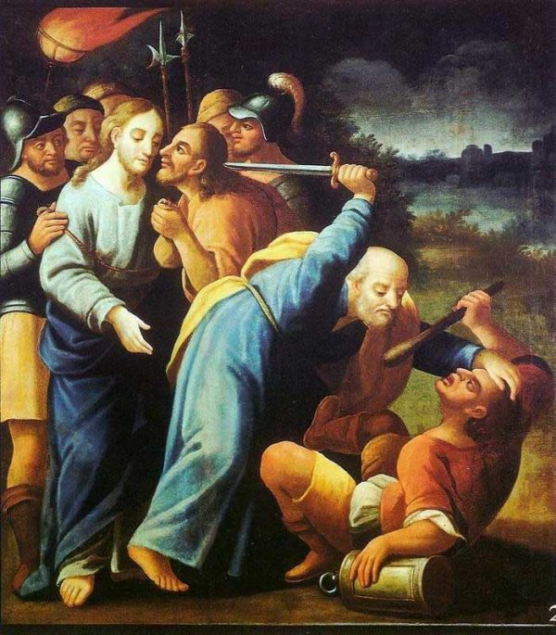
Temptation 1: Fight
22:47While he was still speaking, there came a crowd, and the man called Judas, one of the twelve, was leading them. said to him, "Judas, would you betray the Son of Man with a kiss?" 49And when those who were around him saw what would follow, they said, "Lord, shall we strike with the sword?" 50And one of them struck the servant of the high priest and cut off He drew near to Jesus to kiss him, 48but Jesus his right ear.

Slide 12
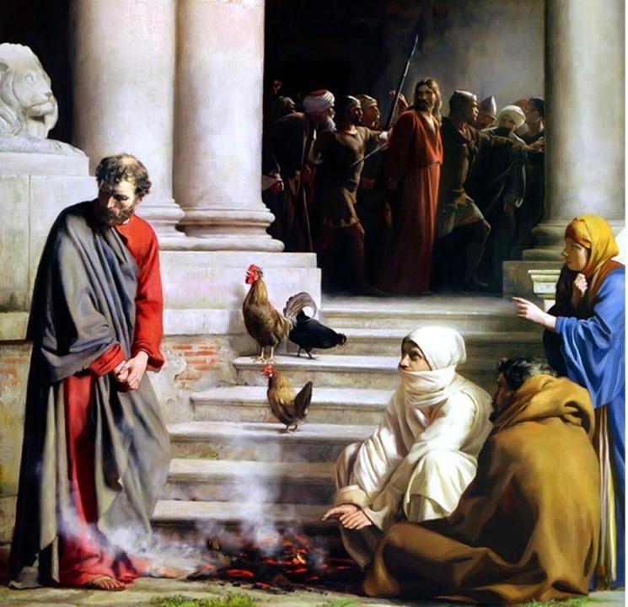
Temptation 2: Flight
Luke 22:59And after an interval of about an hour still another insisted, saying, "Certainly this man also was with him, for he too is a Galilean." 60But Peter said, "Man, I do not know what you are talking about." And immediately, while he was still speaking, the rooster crowed. 61And the Lord turned and looked at Peter. And Peter remembered the saying of the Lord, how he had said to him, "Before the rooster crows today, you will deny me three times." 62And he went out and wept bitterly.

Slide 13
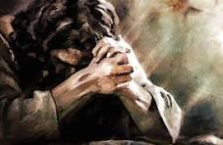
Not my will but yours be done

Slide 14
Following Jesus’ example
Pray
Absorb
Stand

Slide 15
Romans 8:31 – 39: If God is for us
31What then shall we say to these things? If God is for us, who can be against us? 32He who did not spare his own Son but gave him up for us all, how will he not also with him graciously give us all things? 33Who shall bring any charge against God 's elect? It is God who justifies. 34Who is to condemn? Christ Jesus is the one who died — more than that, who was raised — who is at the right hand of God, who indeed is interceding for us. 35Who shall separate us from the love of Christ? Shall tribulation, or distress, or persecution, or famine, or nakedness, or danger, or sword?
36As it is written, "For your sake we are being killed all the day long; we are regarded as sheep to be slaughtered."
37No, in all these things we are more than conquerors through him who loved us. 38For I am sure that neither death nor life, nor angels nor rulers, nor things present nor things to come, nor powers, 39nor height nor depth, nor anything else in all creation, will be able to separate us from the love of God in Christ Jesus our Lord.

