Slide 1
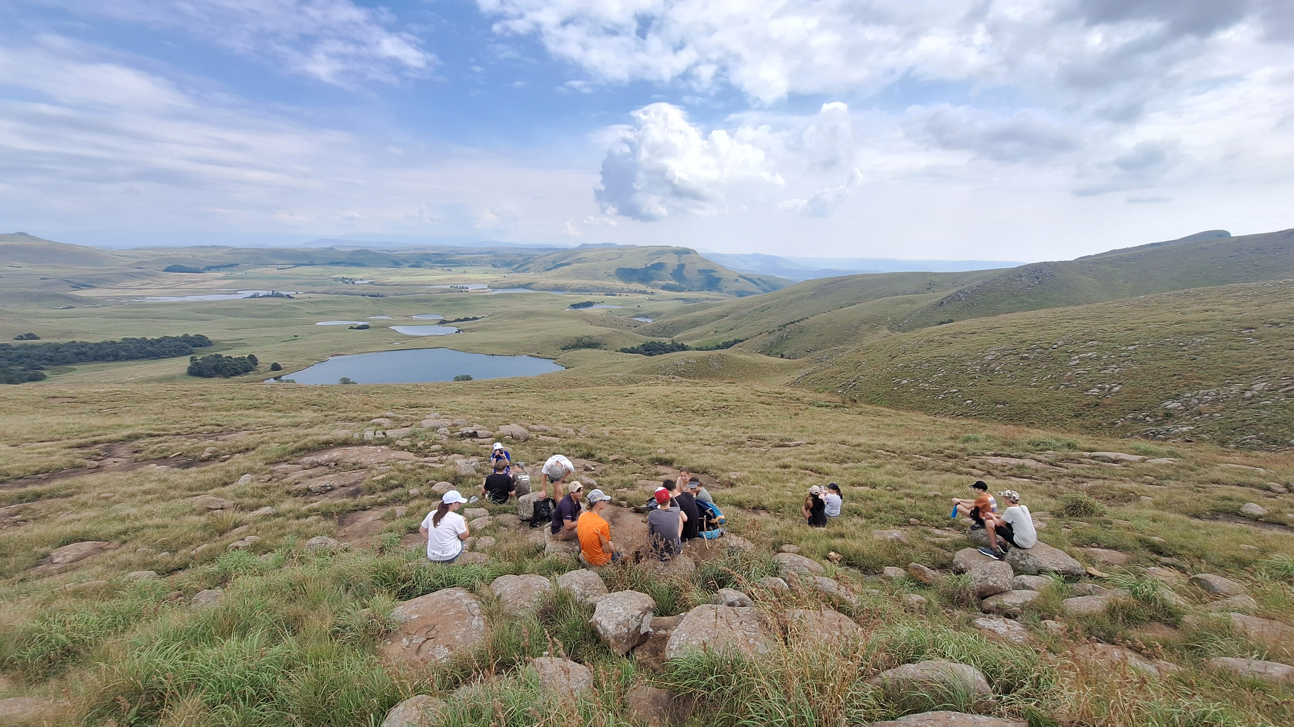
Pause Sunday:
How is your journey?

Slide 2
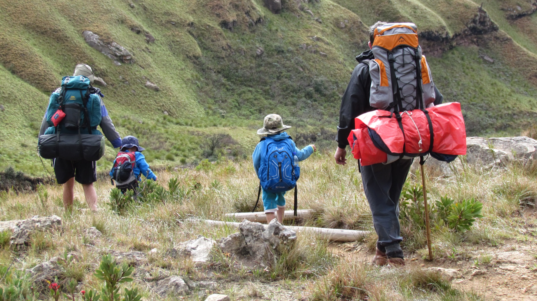
1 Thessalonians 2:11-12 AMP
[11] For you know how we were exhorting and encouraging and imploring each one of you just as a father does [in dealing with] his own children, [guiding you] [12] to live lives [of honor, moral courage, and personal integrity] worthy of the God who [saves you and] calls you into His own kingdom and glory.

Slide 3
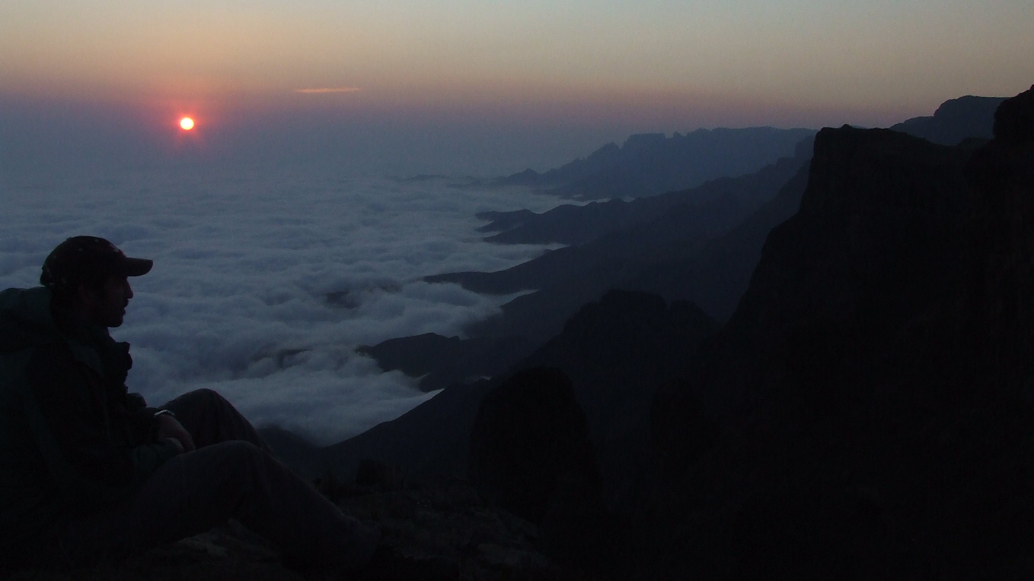
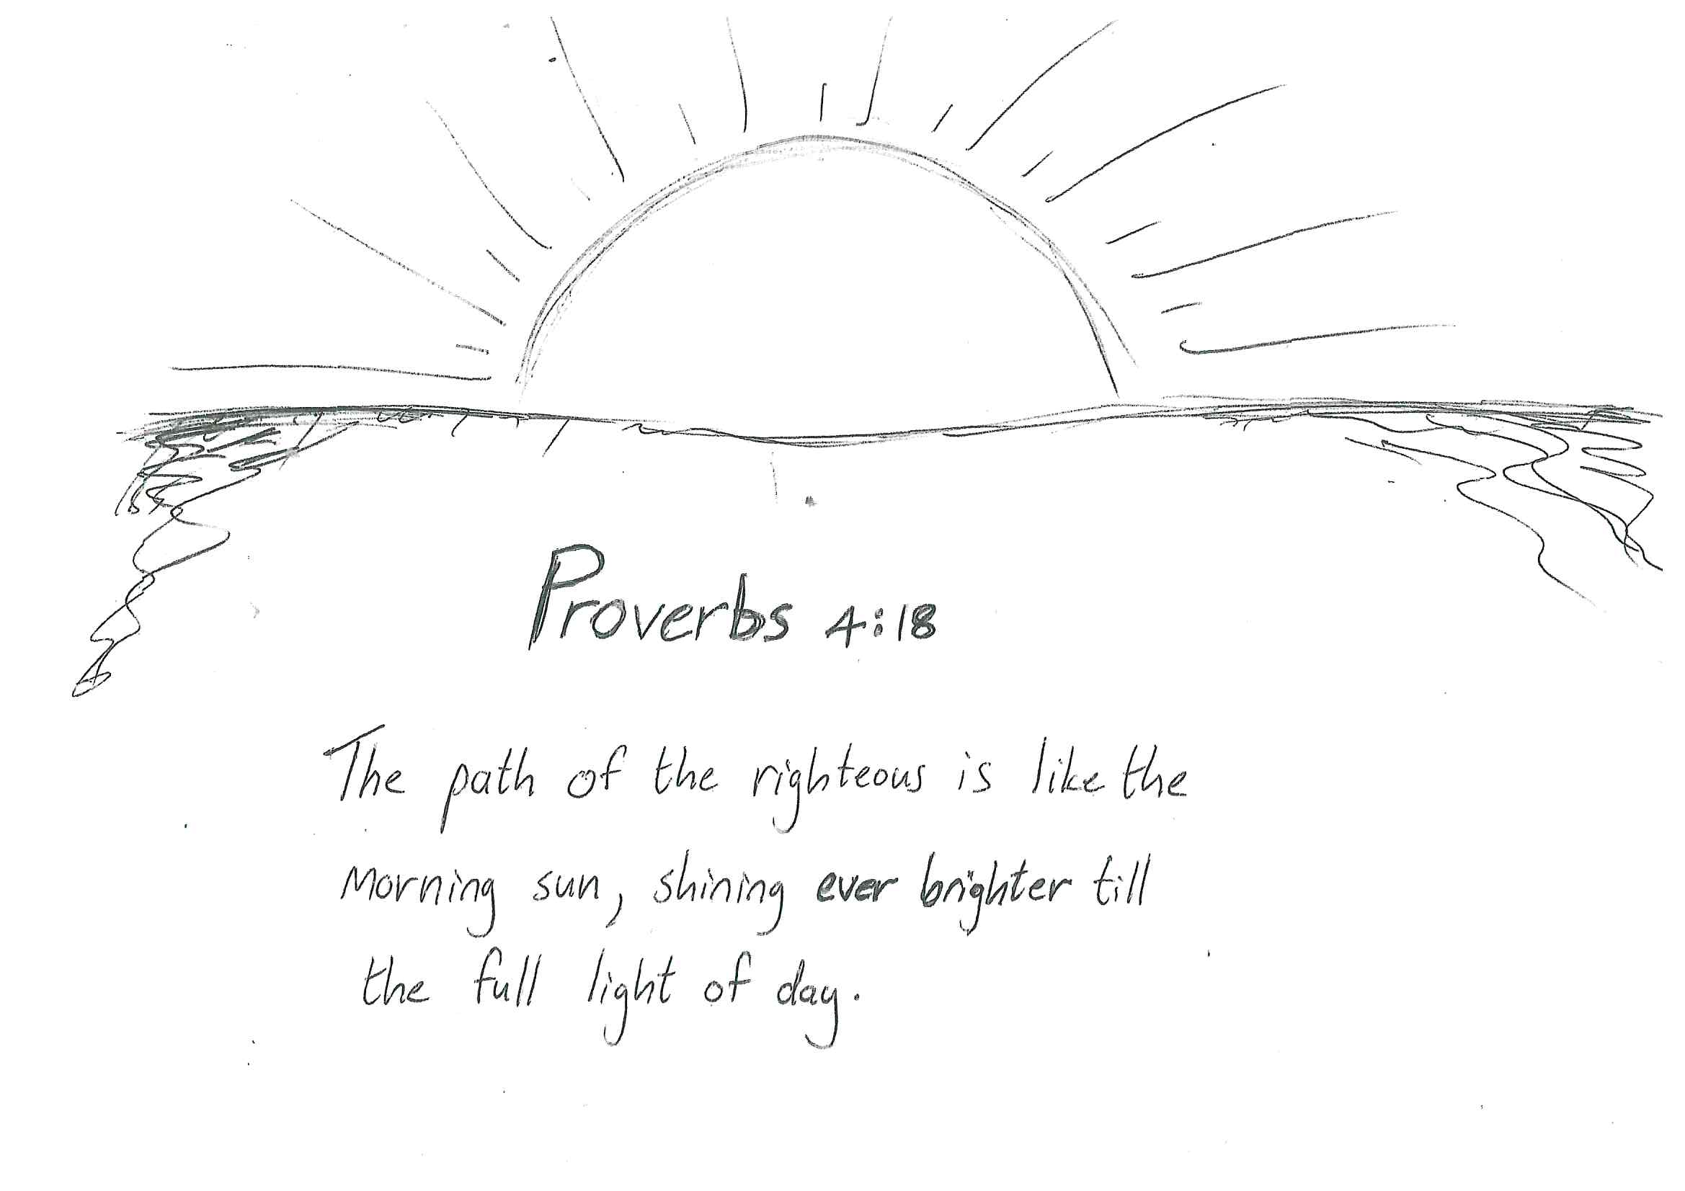

Slide 4
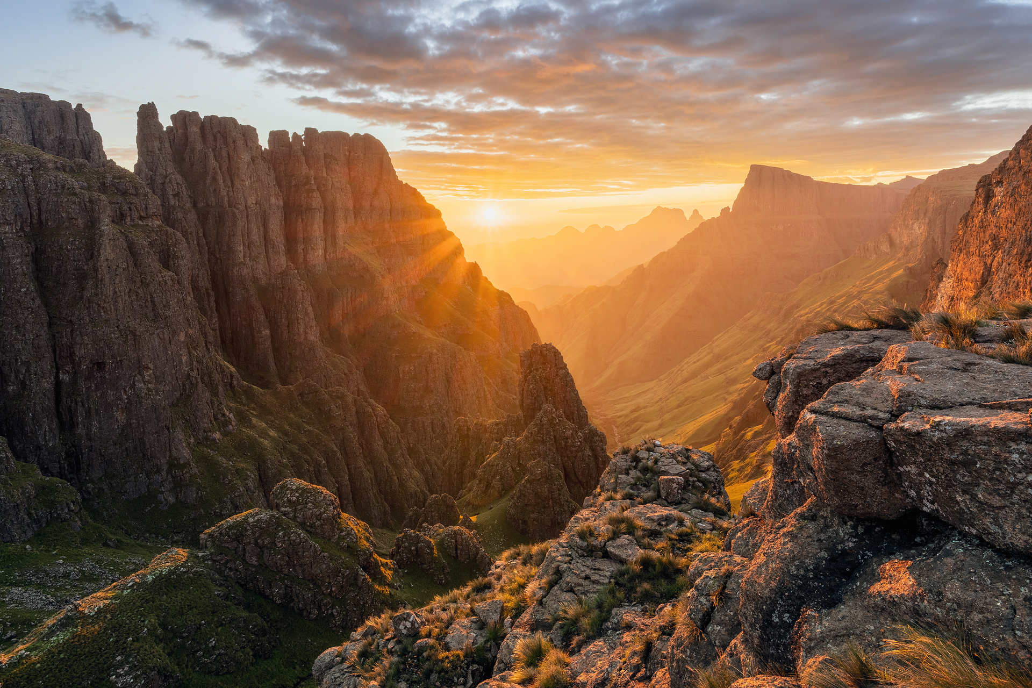


Slide 5
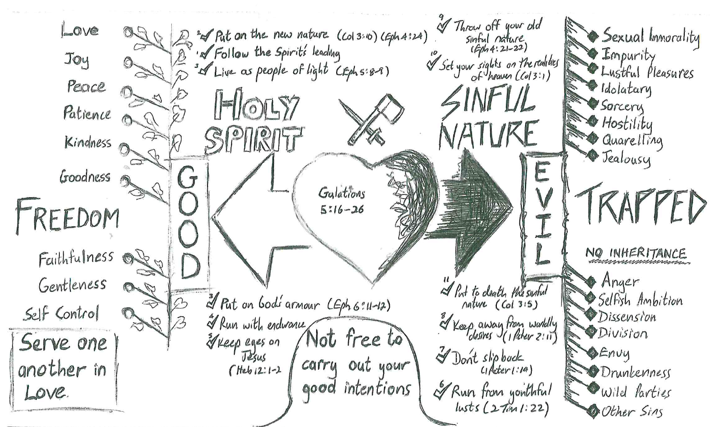

Slide 10
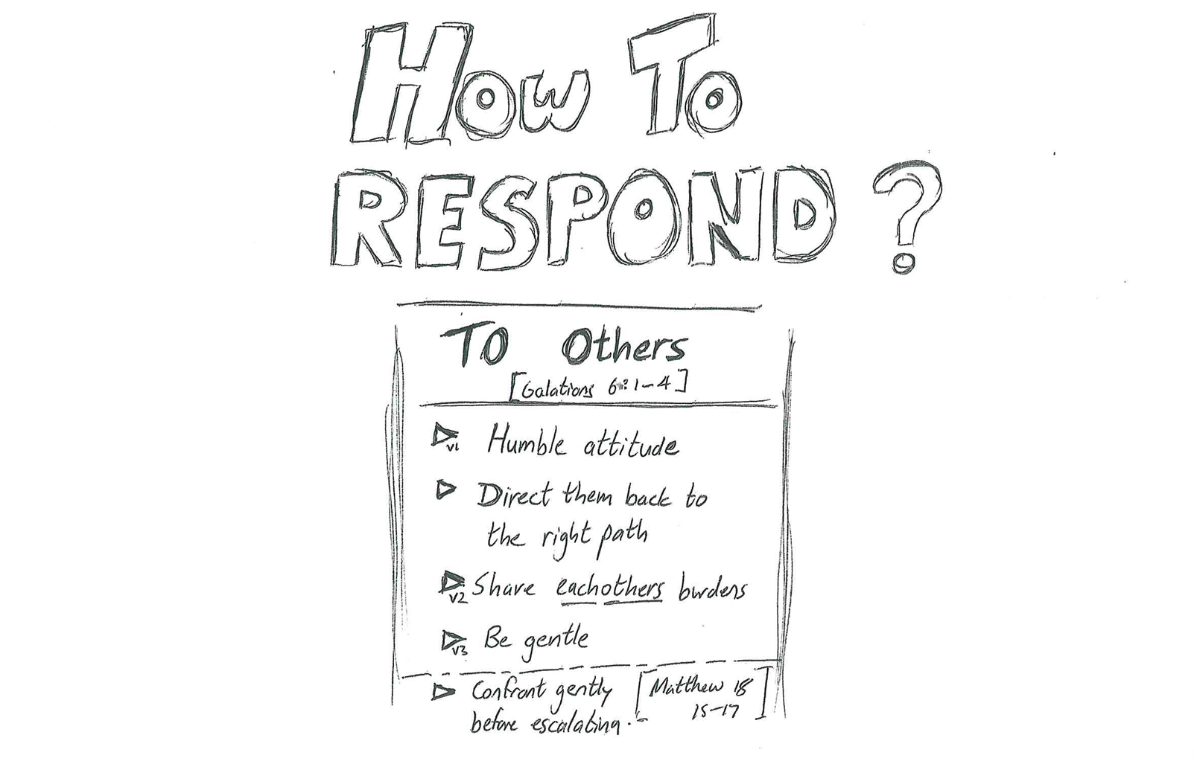

Slide 11
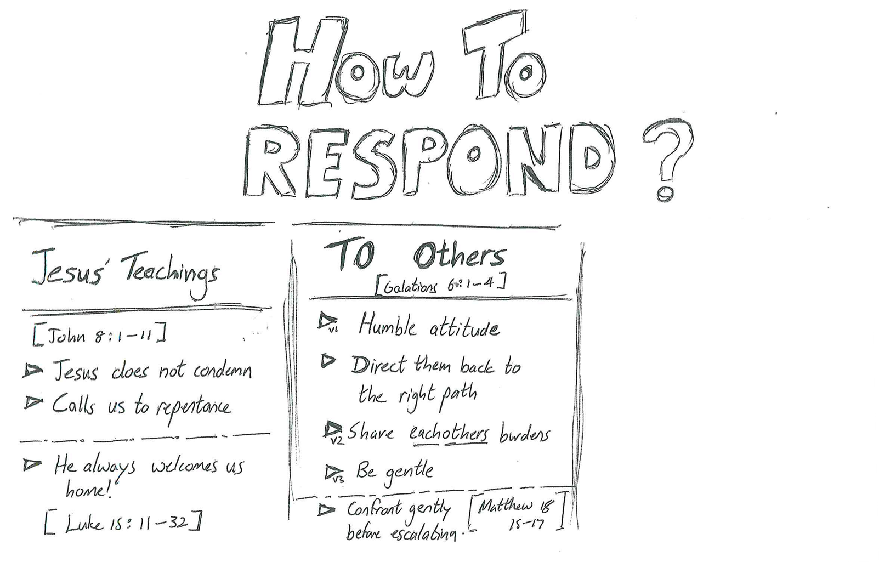

Slide 12
