Slide 1
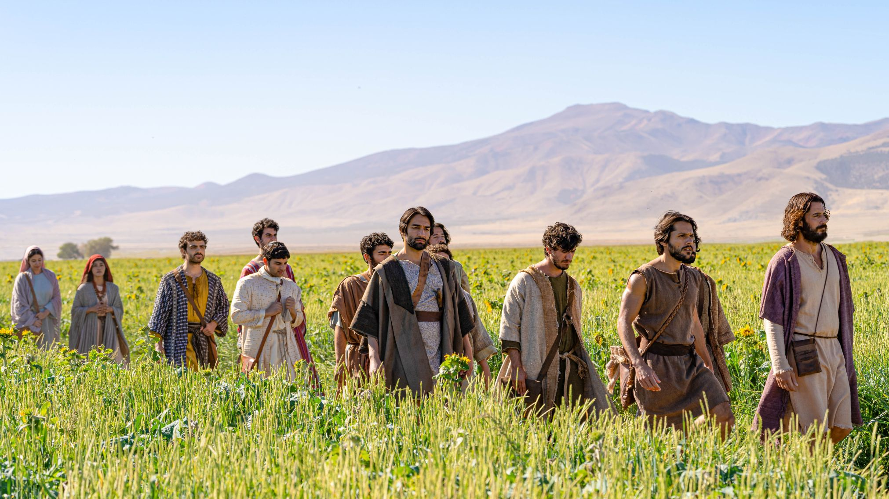
LUKE ~ SEASON 2
17:20–37
Journeying with Jesus

Slide 2
Luke 17:20–21
²⁰ Being asked by the Pharisees when the kingdom of God would come, he answered them, “The kingdom of God is not coming in ways that can be observed, ²¹ nor will they say, ‘Look, here it is!’ or ‘There!’ for behold, the kingdom of God is . . .

Slide 3
Luke 17:20–21
²⁰ Being asked by the Pharisees when the kingdom of God would come, he answered them, “The kingdom of God is not coming in ways that can be observed, ²¹ nor will they say, ‘Look, here it is!’ or ‘There!’ for behold, the kingdom of God is . . .
. . . within you?

Slide 4
Luke 17:20–21
²⁰ Being asked by the Pharisees when the kingdom of God would come, he answered them, “The kingdom of God is not coming in ways that can be observed, ²¹ nor will they say, ‘Look, here it is!’ or ‘There!’ for behold, the kingdom of God is . . .
. . . within you?
. . . in your midst, among you?

Slide 5
Luke 17:20–21
²⁰ Being asked by the Pharisees when the kingdom of God would come, he answered them, “The kingdom of God is not coming in ways that can be observed, ²¹ nor will they say, ‘Look, here it is!’ or ‘There!’ for behold, the kingdom of God is . . .
. . . within you?
. . . in your midst, among you?
. . . within your grasp?

Slide 6
Luke 17:20–21
²⁰ Being asked by the Pharisees when the kingdom of God would come, he answered them, “The kingdom of God is not coming in ways that can be observed, ²¹ nor will they say, ‘Look, here it is!’ or ‘There!’ for behold,
the kingdom of God is within your grasp!

Slide 7
Luke 17:22–37
²² And he said to the disciples, “The days are coming when you will desire to see one of the days of the Son of Man, and you will not see it. ²³ And they will say to you, ‘Look, there!’ or ‘Look, here!’ Do not go out or follow them. ²⁴ For as the lightning flashes and lights up the sky from one side to the other, so will the Son of Man be in his day. ²⁵ But first he must suffer many things and be rejected by this generation. ²⁶ Just as it was in the days of Noah, so will it be in the days of the Son of Man. ²⁷ They were eating and drinking and marrying and being given in marriage, until the day when Noah entered the ark, and the flood came and destroyed them all. ²⁸ Likewise, just as it was in the days of Lot—they were eating and drinking, buying and selling, planting and building, ²⁹ but on the day when Lot went out from Sodom, fire and sulfur rained from heaven and destroyed them all— ³⁰ so will it be on the day when the Son of Man is revealed. ³¹ On that day, let the one who is on the housetop, with his goods in the house, not come down to take them away, and likewise let the one who is in the field not turn back. ³² Remember Lot’s wife. ³³ Whoever seeks to preserve his life will lose it, but whoever loses his life will keep it. ³⁴ I tell you, in that night there will be two in one bed. One will be taken and the other left. ³⁵ There will be two women grinding together. One will be taken and the other left.” ³⁷ And they said to him, “Where, Lord?” He said to them, “Where the corpse is, there the vultures will gather.”

Slide 8

Daniel 7:1–8

Slide 9
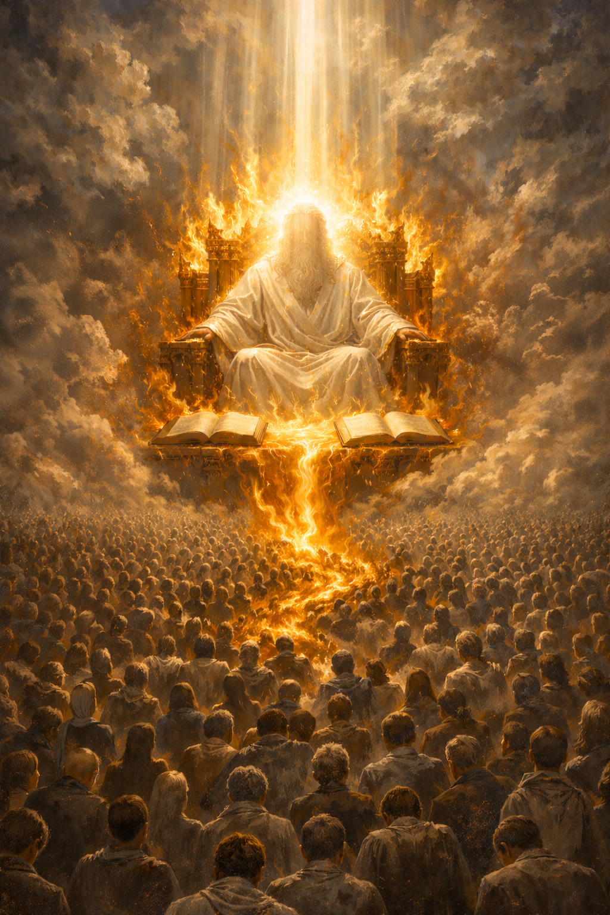
Daniel 7:9–12

Slide 10

Daniel 7:9–12

Slide 11
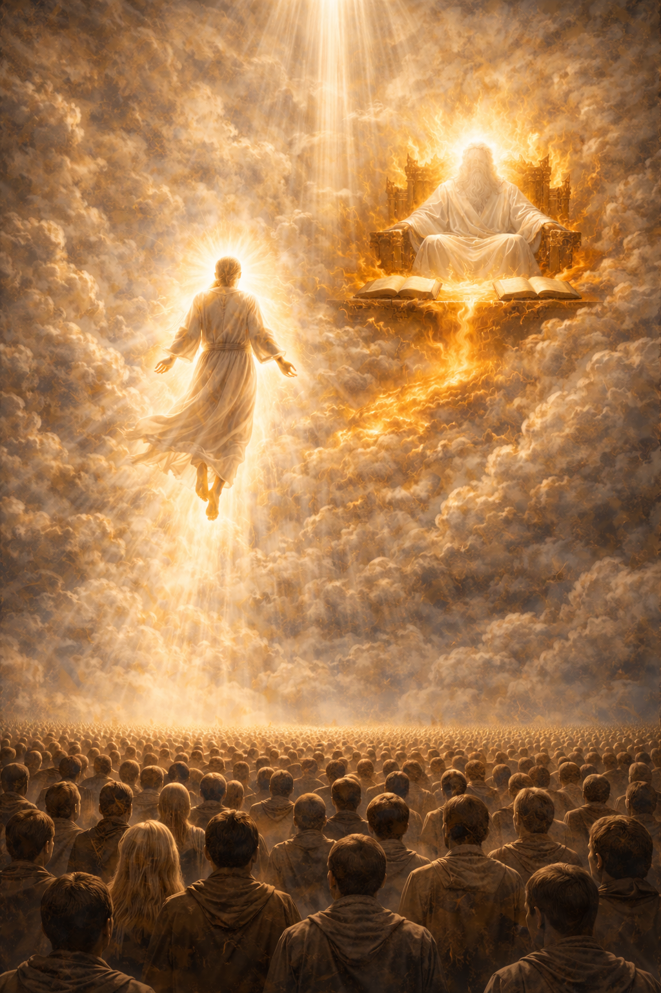
Daniel 7:13–14

Slide 12
Daniel 7:13–14
¹³ “I saw in the night visions,
and behold, with the clouds of heaven
there came one like a son of man,
and he came to the Ancient of Days
and was presented before him.
¹⁴ And to him was given dominion
and glory and a kingdom,
that all peoples, nations, and languages
should serve him;
his dominion is an everlasting dominion,
which shall not pass away,
and his kingdom one
that shall not be destroyed.

Slide 13
Daniel 7:15–28

Slide 14
Luke 17:22
“The days are coming when you will desire to see one of the days of the Son of Man, and you will not see it.

Slide 15
Luke 17:23
And they will say to you, ‘Look, there!’ or ‘Look, here!’ Do not go out or follow them.

Slide 16
Luke 17:24
For as the lightning flashes and lights up the sky from one side to the other, so will the Son of Man be in his day.

Slide 17
Luke 17:25
But first he must suffer many things and be rejected by this generation.

Slide 18
Luke 17:26–30
Just as it was in the days of Noah, so will it be in the days of the Son of Man. They were eating and drinking and marrying and being given in marriage, until the day when Noah entered the ark, and the flood came and destroyed them all. Likewise, just as it was in the days of Lot—they were eating and drinking, buying and selling, planting and building, but on the day when Lot went out from Sodom, fire and sulfur rained from heaven and destroyed them all—so will it be on the day when the Son of Man is revealed.

Slide 19
Luke 17:31–33
On that day, let the one who is on the housetop, with his goods in the house, not come down to take them away, and likewise let the one who is in the field not turn back. Remember Lot’s wife. Whoever seeks to preserve his life will lose it, but whoever loses his life will keep it.

Slide 20
Luke 21:20–22
“When you see Jerusalem surrounded by armies, then know that its desolation has come near. Then let those who are in Judea flee to the mountains, and let those who are inside the city depart, and let not those who are out in the country enter it, for these are days of vengeance, to fulfill all that is written.”

Slide 21
Luke 17:34–35
I tell you, in that night there will be two in one bed. One will be taken and the other left. There will be two women grinding together. One will be taken and the other left.

Slide 22
Luke 17:37
And they said to him, “Where, Lord?” He said to them, “Where the corpse is, there the vultures will gather.”

Slide 23
Luke 17:37
And they said to him, “Where, Lord?” He said to them, “Where the corpse is, there the vultures will gather.”
“Vultures” = Eagles

Slide 24

Luke 17:37
And they said to him, “Where, Lord?” He said to them, “Where the corpse is, there the vultures will gather.”
“Vultures” = Eagles

Slide 25
Luke 17:20–37
The kingdom of God is within our grasp!

Slide 26
Luke 17:20–37
The kingdom of God is within our grasp . . . until it’s not.

Slide 27
LUKE ~ SEASON 2
17:20–37
Journeying with Jesus

