Slide 1
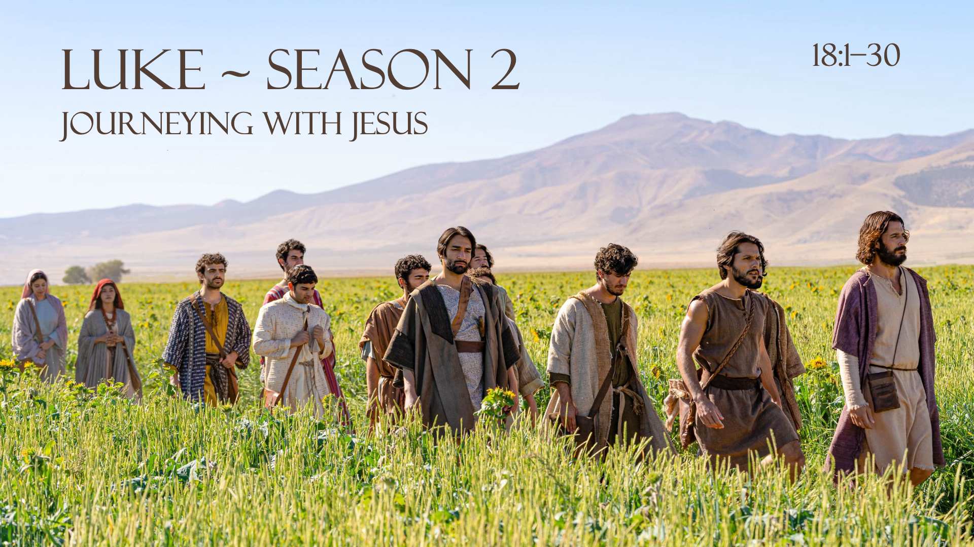

Slide 2
LUKE 18: 1-8 (ESV)
1 And he told them a parable to the effect that they ought always to pray and not lose heart. 2 He said, “In a certain city there was a judge who neither feared God nor respected man. 3 And there was a widow in that city who kept coming to him and saying, ‘Give me justice against my adversary.’ 4 For a while he refused, but afterward he said to himself, ‘Though I neither fear God nor respect man, 5 yet because this widow keeps bothering me, I will give her justice, so that she will not beat me down by her continual coming.’” 6 And the Lord said, “Hear what the unrighteous judge says. 7 And will not God give justice to his elect, who cry to him day and night? Will he delay long over them? 8 I tell you, he will give justice to them speedily. Nevertheless, when the Son of Man comes, will he find faith on earth?”

Slide 3
LUKE 18: 1-8
1 And he told them a parable to the effect that they ought always to pray and not lose heart. 2 He said, “In a certain city there was a judge who neither feared God nor respected man. 3 And there was a widow in that city who kept coming to him and saying, ‘Give me justice against my adversary.’ 4 For a while he refused, but afterward he said to himself, ‘Though I neither fear God nor respect man, 5 yet because this widow keeps bothering me, I will give her justice, so that she will not beat me down by her continual coming.’” 6 And the Lord said, “Hear what the unrighteous judge says. 7 And will not God give justice to his elect, who cry to him day and night? Will he delay long over them? 8 I tell you, he will give justice to them speedily. Nevertheless, when the Son of Man comes, will he find faith on earth?”

Slide 4
LUKE 18: 1-8
1 And he told them a parable to the effect that they ought always to pray and not lose heart. 2 He said, “In a certain city there was a judge who neither feared God nor respected man. 3 And there was a widow in that city who kept coming to him and saying, ‘Give me justice against my adversary.’ 4 For a while he refused, but afterward he said to himself, ‘Though I neither fear God nor respect man, 5 yet because this widow keeps bothering me, I will give her justice, so that she will not beat me down by her continual coming.’” 6 And the Lord said, “Hear what the unrighteous judge says. 7 And will not God give justice to his elect, who cry to him day and night? Will he delay long over them? 8 I tell you, he will give justice to them speedily. Nevertheless, when the Son of Man comes, will he find faith on earth?”

Slide 5
LUKE 18: 1-8
1 And he told them a parable to the effect that they ought always to pray and not lose heart. 2 He said, “In a certain city there was a judge who neither feared God nor respected man. 3 And there was a widow in that city who kept coming to him and saying, ‘Give me justice against my adversary.’ 4 For a while he refused, but afterward he said to himself, ‘Though I neither fear God nor respect man, 5 yet because this widow keeps bothering me, I will give her justice, so that she will not beat me down by her continual coming.’” 6 And the Lord said, “Hear what the unrighteous judge says. 7 And will not God give justice to his elect, who cry to him day and night? Will he delay long over them? 8 I tell you, he will give justice to them speedily. Nevertheless, when the Son of Man comes, will he find faith on earth?”

Slide 6
Contrast Not Comparative

Slide 7
LUKE 18: 1-8
1 And he told them a parable to the effect that they ought always to pray and not lose heart. 2 He said, “In a certain city there was a judge who neither feared God nor respected man. 3 And there was a widow in that city who kept coming to him and saying, ‘Give me justice against my adversary.’ 4 For a while he refused, but afterward he said to himself, ‘Though I neither fear God nor respect man, 5 yet because this widow keeps bothering me, I will give her justice, so that she will not beat me down by her continual coming.’” 6 And the Lord said, “Hear what the unrighteous judge says. 7 And will not God give justice to his elect, who cry to him day and night? Will he delay long over them? 8 I tell you, he will give justice to them speedily. Nevertheless, when the Son of Man comes, will he find faith on earth?”

Slide 8
Persistent
Prayer

Slide 9
Prayer Takes
Faith

Slide 10
Prayer Takes
Patience

Slide 11
Wait for the LORD; be strong, and let your heart take courage; wait for the LORD!
Psalm 27:14

Slide 12
But as for me, I will look to the LORD; I will wait for the God of my salvation; my God will hear me
Micah 7:7

Slide 13
Prayer is surrender, surrender to the will of God and cooperation with that will. If I throw out a boathook from the boat and catch hold of the shore and pull, do I pull the shore to me, or do I pull myself to the shore? Prayer is not pulling God to my will, but the aligning of my will to the will of God.
- E. Stanley Jones

Slide 14
LUKE 18: 9-14
9 He also told this parable to some who trusted in themselves that they were righteous, and treated others with contempt: 10 “Two men went up into the temple to pray, one a Pharisee and the other a tax collector. 11 The Pharisee, standing by himself, prayed[a] thus: ‘God, I thank you that I am not like other men, extortioners, unjust, adulterers, or even like this tax collector. 12 I fast twice a week; I give tithes of all that I get.’ 13 But the tax collector, standing far off, would not even lift up his eyes to heaven, but beat his breast, saying, ‘God, be merciful to me, a sinner!’ 14 I tell you, this man went down to his house justified, rather than the other. For everyone who exalts himself will be humbled, but the one who humbles himself will be exalted.”

Slide 15
LUKE 18: 9-14
9 He also told this parable to some who trusted in themselves that they were righteous, and treated others with contempt: 10 “Two men went up into the temple to pray, one a Pharisee and the other a tax collector. 11 The Pharisee, standing by himself, prayed[a] thus: ‘God, I thank you that I am not like other men, extortioners, unjust, adulterers, or even like this tax collector. 12 I fast twice a week; I give tithes of all that I get.’ 13 But the tax collector, standing far off, would not even lift up his eyes to heaven, but beat his breast, saying, ‘God, be merciful to me, a sinner!’ 14 I tell you, this man went down to his house justified, rather than the other. For everyone who exalts himself will be humbled, but the one who humbles himself will be exalted.”

Slide 16
LUKE 18: 9-14
9 He also told this parable to some who trusted in themselves that they were righteous, and treated others with contempt: 10 “Two men went up into the temple to pray, one a Pharisee and the other a tax collector. 11 The Pharisee, standing by himself, prayed thus: ‘God, I thank you that I am not like other men, extortioners, unjust, adulterers, or even like this tax collector. 12 I fast twice a week; I give tithes of all that I get.’ 13 But the tax collector, standing far off, would not even lift up his eyes to heaven, but beat his breast, saying, ‘God, be merciful to me, a sinner!’ 14 I tell you, this man went down to his house justified, rather than the other. For everyone who exalts himself will be humbled, but the one who humbles himself will be exalted.”

Slide 17
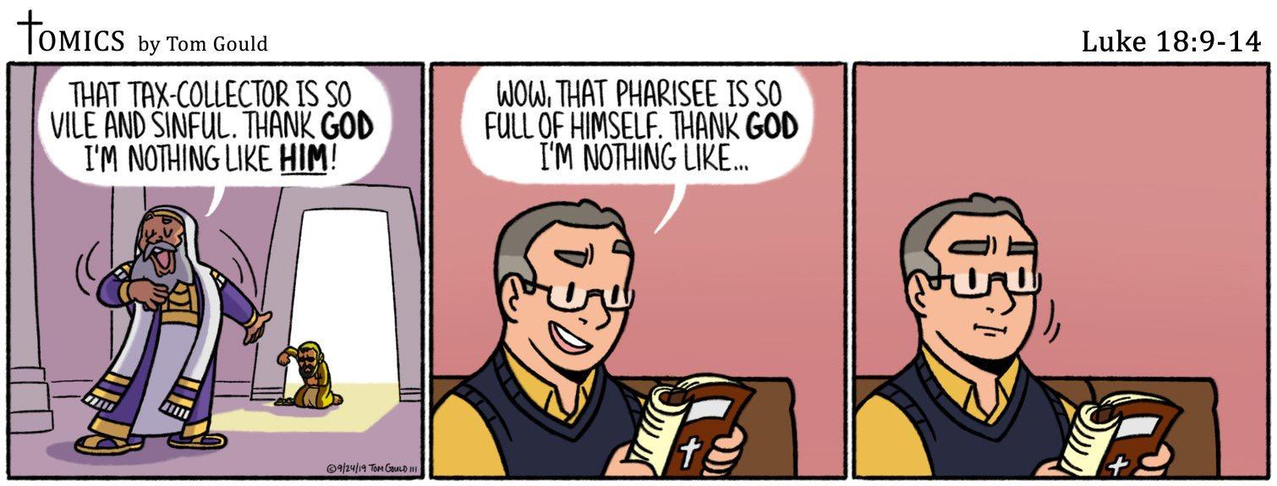

Slide 18
LUKE 18: 9-14
9 He also told this parable to some who trusted in themselves that they were righteous, and treated others with contempt: 10 “Two men went up into the temple to pray, one a Pharisee and the other a tax collector. 11 The Pharisee, standing by himself, prayed[a] thus: ‘God, I thank you that I am not like other men, extortioners, unjust, adulterers, or even like this tax collector. 12 I fast twice a week; I give tithes of all that I get.’ 13 But the tax collector, standing far off, would not even lift up his eyes to heaven, but beat his breast, saying, ‘God, be merciful to me, a sinner!’ 14 I tell you, this man went down to his house justified, rather than the other. For everyone who exalts himself will be humbled, but the one who humbles himself will be exalted.”

Slide 19
LUKE 18: 9-14
9 He also told this parable to some who trusted in themselves that they were righteous, and treated others with contempt: 10 “Two men went up into the temple to pray, one a Pharisee and the other a tax collector. 11 The Pharisee, standing by himself, prayed[a] thus: ‘God, I thank you that I am not like other men, extortioners, unjust, adulterers, or even like this tax collector. 12 I fast twice a week; I give tithes of all that I get.’ 13 But the tax collector, standing far off, would not even lift up his eyes to heaven, but beat his breast, saying, ‘God, be merciful to me, a sinner!’ 14 I tell you, this man went down to his house justified, rather than the other. For everyone who exalts himself will be humbled, but the one who humbles himself will be exalted.”

Slide 20
If we say we have no sin, we deceive ourselves, and the truth is not in us.
John 1:8

Slide 21
LUKE 18: 15-17
15 Now they were bringing even infants to him that he might touch them. And when the disciples saw it, they rebuked them. 16 But Jesus called them to him, saying, “Let the children come to me, and do not hinder them, for to such belongs the kingdom of God. 17 Truly, I say to you, whoever does not receive the kingdom of God like a child shall not enter it.”

Slide 22
LUKE 18: 15-17
18 And a ruler asked him, “Good Teacher, what must I do to inherit eternal life?” 19 And Jesus said to him, “Why do you call me good? No one is good except God alone. 20 You know the commandments: ‘Do not commit adultery, Do not murder, Do not steal, Do not bear false witness, Honor your father and mother.’” 21 And he said, “All these I have kept from my youth.” 22 When Jesus heard this, he said to him, “One thing you still lack. Sell all that you have and distribute to the poor, and you will have treasure in heaven; and come, follow me.” 23 But when he heard these things, he became very sad, for he was extremely rich. 24 Jesus, seeing that he had become sad, said, “How difficult it is for those who have wealth to enter the kingdom of God! 25 For it is easier for a camel to go through the eye of a needle than for a rich person to enter the kingdom of God.” 26 Those who heard it said, “Then who can be saved?” 27 But he said, “What is impossible with man is possible with God.” 28 And Peter said, “See, we have left our homes and followed you.” 29 And he said to them, “Truly, I say to you, there is no one who has left house or wife or brothers[b] or parents or children, for the sake of the kingdom of God, 30 who will not receive many times more in this time, and in the age to come eternal life.”

Slide 23
How can a mortal be innocent before God? Can anyone born of a woman be pure?
JOB 25:4

Slide 24
For whoever keeps the whole law but fails in one point has become guilty of all of it.
James 2:10

Slide 25
For no one can ever be made right with God by doing what the law commands. The law simply shows us how sinful we are.
Romans 3:20

