Slide 1
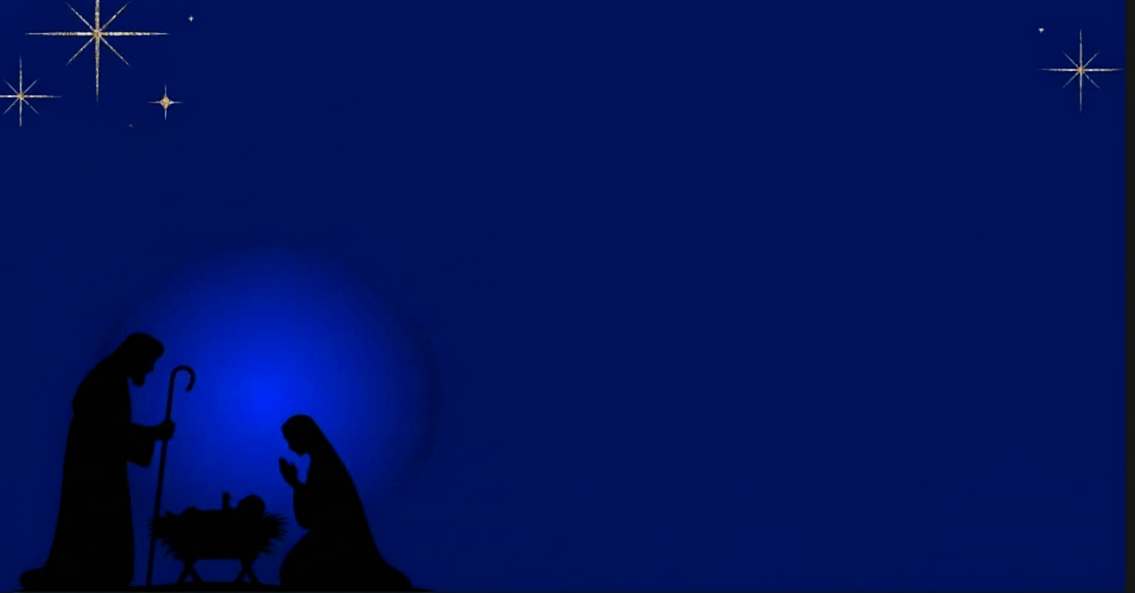
The King is Coming!

Slide 2
John 1
1In the beginning was the Word, and the Word was with God, and the Word was God. 2He was in the beginning with God. 3All things were made through him, and without him was not any thing made that was made. 4In him was life, and the life was the light of men. 5The light shines in the darkness, and the darkness has not overcome it.
9The true light, which gives light to everyone, was coming into the world. 10He was in the world, and the world was made through him, yet the world did not know him. 11He came to his own, and his own people did not receive him.

Slide 3
John 1
12But to all who did receive him, who believed in his name, he gave the right to become children of God, 13who were born, not of blood nor of the will of the flesh nor of the will of man, but of God.
14And the Word became flesh and dwelt among us, and we have seen his glory, glory as of the only Son from the Father, full of grace and truth.
16For from his fullness we have all received, grace upon grace. 17For the law was given through Moses; grace and truth came through Jesus Christ. 18No one has ever seen God; God the only Son, who is at the Father 's side, he has made him known.

Slide 4
John 1
12But to all who did receive him, who believed in his name, he gave the right to become children of God, 13who were born, not of blood nor of the will of the flesh nor of the will of man, but of God.
14And the Word became flesh and dwelt among us, and we have seen his glory, glory as of the only Son from the Father, full of grace and truth.
16For from his fullness we have all received, grace upon grace. 17For the law was given through Moses; grace and truth came through Jesus Christ. 18No one has ever seen God; God the only Son, who is at the Father 's side, he has made him known.

Slide 5
Love Incarnate

Slide 6
Loveless?
Romans 7 18For I know that nothing good dwells in me, that is, in my flesh. For I have the desire to do what is right, but not the ability to carry it out. 19For I do not do the good I want, but the evil I do not want is what I keep on doing. …….24Wretched man that I am! Who will deliver me from this body of death?
25Thanks be to God through Jesus Christ our Lord!

Slide 7
Jesus: The Word of Gods love
John 1:1In the beginning was the Word, and the Word was with God, and the Word was God. 2He was in the beginning with God.
1. Creation:
John 1: 3All things were made through him, and without him was not any thing made that was made.

Slide 8
Jesus: The Word of Gods love
2. Written Word:
John 12:49 For I have not spoken on my own authority, but the Father who sent me has himself given me a commandment — what to say and what to speak.
John 1:17 For the law was given through Moses; grace and truth came through Jesus Christ.

Slide 9
Jesus: The Word of Gods love
3. The Nativity
Are we listening?
John 10 3b-4 The sheep hear his voice, and he calls his own sheep by name and leads them out. ……….he goes before them, and the sheep follow him, for they know his voice.
John 1:9-10 The true light, which gives light to everyone, was coming into the world. He was in the world, and the world was made through him, yet the world did not know him.

Slide 10
Jesus: The presence of Gods love
John 1:14a And the Word became flesh and dwelt among us, and we have seen his glory, glory as of the only Son from the Father….
John 1:11 He came to his own, and his own people did not receive him. 12But to all who did receive him, …, he gave the right to become children of God…

Slide 11
Jesus: The place of Gods love
John 1:18 No one has ever seen God; God the only Son, who is at the Father 's side, he has made him known.

Slide 12
Jesus: The place of Gods love
Paradise Lost – John Milton 1667
(The Father said)“Die he or justice must; unless for him
Some other able, and as willing, pay
The rigid satisfaction, death for death.
Say, heavenly Powers, where shall we find such love?
Which of you will be mortal, to redeem
Man's mortal crime, and just the unjust to save?
Dwells in all Heaven charity so dear?

Slide 13
The place of Gods love
And silence was in Heaven: on Man's behalf
He ask'd, but all the heavenly quire stood mute,
Patron or intercessour none appear'd,
Much less that durst upon his own head draw
The deadly forfeiture, and ransom set.
And now without redemption all mankind
Must have been lost, adjudg'd to Death and Hell

Slide 14
The place of Gods love
By doom severe, had not the Son of God,
In whom the fulness dwells of love divine,
His dearest mediation thus renew'd.
“Father, thy word is past, Man shall find grace;
And shall grace not find means, that finds her way,…

Slide 15
The place of Gods love
Behold me then: me for him, life for life
I offer: on me let thine anger fall;
Account me Man; I for his sake will leave
Thy bosom, and this glory next to thee
Freely put off, and for him lastly die
Well pleased; on me let Death wreak all his rage.

Slide 16
Jesus: The place of Gods love
John 1:18 No one has ever seen God; God the only Son, who is at the Father 's side, he has made him known.
12But to all who ……….believed in his name, he gave the right to become children of God, 13who were born, not of blood nor of the will of the flesh nor of the will of man, but of God.

Slide 17
Love Incarnate
1 John 4:7 – 12 Beloved, let us love one another, for love is from God, and whoever loves has been born of God and knows God. 8Anyone who does not love does not know God, because God is love. 9In this the love of God was made manifest among us, that God sent his only Son into the world, so that we might live through him. 10In this is love, not that we have loved God but that he loved us and sent his Son to be the propitiation for our sins. 11Beloved, if God so loved us, we also ought to love one another. 12No one has ever seen God; if we love one another, God abides in us and his love is perfected in us.

