Slide 1
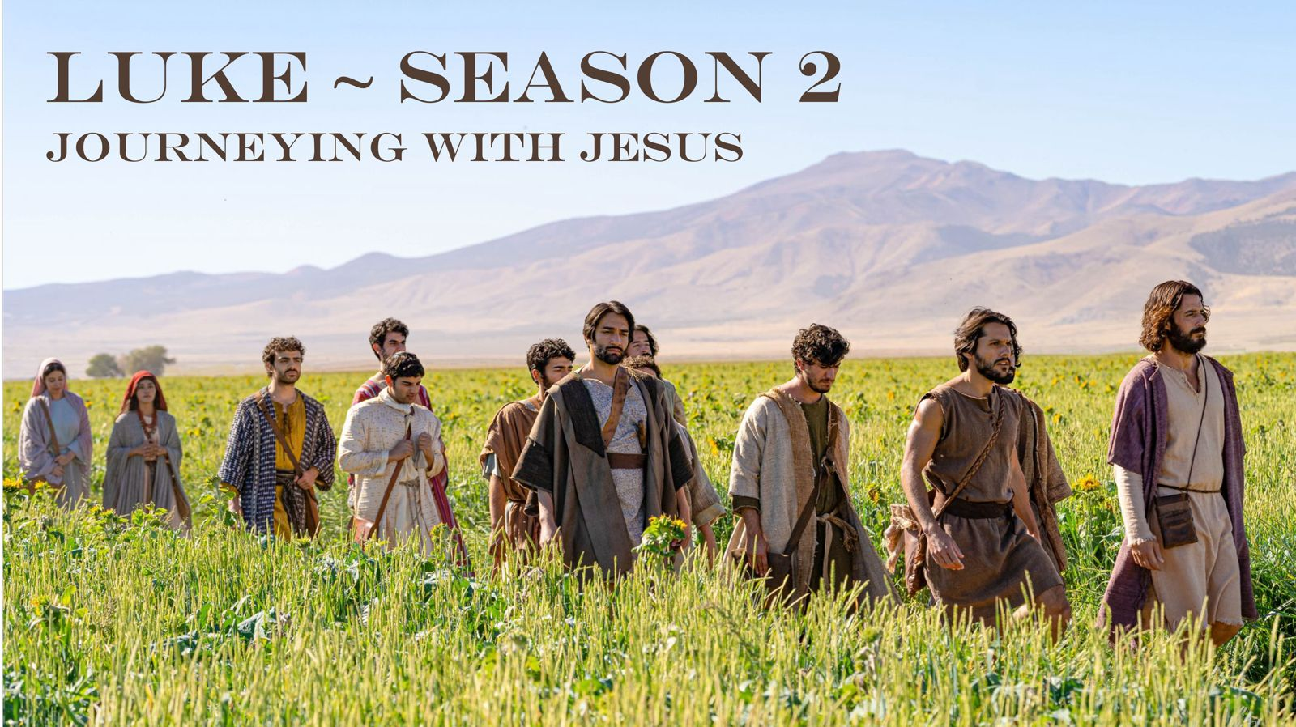

Slide 2
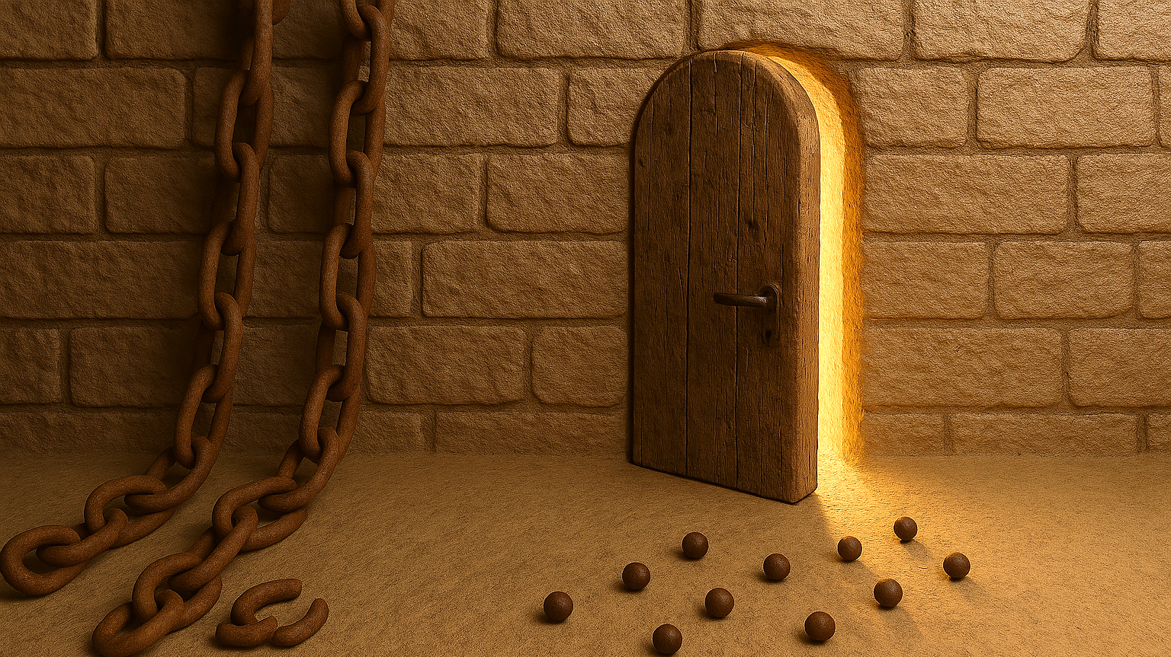
The Gospel according to Luke
Written by Luke as a factual (eyewitness) account.
Luke’s themes:
Jesus is the fulfillment of God’s covenant (promise).
Jesus’ mission:
Luke 4:18 – 19 Jesus says “The Spirit of the Lord is upon me, because he has anointed me to proclaim good news to the poor. He has sent me to proclaim liberty to the captives and recovering of sight to the blind, to set at liberty those who are oppressed, to proclaim the year of the Lord’s favour.”
True Kingdom of God.
People of the Kingdom of God.
Opposition to the King and his Kingdom.

Slide 3
Part 2: The “travelogue” of Jesus
Jesus is teaching his disciples on the road to Jerusalem.
What following him looks like to be a true disciple.
The repetition in Luke 13 and 14 – demonstration and parable.

Slide 4
The Chains, the Seed and the Narrow Door
Luke 13:10 – 14:6

Slide 5
The Chains
V 10 - 11Now he was teaching in one of the synagogues on the Sabbath. And behold, there was a woman who had had a disabling spirit for eighteen years. She was bent over and could not fully straighten herself.
Jesus is preaching by invitation at a synagogue.
A woman is there who has been afflicted by a physical ailment for 18 years.
The cause of ailments - physical, mental, emotional, spiritual.

Slide 6
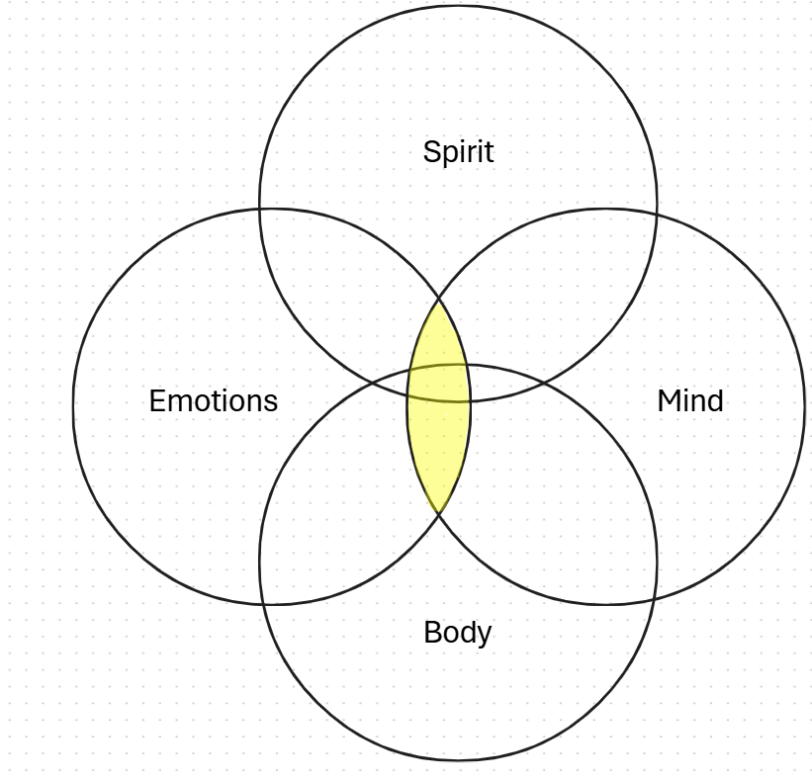
The Chains of spiritual affliction

Slide 7
The Chains
“For eighteen years she had not gazed upon the sun; for eighteen years no star of night had gladdened her eye; her face was drawn downward towards the dust, and all the light of her life was dim: she walked about as if she were searching for a grave, and I do not doubt she often felt that it would have been gladness to have found one.”
(Charles Spurgeon)

Slide 8
Chain breaker
v 12 – 13 When Jesus saw her, he called her over and said to her, "Woman, you are freed from your disability." And he laid his hands on her, and immediately she was made straight, and she glorified God.
v 12 Jesus sees her pain.
v 12 Jesus calls her to him.
v 12 He speaks life over her.
v 13 Jesus touches and heals her.

Slide 9
The Seed
THEREFORE…
Because God is…
…His Kingdom WILL grow and rise – like a large tree.
…His Kingdom WILL be unstoppable – like yeast in dough.
…His Kingdom WILL be a shelter for all who enter it.
A Kingdom we want to be a part of and play a part in!
1Cor 3:7 - 9 “neither he who plants nor he who waters is anything, but only God who gives the growth. He who plants and he who waters are one, and each will receive his wages according to his labor. For we are God’s fellow workers. You are God’s field, God’s building.
He wins!

Slide 10
The Narrow Door
If one wants to be a part of the Kingdom one must strive to enter through the narrow door.
Jesus is the narrow door.
John 10:7, 9 So Jesus again said to them, "Truly, truly, I say to you, I am the door of the sheep… If anyone enters by me, he will be saved and will go in and out and find pasture.”
Strive = agōnizomai.
Before it is too late.

