Slide 1
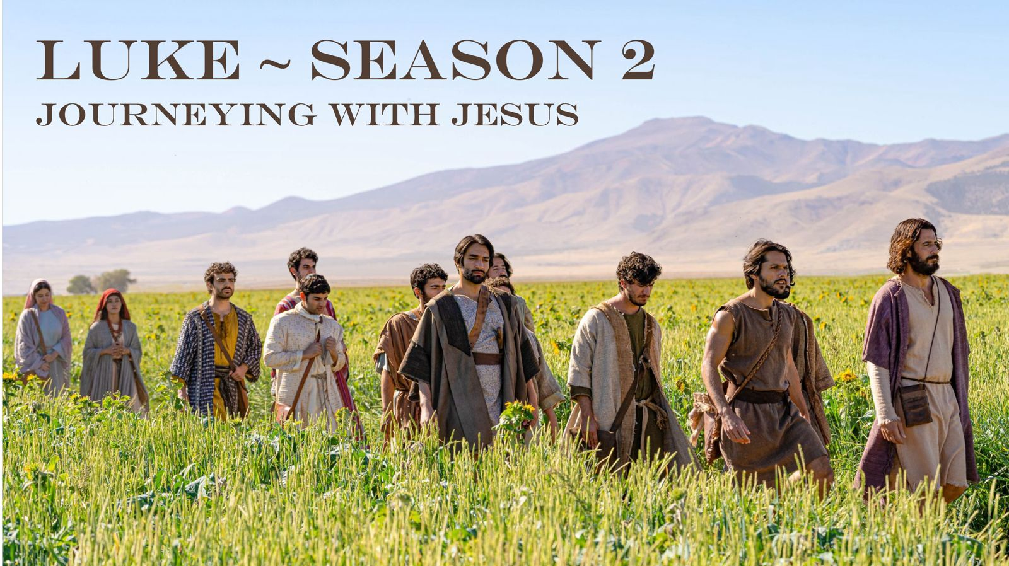

Slide 2

The Gospel according to Luke
Written by Luke a physician and travelling companion of the apostle Paul.
A factual account of all Jesus did and said.
Luke proves Jesus is the fulfillment of God’s covenant with mankind.
Jesus is the gospel = good news
Luke 4:18 – 19 Jesus says “The Spirit of the Lord is upon me, because he has anointed me to proclaim good news to the poor. He has sent me to proclaim liberty to the captives and recovering of sight to the blind, to set at liberty those who are oppressed, to proclaim the year of the Lord’s favour.”

Slide 3
The Gospel according to Luke
Good news according to Luke is for EVERYONE.
Seen in the rich imagery of banquets.
In this season of Luke we are looking at Jesus’ travelogue.
Jesus is steadfastly heading towards his crucifixion in Jerusalem.
He is teaching his disciples on the road what true discipleship looks like.
Trust in God and opposition to Jesus are key themes.

Slide 4
Reading Luke 11:14 – 12:12

Slide 5
Introduction: Jesus Messiah
Isaiah 35:6 (the Messiah will cause) "the tongue of the mute [to] sing for joy."
There is no account in the Bible of a prophet or apostle causing the mute to speak. Yet Jesus healed many who were mute (twice in Matthew, twice in Mark).
Despite this incredible miracle – there are varied responses to Jesus by the people.
These responses reveal 3 hearts towards Jesus

Slide 6
The 3 Hearts
1. Unbelieving or resistant heart
2. The doubting heart
3. The heart that marvels at Jesus

Slide 7
The unbelieving or resistant heart
v15 “But some of them said, "He casts out demons by Beelzebul, the prince of demons,“
Why did the some of the people attack Jesus?
1. There are 2 kingdoms at war with one another
“For he (God) has rescued us from the dominion of darkness and brought us into the kingdom of the Son he loves.” — Colossians 1:13 (NIV)
“For we do not wrestle against flesh and blood, but against the rulers, against the authorities, against the cosmic powers over this present darkness, against the spiritual forces of evil in the heavenly places.” — Ephesians 6:12 (ESV)

Slide 8
The unbelieving or resistant heart
2. Jesus confronts our idolatry and sin
Idols are anything that has taken the place of God in your life.
Tim Keller says “Idols are the thing you think about when you are alone”
The problem with idolatry.
The 7 woes (11:39 – 52)
Keeping our house clean
“Jesus answered him, ‘If anyone loves me, he will keep my word, and my Father will love him, and we will come to him and make our home with him.’” — John 14:23 (ESV)

Slide 9
2. The doubting heart
v16 while others, to test him, kept seeking from him a sign from heaven.
Why did they need more signs?
Understanding right eschatology.

Slide 10
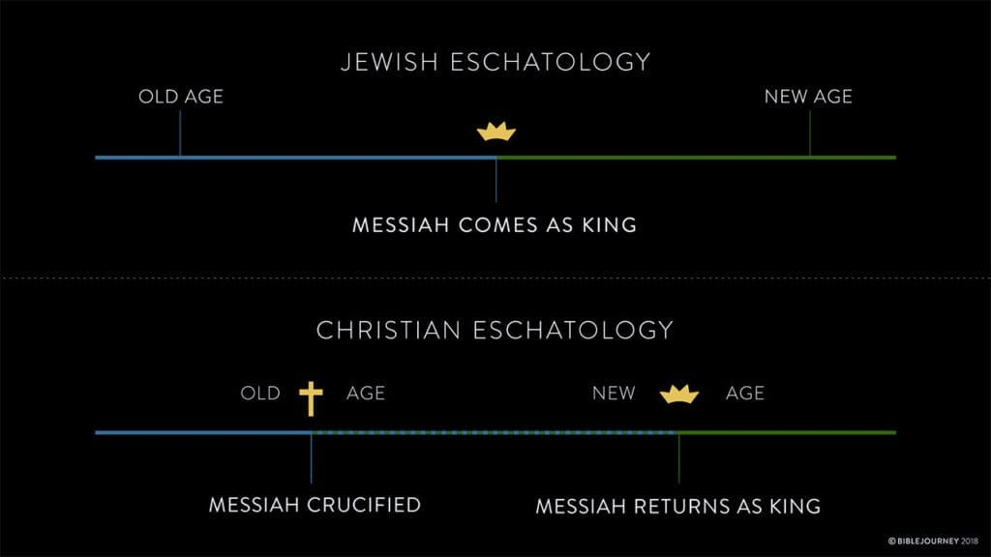

Slide 11
2. The doubting heart
“And without faith it is impossible to please him, for whoever would draw near to God must believe that he exists and that he rewards those who seek him.” — Hebrews 11:6 (ESV)
Jesus’ metaphor of the eyes.
Unbelieving heart = blind.
Doubting heart = calloused eyes
v 23 “If you are not with me then you are against me and whoever does not gather with me scatters.”

Slide 12
3. The heart that marvels at Jesus
The marvelling heart:
1. Believes in His marvellous power.
2. Revels in His marvellous love.
3. Worships in His marvellous presence.
Those whose eyes are set on Jesus – are fearless witnesses of the goodness of God.

