Slide 1
Luke 12:13 - 13:9

Slide 2
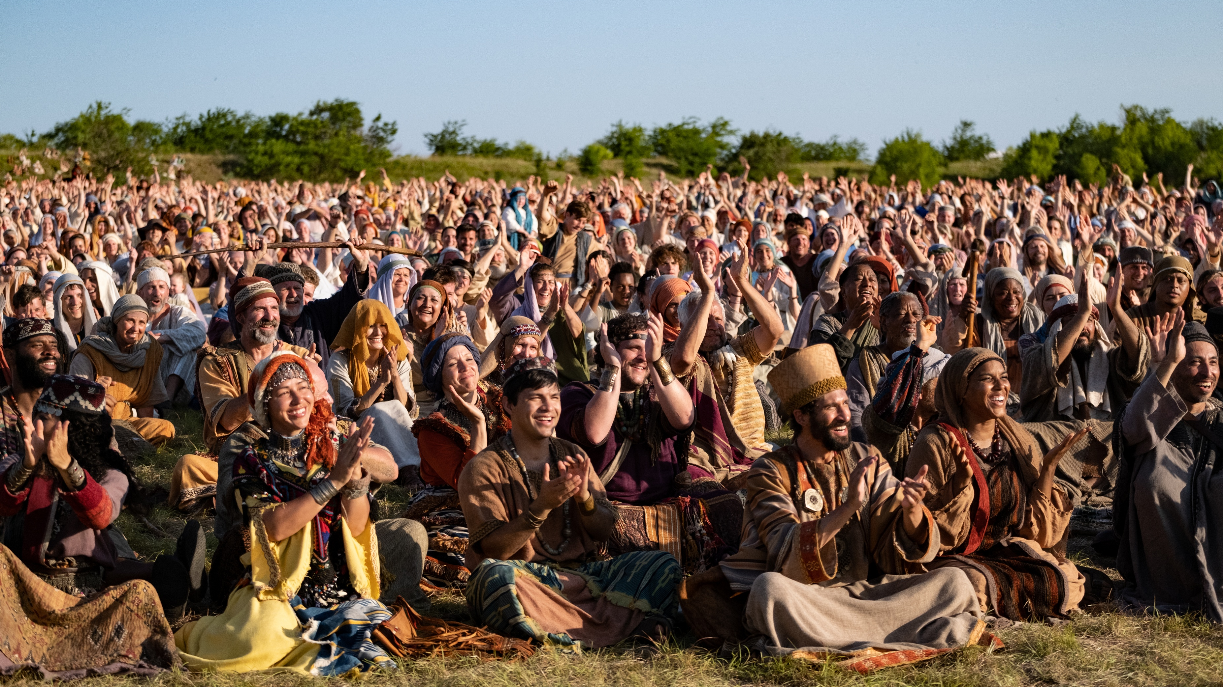
Luke 12:13-15 NLT
[13] Then someone called from the crowd, “Teacher, please tell my brother to divide our father’s estate with me.” [14] Jesus replied, “Friend, who made me a judge over you to decide such things as that?” [15] Then he said, “Beware! Guard against every kind of greed. Life is not measured by how much you own.”

Slide 3
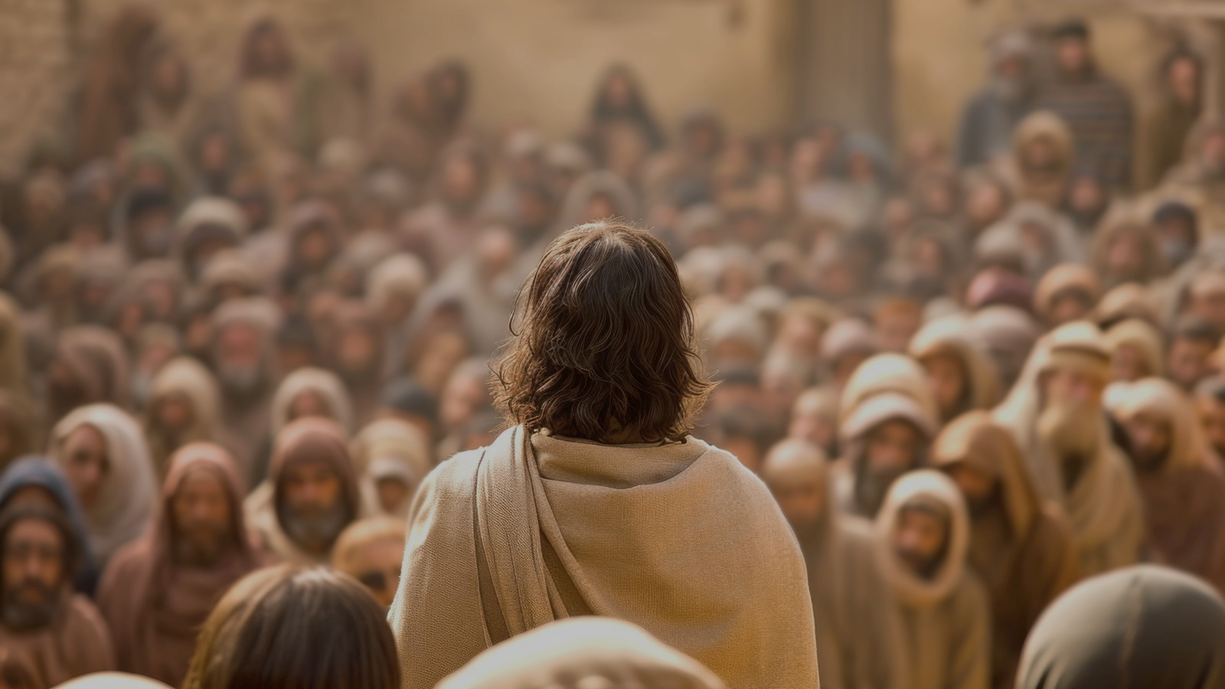
Luke 13:1-5 NIV
[1] Now there were some present at that time who told Jesus about the Galileans whose blood Pilate had mixed with their sacrifices. [2] Jesus answered, “Do you think that these Galileans were worse sinners than all the other Galileans because they suffered this way? [3] I tell you, no! But unless you repent, you too will all perish. [4] Or those eighteen who died when the tower in Siloam fell on them—do you think they were more guilty than all the others living in Jerusalem? [5] I tell you, no! But unless you repent, you too will all perish.”

Slide 4
Luke 12:16-21 NLT
[16] Then he told them a story: “A rich man had a fertile farm that produced fine crops. [17] He said to himself, ‘What should I do? I don’t have room for all my crops.’ [18] Then he said, ‘I know! I’ll tear down my barns and build bigger ones. Then I’ll have room enough to store all my wheat and other goods. [19] And I’ll sit back and say to myself, “My friend, you have enough stored away for years to come. Now take it easy! Eat, drink, and be merry!”’ [20] “But God said to him, ‘You fool! You will die this very night. Then who will get everything you worked for?’ [21] “Yes, a person is a fool to store up earthly wealth but not have a rich relationship with God.”

Slide 5
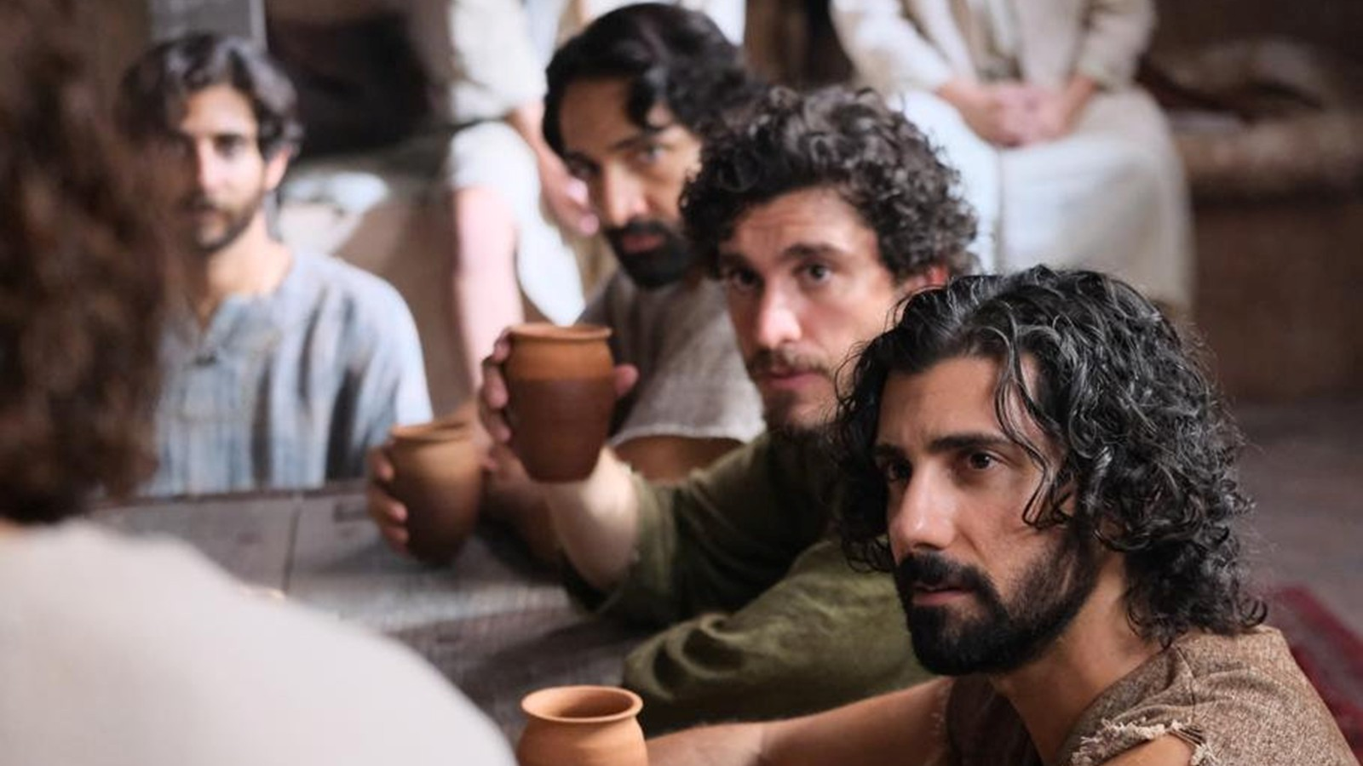
Luke 12:22-34 NLT
[22] Then, turning to his disciples, Jesus said, “That is why I tell you not to worry about everyday life—whether you have enough food to eat or enough clothes to wear. [23] For life is more than food, and your body more than clothing. [24] Look at the ravens. They don’t plant or harvest or store food in barns, for God feeds them. And you are far more valuable to him than any birds! [25] Can all your worries add a single moment to your life? [26] And if worry can’t accomplish a little thing like that, what’s the use of worrying over bigger things?

Slide 6
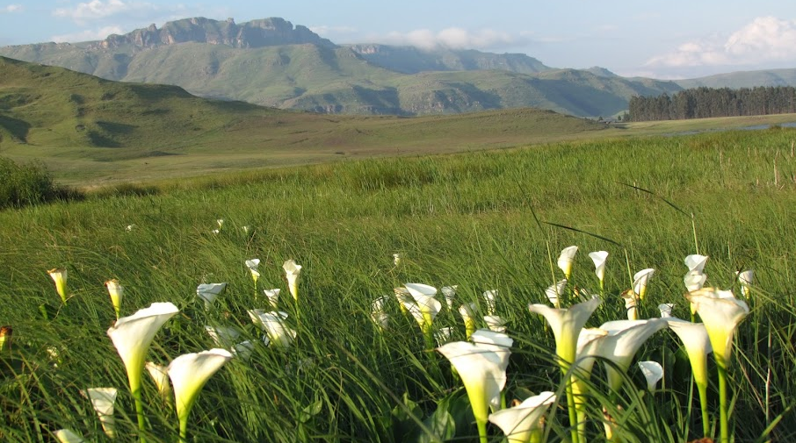
Luke 12:22-34 NLT ctd.
[27] “Look at the lilies and how they grow. They don’t work or make their clothing, yet Solomon in all his glory was not dressed as beautifully as they are. [28] And if God cares so wonderfully for flowers that are here today and thrown into the fire tomorrow, he will certainly care for you. Why do you have so little faith? [29] “And don’t be concerned about what to eat and what to drink. Don’t worry about such things. [30] These things dominate the thoughts of unbelievers all over the world, but your Father already knows your needs.

Slide 7
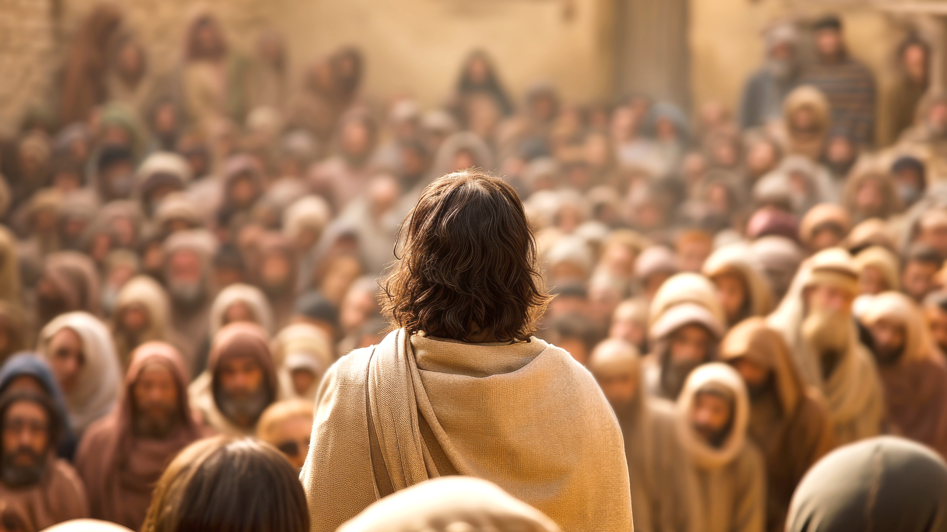
Luke 12:31 NLT
[31] Seek the Kingdom of God above all else, and he will give you everything you need.

Slide 8

Luke 12:32-34 NLT
[32] “So don’t be afraid, little flock. For it gives your Father great happiness to give you the Kingdom. [33] “Sell your possessions and give to those in need. This will store up treasure for you in heaven! And the purses of heaven never get old or develop holes. Your treasure will be safe; no thief can steal it and no moth can destroy it. [34] Wherever your treasure is, there the desires of your heart will also be.

Slide 9

Luke 12:35-48 NIV
[35] “Be dressed ready for service and keep your lamps burning, [36] like servants waiting for their master to return from a wedding banquet, so that when he comes and knocks they can immediately open the door for him. [37] It will be good for those servants whose master finds them watching when he comes. Truly I tell you, he will dress himself to serve, will have them recline at the table and will come and wait on them. [38] It will be good for those servants whose master finds them ready, even if he comes in the middle of the night or toward daybreak

Slide 10

Luke 12:35-48 NIV ctd.
[39] But understand this: If the owner of the house had known at what hour the thief was coming, he would not have let his house be broken into. [40] You also must be ready, because the Son of Man will come at an hour when you do not expect him.” [41] Peter asked, “Lord, are you telling this parable to us, or to everyone?”

Slide 11
Luke 12:35-48 NIV ctd.
[42] The Lord answered, “Who then is the faithful and wise manager, whom the master puts in charge of his servants to give them their food allowance at the proper time? [43] It will be good for that servant whom the master finds doing so when he returns. [44] Truly I tell you, he will put him in charge of all his possessions. [45] But suppose the servant says to himself, ‘My master is taking a long time in coming,’ and he then begins to beat the other servants, both men and women, and to eat and drink and get drunk.

Slide 12
Luke 12:35-48 NIV ctd.
[42] The Lord answered, “Who then is the faithful and wise manager, whom the master puts in charge of his servants to give them their food allowance at the proper time? [43] It will be good for that servant whom the master finds doing so when he returns. [44] Truly I tell you, he will put him in charge of all his possessions. [45] But suppose the servant says to himself, ‘My master is taking a long time in coming,’ and he then begins to beat the other servants, both men and women, and to eat and drink and get drunk.

Slide 13
Luke 12:35-48 NIV ctd.
[46] The master of that servant will come on a day when he does not expect him and at an hour he is not aware of. He will cut him to pieces and assign him a place with the unbelievers. [47] “The servant who knows the master’s will and does not get ready or does not do what the master wants will be beaten with many blows. [48] But the one who does not know and does things deserving punishment will be beaten with few blows. From everyone who has been given much, much will be demanded; and from the one who has been entrusted with much, much more will be asked.

Slide 14
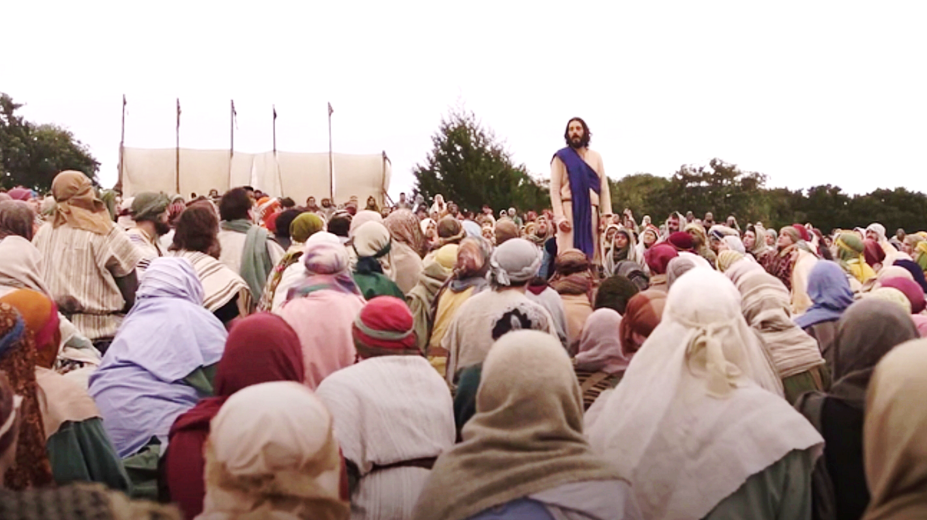
Luke 12:49-50 NLT
[49] "I have come to set the world on fire, and I wish it were already burning!
[50] I have a terrible baptism of suffering ahead of me, and I am under a heavy burden until it is accomplished

Slide 15
Luke 12:51-59 NIV
[51] Do you think I came to bring peace on earth? No, I tell you, but division. [52] From now on there will be five in one family divided against each other, three against two and two against three. [53] They will be divided, father against son and son against father, mother against daughter and daughter against mother, mother-in-law against daughter-in-law and daughter-in-law against mother-in-law.”

Slide 16
Luke 12:51-59 NIV ctd.
[54] He said to the crowd: “When you see a cloud rising in the west, immediately you say, ‘It’s going to rain,’ and it does. [55] And when the south wind blows, you say, ‘It’s going to be hot,’ and it is. [56] Hypocrites! You know how to interpret the appearance of the earth and the sky. How is it that you don’t know how to interpret this present time? [57] “Why don’t you judge for yourselves what is right? [58] As you are going with your adversary to the magistrate, try hard to be reconciled on the way, or your adversary may drag you off to the judge, and the judge turn you over to the officer, and the officer throw you into prison. [59] I tell you, you will not get out until you have paid the last penny.”

Slide 17
Luke 13:1-5 NLT
[1]About this time Jesus was informed that Pilate had murdered some people from Galilee as they were offering sacrifices at the Temple. [2]“Do you think those Galileans were worse sinners than all the other people from Galilee?” Jesus asked. “Is that why they suffered? [3]Not at all! And you will perish, too, unless you repent of your sins and turn to God. [4]And what about the eighteen people who died when the tower in Siloam fell on them? Were they the worst sinners in Jerusalem? [5]No, and I tell you again that unless you repent, you will perish, too.”

Slide 18
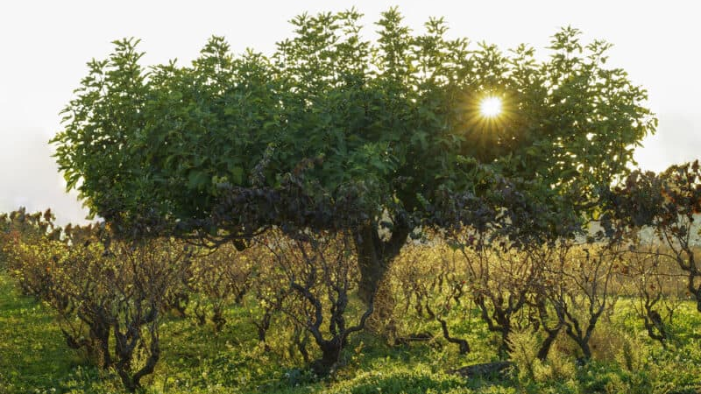
Luke 13:6-9 NLT
[6]Then Jesus told this story: “A man planted a fig tree in his garden and came again and again to see if there was any fruit on it, but he was always disappointed. [7]Finally, he said to his gardener, ‘I’ve waited three years, and there hasn’t been a single fig! Cut it down. It’s just taking up space in the garden.’ [8] “The gardener answered, ‘Sir, give it one more chance. Leave it another year, and I’ll give it special attention and plenty of fertilizer. [9]If we get figs next year, fine. If not, then you can cut it down.’”

