Slide 1

FAN INTO FLAME

Slide 2
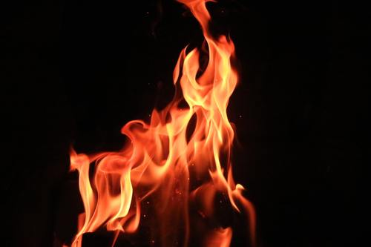
Context
Paul writing from prison and is close to the end of his life, send this letter to his protégé and spiritual son Timothy who was leading the Ephesian church at the time.
The weight of the responsibility of Timothy’s calling, personal opposition, and heresy in the church – is a discouragement to him and lead him to doubt / fear.
Paul’ encourages Timothy in 3 ways:
1. that he is not alone
2. that he possesses a sincere faith
3. that he has the indwelling Holy Spirit.
He instructs him to FAN INTO FLAME the gift of God.

Slide 3
Context
Significance of this metaphor:
God’s fire at the tabernacle and at Solomons temple
God’s fire at Pentecost
God’s fire = God’s presence and power with them / him.
Purifying fire that cleanses from sin
Light of God that overcomes darkness
Warmth of God’s love
We have the fire of God in us!

Slide 4
Context
Flames deadening without air movement is a warning and an encouragement:
The fire in us - the power of God in us can fade if neglect the gift.
1 Thes 5:19 “Do not quench the Spirit.”
But the Holy Spirit will move when we act in certain ways.
Paul gives Timothy advice as to how he could fan into flame the Spirit in his life.

Slide 5
2 Timothy 1:8 - 14
8 Therefore do not be ashamed of the testimony about our Lord, nor of me his prisoner, but share in suffering for the gospel by the power of God, 9 who saved us and called us to a holy calling, not because of our works but because of his own purpose and grace, which he gave us in Christ Jesus before the ages began, 10 and which now has been manifested through the appearing of our Savior Christ Jesus, who abolished death and brought life and immortality to light through the gospel, 11 for which I was appointed a preacher and apostle and teacher, 12 which is why I suffer as I do. But I am not ashamed, for I know whom I have believed, and I am convinced that he is able to guard until that day what has been entrusted to me. 13 Follow the pattern of the sound words that you have heard from me, in the faith and love that are in Christ Jesus. 14 By the Holy Spirit who dwells within us, guard the good deposit entrusted to you.

Slide 6
1. Do not be ashamed
8Therefore do not be ashamed of the testimony about our Lord, nor of me his prisoner, but share in suffering for the gospel by the power of God, 9 (a) who saved us and called us to a holy calling,
Do not be ashamed (to be fearful – timid – do not shrink back - feel shame) of the gospel.
Jesus has a severe warning for those who are ashamed of Him (Mk 8:38)
Why? Because to be ashamed is to quench the Spirit

Slide 7
1. Do not be ashamed
Rather to fan into flame the power of the Spirit by:
1) Share in suffering for the gospel
2) by the power of God
3) For your Holy calling – the Glory of God
You are his chosen instrument
You always get another chance

Slide 8
2. Rest in Grace
v9b not because of our works but because of his own purpose and grace, which he gave us in Christ Jesus before the ages began, …….. 11 for which I was appointed a preacher and apostle and teacher, 12 which is why I suffer as I do. But I am not ashamed, for I know whom I have believed, and I am convinced that he is able to guard until that day what has been entrusted to me.
Not our works (ability) that qualify us – but His purposes and grace.
Know WHOM you have believed – His doing and His name stake.
He is able to guard what has been entrusted to you.

Slide 9
3. Guard the good deposit
13 Follow the pattern of the sound words that you have heard from me, in the faith and love that are in Christ Jesus. 14 By the Holy Spirit who dwells within us, guard the good deposit entrusted to you.
Follow the pattern of sound words (teaching)
By the Holy Spirit guard, the good deposit.

Slide 10
2 Tim 1:6 - For this reason…
Each one reach one…

