Slide 1
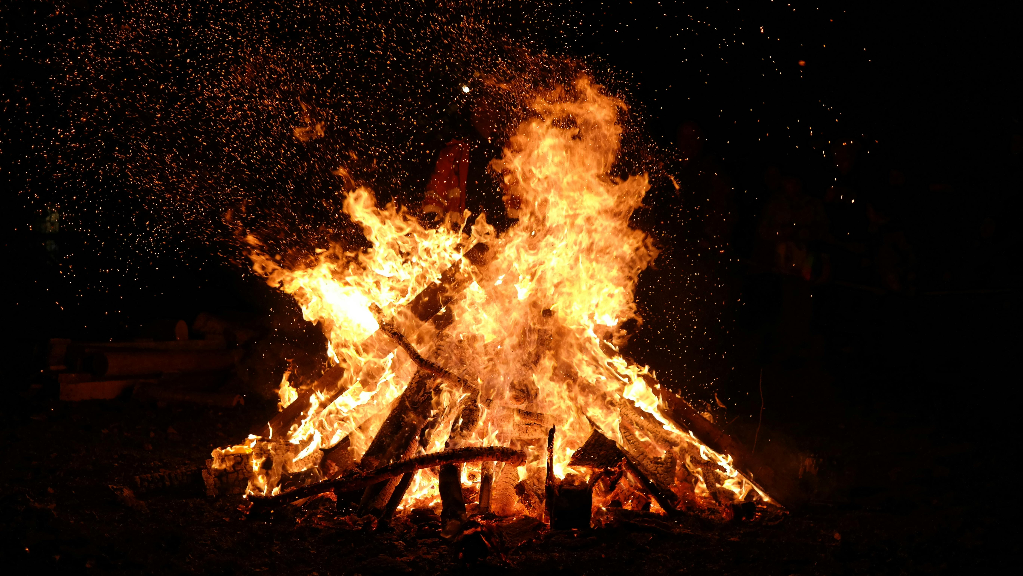
FAN INTO FLAME

Slide 2
2 Timothy 1:1 - 7
1 Paul, an apostle of Christ Jesus by the will of God according to the promise of the life that is in Christ Jesus,
2 To Timothy, my beloved child: Grace, mercy, and peace from God the Father and Christ Jesus our Lord.
3 I thank God whom I serve, as did my ancestors, with a clear conscience, as I remember you constantly in my prayers night and day. 4 As I remember your tears, I long to see you, that I may be filled with joy. 5 I am reminded of your sincere faith, a faith that dwelt first in your grandmother Lois and your mother Eunice and now, I am sure, dwells in you as well. 6 For this reason I remind you to fan into flame the gift of God, which is in you through the laying on of my hands, 7 for God gave us a spirit not of fear but of power and love and self-control.

Slide 3
Context
Paul writing from prison and is close to the end of his life, send this letter to his protégé and spiritual son Timothy who was leading the Ephesian church at the time.
The weight of the responsibility of Timothy’s calling, personal opposition, and heresy in the church – is a discouragement to him and lead him to doubt / fear.
Paul’s purpose in writing was to pass on the mantle of church leadership, to provide wisdom and encouragement to Timothy who was facing these strong headwinds.
Paul encourages and strengthens Timothy by reminding him of 3 things in verses 1 – 7.

Slide 4
1. Covered by authority and love
2 Timothy 1:1 Paul, an apostle of Christ Jesus by the will of God according to the promise of the life that is in Christ Jesus,
2 To Timothy, my beloved child: Grace, mercy, and peace from God the Father and Christ Jesus our Lord.
1. Reminding Timothy that he is covered by authority of an apostle (ordained leader).
2. Reminding Timothy of the affection with which he is loved – a beloved child.
This is a reminder Jesus’ authority and love for us and the role elders and mentors should play in our lives.
Who is mentoring you in the faith?

Slide 5
2. Secure in the assurance of faith
2 Tim 1:5 I am reminded of your sincere faith, a faith that dwelt first in your grandmother Lois and your mother Eunice and now, I am sure, dwells in you as well.
Timothy is reminded of his sincere (genuine) faith.
the same faith evident in his mother and grandmother. *Hebrews 11&12
the generational faithfulness of God. *Deuteronomy 7:9
When facing tough moments, desert seasons, we can look to our predecessors in the faith.
The power of a woman’s / mother’s / grandmother’s prayers and the strength of their faith.
How sincere is your faith at the moment? What example are you setting for future generations?

Slide 6
3. Filled with the Gift of God
2 Tim 1:6 For this reason I remind you to fan into flame the gift of God, which is in you through the laying on of my hands, 7 for God gave us a spirit not of fear but of power and love and self-control.
Paul reminds Timothy of a time when he received the Holy Spirit by the laying on of Paul’s hands – an experiential moment.
That he does not have a spirit of fear but has…
The Spirit of power
The Spirit of love
The Spirit of self-control (sound mind)
Are you filled with and empowered by the Holy Spirit?

Slide 7
Fan into Flame
2 Tim 1:6 For this reason I remind you to fan into flame the gift of God, which is in you through the laying on of my hands, 7 for God gave us a spirit not of fear but of power and love and self-control.

