Slide 1
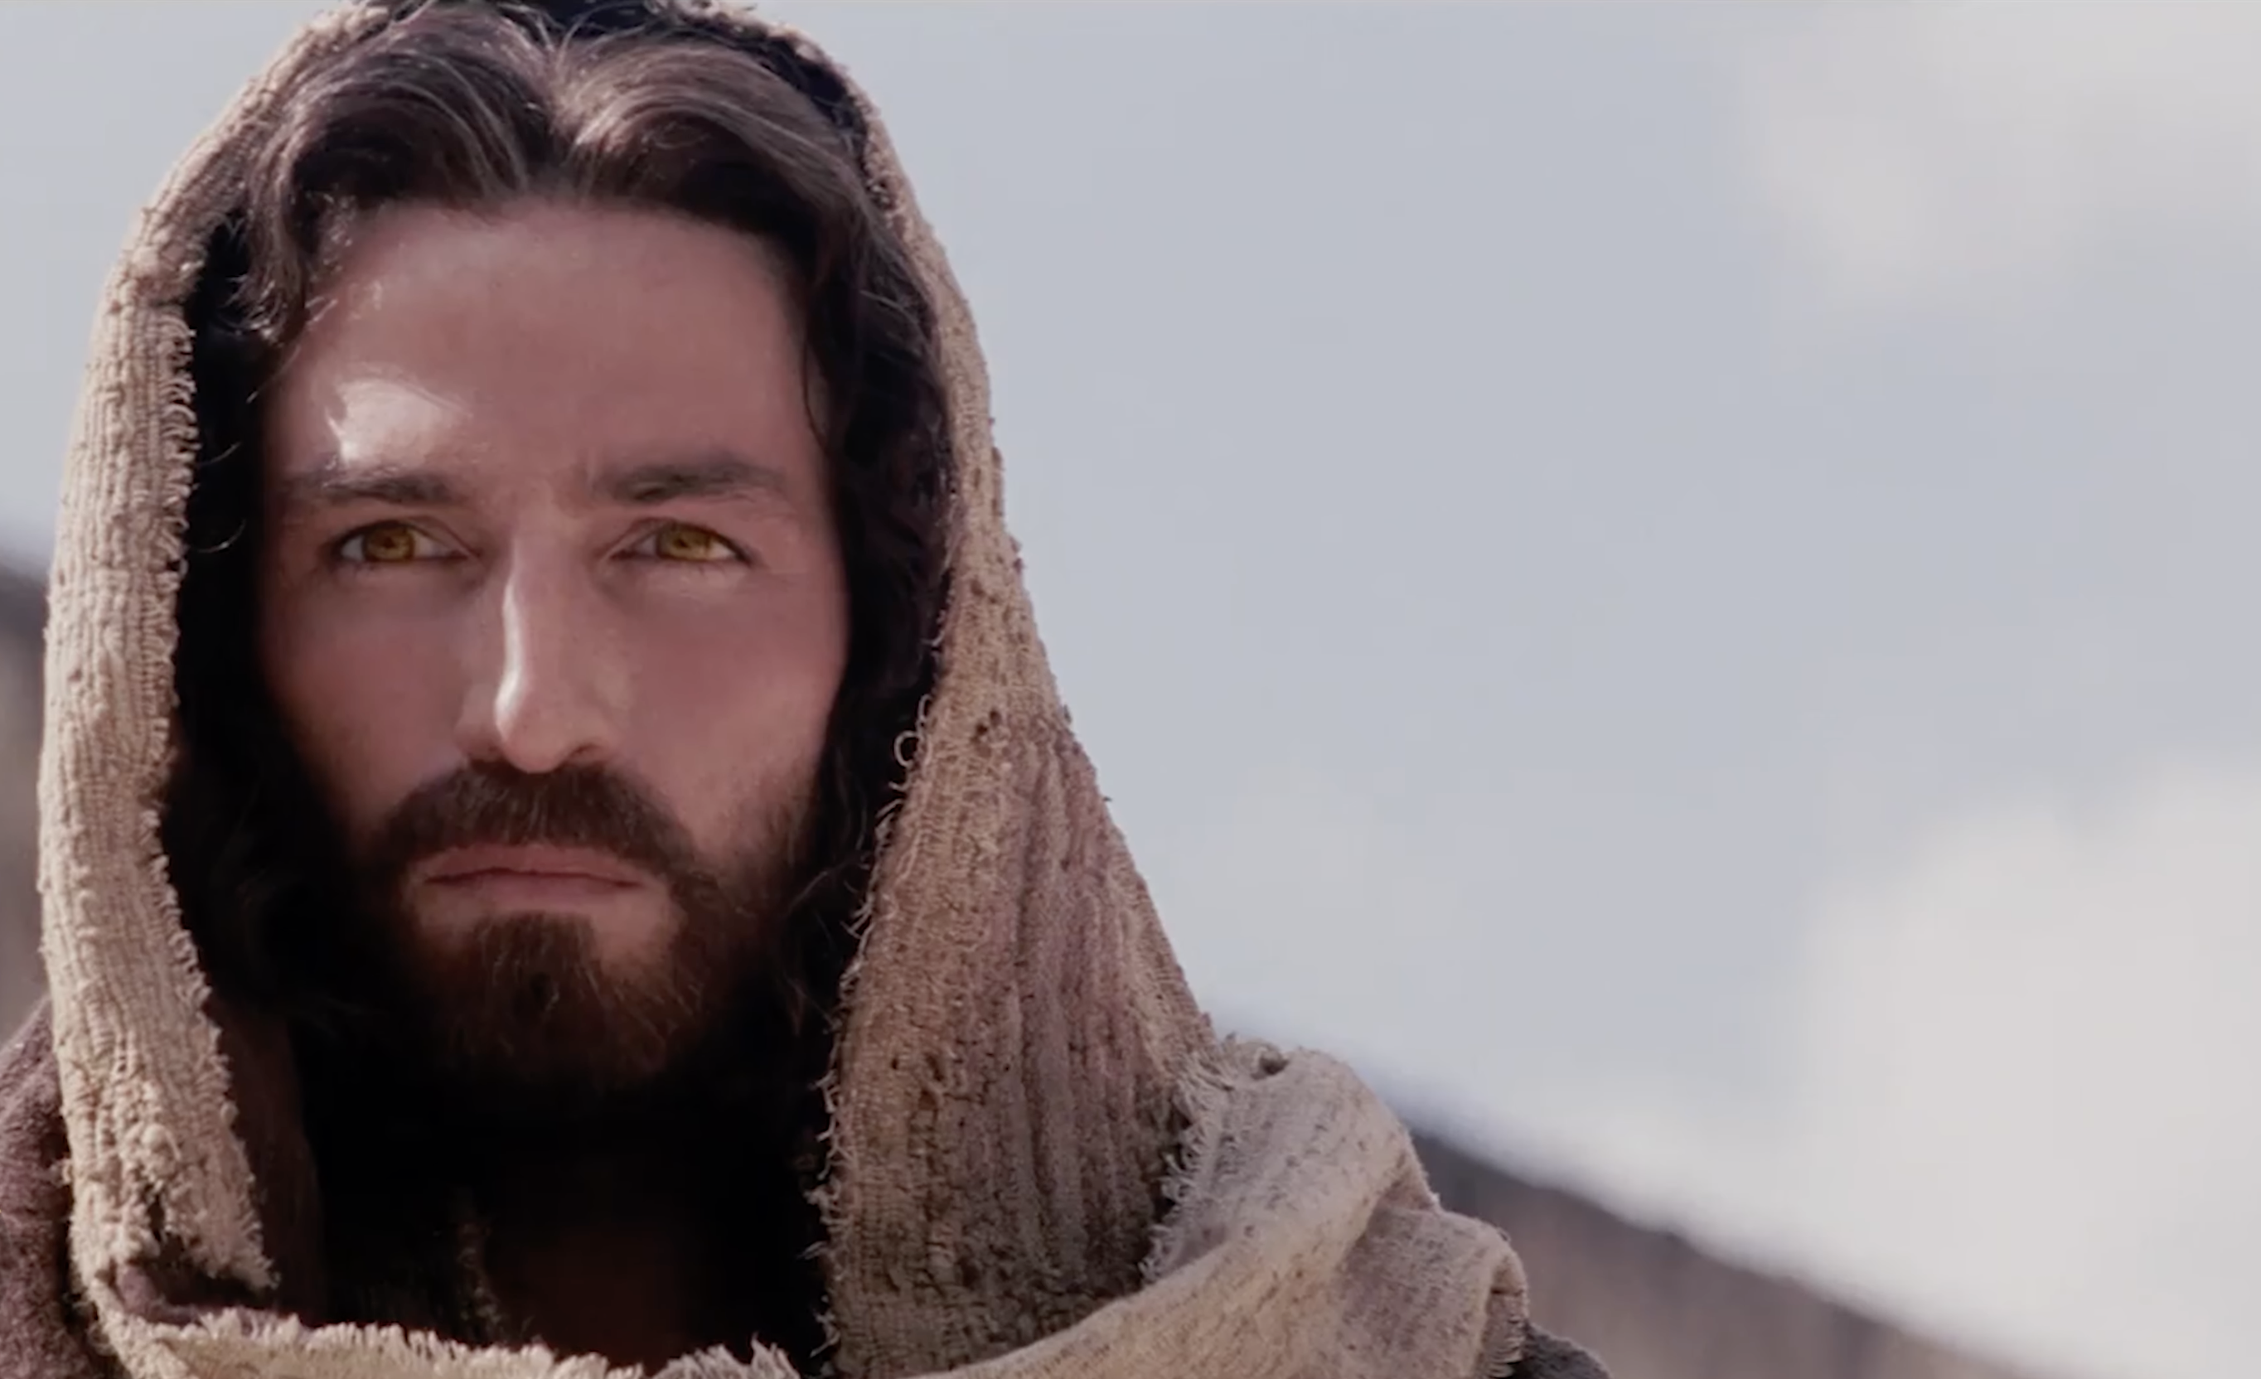
Luke ~ Season 1
The Mission of
The Son of God
8:22–39

Slide 2
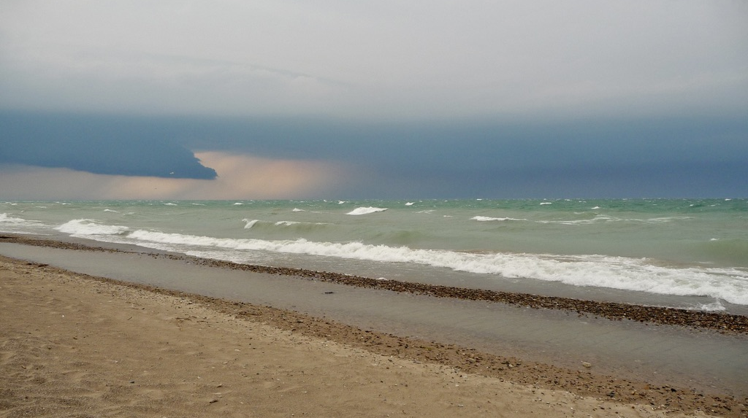

Slide 3
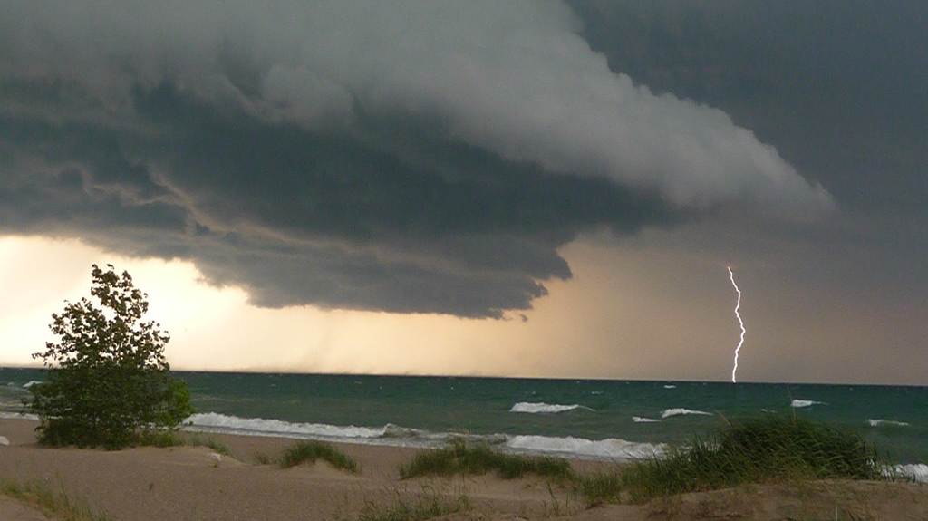

Slide 4
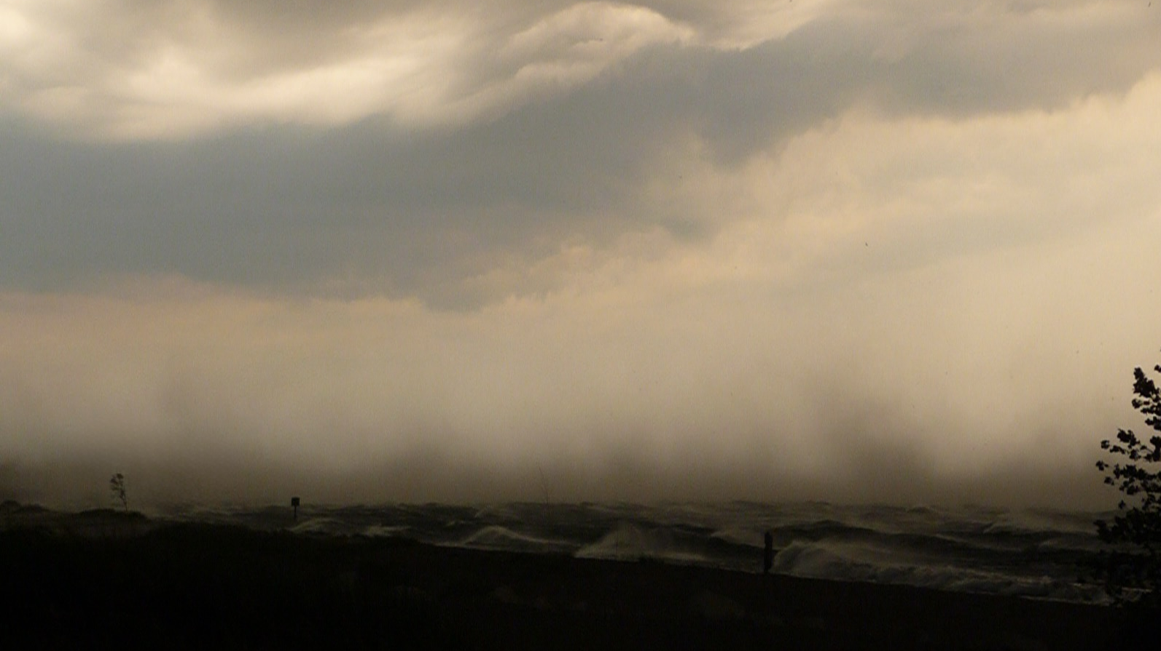

Slide 5
22 One day he got into a boat with his disciples, and he said to them, “Let us go across to the other side of the lake.” So they set out, 23 and as they sailed he fell asleep. And a windstorm came down on the lake, and they were filling with water and were in danger. 24 And they went and woke him, saying, “Master, Master, we are perishing! And he awoke and rebuked the wind and the raging waves, and they ceased, and there was a calm. 25 He said to them, “Where is your faith?” And they were afraid, and they marveled, saying to one another, “Who then is this, that he commands even winds and water, and they obey him?” (Luke 8:22-25 ESV)

Slide 6
O LORD God of hosts, who is mighty as you are,
O LORD, with your faithfulness all around you?
You rule the raging of the sea;
when its waves rise, you still them.
Psalm 89:8–9

Slide 7
By awesome deeds you answer us with righteousness,
O God of our salvation...the one who by his strength established the mountains, being girded with might, who stills the roaring of the seas, the roaring of their waves.
Psalm 65:5–7

Slide 8
The floods have lifted up, O LORD, the floods have lifted up their voice; the floods lift up their roaring. Mightier than the thunders of many waters, mightier than the waves of the sea, the LORD on high is mighty!
Psalm 93:3–4

Slide 9
He made the storm be still,
and the waves of the sea were hushed.
Psalm 107:29

Slide 10
22 One day he got into a boat with his disciples, and he said to them, “Let us go across to the other side of the lake.” So they set out, 23 and as they sailed he fell asleep. And a windstorm came down on the lake, and they were filling with water and were in danger. 24 And they went and woke him, saying, “Master, Master, we are perishing! And he awoke and rebuked the wind and the raging waves, and they ceased, and there was a calm. 25 He said to them, “Where is your faith?” And they were afraid, and they marveled, saying to one another, “Who then is this, that he commands even winds and water, and they obey him?” (Luke 8:22-25 ESV)

Slide 11
26 Then they sailed to the country of the Gerasenes, which is opposite Galilee. 27 When Jesus had stepped out on land, there met him a man from the city who had demons. For a long time he had worn no clothes, and he had not lived in a house but among the tombs. 28 When he saw Jesus, he cried out and fell down before him and said with a loud voice, “What have you to do with me, Jesus, Son of the Most High God? I beg you, do not torment me.” 29 For he had commanded the unclean spirit to come out of the man. (For many a time it had seized him. He was kept under guard and bound with chains and shackles, but he would break the bonds and be driven by the demon into the desert.) 30 Jesus then asked him, “What is your name?” And he said, “Legion,” for many demons had entered him. 31 And they begged him not to command them to depart into the abyss. 32 Now a large herd of pigs was feeding there on the hillside, and they begged him to let them enter these. So he gave them permission. 33 Then the demons came out of the man and entered the pigs, and the herd rushed down
the steep bank into the lake and drowned. (Luke 8:26-33 ESV)

Slide 12
26 Then they sailed to the country of the Gerasenes, which is opposite Galilee. 27 When Jesus had stepped out on land, there met him a man from the city who had demons. For a long time he had worn no clothes, and he had not lived in a house but among the tombs. 28 When he saw Jesus, he cried out and fell down before him and said with a loud voice, “What have you to do with me, Jesus, Son of the Most High God? I beg you, do not torment me.” 29 For he had commanded the unclean spirit to come out of the man. (For many a time it had seized him. He was kept under guard and bound with chains and shackles, but he would break the bonds and be driven by the demon into the desert.) 30 Jesus then asked him, “What is your name?” And he said, “Legion,” for many demons had entered him. 31 And they begged him not to command them to depart into the abyss. 32 Now a large herd of pigs was feeding there on the hillside, and they begged him to let them enter these. So he gave them permission. 33 Then the demons came out of the man and entered the pigs, and the herd rushed down the steep bank into the lake and drowned. (Luke 8:26-33 ESV)

Slide 13
26 Then they sailed to the country of the Gerasenes, which is opposite Galilee. 27 When Jesus had stepped out on land, there met him a man from the city who had demons. For a long time he had worn no clothes, and he had not lived in a house but among the tombs. 28 When he saw Jesus, he cried out and fell down before him and said with a loud voice, “What have you to do with me, Jesus, Son of the Most High God? I beg you, do not torment me.” 29 For he had commanded the unclean spirit to come out of the man. (For many a time it had seized him. He was kept under guard and bound with chains and shackles, but he would break the bonds and be driven by the demon into the desert.) 30 Jesus then asked him, “What is your name?” And he said, “Legion,” for many demons had entered him. 31 And they begged him not to command them to depart into the abyss. 32 Now a large herd of pigs was feeding there on the hillside, and they begged him to let them enter these. So he gave them permission. 33 Then the demons came out of the man and entered the pigs, and the herd rushed down the steep bank into the lake and drowned. (Luke 8:26-33 ESV)

Slide 14
34 When the herdsmen saw what had happened, they fled and told it in the city and in the country. 35 Then people went out to see what had happened, and they came to Jesus and found the man from whom the demons had gone, sitting at the feet of Jesus, clothed and in his right mind, and they were afraid. 36 And those who had seen it told them how the demon-possessed man had been healed. 37 Then all the people of the surrounding country of the Gerasenes asked him to depart from them, for they were seized with great fear. So he got into the boat and returned. 38 The man from whom the demons had gone begged that he might be with him, but Jesus sent him away, saying, 39 “Return to your home, and declare how much God has done for you.” And he went away, proclaiming throughout the whole city how much Jesus had done for him. (Luke 8:34-39)

Slide 15
34 When the herdsmen saw what had happened, they fled and told it in the city and in the country. 35 Then people went out to see what had happened, and they came to Jesus and found the man from whom the demons had gone, sitting at the feet of Jesus, clothed and in his right mind, and they were afraid. 36 And those who had seen it told them how the demon-possessed man had been healed. 37 Then all the people of the surrounding country of the Gerasenes asked him to depart from them, for they were seized with great fear. So he got into the boat and returned. 38 The man from whom the demons had gone begged that he might be with him, but Jesus sent him away, saying, 39 “Return to your home, and declare how much God has done for you.” And he went away, proclaiming throughout the whole city how much Jesus had done for him. (Luke 8:34-39)

