Slide 1

Beholding the Glory of God
LUKE 9:18 - 36

Slide 2
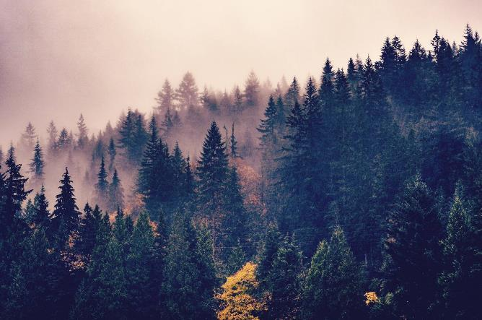
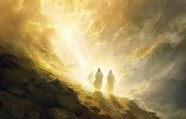
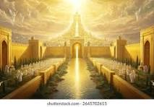
Introduction
Luke aims to show all that Jesus fulfilled.
Luke 1:1 Many have undertaken to draw up an account of the things that have been fulfilled (accomplished) among us, (by Jesus) (NIV)
Hebrews 1:1Long ago, at many times and in many ways, God spoke to our fathers by the prophets, 2but in these last days he has spoken to us by his Son, whom he appointed the heir of all things, through whom also he created the world. 3He is the radiance of the glory of God and the exact imprint of his nature, and he upholds the universe by the word of his power.

Slide 3
Introduction
2 Corinthians 3:17-18 17Now the Lord is the Spirit, and where the Spirit of the Lord is, there is freedom. 18And we all, with unveiled face, beholding the glory of the Lord, are being transformed into the same image from one degree of glory to another. For this comes from the Lord who is the Spirit.

Slide 4
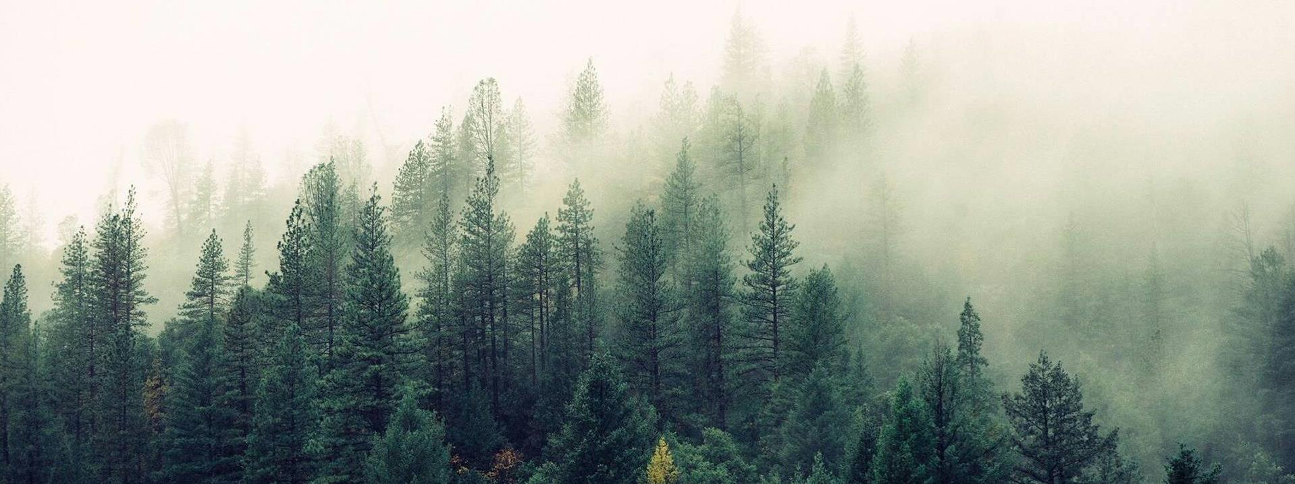
Believe
Subtitle

Slide 5
Luke 9: 18 - 20
18Now it happened that as he was praying alone, the disciples were with him. And he asked them, "Who do the crowds say that I am?" 19And they answered, "John the Baptist. But others say, Elijah, and others, that one of the prophets of old has risen." 20Then he said to them, "But who do you say that I am?" And Peter answered, "The Christ of God.“21And he strictly charged and commanded them to tell this to no one,

Slide 6
Believe in Jesus
Believe - think - say…
Who do YOU SAY (believe) Jesus is?
And Peter answered, "The Christ of God.“
Jesus is the Gospel =
Love of God - saves us from the wrath of God - for the Glory of God

Slide 7
Die
Subtitle

Slide 8
Luke 9: 21 - 27
22saying, "The Son of Man must suffer many things and be rejected by the elders and chief priests and scribes, and be killed, and on the third day be raised."
23And he said to all, "If anyone would come after me, let him deny himself and take up his cross daily and follow me. 24For whoever would save his life will lose it, but whoever loses his life for my sake will save it. 25For what does it profit a man if he gains the whole world and loses or forfeits himself? 26For whoever is ashamed of me and of my words, of him will the Son of Man be ashamed when he comes in his glory and the glory of the Father and of the holy angels. 27But I tell you truly, there are some standing here who will not taste death until they see the kingdom of God."

Slide 9
Die to Self and the World
“Our God bids us first build a cemetery before we build a church or dwelling house, showing us that the resurrection of [the nations] must be effected by our own destruction.”
Anonymous Missionary

Slide 10
Die to Self and the World
John 12:24 Truly, truly, I say to you, unless a grain of wheat falls into the earth and dies, it remains alone; but if it dies, it bears much fruit.
Jesus models his way – suffer, rejected, killed
What does it look like for you to die for Jesus? To deny yourself, take up your cross, and follow him?

Slide 11
Die to Self and the World
“Before you get serious about Jesus. First consider how good you are going to look on wood.” Ronald Rolheiser
Gal 2:20 I have been crucified with Christ. It is no longer I who live, but Christ who lives in me. And the life I now live in the flesh I live by faith in the Son of God, who loved me and gave himself for me.

Slide 12
Listen

Slide 13
Luke 9: 27 - 36
27But I tell you truly, there are some standing here who will not taste death until they see the kingdom of God.“ 28Now about eight days after these sayings he took with him Peter and John and James and went up on the mountain to pray. 29And as he was praying, the appearance of his face was altered, and his clothing became dazzling white. 30And behold, two men were talking with him, Moses and Elijah, 31who appeared in glory and spoke of his departure, which he was about to accomplish at Jerusalem. 32Now Peter and those who were with him were heavy with sleep, but when they became fully awake they saw his glory and the two men who stood with him. 33And as the men were parting from him, Peter said to Jesus, "Master, it is good that we are here. Let us make three tents, one for you and one for Moses and one for Elijah" — not knowing what he said. 34As he was saying these things, a cloud came and overshadowed them, and they were afraid as they entered the cloud. 35And a voice came out of the cloud, saying, "This is my Son, my Chosen One; listen to him!" 36And when the voice had spoken, Jesus was found alone. And they kept silent and told no one in those days anything of what they had seen.

Slide 14
The Glory of his Radiance
29And as he was praying, the appearance of his face was altered, and his clothing became dazzling white.
Revelation 21:22And I saw no temple in the city, for its temple is the Lord God the Almighty and the Lamb. 23And the city has no need of sun or moon to shine on it, for the glory of God gives it light, and its lamp is the Lamb.

Slide 15
The Glory of the Law and the Prophets
30And behold, two men were talking with him, Moses and Elijah, 31who appeared in glory and spoke of his departure, which he was about to accomplish at Jerusalem.
Matthew 5:17 "Do not think that I have come to abolish the Law or the Prophets; I have not come to abolish them but to fulfill them.”

Slide 16
The Glory of his Word
Mountains, in ancient imagination, was where heaven met earth and where God communicated with mankind.
1 John 1:1 That which was from the beginning, which we have heard, which we have seen with our own eyes, which we have gazed upon and touched with our own hands—this is the Word of life.
5And a voice came out of the cloud, saying, "This is my Son, my Chosen One; listen to him!"

Slide 17
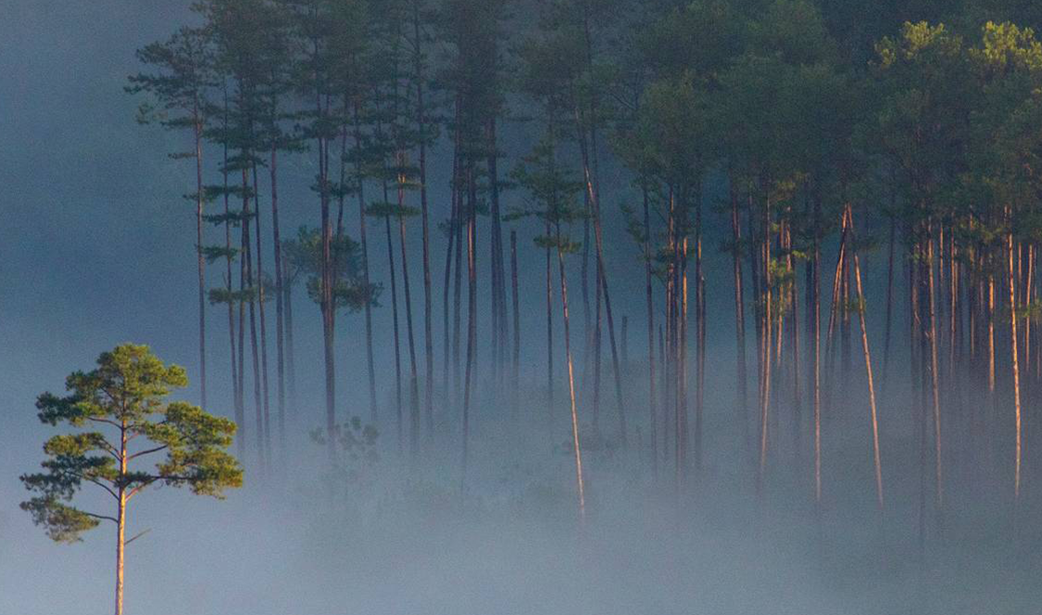
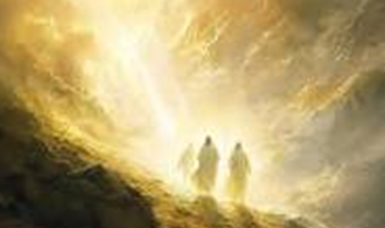
The way to behold Gods Glory is to Believe, Die, Listen.

