Slide 1
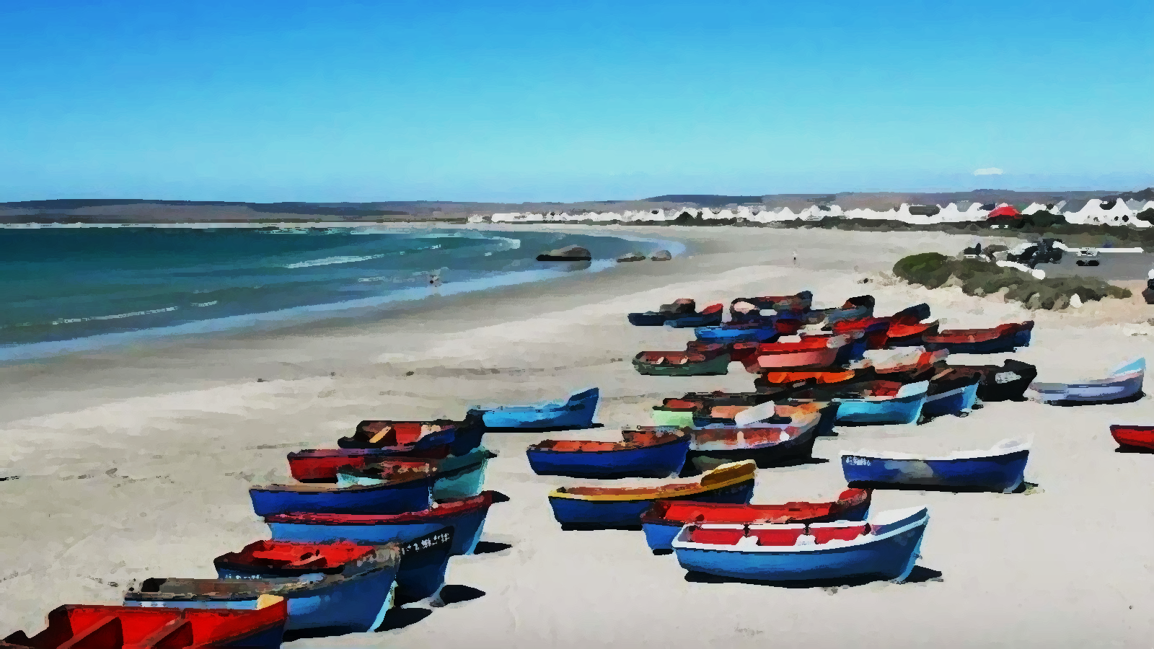
On Mission with Jesus

Slide 2
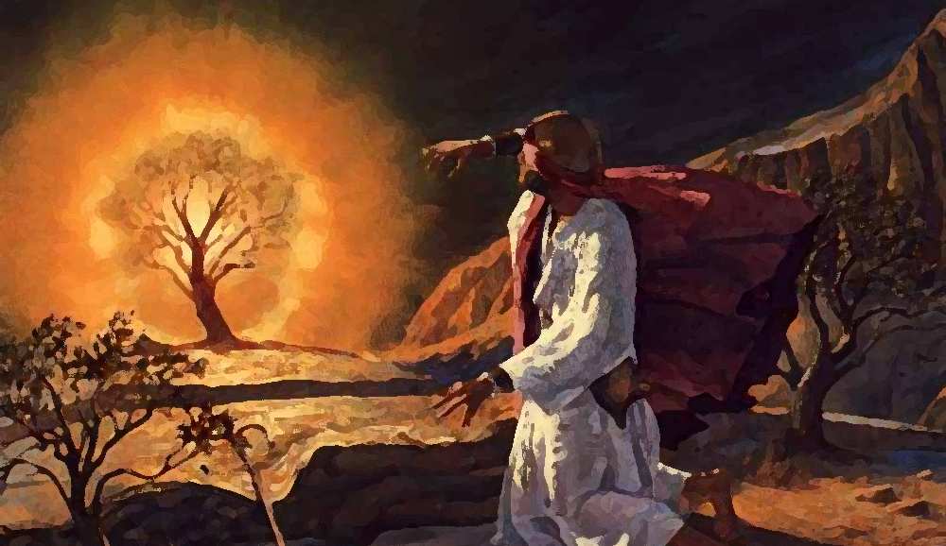

Slide 3
Exodus 3:1-6 NLT
[1] One day Moses was tending the flock of his father-in-law, Jethro, the priest of Midian. He led the flock far into the wilderness and came to Sinai, the mountain of God. [2] There the angel of the Lord appeared to him in a blazing fire from the middle of a bush. Moses stared in amazement. Though the bush was engulfed in flames, it didn’t burn up. [3] “This is amazing,” Moses said to himself. “Why isn’t that bush burning up? I must go see it.” [4] When the Lord saw Moses coming to take a closer look, God called to him from the middle of the bush, “Moses! Moses!” “Here I am!” Moses replied. [5] “Do not come any closer,” the Lord warned. “Take off your sandals, for you are standing on holy ground. [6] I am the God of your father—the God of Abraham, the God of Isaac, and the God of Jacob.” When Moses heard this, he covered his face because he was afraid to look at God

Slide 4
Exodus 3:7-10 NLT
[7] Then the Lord told him, “I have certainly seen the oppression of my people in Egypt. I have heard their cries of distress because of their harsh slave drivers. Yes, I am aware of their suffering. [8] So I have come down to rescue them from the power of the Egyptians and lead them out of Egypt into their own fertile and spacious land. It is a land flowing with milk and honey—the land where the Canaanites, Hittites, Amorites, Perizzites, Hivites, and Jebusites now live. [9] Look! The cry of the people of Israel has reached me, and I have seen how harshly the Egyptians abuse them.
[10] Now go, for I am sending you to Pharaoh. You must lead my people Israel out of Egypt.”

Slide 5
Moses’ Response
Exodus 3:11 NLT
[11] But Moses protested to God, “Who am I to appear before Pharaoh? Who am I to lead the people of Israel out of Egypt?”

Slide 6
Exodus 3:11 NLT
[11] But Moses protested to God, “Who am I to appear before Pharaoh? Who am I to lead the people of Israel out of Egypt?”
Exodus 3:12 NLT
[12] God answered, “I will be with you. And this is your sign that I am the one who has sent you: When you have brought the people out of Egypt, you will worship God at this very mountain.”

Slide 7
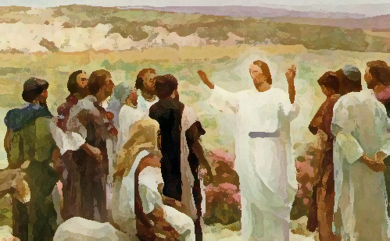
Matthew 28:18-20 NLT
[18] Jesus came and told his disciples, “I have been given all authority in heaven and on earth. [19] Therefore, go and make disciples of all the nations, baptizing them in the name of the Father and the Son and the Holy Spirit. [20] Teach these new disciples to obey all the commands I have given you. And be sure of this: I am with you always, even to the end of the age.”

Slide 8
Exodus 3:13 NLT
[13] But Moses protested (again), “If I go to the people of Israel and tell them, ‘The God of your ancestors has sent me to you,’ they will ask me, ‘What is his name?’ Then what should I tell them?”

Slide 9
Exodus 3:13 NLT
[13] But Moses protested (again), “If I go to the people of Israel and tell them, ‘The God of your ancestors has sent me to you,’ they will ask me, ‘What is his name?’ Then what should I tell them?”
Exodus 3:14 NLT
[14] God replied to Moses, “I Am Who I Am. Say this to the people of Israel: I Am has sent me to you.” [15] God also said to Moses, “Say this to the people of Israel: Yahweh, the God of your ancestors—the God of Abraham, the God of Isaac, and the God of Jacob—has sent me to you. This is my eternal name, my name to remember for all generations. [16] “Now go...

Slide 10
Exodus 4:1 NLT
[1] But Moses protested again, “What if they won’t believe me or listen to me? What if they say, ‘The Lord never appeared to you’?”
Exodus 4:2-3 NLT
[2] Then the Lord asked him, “What is that in your hand?” “A shepherd’s staff,” Moses replied. [3] “Throw it down on the ground,” the Lord told him. So Moses threw down the staff, and it turned into a snake! Moses jumped back.

Slide 11
Exodus 3:4-9 NLT
[4] Then the Lord told him, “Reach out and grab its tail.” So Moses reached out and grabbed it, and it turned back into a shepherd’s staff in his hand. [5] “Perform this sign,” the Lord told him. “Then they will believe that the Lord, the God of their ancestors—the God of Abraham, the God of Isaac, and the God of Jacob—really has appeared to you.” [6] Then the Lord said to Moses, “Now put your hand inside your cloak.” So Moses put his hand inside his cloak, and when he took it out again, his hand was white as snow with a severe skin disease. [7] “Now put your hand back into your cloak,” the Lord said. So Moses put his hand back in, and when he took it out again, it was as healthy as the rest of his body. [8] The Lord said to Moses, “If they do not believe you and are not convinced by the first miraculous sign, they will be convinced by the second sign. [9] And if they don’t believe you or listen to you even after these two signs, then take some water from the Nile River and pour it out on the dry ground. When you do, the water from the Nile will turn to blood on the ground.”

Slide 12
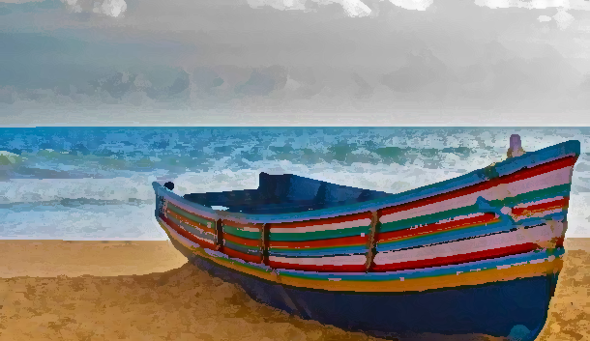
John 14:12-14 NLT
[12] “I tell you the truth, anyone who believes in me will do the same works I have done, and even greater works, because I am going to be with the Father. [13] You can ask for anything in my name, and I will do it, so that the Son can bring glory to the Father. [14] Yes, ask me for anything in my name, and I will do it!

Slide 13
Exodus 4:10 NLT
[10] But Moses pleaded with the Lord, “O Lord, I’m not very good with words. I never have been, and I’m not now, even though you have spoken to me. I get tongue-tied, and my words get tangled.”
Exodus 4:11 NLT
[11] Then the Lord asked Moses, “Who makes a person’s mouth? Who decides whether people speak or do not speak, hear or do not hear, see or do not see? Is it not I, the Lord? [12] Now go! I will be with you as you speak, and I will instruct you in what to say.”

Slide 14
Exodus 4:13-17 NLT
[13] But Moses again pleaded, “Lord, please! Send anyone else.” [14] Then the Lord became angry with Moses. “All right,” he said. “What about your brother, Aaron the Levite? I know he speaks well. And look! He is on his way to meet you now. He will be delighted to see you. [15] Talk to him, and put the words in his mouth. I will be with both of you as you speak, and I will instruct you both in what to do. [16] Aaron will be your spokesman to the people. He will be your mouthpiece, and you will stand in the place of God for him, telling him what to say. [17] And take your shepherd’s staff with you, and use it to perform the miraculous signs I have shown you.”

Slide 15
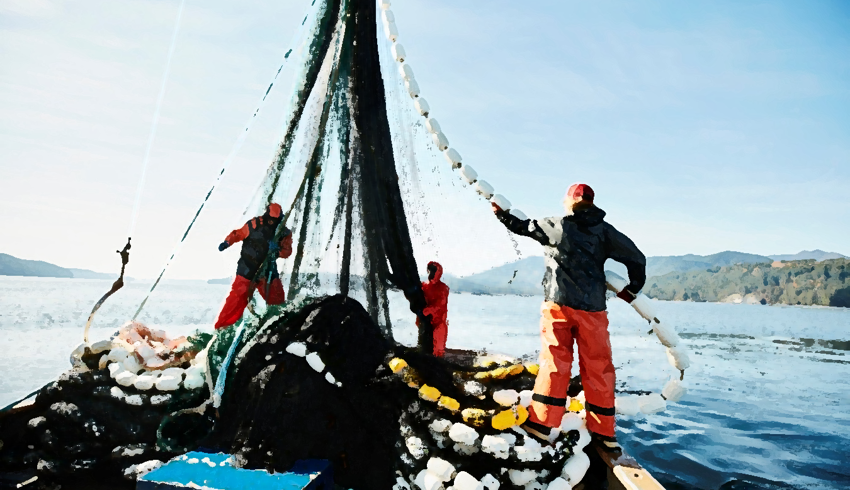
1 Corinthians 12:7 NLT
[7] A spiritual gift is given to each of us so we can help each other.

Slide 16
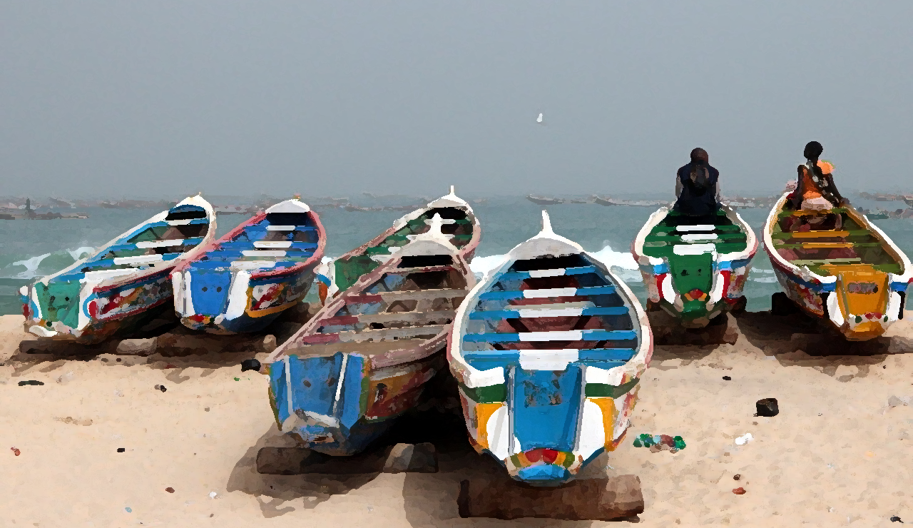
Each called… To Go

