Slide 1
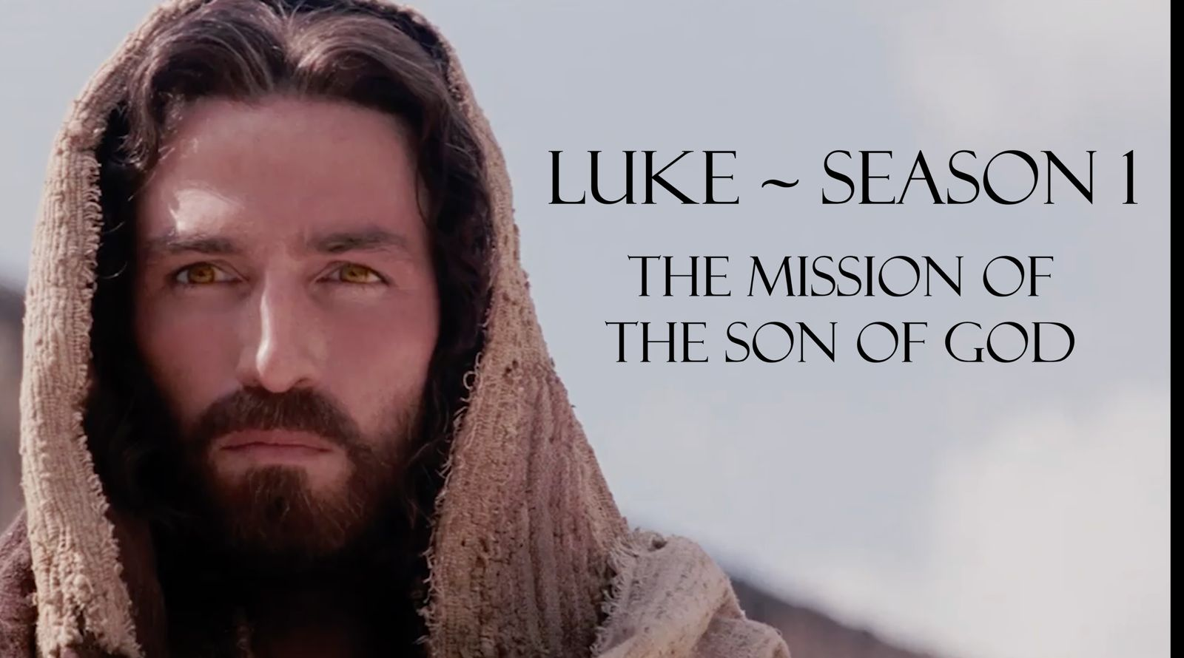
Luke 8: 8:1-21

Slide 2
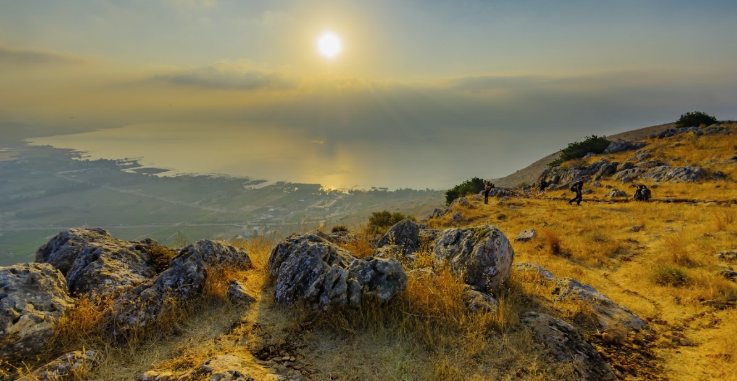
Luke 8:1-3 NIV
[1] Soon afterward Jesus began a tour of the nearby towns and villages, preaching and announcing the Good News about the Kingdom of God. He took his twelve disciples with him, [2] along with some women who had been cured of evil spirits and diseases. Among them were Mary Magdalene, from whom he had cast out seven demons; [3] Joanna, the wife of Chuza, Herod’s business manager; Susanna; and many others who were contributing from their own resources to support Jesus and his disciples.

Slide 3
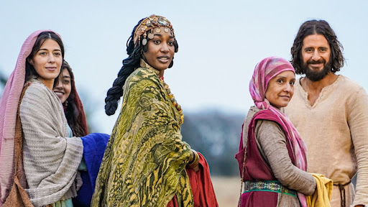

Slide 4
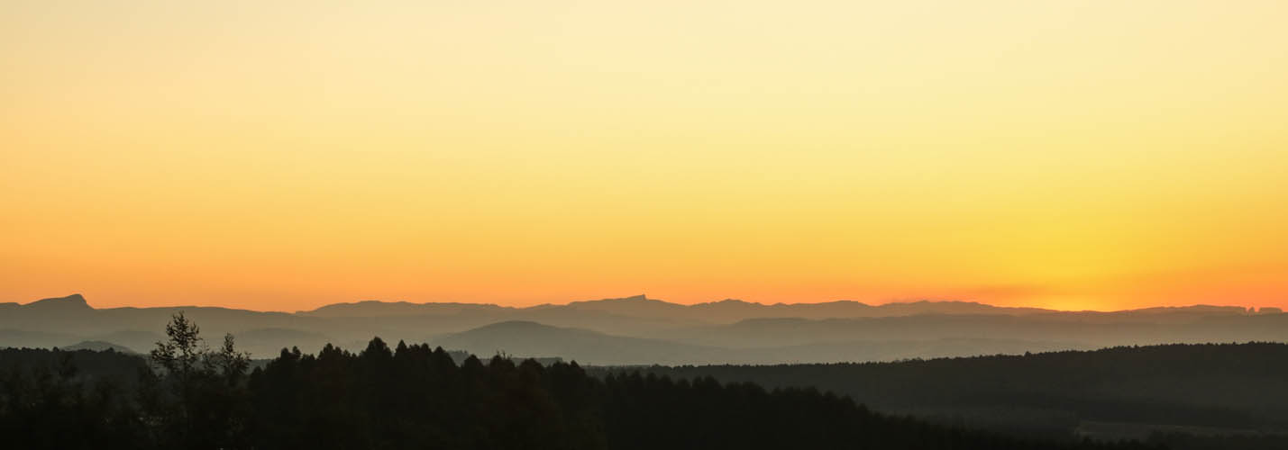
What is God’s Mission for the church today?
To be-come....
Being with Jesus, Becoming like Jesus
To be the bride of Christ - without spot or blemish (Internal sanctification) Fruitfulness of character (love, joy, peace, patience, goodness, faithfulness and self control) To stand as a light in the world - for our lives to reflect a different way of living. That points to Jesus as king
To be-going
Doing what Jesus did
To continue Jesus ministry of seeing people reconciled to Christ To demonstrate God's love to the world (a love that transcends race or class) For captives (those caught up by oppression and sin) to be set free For the kingdom of God to be establish and expanded
If you're not be-coming and be-going you're not living out God's full purpose for your life!

Slide 5
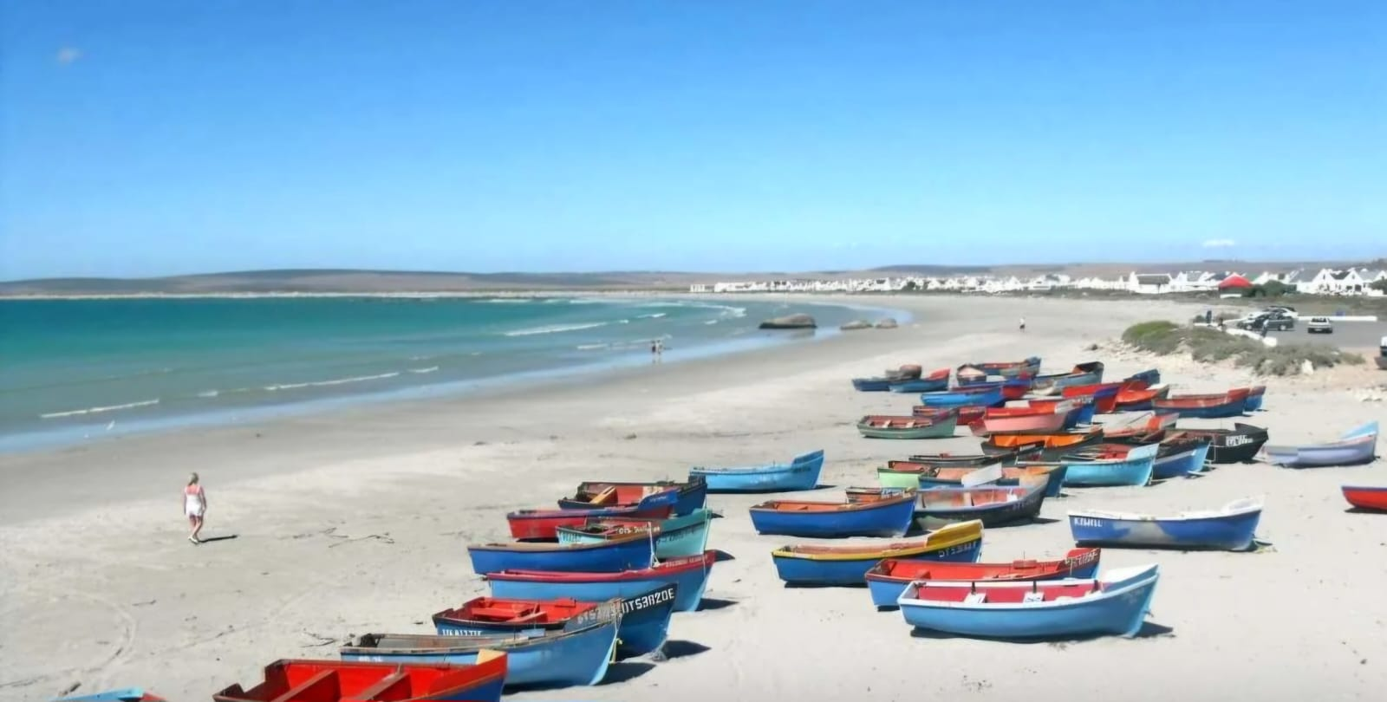
To be-going…

Slide 6
Luke 8:4-10 NIV
[4] One day Jesus told a story in the form of a parable to a large crowd that had gathered from many towns to hear him: [5] “A farmer went out to plant his seed. As he scattered it across his field, some seed fell on a footpath, where it was stepped on, and the birds ate it. [6] Other seed fell among rocks. It began to grow, but the plant soon wilted and died for lack of moisture. [7] Other seed fell among thorns that grew up with it and choked out the tender plants.

Slide 7
Luke 8:4-10 NIV
[8] Still other seed fell on fertile soil. This seed grew and produced a crop that was a hundred times as much as had been planted!” When he had said this, he called out, “Anyone with ears to hear should listen and understand.” [9] His disciples asked him what this parable meant. [10] He replied, “You are permitted to understand the secrets of the Kingdom of God. But I use parables to teach the others so that the Scriptures might be fulfilled: ‘When they look, they won’t really see. When they hear, they won’t understand.’

Slide 8
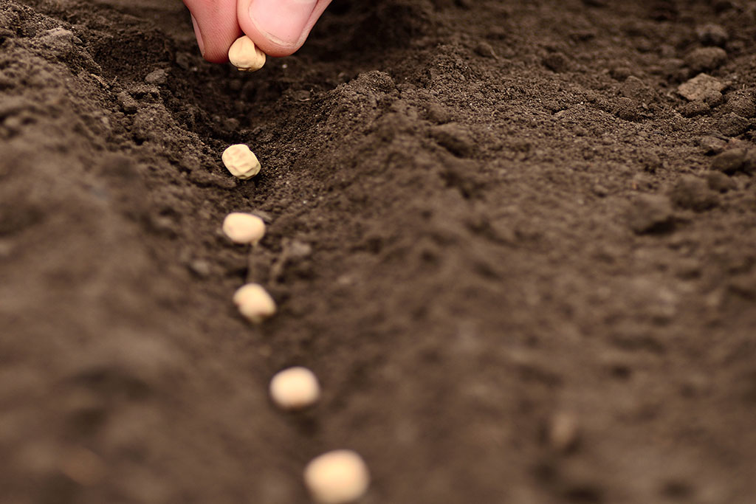

Luke 8:11 NIV
[11] “This is the meaning of the parable: The seed is God’s word.

Slide 9
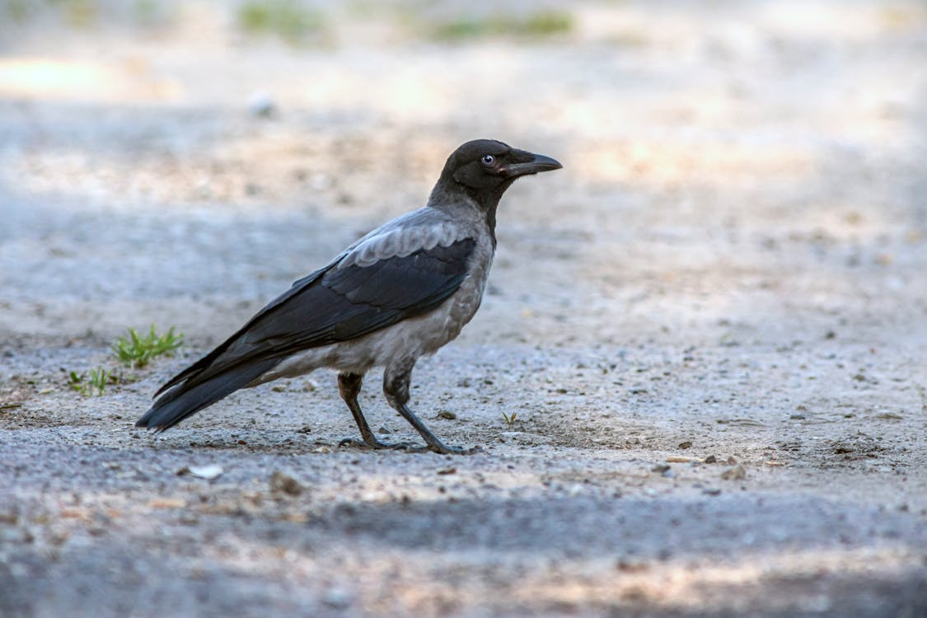

1
Luke 8:12 NIV
[12] The seeds that fell on the footpath represent those who hear the message, only to have the devil come and take it away from their hearts and prevent them from believing and being saved.

Slide 10
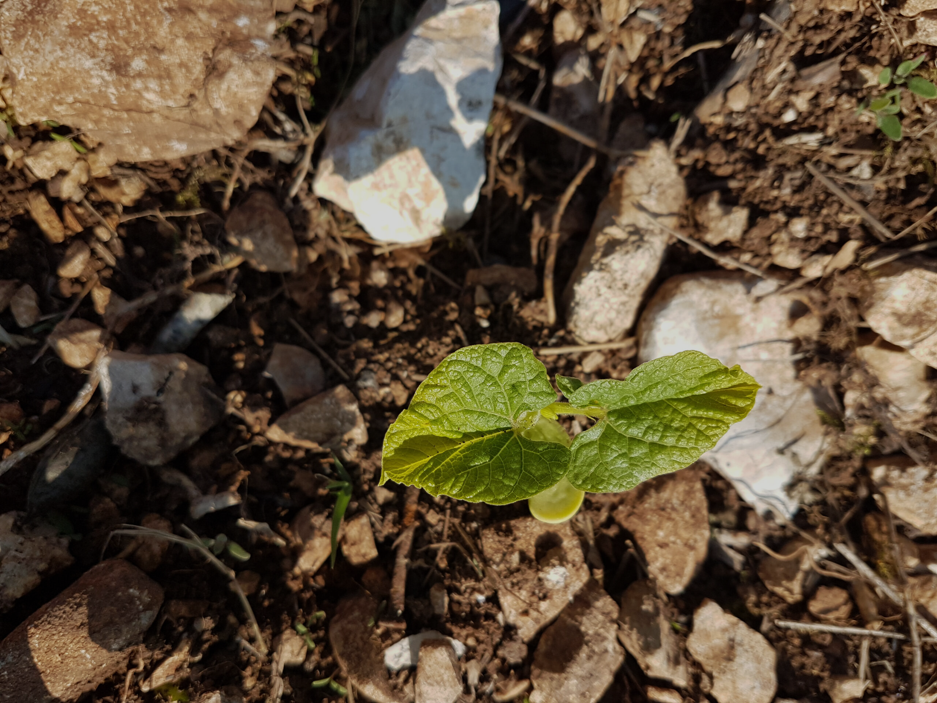
2
Luke 8:13 NIV
[13] The seeds on the rocky soil represent those who hear the message and receive it with joy. But since they don’t have deep roots, they believe for a while, then they fall away when they face temptation.

Slide 11
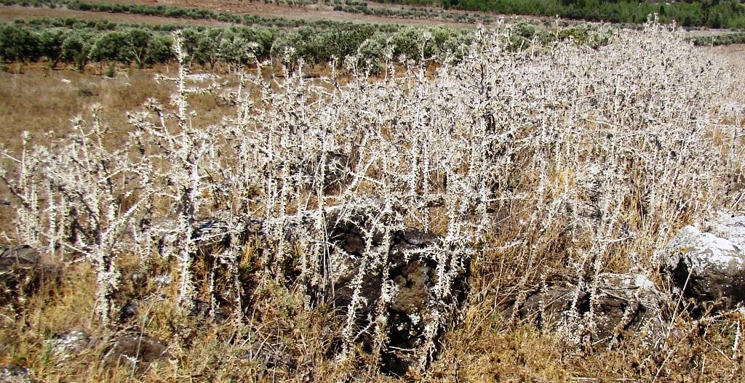
3
Luke 8:14 NIV
[14] The seeds that fell among the thorns represent those who hear the message, but all too quickly the message is crowded out by the cares and riches and pleasures of this life. And so they never grow into maturity.

Slide 12
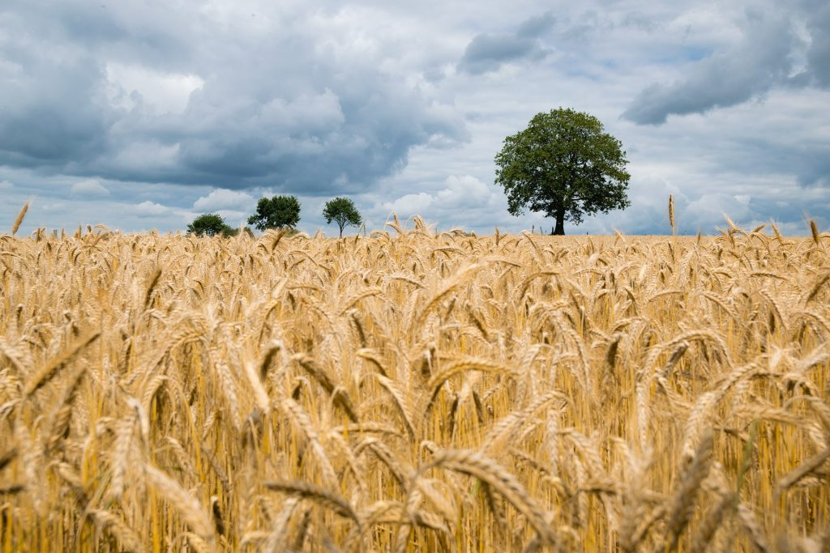
4
Luke 8:15 NIV
[15] And the seeds that fell on the good soil represent honest, good-hearted people who hear God’s word, cling to it, and patiently produce a huge harvest.

Slide 13
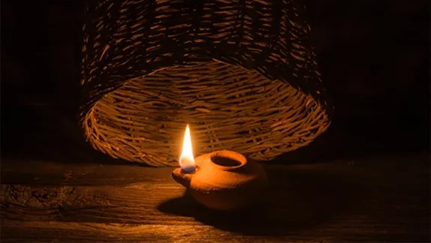
Luke 8:16-17 NLT
[16]“No one lights a lamp and then covers it with a bowl or hides it under a bed. A lamp is placed on a stand, where its light can be seen by all who enter the house. [17] For all that is secret will eventually be brought into the open, and everything that is concealed will be brought to light and made known to all.

Slide 14
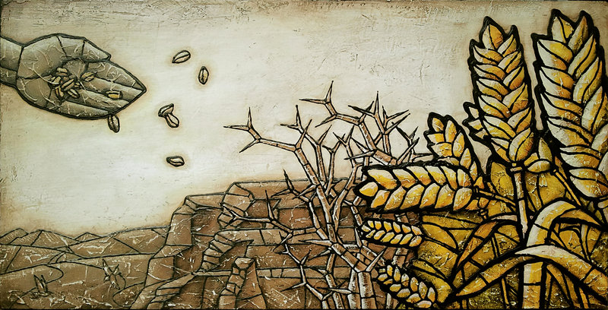
Luke 8:18 NLT
[18] “So pay attention to how you hear. To those who listen to my teaching, more understanding will be given. But for those who are not listening, even what they think they understand will be taken away from them.”

Slide 15
Luke 8:19-21NLT
[19] Then Jesus’ mother and brothers came to see him, but they couldn’t get to him because of the crowd. [20] Someone told Jesus, “Your mother and your brothers are standing outside, and they want to see you.” [21] Jesus replied, “My mother and my brothers are all those who hear God’s word and obey it.”

