Slide 1
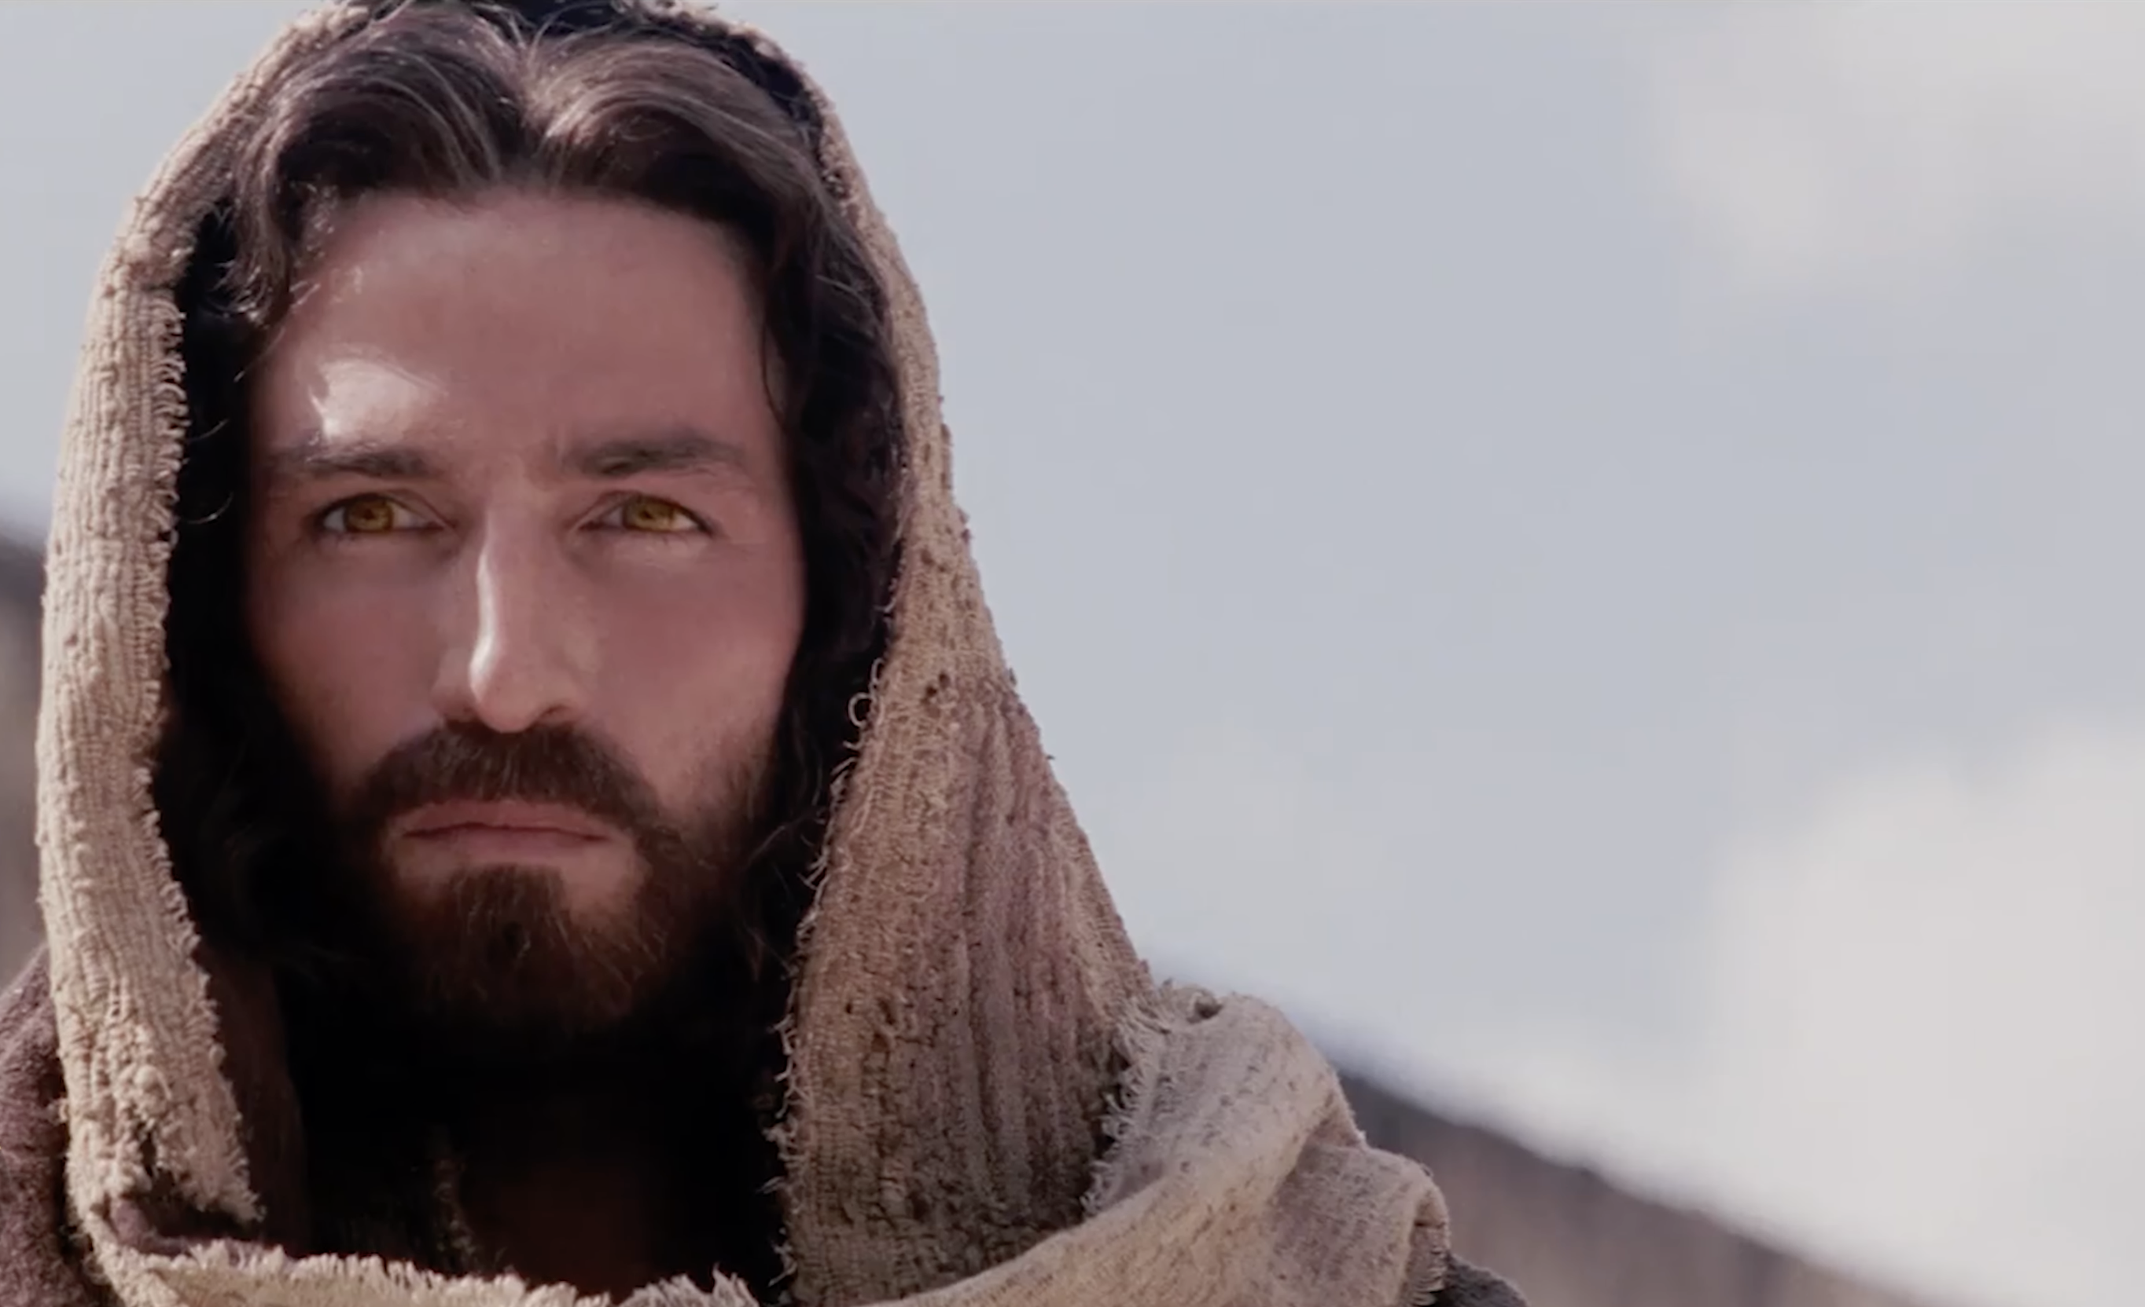
Luke ~ Season 1
The Mission of
The Son of God
7: 1–35

Slide 2
Luke 7:29–35 – The Pharisees
²⁹ (When all the people heard this, and the tax collectors too, they declared God just, having been baptized with the baptism of John, ³⁰ but the Pharisees and the lawyers rejected the purpose of God for themselves, not having been baptized by him.) ³¹ “To what then shall I compare the people of this generation, and what are they like? ³² They are like children sitting in the marketplace and calling to one another, “‘We played the flute for you, and you did not dance; we sang a dirge, and you did not weep.’ ³³ For John the Baptist has come eating no bread and drinking no wine, and you say, ‘He has a demon.’ ³⁴ The Son of Man has come eating and drinking, and you say, ‘Look at him! A glutton and a drunkard, a friend of tax collectors and sinners!’ ³⁵ Yet wisdom is justified by all her children.”

Slide 3
Luke 7:18–28 – John the Baptizer
¹⁸ The disciples of John reported all these things to him. And John, ¹⁹ calling two of his disciples to him, sent them to the Lord, saying, “Are you the one who is to come, or shall we look for another?” ²⁰ And when the men had come to him, they said, “John the Baptist has sent us to you, saying, ‘Are you the one who is to come, or shall we look for another?’ ” ²¹ In that hour he healed many people of diseases and plagues and evil spirits, and on many who were blind he bestowed sight. ²² And he answered them, “Go and tell John what you have seen and heard: the blind receive their sight, the lame walk, lepers are cleansed, and the deaf hear, the dead are raised up, the poor have good news preached to them. ²³ And blessed is the one who is not offended by me.” ²⁴ When John’s messengers had gone, Jesus began to speak to the crowds concerning John: “What did you go out into the wilderness to see? A reed shaken by the wind? ²⁵ What then did you go out to see? A man dressed in soft clothing? Behold, those who are dressed in splendid clothing and live in luxury are in kings’ courts. ²⁶ What then did you go out to see? A prophet? Yes, I tell you, and more than a prophet. ²⁷ This is he of whom it is written, “‘Behold, I send my messenger before your face, who will prepare your way before you.’ ²⁸ I tell you, among those born of women none is greater than John. Yet the one who is least in the kingdom of God is greater than he.”

Slide 4
Luke 3:7–17
⁷ He said therefore to the crowds that came out to be baptized by him, “You brood of vipers! Who warned you to flee from the wrath to come? ⁸ Bear fruits in keeping with repentance . . .⁹ Even now the axe is laid to the root of the trees. Every tree therefore that does not bear good fruit is cut down and thrown into the fire.” . . .
¹⁵ As the people were in expectation, and all were questioning in their hearts concerning John, whether he might be the Christ, ¹⁶ John answered them all, saying, “I baptize you with water, but he who is mightier than I is coming, the strap of whose sandals I am not worthy to untie. He will baptize you with the Holy Spirit and fire. ¹⁷ His winnowing fork is in his hand, to clear his threshing floor and to gather the wheat into his barn, but the chaff he will burn with unquenchable fire.”

Slide 5
Isaiah
35:5–6
“Then the eyes of the blind shall be opened, and the ears of the deaf unstopped; then shall the lame man leap like a deer, and the tongue of the mute sing for joy.”
29:16
“Your dead shall live; their bodies shall rise . . .”
61:1
“The Spirit of the Lord God is upon me, because the Lord has anointed me to bring good news to the poor . . .”

Slide 6
Luke 7:18–28 – John the Baptizer
¹⁸ The disciples of John reported all these things to him. And John, ¹⁹ calling two of his disciples to him, sent them to the Lord, saying, “Are you the one who is to come, or shall we look for another?” ²⁰ And when the men had come to him, they said, “John the Baptist has sent us to you, saying, ‘Are you the one who is to come, or shall we look for another?’ ” ²¹ In that hour he healed many people of diseases and plagues and evil spirits, and on many who were blind he bestowed sight. ²² And he answered them, “Go and tell John what you have seen and heard: the blind receive their sight, the lame walk, lepers are cleansed, and the deaf hear, the dead are raised up, the poor have good news preached to them. ²³ And blessed is the one who is not offended by me.” ²⁴ When John’s messengers had gone, Jesus began to speak to the crowds concerning John: “What did you go out into the wilderness to see? A reed shaken by the wind? ²⁵ What then did you go out to see? A man dressed in soft clothing? Behold, those who are dressed in splendid clothing and live in luxury are in kings’ courts. ²⁶ What then did you go out to see? A prophet? Yes, I tell you, and more than a prophet. ²⁷ This is he of whom it is written, “‘Behold, I send my messenger before your face, who will prepare your way before you.’ ²⁸ I tell you, among those born of women none is greater than John. Yet the one who is least in the kingdom of God is greater than he.”

Slide 7
Luke 7:11–17 – The Crowds
¹¹ Soon afterward he went to a town called Nain, and his disciples and a great crowd went with him. ¹² As he drew near to the gate of the town, behold, a man who had died was being carried out, the only son of his mother, and she was a widow, and a considerable crowd from the town was with her. ¹³ And when the Lord saw her, he had compassion on her and said to her, “Do not weep.” ¹⁴ Then he came up and touched the bier, and the bearers stood still. And he said, “Young man, I say to you, arise.” ¹⁵ And the dead man sat up and began to speak, and Jesus gave him to his mother. ¹⁶ Fear seized them all, and they glorified God, saying, “A great prophet has arisen among us!” and “God has visited his people!” ¹⁷ And this report about him spread through the whole of Judea and all the surrounding country.

Slide 8
Luke 7:1–10 – The Centurion
After he had finished all his sayings in the hearing of the people, he entered Capernaum. ² Now a centurion had a servant who was sick and at the point of death, who was highly valued by him. ³ When the centurion heard about Jesus, he sent to him elders of the Jews, asking him to come and heal his servant. ⁴ And when they came to Jesus, they pleaded with him earnestly, saying, “He is worthy to have you do this for him, ⁵ for he loves our nation, and he is the one who built us our synagogue.” ⁶ And Jesus went with them. When he was not far from the house, the centurion sent friends, saying to him, “Lord, do not trouble yourself, for I am not worthy to have you come under my roof. ⁷ Therefore I did not presume to come to you. But say the word, and let my servant be healed. ⁸ For I too am a man set under authority, with soldiers under me: and I say to one, ‘Go,’ and he goes; and to another, ‘Come,’ and he comes; and to my servant, ‘Do this,’ and he does it.” ⁹ When Jesus heard these things, he marveled at him, and turning to the crowd that followed him, said, “I tell you, not even in Israel have I found such faith.” ¹⁰ And when those who had been sent returned to the house, they found the servant well.

Slide 9
Luke ~ Season 1
The Mission of
The Son of God
7: 1–35

