Slide 1
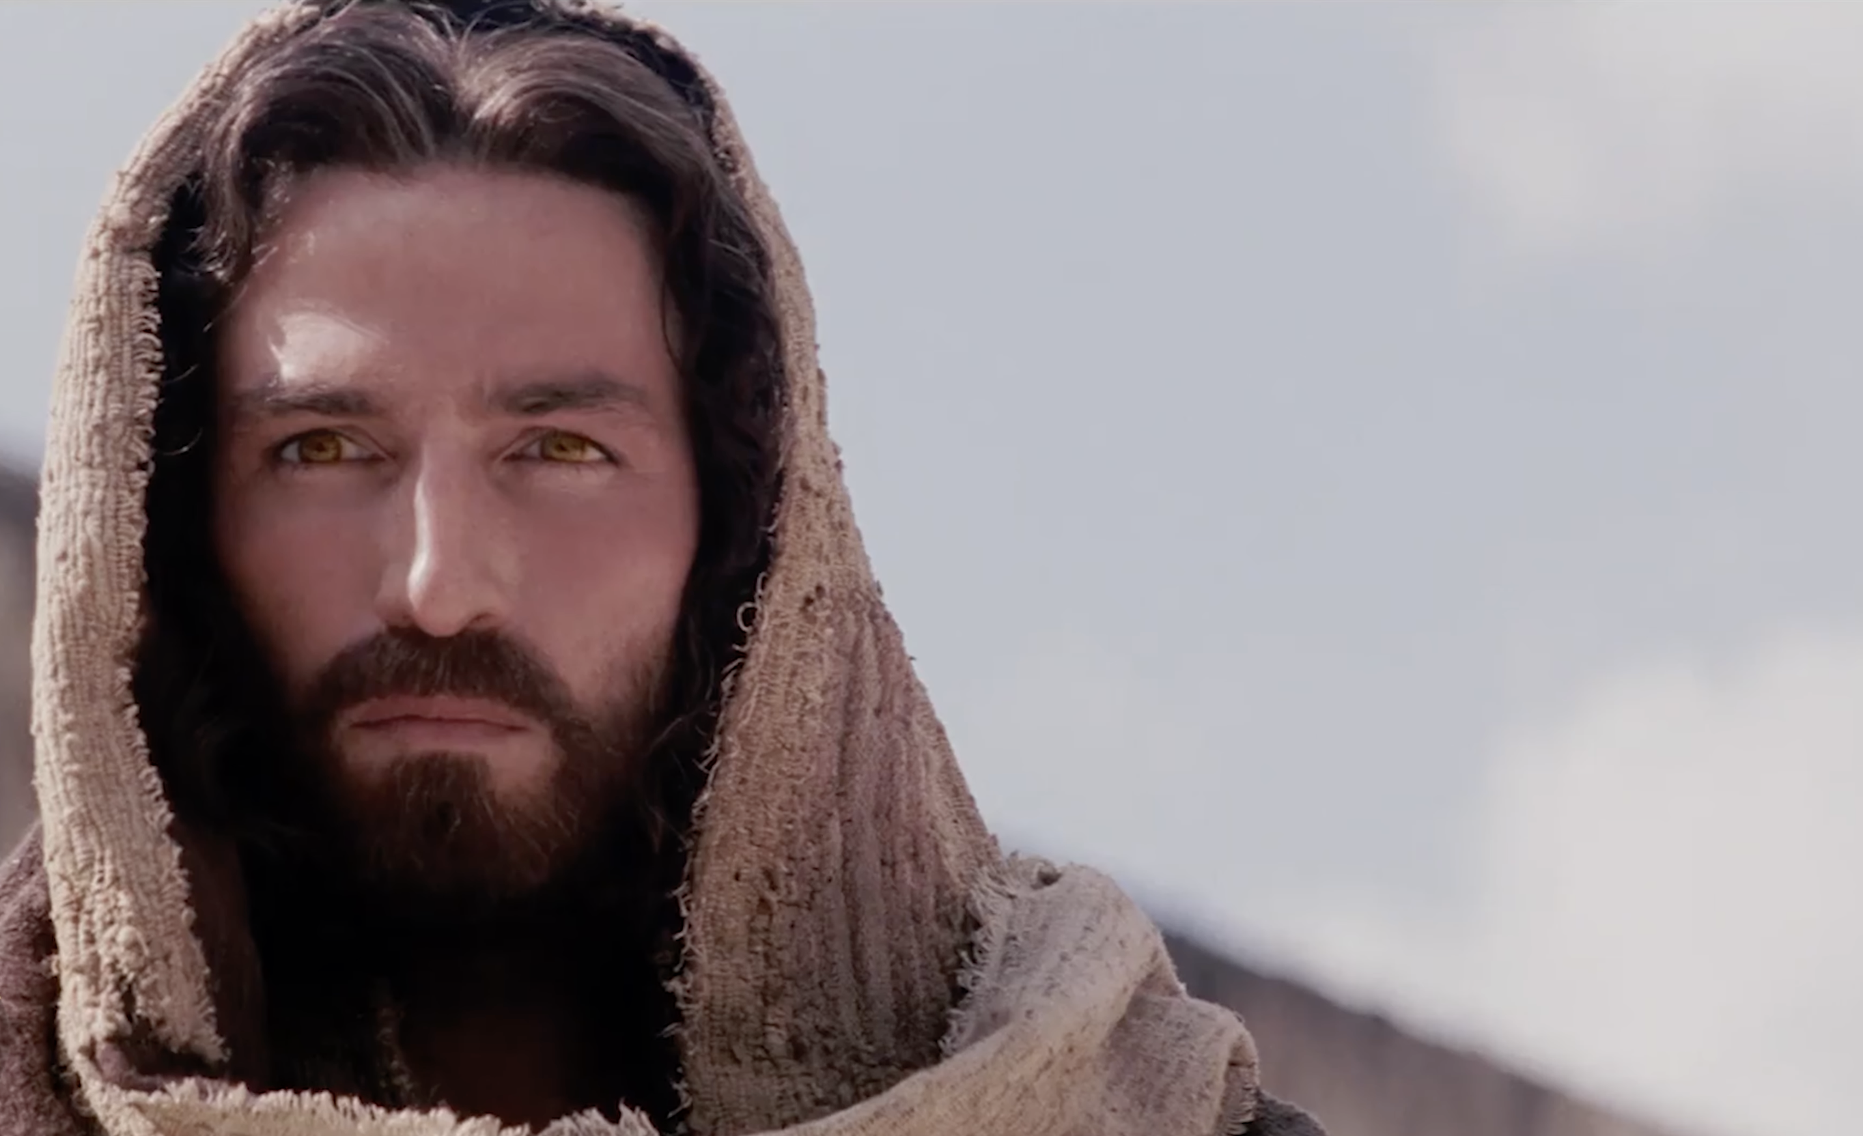
Luke ~ Season 1
The Mission of
The Son of God
Luke 6: 17-49

Slide 2
UPSIDE-DOWN or RIGHT-SIDE-Up
KINGDOM?
LUKE 6:17-49

Slide 3
Luke 6:17-19 ESV
[17] And he came down with them and stood on a level place, with a great crowd of his disciples and a great multitude of people from all Judea and Jerusalem and the seacoast of Tyre and Sidon, [18] who came to hear him and to be healed of their diseases. And those who were troubled with unclean spirits were cured. [19] And all the crowd sought to touch him, for power came out from him and healed them all.

Slide 4
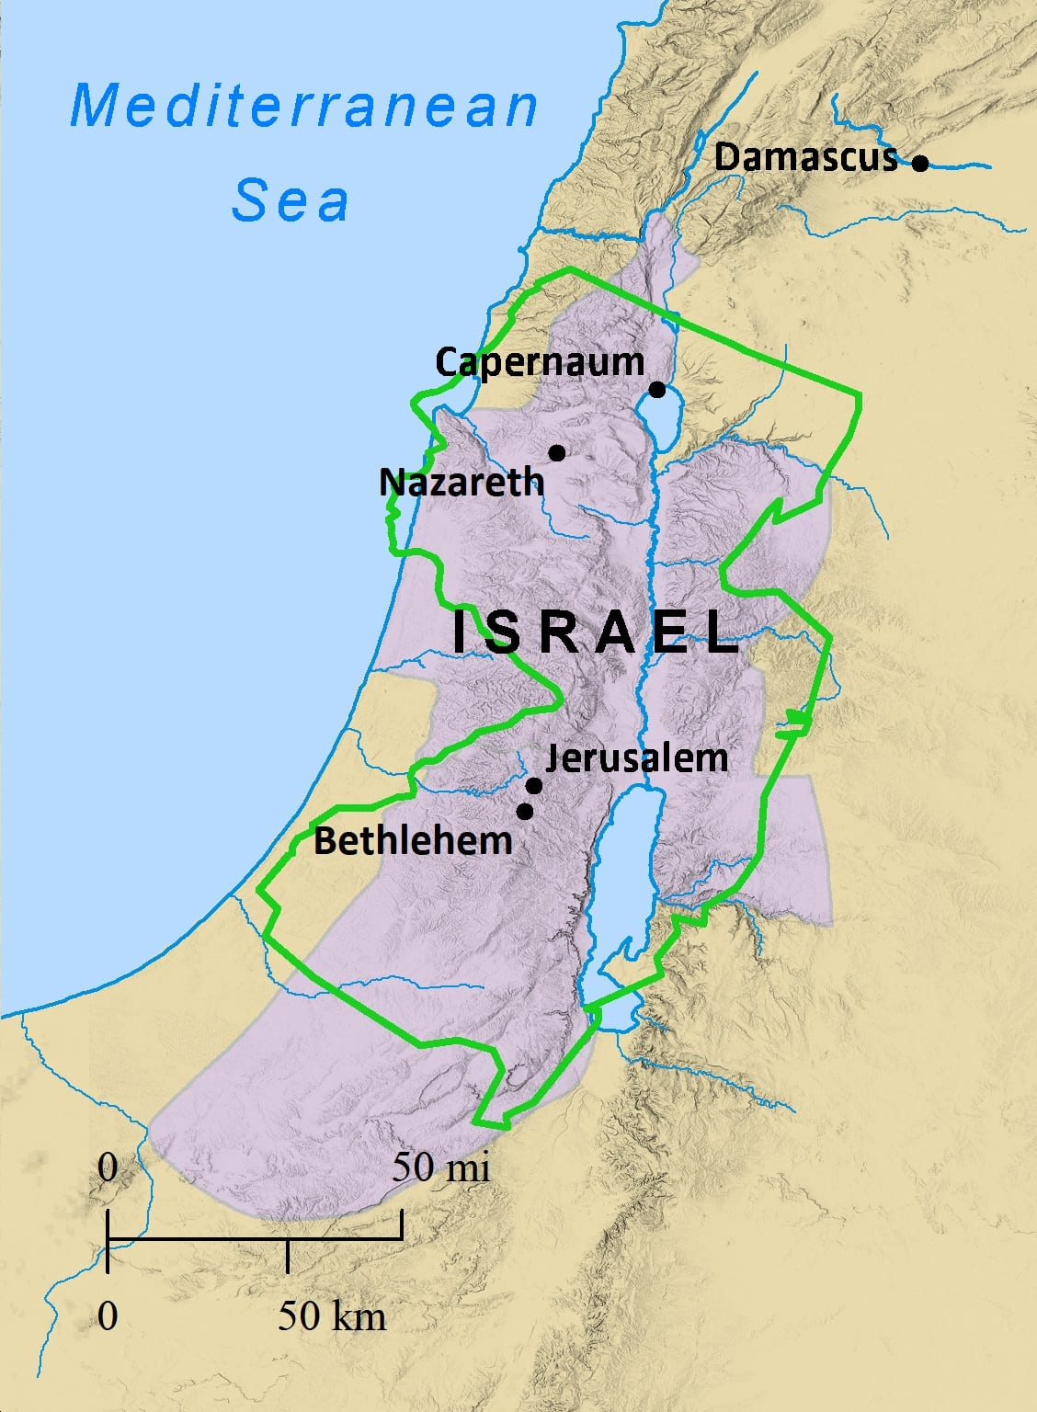




.
Sidon
.
Tyre
The Multitudes…
From Sidon – 80km
From Tyre – 56km
From Jerusalem – 137km
TO HEAR JESUS
TO BE HEALED BY JESUS
TO BE DELIVERED FROM EVIL SPIRITS BY JESUS
TO TOUCH JESUS

Slide 5
Luke 6:20-23 ESV
^{[20]} And he lifted up his eyes on his disciples, and said: “Blessed are you who are poor, for yours is the kingdom of God. ^{[21]} “Blessed are you who are hungry now, for you shall be satisfied. “Blessed are you who weep now, for you shall laugh. ^{[22]} “Blessed are you when people hate you and when they exclude you and revile you and spurn your name as evil, on account of the Son of Man! ^{[23]} Rejoice in that day, and leap for joy, for behold, your reward is great in heaven; for so their fathers did to the prophets.

Slide 6
PARADOXICAL (Upside-down) STATEMENTS for a Spiritual Revolution:
The poor = SEVERE POVERTY (Spiritually like beggars who are totally reliant on receiving from God what we absolutely need) KINGDOM
The hungry = BASIC NEEDS (hunger and thirst to be satisfied by Jesus; long for more even!) FILLED
The weeping = LOW & NEEDY (condition and awareness of sin and its effects which produces repentance to salvation) LAUGHTER/JOY

Slide 7
Luke 6:24-26 ESV
^{[24]} “But woe to you who are rich, for you have received your consolation. ^{[25]} “Woe to you who are full now, for you shall be hungry. “Woe to you who laugh now, for you shall mourn and weep. ^{[26]} “Woe to you, when all people speak well of you, for so their fathers did to the false prophets.

Slide 8
MORE PARADOXICAL STATEMENTS (STRANGE WOES) :
RICH RECEIVED CONSOLATION
ARE FULL NOW SHALL BE HUNGRY
LAUGH NOW SHALL WEEP
PEOPLE SPEAK WELL OF YOU PEOPLE
WILL SPEAK BADLY ABOUT YOU
NORMALLY NO WOE IN THESE THINGS!
BUT IF NO SENSE OF NEED…. THEN CAN BECOME OBSTACLES TO KINGDOM!

Slide 9
Luke 6:27-31 ESV
^{[27]} “But I say to you who hear, Love your enemies, do good to those who hate you, ^{[28]} bless those who curse you, pray for those who abuse you. ^{[29]} To one who strikes you on the cheek, offer the other also, and from one who takes away your cloak do not withhold your tunic either. ^{[30]} Give to everyone who begs from you, and from one who takes away your goods do not demand them back. ^{[31]} And as you wish that others would do to you, do so to them.

Slide 10
LOVE in action
Simple commands … but hard to obey!
Don’t wait for WARM FUZZY FEELINGS – you’ll never get to loving others
Jesus demonstrated LOVING with His life. Sacrificial.
The broader application of the golden rule

Slide 11
Spurgeon:
“Oh, that all men acted on it,
and there would be no slavery, no war,
no swearing, no striking, no lying, no robbing;
but all would be justice and love!
What a kingdom is this which has such a law!”
…An Upside-down Kingdom!

Slide 12
Luke 6:27-35 ESV
^{[32]} “If you love those who love you, what benefit is that to you? For even sinners love those who love them. ^{[33]} And if you do good to those who do good to you, what benefit is that to you? For even sinners do the same. ^{[34]} And if you lend to those from whom you expect to receive, what credit is that to you? Even sinners lend to sinners, to get back the same amount.
^{[35]} But love your enemies, and do good, and lend, expecting nothing in return, and your reward will be great, and you will be sons of the Most High, for he is kind to the ungrateful and the evil.

Slide 13
Be imitators of God – showed love towards His enemies
Show in word and action that Christ lives in us

Slide 14
Luke 6:36-38 ESV
^{[36]} Be merciful, even as your Father is merciful. ^{[37]} “Judge not, and you will not be judged; condemn not, and you will not be condemned; forgive, and you will be forgiven; ^{[38]} give, and it will be given to you. Good measure, pressed down, shaken together, running over, will be put into your lap. For with the measure you use it will be measured back to you.”

Slide 15

Showing mercy
Judging
Condemning
Forgiving
Giving
For with the measure you use
it will be measured back to you.
V 38

Slide 16
Luke 6:39-42 ESV
^{[39]} He also told them a parable: “Can a blind man lead a blind man? Will they not both fall into a pit? ^{[40]} A disciple is not above his teacher, but everyone when he is fully trained will be like his teacher. ^{[41]} Why do you see the speck that is in your brother’s eye, but do not notice the log that is in your own eye? ^{[42]} How can you say to your brother, ‘Brother, let me take out the speck that is in your eye,’ when you yourself do not see the log that is in your own eye? You hypocrite, first take the log out of your own eye, and then you will see clearly to take out the speck that is in your brother’s eye.

Slide 17
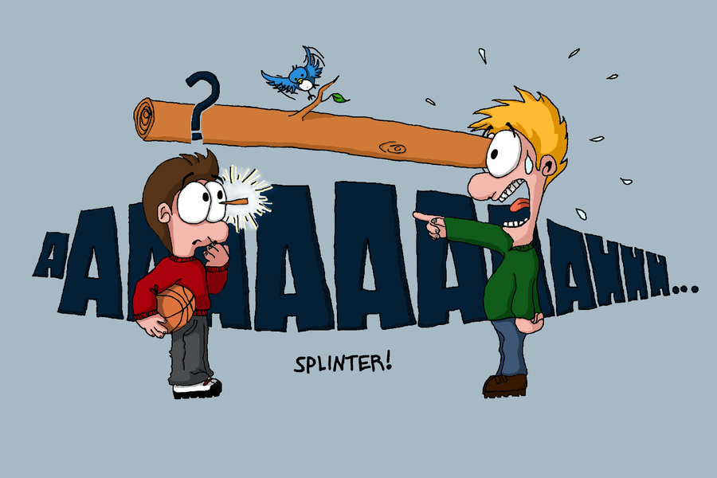
We are generally more tolerant of our own sin
than we are to the sin of others!

Slide 18
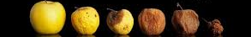
Luke 6:43-45 ESV
^{[43]} “For no good tree bears bad fruit, nor again does a bad tree bear good fruit, ^{[44]} for each tree is known by its own fruit. For figs are not gathered from thornbushes, nor are grapes picked from a bramble bush.
^{[45]} The good person out of the good treasure of his heart produces good, and the evil person out of his evil treasure produces evil, for out of the abundance of the heart his mouth speaks.

Slide 19

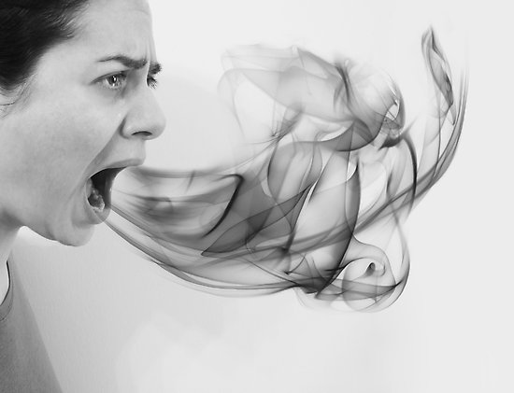
Do I bear fruit to God’s Glory?
My words reveal my heart…

Slide 20
Luke 6:46-49 ESV
^{[46]} “Why do you call me ‘Lord, Lord,’ and not do what I tell you?
^{[47]} Everyone who comes to me and hears my words and does them, I will show you what he is like: ^{[48]} he is like a man building a house, who dug deep and laid the foundation on the rock. And when a flood arose, the stream broke against that house and could not shake it, because it had been well built.

Slide 21
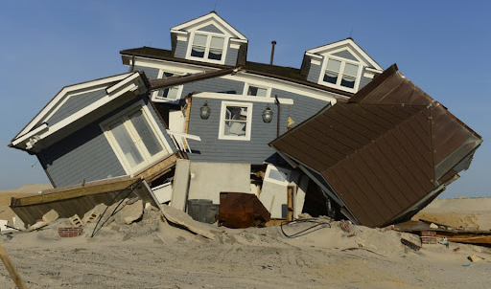
Luke 6:46-49 ESV
^{[49]} But the one who hears and does not do them is like a man who built a house on the ground without a foundation. When the stream broke against it, immediately it fell, and the ruin of that house was great.”

Slide 22

Come to me …Surrender
Hear my words …Discipleship
Do them …Obedience

Slide 23
What words of Jesus stood out to you? DO THEM
Our lives will be shaken at some point, how are your foundations? Are you coming to Jesus, hearing His words, and doing what He has told you?
Even when we do them, the revelation of this upside down Kingdom – or actually right-side-up Kingdom – should drive us back over and over as needy sinners to our Saviour.

Slide 24
Revelation of Who Jesus is & His powerful ministry
Who is blessed in this right-side-up Kingdom? The Poor
Woe to who? The Rich who have no need of Jesus
Called to love our enemies…
Measure back in mercy, forgiveness and generosity, not judgment and condemnation
How well can you see past your log?
What is in your heart matters!
How are you building your life? Are you surrendering, hearing and doing?

